Slide 1
Sphere’s the thing
Prisms and cylinders

Slide 2
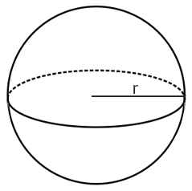
Volume of a sphere
The formula
$$Volume=\frac{4}{3}πr^{3}$$

Slide 3
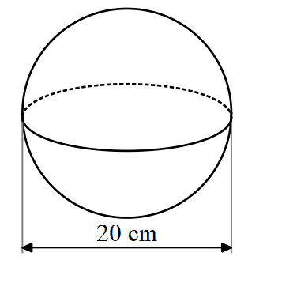
Volume of a sphere – part 1
Worked example 1
$$V=\frac{4}{3}πr^{3}$$
V= $\frac{4}{3}×π×{\left(10\right)}^{3}$
$$V=4188.79020$$
$$V=4188.8 cm^{3}$$

Slide 4
Volume of a sphere – part 2
Worked example 1
$$V=\frac{4}{3}πr^{3}$$
V= $\frac{4}{3}×π×{\left(10\right)}^{3}$
$$V=4188.79020$$
$$V=4188.8 cm^{3}$$
Why is $r=10$ and not $20$?
Is cubic centimetres the correct unit?

Slide 5
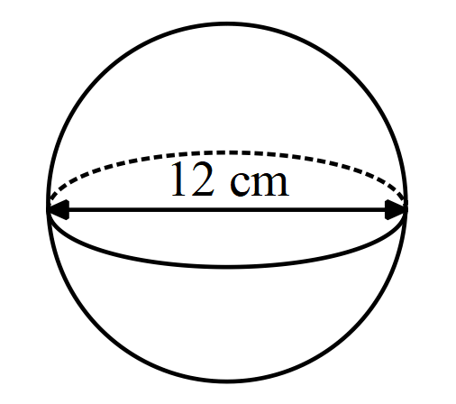
Volume of a sphere – your turn
$$V=\frac{4}{3}πr^{3}$$

Slide 6
Volume of a sphere – solution
$$V=\frac{4}{3}πr^{3}$$
$$V=\frac{4}{3}×π×6^{3}$$
$$V=904.77868…$$
$$V=904.8cm^{3}$$

Slide 7
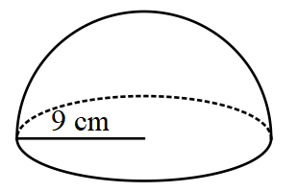
Volume of a hemisphere – part 1
Worked example 1
$$V=\frac{4}{3}πr^{3}$$
$$V=\frac{1}{2}×\frac{4}{3}πr^{3}$$
V= $\frac{2}{3}×π×{\left(9\right)}^{3}$
$$V=1526.81403…$$
$$V=1526.8 cm^{3}$$

Slide 8
Volume of a hemisphere – part 2
Worked example 1
$$V=\frac{4}{3}πr^{3}$$
$$V=\frac{1}{2}×\frac{4}{3}πr^{3}$$
V= $\frac{2}{3}×π×{\left(9\right)}^{3}$
$$V=1526.81403…$$
$$V=1526.8 cm^{3}$$
Why has $\frac{1}{2}$ been added to the formula?
Where did $\frac{2}{3}$ come from?

Slide 9
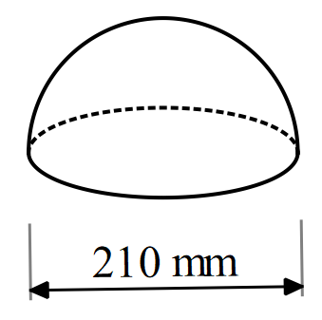
Volume of a hemisphere
Your turn
$$V=\frac{4}{3}πr^{3}$$
How is this diagram different from the example?

Slide 10
Volume of a hemisphere – solution
$$V=\frac{4}{3}πr^{3}$$
$$V=\frac{1}{2}×\frac{4}{3}×π×{105}^{3}$$
$$V=2 424 524.130408…$$
$$V=2 424 524.13mm^{3}$$
How is this diagram different from the example?

Slide 11
Surface area of a sphere – part 1
The formula
$$Surface area=4πr^{2}$$

Slide 12
Surface area of a sphere – part 2
Worked example
$$SA=4πr^{2}$$
$$SA=4×π×{\left(10\right)}^{2}$$
SA=1256.63706…
$$SA=1256.6cm^{2}$$

Slide 13
Surface area of a sphere – part 3
Worked example
$$SA=4πr^{2}$$
$$SA=4×π×{\left(10\right)}^{2}$$
SA=1256.63706…
$$SA=1256.6cm^{2}$$
Why is $r=10$ and not $20$?

Slide 14
Surface area of a sphere – your turn
$$SA=4πr^{2}$$

Slide 15
Surface area of a sphere – solution
$$SA=4πr^{2}$$
$$SA=4×π×6^{2}$$
$$SA=452.38934…$$
$$SA=452.4cm^{2}$$

Slide 16
Surface area of a hemisphere – part 1
Worked example
$$SA=4πr^{2}$$
$$SA=\frac{1}{2}×4πr^{2}+πr^{2}$$
$$SA=\frac{1}{2}×4×π×9^{2}+π×9^{2}$$
$SA=$ 763.40701…
$$SA=763.4cm^{2}$$

Slide 17
Surface area of a hemisphere – part 2
Worked example
Why has the first part of the expression been multiplied by $\frac{1}{2}$ ?
$$SA=4πr^{2}$$
$$SA=\frac{1}{2}×4πr^{2}+πr^{2}$$
$$SA=\frac{1}{2}×4×π×9^{2}+π×9^{2}$$
$SA=$ 763.40701…
$$SA=763.4cm^{2}$$
Why was $πr^{2}$ added?
How else could this be written?

Slide 18
Surface area of a hemisphere – your turn
$$SA=4πr^{2}$$

Slide 19
Surface area of a hemisphere – solution
$$SA=4πr^{2}$$
$$SA=\frac{1}{2}×4×π×{105}^{2}+π×{105}^{2}$$
$SA=103 908.177017$…
$$SA=103 908.2 mm^{2}$$

Slide 20
Copyright
© State of New South Wales (Department of Education), 2024
The copyright material published in this resource is subject to the Copyright Act 1968 (Cth) and is owned by the NSW Department of Education or, where indicated, by a party other than the NSW Department of Education (third-party material).
Copyright material available in this resource and owned by the NSW Department of Education is licensed under a Creative Commons Attribution 4.0 International (CC BY 4.0) licence.
This licence allows you to share and adapt the material for any purpose, even commercially.
Attribution should be given to © State of New South Wales (Department of Education), 2023.
Material in this resource not available under a Creative Commons licence:
the NSW Department of Education logo, other logos and trademark-protected material
Material owned by a third party that has been reproduced with permission. You will need to obtain permission from the third party to reuse its material.
Links to third-party material and websites
Please note that the provided (reading/viewing material/list/links/texts) are a suggestion only and implies no endorsement, by the New South Wales Department of Education, of any author, publisher, or book title. School principals and teachers are best placed to assess the suitability of resources that would complement the curriculum and reflect the needs and interests of their students.
If you use the links provided in this document to access a third party’s website, you acknowledge that the terms of use, including licence terms set out on the third-party’s website apply to the use which may be made of the materials on that third-party website or where permitted by the Copyright Act 1968 (Cth). The department accepts no responsibility for content on third-party websites.

