Slide 1
Scientific notation
Explicit teaching

Slide 2
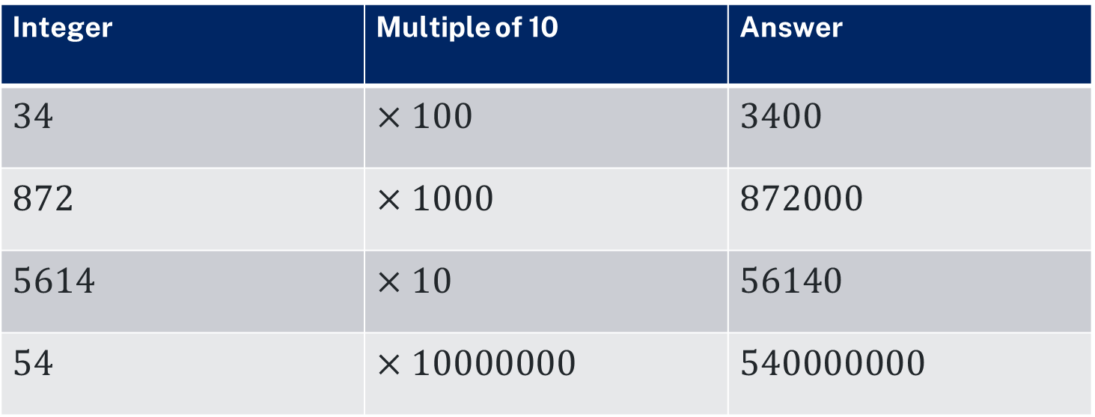
Multiplying an integer by multiples of 10
Scientific notation
Integer | Multiple of 10 | Answer
$$34$$ | $$×100$$ | $$3400$$
$$872$$ | $$×1000$$ | $$872000$$
$$5614$$ | $$×10$$ | $$56140$$
$$54$$ | $$×10000000$$ | $$540000000$$
Notes:
The following table shows an integer, a multiple of 10, which the integer is to be multiplied by, and the answer.
Ask students what they notice and what they wonder.
Explain that when multiplying by 10, the number 4 which represented 4 ones, now becomes 40 ones which is equivalent to 4 tens, and so the 4 moves over to the tens place value column.

Slide 3
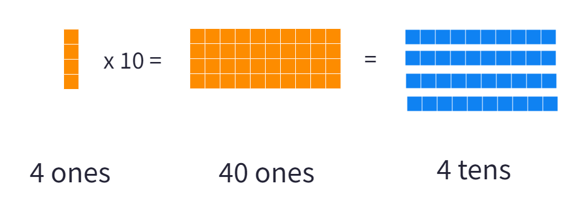

Multiplying an integer by 10
Scientific notation
$$×10$$
4 ones
40 ones
4 tens
Notes:
Explain that when multiplying by 10, the number 4 which represented 4 ones, now becomes 40 ones which is equivalent to 4 tens, and so the 4 moves over to the tens place value column.

Slide 4
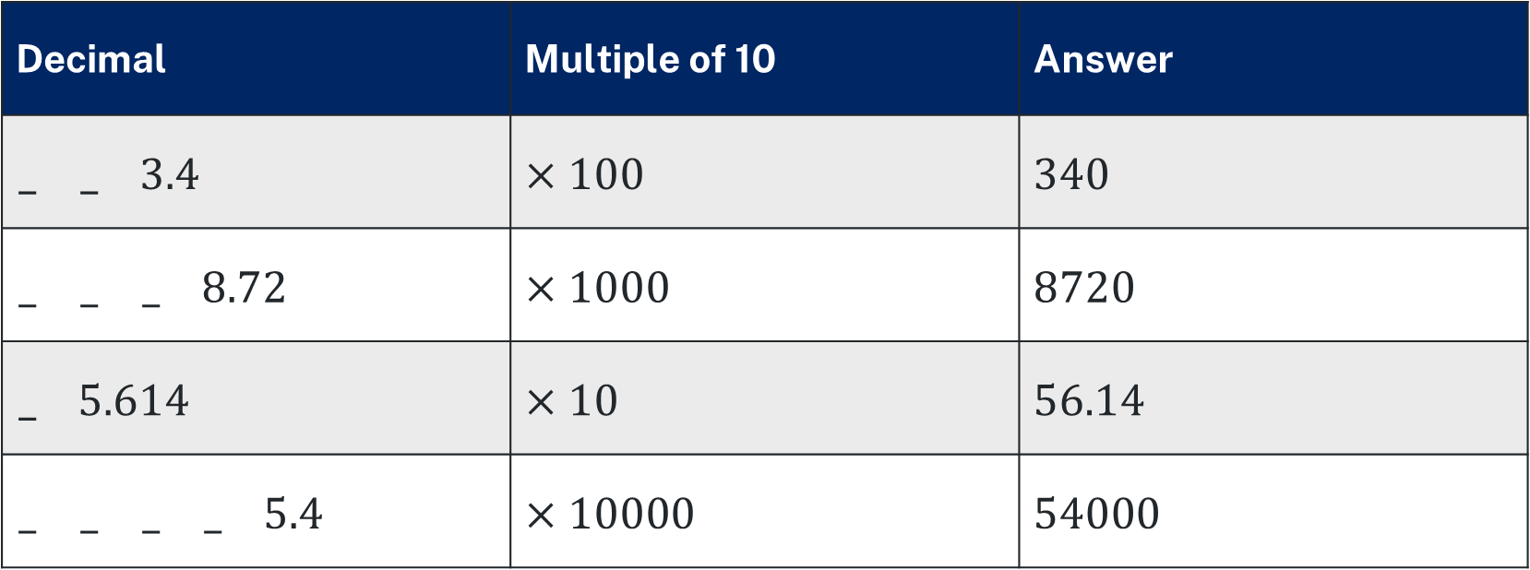
Multiplying decimals by multiples of 10
Decimal | Multiple of 10 | Answer
__$3.4$ | $$×100$$ | $$340$$
___$8.72$ | $$×1000$$ | $$8720$$
_$5.614$ | $$×10$$ | $$56.14$$
____$5.4$ | $$×10000$$ | $$54000$$
Each arrow shows the movement of the digits.
The zeroes fill the empty spaces.
Notes:
The following table shows a decimal, a multiple of 10, which the decimal is multiplied by, and the answer.
4 tenths multiplied by 10 becomes 40 tenths which is equivalent to 4 ones.
Multiplying decimals by multiples of 10 follows the same thinking as multiplying integers
You must put a zero in the empty places, to keep all the values in their correct place.

Slide 5



Multiples of 10 in index form
Scientific notation
Writing multiples of 10 in index form helps prevent miscounting the number of zeroes in a number.
1000000
100000000
10000000000
$${10}^{6}$$
$${10}^{8}$$
$${10}^{10}$$

Slide 6

Writing numbers using scientific notation
Scientific notation
Is $45 × 106$in scientific notation? Why or Why not?
Scientific notation is written with:
A number between 1 and 10
Multiplied by a power of 10

Slide 7
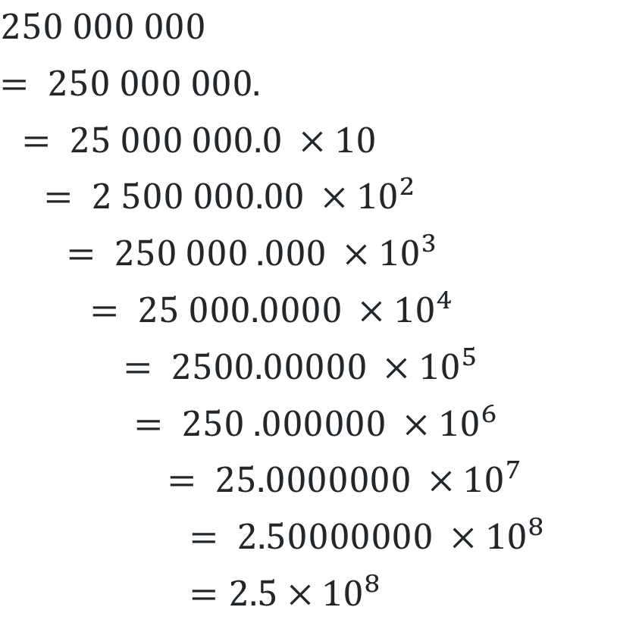
Worked example 1
Converting to scientific notation
$$250 000 000$$
$$= 250 000 000.$$
$$= 25 000 000.0 ×10$$
$$= 2 500 000.00 ×{10}^{2}$$
$$= 250 000 .000 ×{10}^{3}$$
$$= 25 000.0000 ×{10}^{4}$$
$$= 2500.00000 ×{10}^{5}$$
$$= 250 .000000 ×{10}^{6}$$
$$= 25.0000000 ×{10}^{7}$$
$$= 2.50000000 ×{10}^{8}$$
$$=2.5×{10}^{8}$$
Notes:
- Reveal the question to students and its solution.
- Students read in silence.
- Students individually think and explain to themselves what is happening in each step.
- Students hold up a thumbs up to the teacher when they have finished reading and have some sort of understanding.

Slide 8
What is happening?
Prompts 1
$$250 000 000$$
$$= 250 000 000.$$
$$= 25 000 000.0 ×10$$
$$= 2 500 000.00 ×{10}^{2}$$
$$= 250 000 .000 ×{10}^{3}$$
$$= 25 000.0000 ×{10}^{4}$$
$$= 2500.00000 ×{10}^{5}$$
$$= 250 .000000 ×{10}^{6}$$
$$= 25.0000000 ×{10}^{7}$$
$$= 2.50000000 ×{10}^{8}$$
$$=2.5×{10}^{8}$$
How do the powers of 10 relate to the movement of the digits?
Why are we moving the digits to the right now?
Notes:
Think-Pair-Share. Students explain the solution to their partner.
- In pairs students then answer the self-explanation questions.
Finally, randomly select students to share their answers with the whole class.

Slide 9

Your turn 1
Scientific notation
Write $7440$ in scientific notation.

Slide 10
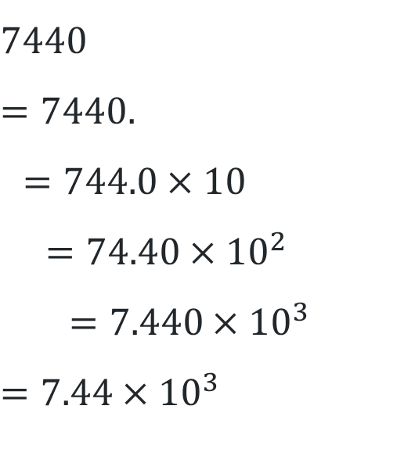
Your turn 1 – solutions
Write $7440$ in scientific notation.
$$7440$$
$$=7440.$$
$$=744.0×10$$
$$=74.40×{10}^{2}$$
$$=7.440×{10}^{3}$$
$$=7.44×{10}^{3}$$

Slide 11
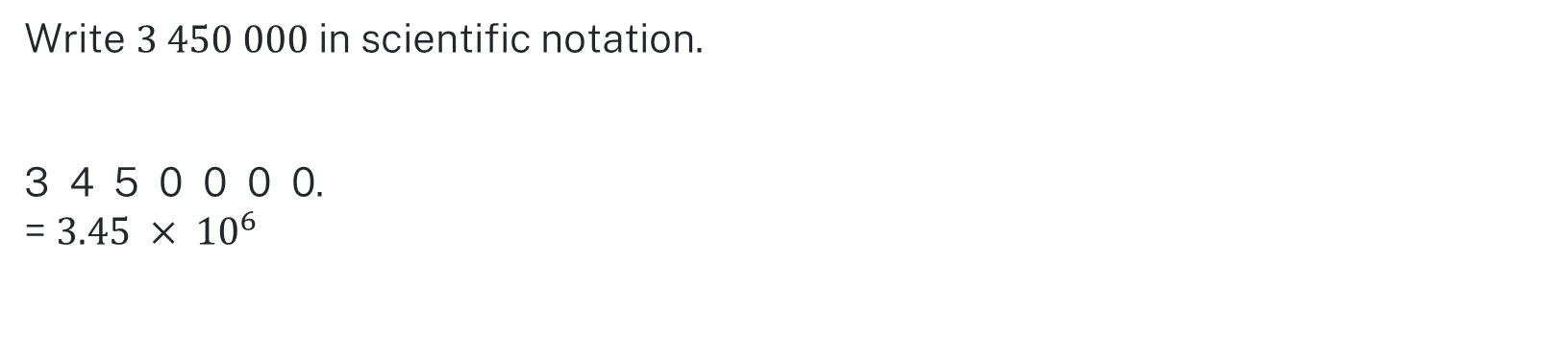
Worked example 2
Converting to scientific notation
Write $3 450 000$in scientific notation.
3 4 5 0 0 0 0.
= $3.45 × {10}^{6}$

Slide 12
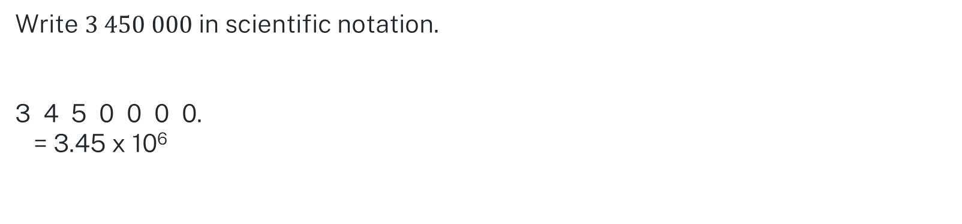
What do you think?
Prompts 2
Write $3 450 000$in scientific notation.
3 4 5 0 0 0 0.
= 3.45 x 10⁶
What happened to the zeroes?
How do you know what power to put on the 10?
Why do we multiply by powers of ten?

Slide 13

Your turn 2
Scientific notation
Write $20180$ in scientific notation.

Slide 14
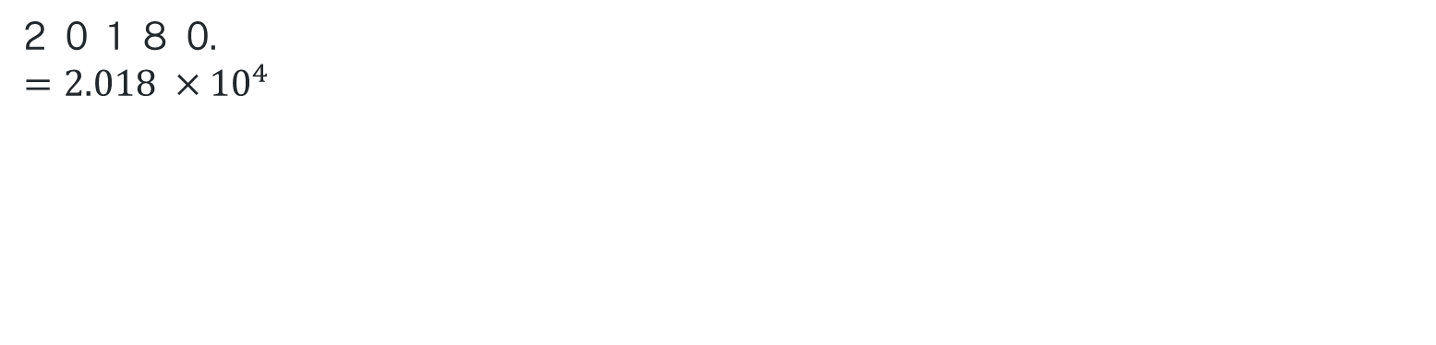
Your turn 2 – solutions
Scientific notation
Write $20180$ in scientific notation.
2 0 1 8 0.
$$=2.018 ×{10}^{4}$$

Slide 15
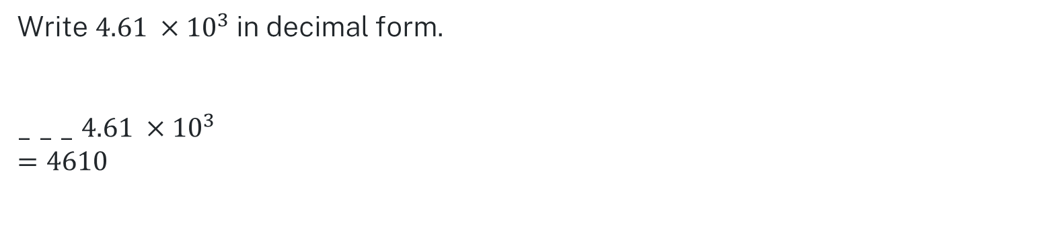
Worked example 3
Converting from scientific notation
Write $4.61 ×{10}^{3}$in decimal form.
_ _ _ $4.61 ×{10}^{3}$
$$=4610$$

Slide 16
What is different?
Prompts 3
Write $4.61 ×{10}^{3}$in decimal form.
_ _ _ $4.61 ×{10}^{3}$
$$=4610$$
Why are the digits moving to the left?

Slide 17
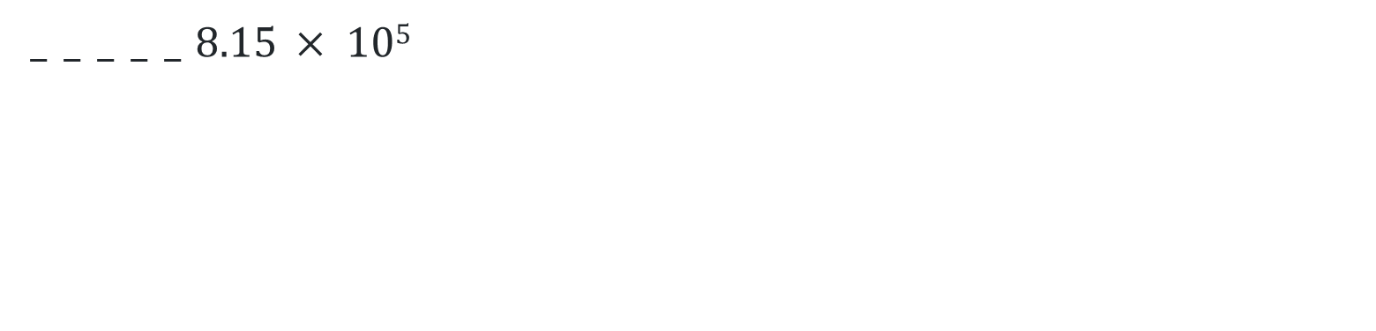

Your turn 3
Scientific notation
Write $8.15 × 105$in decimal form.
_ _ _ _ _ $8.15 × 105$

Slide 18
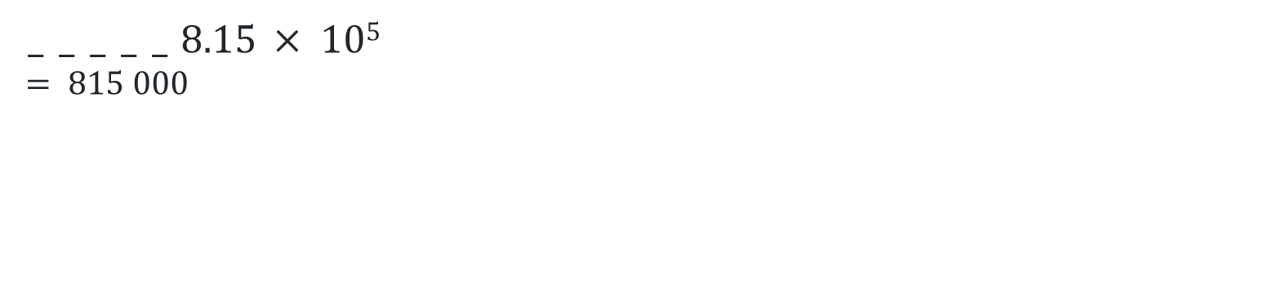
Your turn 3 – solutions
Scientific notation
Write $8.15 × 105$in decimal form.
_ _ _ _ _ $8.15 × 105$
$$= 815 000$$

