Slide 1
Indices bingo
Apply

Slide 2
Which one doesn’t belong?
$2^{0}$
$2^{3}÷2^{3}$
$4^{3}÷4^{2}$
$4^{3}÷2^{6}$

Slide 3
Apply
Deep dive

Slide 4
1.
Simplify the expression and check your bingo card.
$$a^{5}÷a^{3}$$

Slide 5
2.
Simplify the expression and check your bingo card.
$$a^{12}÷a^{3}$$

Slide 6
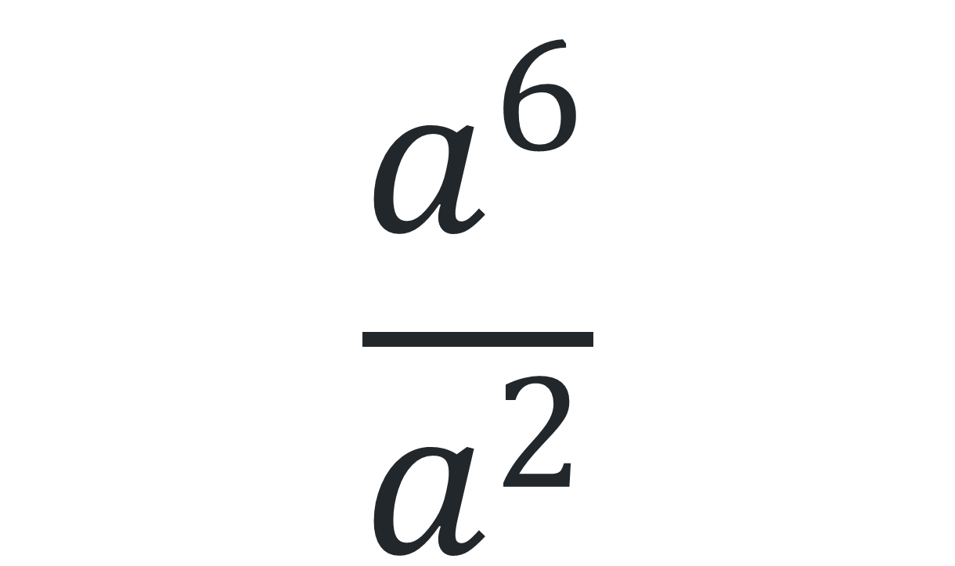
3.
Simplify the expression and check your bingo card.
$$\frac{a^{6}}{a^{2}}$$

Slide 7
4.
Simplify the expression and check your bingo card.
$$a^{5}÷a^{5}$$

Slide 8
5.
Simplify the expression and check your bingo card.
$$a^{3}÷a^{5}$$

Slide 9
6.
Simplify the expression and check your bingo card.
$$a^{6}÷a^{5}$$

Slide 10
7.
Simplify the expression and check your bingo card.
$$a÷a$$

Slide 11
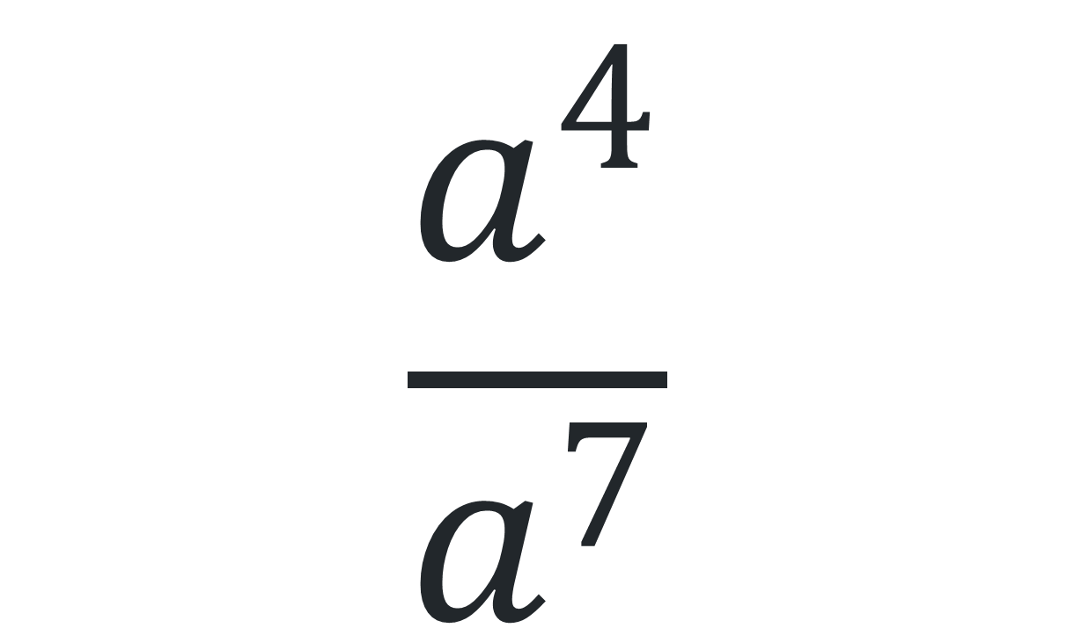
8.
Simplify the expression and check your bingo card.
$$\frac{a^{4}}{a^{7}}$$

Slide 12
9.
Simplify the expression and check your bingo card.
$$a^{10}÷a^{2}$$

Slide 13
10.
Simplify the expression and check your bingo card.
$$a^{0}+a^{0}$$

Slide 14
11.
Simplify the expression and check your bingo card.
$${\left({4a}^{3}\right)}^{2}÷{4a}^{4}$$

Slide 15
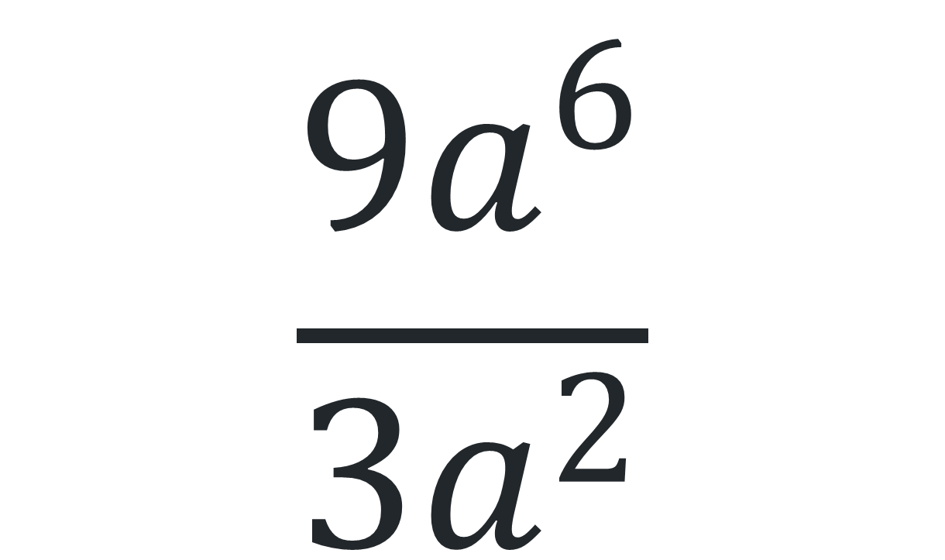
12.
Simplify the expression and check your bingo card.
$$\frac{9a^{6}}{3a^{2}}$$

Slide 16
13.
Simplify the expression and check your bingo card.
$${\left(a^{6}\right)}^{2}÷{\left(a^{3}\right)}^{2}$$

Slide 17
14.
Simplify the expression and check your bingo card.
$$a^{6}×a^{3}÷a^{4}$$

Slide 18
15.
Simplify the expression and check your bingo card.
$$6+a^{0}$$

Slide 19
16.
Simplify the expression and check your bingo card.
$$3a^{0}$$

Slide 20
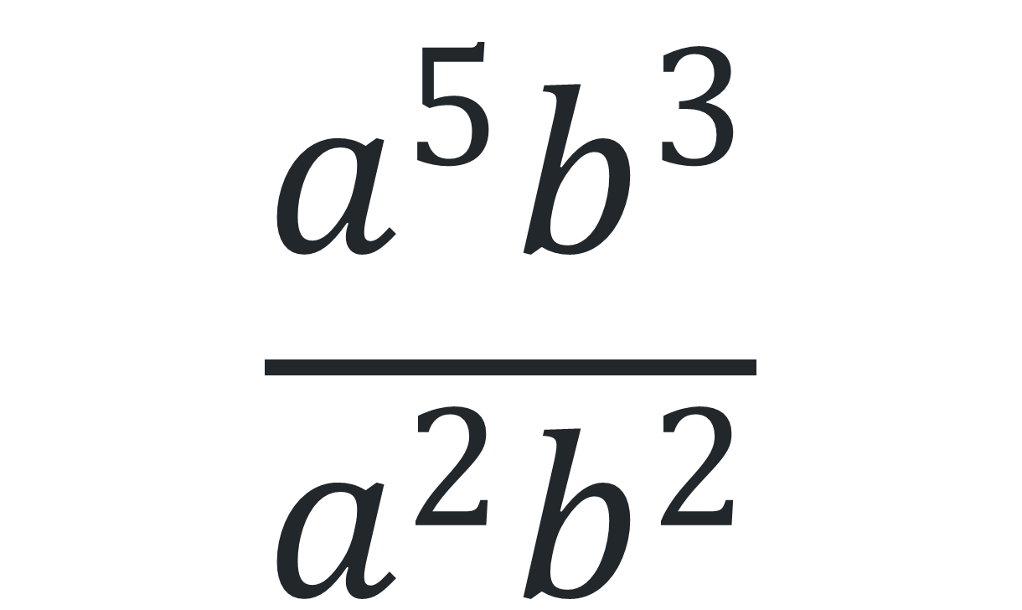
17.
Simplify the expression and check your bingo card.
$$\frac{a^{5}b^{3}}{a^{2}b^{2}}$$

Slide 21
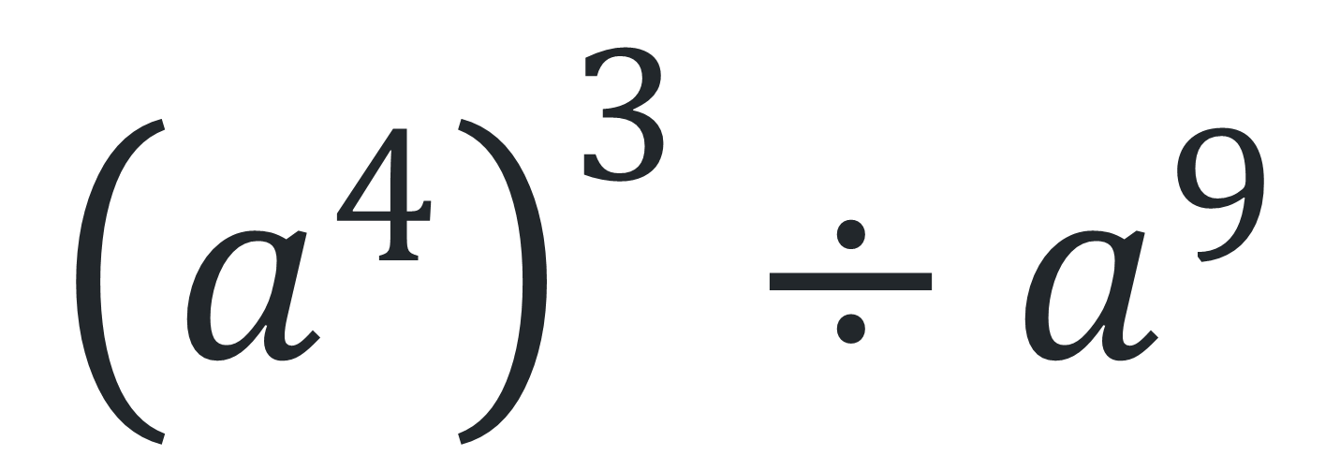
18.
Simplify the expression and check your bingo card.
$${\left(a^{4}\right)}^{3}÷a^{9}$$

