Slide 1
How much will I earn?
Explicit teaching

Slide 2
How do I know I am getting paid correctly?
Fair Work Commission
What do they do?
Develop awards
Approve enterprise agreements
Help resolve issues in the workplace
https://www.fwc.gov.au/

Slide 3
Types of employment
Why are there different types?
Type | Conditions
Full time | 38 hours a week. Certainty in shifts, pay and allowances.
Part time | Less than 38 hours per week. Predictability over work hours. Same pay and allowances as full-time employees.
Casual | Work irregular hours. Have flexible schedules. Typically paid for the hours they work. Do not have the same employment benefits and job security as permanent employees, such as sick pay or annual leave.

Slide 4
Wages (1)
Definition
A wage is a payment for work completed.
Wages are calculated based on an hourly rate and can include an overtime allowance and penalty rate allowances.
These are outlined in an award.
What is the difference between overtime and penalty rates?

Slide 5
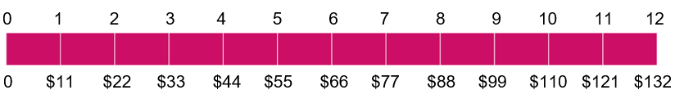
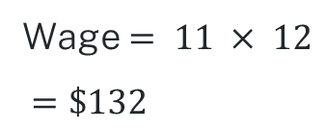
Wages (2)
Example 1
Oliver has a job in which he is employed as a casual. He receives $11 an hour for normal hours worked. If Oliver works 12 hours in one week, what is his wage?
Wage $= 11 × 12$
$=\$132$
Time worked (hours)

Slide 6
Wages (3)
Example 1 – self explanation prompts
Oliver has a job in which he is employed as a casual. He receives $11 an hour for normal hours worked. If Oliver works 12 hours in one week, what is his wage?
Wage $= 11 × 12$
$=\$132$
What are some shift combinations that Oliver may have worked this week?
Time worked (hours)

Slide 7
Wages (4)
Your turn – Question 1
Tran earns $12.50 an hour when he works at the local nursery. How much will he earn in a week if he works 9 hours at normal time?

Slide 8
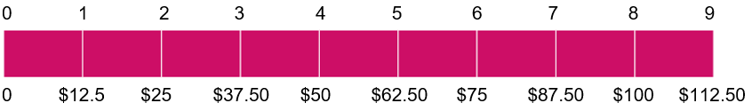
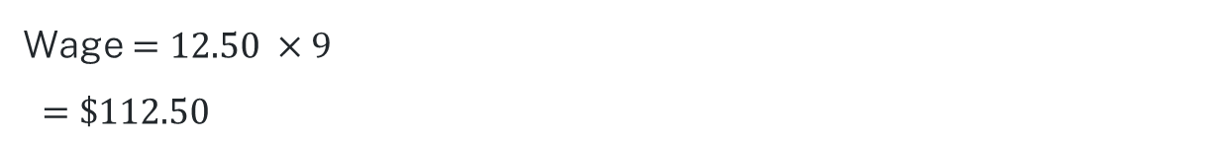
Wages (5)
Your turn – solution 1
Tran earns $12.50 an hour when he works at the local nursery. How much will he earn in a week if he works 9 hours at normal time?
Wage $=12.50 ×9$
$=\$112.50$
Time worked (hours)

Slide 9
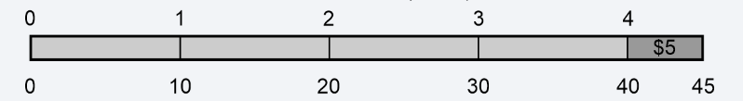
Wages (6)
Example 2
Calculate the hourly rate of pay if a person worked a 4-hour shift and earned $45 including a $5 tip.
Time worked (hours)
The hourly rate of pay will be $10 per hour.

Slide 10
Wages (7)
Example 2
Calculate the hourly rate of pay if a person worked a 4-hour shift and earned $45 including a $5 tip.
Time worked (hours)
How does this show an hourly rate of $10?
Why is the $5 inside the bar?
The hourly rate of pay will be $10 per hour.

Slide 11
Wages (8)
Your turn – Question 2
Calculate the hourly rate of pay if a person worked a 6-hour shift and earned $80. This included $8 for working in a confined space.

Slide 12
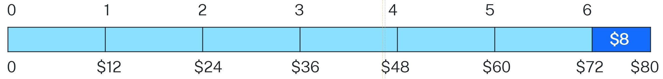
Wages (9)
Your turn – solution 2
Calculate the hourly rate of pay if a person worked a 6-hour shift and earned $80. This included $8 for working in a confined space.
The hourly rate of pay will be $12 per hour.

Slide 13
Overtime (1)
The language
Words | Decimal / Fraction
Normal time | 1
Time and a half | 1 ½ = 1.5
Double time | 2
Double time and a half | 2 ½ = 2.5

Slide 14
Overtime (2)
Example 3
Macy works 5 hours on a Saturday. She is paid $11.55 an hour and receives time and a half for working on Saturdays. How much is her pay for this shift?
Pay = 11.55 x 1.5 x 5
= $86.63

Slide 15
Overtime (3)
Example 3 – self explanation prompt
Macy works 5 hours on a Saturday. She is paid $11.55 an hour and receives time and a half for working on Saturdays. How much is her pay for this shift?
Pay = 11.55 x 1.5 x 5
= $86.63
What number represents time and a half?

Slide 16
Overtime (4)
Your turn – question 3
Ashton receives $14.30 an hour. He works 6 hours on a public holiday where he receives a penalty rate of time and a half. How much does he earn for this shift?

Slide 17
Overtime (5)
Your turn – solution 3
Ashton receives $14.30 an hour. He works 6 hours on a public holiday where he receives a penalty rate of time and a half. How much does he earn for this shift?
Pay = 14.30 x 1.5 x 6
= $128.70

Slide 18
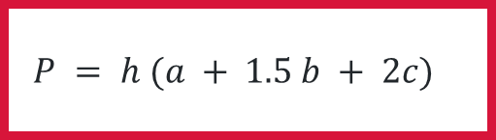
The formula
Let’s make it easier to calculate
Total pay = hourly rate x ( normal time hours + 1.5 x time and a half hours + 2 x double time hours)
Let P = total Pay
h = hourly rate
a = normal time hours
b = time and a half hours
c = double time hours
$$P = h (a + 1.5 b + 2c)$$

Slide 19
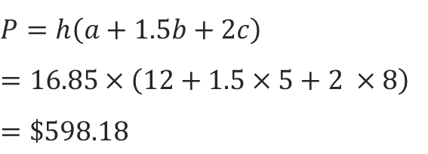
Using the formula (1)
Example 4
The hourly rate at a service station is $16.85. Find the total pay for John whose hours are in the table below.
Hours at normal time | Hours at time and a half | Hours at double time
12 | 5 | 8
$$P=h\left(a+1.5b+2c\right)$$
$$=16.85×\left(12+1.5×5+2 ×8\right)$$
$$=\$598.18$$

Slide 20
Using the formula (2)
Example 4 – self explanation prompts
The hourly rate at a service station is $16.85. Find the total pay for John whose hours are in the table below.
Hours at normal time | Hours at time and a half | Hours at double time
12 | 5 | 8
$$P=h\left(a+1.5b+2c\right)$$
$$=16.85×\left(12+1.5×5+2 ×8\right)$$
$$=\$598.18$$
Can you label the variables in the question?
Why would we use the formula to calculate pay?

Slide 21
Using the formula (3)
Your turn – Question 4
Calculate the weekly earnings of someone who earns $24.50 an hour and works the following hours.
Hours at normal time | Hours at time and a half | Hours at double time
24 | 7 | 3

Slide 22
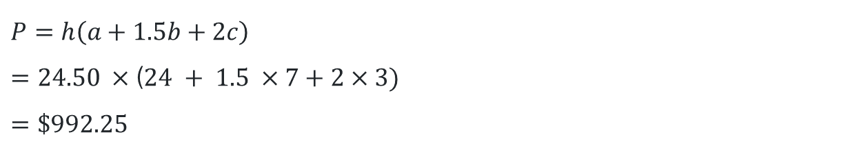
Using the formula (4)
Your turn – solution 4
Calculate the weekly earnings of someone who earns $24.50 an hour and works the following hours.
Hours at normal time | Hours at time and a half | Hours at double time
24 | 7 | 3
$$P=h\left(a+1.5b+2c\right)$$
$=24.50 ×$($24 + 1.5 ×7+2×3)$
$$=\$992.25$$

Slide 23

Using the formula (5)
Example 5
Hammish does not know his hourly rate. He gets paid $697.30 for the hours displayed in the table below. Can you find his hourly rate?
Hours at normal time | Hours at time and a half | Hours at double time
15 | 10 | 4
$$P=h\left(a+1.5b+2c\right)$$
$$697.30=h×\left(15+1.5×10+2 ×4\right)$$
$$697.30=h×38$$
$\frac{697.30}{38}=h$
$$h=\$18.35$$

Slide 24
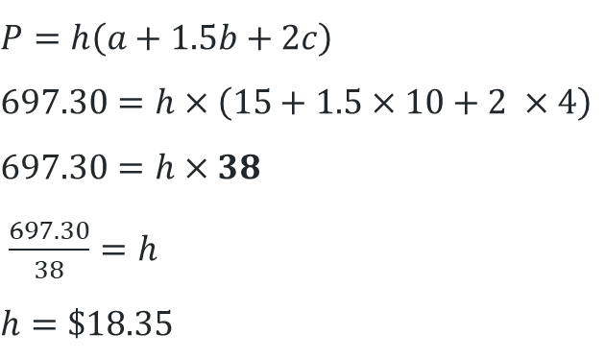
Using the formula (6)
Example 5
Hammish does not know his hourly rate. He gets paid $697.30 for the hours displayed in the table below. Can you find his hourly rate?
How is this question different from the previous?
Hours at normal time | Hours at time and a half | Hours at double time
15 | 10 | 4
$$P=h\left(a+1.5b+2c\right)$$
$$697.30=h×\left(15+1.5×10+2 ×4\right)$$
$$697.30=h×38$$
$\frac{697.30}{38}=h$
$$h=\$18.35$$
Where did the 38 come from?

Slide 25
Using the formula (7)
Your turn – question 5
Calculate the hourly rate of pay for of someone who earns $980.20 per week and works the following hours.
Hours at normal time | Hours at time and a half | Hours at double time
22 | 8 | 12

Slide 26
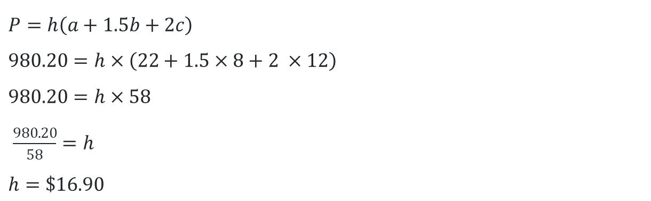
Using the formula (8)
Your turn – solution 5
Calculate the hourly rate of pay for of someone who earns $980.20 per week and works the following hours.
Hours at normal time | Hours at time and a half | Hours at double time
22 | 8 | 12
$$P=h\left(a+1.5b+2c\right)$$
$$980.20=h×\left(22+1.5×8+2 ×12\right)$$
$$980.20=h×58$$
$\frac{980.20}{58}=h$
$h=\$16.90$

