Slide 1
What? More pay!
Explicit teaching

Slide 2
Launch

Slide 3
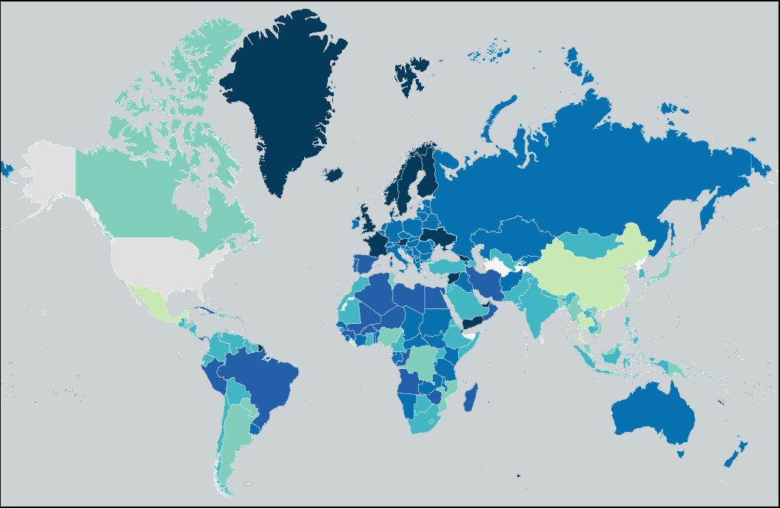
What do you notice / what do you wonder?
Minimum mandatory paid vacation days, normalised for a five-day work week
No data at all
No mandatory vacation
1 to 5 days
6 to 10 days
11 to 15 days
16 to 20 days
21 to 22 days
23 to 28 days
Map of Vacation Days Around the World’ by Guest2625 is licensed under CC BY-SA 4.0

Slide 4
Explore

Slide 5
How did it start?
Why do we have annual leave?
1890s – strike action for employee’s rights.
1906 – 10 days paid annual leave introduced
The first award in Australia was the maritime and shearers’ awards outlining working conditions and rights of workers.
Notes:
In the 1890’s maritime workers took strike action to protest about employee’s rights.
In 1906 the federal maritime award introduced 10 days paid annual leave to all workers.
The first award in Australia was the maritime and shearers awards outlining working conditions and rights of workers.

Slide 6
How did it start? (2)
Why do we have annual leave?
1890s – strike action for employee’s rights.
1906 – 10 days paid annual leave introduced
What is a strike? Why do they occur?
The first award in Australia was the maritime and shearers’ awards outlining working conditions and rights of workers.
What is an award?
Notes:
Explain to students what a strike and why they might occur.
Explain to students what an award is.

Slide 7
When did it become the normal?
Why do we have annual leave?
1935 – one week paid annual leave for The Printer’s Union
1945 – after WWII, two weeks’ annual leave.
1974 – 4 weeks annual leave
Notes:
The Printer’s Union won one week paid annual leave in 1935.
After WWII in 1945, workers across Australia won the right to two weeks’ annual leave.
It wasn’t until 1974 that the NSW Industrial Relations Commission introduced 4 weeks annual leave each year.

Slide 8
When did it become the normal? (2)
Why do we have annual leave?
1935 – one week paid annual leave for The Printer’s Union
What is a union?
1945 – after WWII, two weeks’ annual leave.
1974 – 4 weeks annual leave
Notes:
Ask students to explain what a union is.

Slide 9
Why do we have annual leave loading?
We have overtime to thank.
In the 1970s many people worked in industry and did overtime which was paid on top of their normal income.
Annual leave loading was introduced to compensate workers during their holidays for missing out on overtime pay.

Slide 10
Why do we have annual leave loading? (2)
We have overtime to thank.
In the 1970s many people worked in industry and did overtime which was paid on top of their normal income.
Annual leave loading was introduced to compensate workers during their holidays for missing out on overtime pay.
We can thank the people who work overtime for the extra money we get in holiday pay.

Slide 11
Summarise

Slide 12

Calculating leave loading (1)
Example 1
Emily works as a full-time employee at a company that provides leave loading at a rate of 17.5%.
Her base salary is $1500 per week. Emily is planning to take one week of annual leave. Calculate her leave loading.
$$\frac{17.5}{100}×1500=\$262.50$$

Slide 13
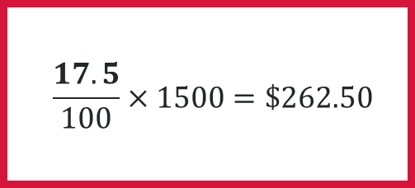
Calculating leave loading (2)
Example 1 prompts
Emily works as a full-time employee at a company that provides leave loading at a rate of 17.5%.
Her base salary is $1500 per week. Emily is planning to take one week of annual leave. Calculate her leave loading.
Why is there a multiplication sign?
$$\frac{17.5}{100}×1500=\$262.50$$
Would it have mattered if I used 0.175?
Would it have mattered if I used 17.5?

Slide 14
Calculating leave loading (3)
Your turn – question 1
John works part-time at the town car wash.
He earns $380 per week and is wishing to take one week of annual leave to go fishing with his mates.
If he is entitled to 17.5% annual leave loading, how much extra money will he receive for the week?

Slide 15
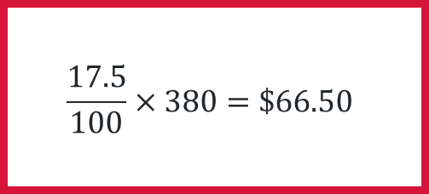
Calculating leave loading (4)
Your turn – solution 1
John works part-time at the town car wash.
He earns $380 per week and is wishing to take one week of annual leave to go fishing with his mates.
If he is entitled to 17.5% annual leave loading, how much extra money will he receive for the week?
$$\frac{17.5}{100}×380=\$66.50$$

Slide 16
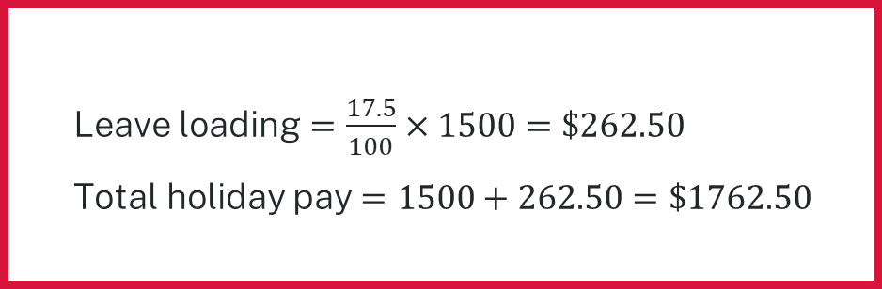
Calculating leave loading (5)
Example 2
Emily works as a full-time employee at a company that provides leave loading at a rate of 17.5%. Her base salary is $1500 per week.
Emily is planning to take a week of annual leave.
What will be her pay for that week?
Leave loading $=\frac{17.5}{100}×1500=\$262.50$
Total holiday pay $=1500+262.50=\$1762.50$

Slide 17
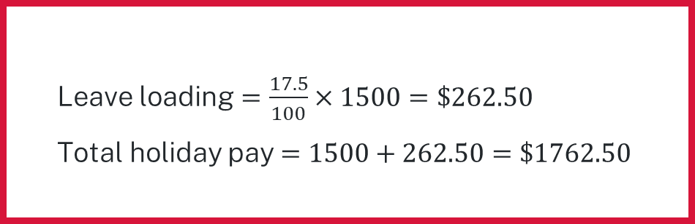
Calculating leave loading (6)
Example 2 prompts
Emily works as a full-time employee at a company that provides leave loading at a rate of 17.5%. Her base salary is $1500 per week.
Emily is planning to take a week of annual leave.
What will be her pay for that week?
Leave loading $=\frac{17.5}{100}×1500=\$262.50$
Total holiday pay $=1500+262.50=\$1762.50$
How has the question changed?
Why is 1500 added to the leave loading?

Slide 18
Calculating leave loading (7)
Your turn – question 2
John works part-time at the town car wash.
He earns $380 per week and is wishing to take annual leave to go fishing with his mates.
If he is entitled to 17.5% annual leave loading, how much will he receive for the week?

Slide 19
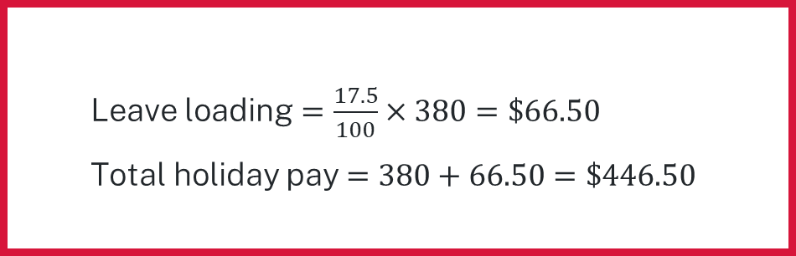
Calculating leave loading (8)
Your turn – solution 2
John works part-time at the town car wash.
He earns $380 per week and is wishing to take annual leave to go fishing with his mates.
If he is entitled to 17.5% annual leave loading, how much will he receive for the week?
Leave loading $=\frac{17.5}{100}×380=\$66.50$
Total holiday pay $=380+66.50=\$446.50$

Slide 20
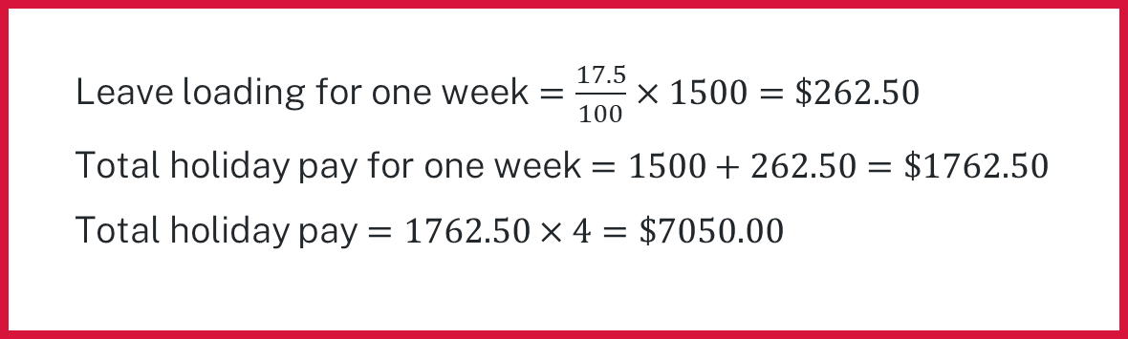
Calculating leave loading (9)
Example 3
Emily works as a full-time employee at a company that provides leave loading at a rate of 17.5%. Her base salary is $1500 per week.
Emily is planning to taking 4 weeks’ annual leave.
What will be her pay for this time?
Leave loading for one week $=\frac{17.5}{100}×1500=\$262.50$
Total holiday pay for one week $=1500+262.50=\$1762.50$
Total holiday pay $=1762.50×4=\$7050.00$

Slide 21
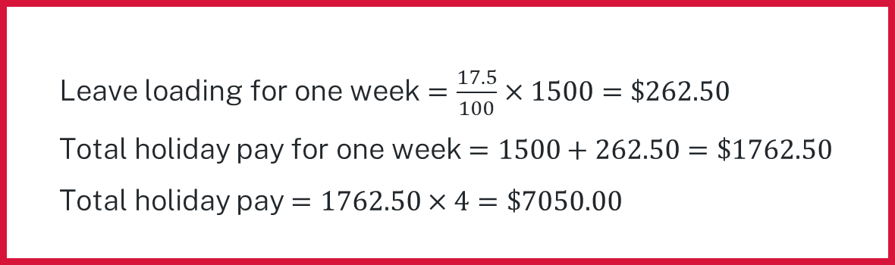
Calculating leave loading (10)
Example 3 prompts
Emily works as a full-time employee at a company that provides leave loading at a rate of 17.5%. Her base salary is $1500 per week.
Emily is planning to taking 4 weeks’ annual leave.
What will be her pay for this time?
Leave loading for one week $=\frac{17.5}{100}×1500=\$262.50$
Total holiday pay for one week $=1500+262.50=\$1762.50$
Total holiday pay $=1762.50×4=\$7050.00$
How has the question changed?
What does this calculation find?

Slide 22
Calculating leave loading (11)
Your turn – question 3
John works part-time at the town car wash.
He earns $380 per week and is wishing to take two weeks’ annual leave to go fishing with his mates.
If he is entitled to 17.5% annual leave loading, how much pay will he receive in total?

Slide 23
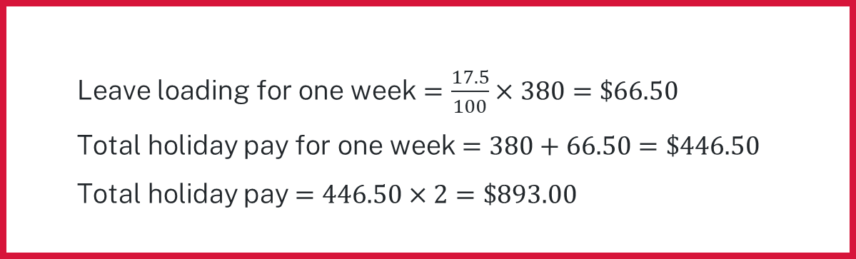
Calculating leave loading (12)
Your turn – solution 3
John works part-time at the town car wash.
He earns $380 per week and is wishing to take two weeks’ annual leave to go fishing with his mates.
If he is entitled to 17.5% annual leave loading, how much pay will he receive in total?
Leave loading for one week $=\frac{17.5}{100}×380=\$66.50$
Total holiday pay for one week $=380+66.50=\$446.50$
Total holiday pay $=446.50×2=\$893.00$

