Slide 1
Watch money grow
Explicit teaching

Slide 2
Frayer model (1)
Simple interest
Simple interest
Definition
Simple interest is when the interest payment in each period is a fixed percentage of the principal (the initial lump sum of money)
Examples
Notes:
Students to come up with an example

Slide 3
Frayer model (2)
Simple interest
Simple interest
Definition
Simple interest is when the interest payment in each period is a fixed percentage of the principal (the initial lump sum of money)
Characteristics
Examples
$20 000 invested at
3% p.a. for 3 years
becomes $21 800.
Year | Interest | Balance
1 | $600 | $20 600
2 | $600 | $21 200
3 | $600 | $21 800
Notes:
Students to consider characteristics

Slide 4
Frayer model (3)
Simple interest
Simple interest
Definition
Simple interest is when the interest payment in each period is a fixed percentage of the principal (the initial lump sum of money)
Characteristics
The amount of interest each period is the same.
The balance increases at a constant rate.
Non examples
Examples
$20 000 invested at
3% p.a. for 3 years
becomes $21 800.
Year | Interest | Balance
1 | $600 | $20 600
2 | $600 | $21 200
3 | $600 | $21 800
Notes:
Students to consider a non-example

Slide 5
Frayer model (4)
Simple interest
Simple interest
Definition
Simple interest is when the interest payment in each period is a fixed percentage of the principal (the initial lump sum of money)
Characteristics
The amount of interest each period is the same.
The balance increases at a constant rate.
Non examples
Examples
$20 000 invested at
3% p.a. for 3 years
becomes $21 800.
Year | Interest | Balance
1 | $600 | $20 600
2 | $600 | $21 200
3 | $600 | $21 800
Year | Interest | Balance
1 | $600 | $20 600
2 | $618 | $21 218
3 | $636.54 | $21 854.54
Notes:
Completed frayer model.

Slide 6
The formula
Simple interest
$$I=Prn$$
where $I=simple interest$
$$P=principal$$
$$r=interest rate per time period$$
$$n=number of time periods$$

Slide 7
The simple interest formula
Simple interest
$$I=Prn$$
where $I=simple interest$
$$P=principal$$
$$r=interest rate per time period$$
$$n=number of time periods$$
Which mathematical symbol is in between each variable?

Slide 8
Simple interest (1)
Using the formula – example 1
$3500 is invested for 5 years at a simple interest rate of 2.6% p.a. Calculate the final value of the investment
$I=Prn$
$I=P×r×n$
$I=3500×\frac{2.6}{100}×5$
$I=455$
$\text{Final} \text{value}=3500+455$
$\text{Final} \text{value}=\$3955$

Slide 9
Simple interest (2)
Using the formula – example 1 self-explanation prompts
$3500 is invested for 5 years at a simple interest rate of 2.6% p.a. Calculate the final value of the investment
$I=Prn$
$I=P×r×n$
$I=3500×\frac{2.6}{100}×5$
$I=455$
$\text{Final} \text{value}=3500+455$
$\text{Final} \text{value}=\$3955$
What does p.a. stand for?
Why did multiplication symbols get added?
Where did $\frac{2.6}{100}$come from?
Why did 455 get added to initial investment?

Slide 10
Simple interest (3)
Your turn – question 1
$4500 is invested for 2 years at a simple interest rate of 3.1% p.a. Find the value of the investment after 2 years.

Slide 11
Simple interest (4)
Your turn – solution 1
$4500 is invested for 2 years at a simple interest rate of 3.1% p.a. Find the value of the investment after 2 years.
$I=Prn$
$I=P×r×n$
$I=4500×3.1\%×2$
$I=279$
$\text{Final} \text{value}=4500+279$
$\text{Final} \text{value}=\$4779$

Slide 12
Simple interest (5)
Using the formula – example 2
$2000 is invested for 2 years at a simple interest rate. At the end of 2 years the investment has increased to $2128. Find the interest rate that would achieve this after 2 years.
$$I=Prn$$
$$128=2000×r×2$$
$$128=4000 × r$$
$$r=\frac{128}{4000}$$
$$r=0.032$$
$$r=0.032×100$$
$$r=3.2\%$$
$$I=2128−2000$$
$$I=128$$
$$P=2000$$
$$r= ?$$
$$n=2$$

Slide 13
Simple interest (6)
Using the formula – example 2 prompts
$2000 is invested for 2 years at a simple interest rate. At the end of 2 years the investment has increased to $2128. Find the interest rate that would achieve this after 2 years.
$$I=Prn$$
$$128=2000×r×2$$
$$128=4000 × r$$
$$r=\frac{128}{4000}$$
$$r=0.032$$
$$r=0.032×100$$
$$r=3.2\%$$
$$I=2128−2000$$
$$I=128$$
$$P=2000$$
$$r= ?$$
$$n=2$$
Why did these numbers get subtracted?
Why was this fraction multiplied by 100?

Slide 14
Simple interest (7)
Your turn – question 2
$4000 is invested for 3 years at a simple interest rate. At the end of 3 years the investment has increased to $4348. Find the interest rate that would achieve this after 4 years.

Slide 15
Simple interest (8)
Your turn – solution 2
$4000 is invested for 3 years at a simple interest rate. At the end of 3 years the investment has increased to $4348. Find the interest rate that would achieve this after 4 years.
$$I=4348−4000$$
$$I=348$$
$$P=4000$$
$$r= ?$$
$$n=3$$
$$I=Prn$$
$$348=4000×r×3$$
$$348=12000r$$
$$r=\frac{348}{12000}×100$$
$$r=2.9\%$$

Slide 16
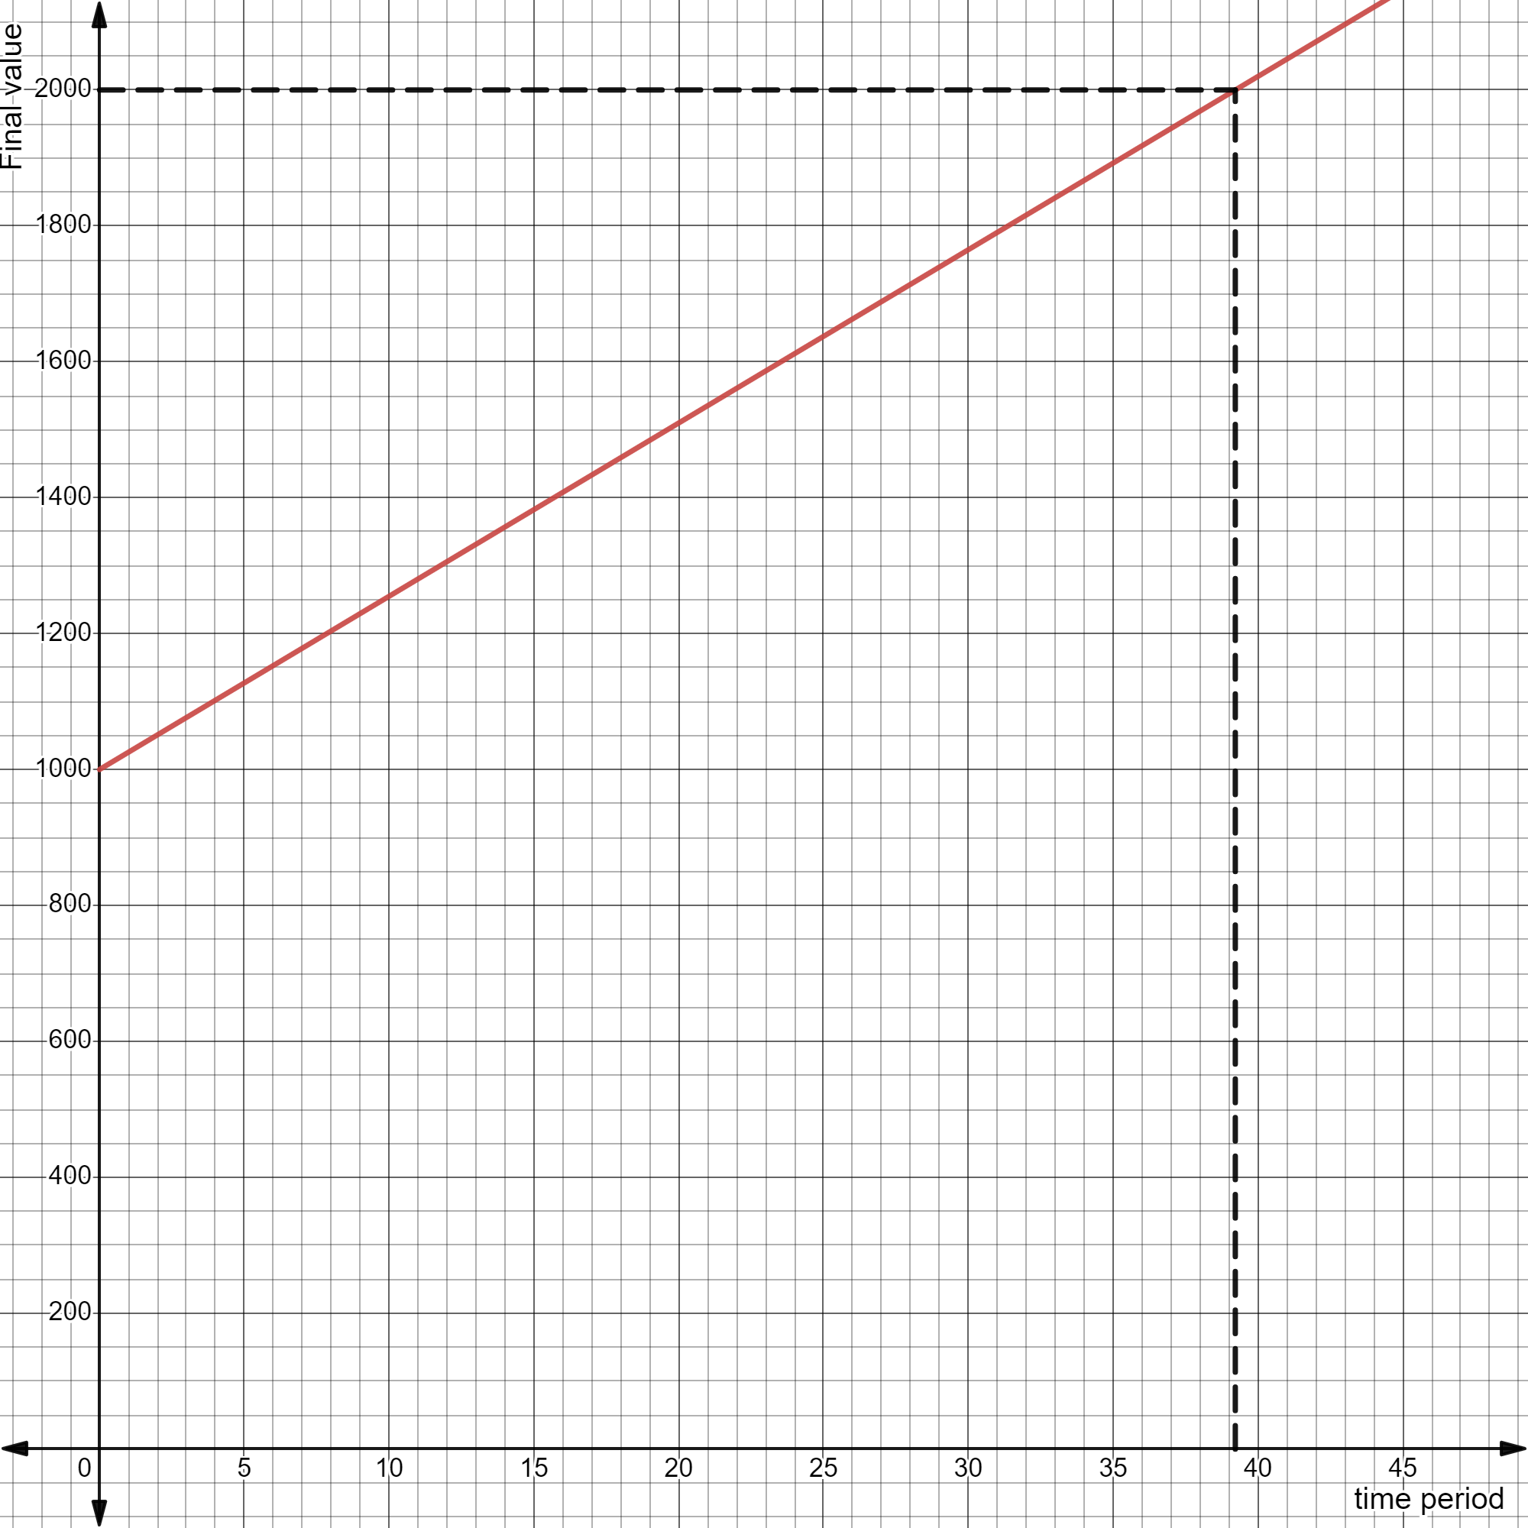
Simple interest (9)
Using a graph – example 3 answer
The graph shows an amount of $1000, invested with a simple interest rate of 2.55%.
Use the graph to find approximately how long it takes the investment to double.
The investment will take approximately 39 years to double.
years

Slide 17
Simple interest (10)
Why has a line been drawn from $2000?
Using a graph – example 3 self-explanation prompts
The graph shows an amount of $1000, invested with a simple interest rate of 2.55%.
Use the graph to find approximately how long it takes the investment to double.
What does this vertical line represent?
The investment will take approximately 39 years to double.
Where did 39 come from?
years

Slide 18
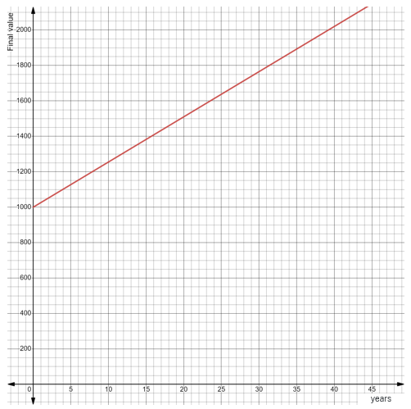
Simple interest (11)
Your turn – question 3
The graph shows an investment of $1000, invested with a simple interest rate of 2.55%.
Use the graph to find the approximate amount of the investment after 5 years.

Slide 19
Simple interest (12)
Your turn – question 3
The graph shows an investment of $1000, invested with a simple interest rate of 2.55%.
Use the graph to find the approximate amount of the investment after 5 years.
After 5 years the investment will be approximately $1130.

