Slide 1
Contemporary practice
Visual arts
29 April 2024
Creative arts curriculum team

Slide 2
Acknowledgement of Country
We recognise the Ongoing Custodians of the lands and waterways where we work and live. We pay respect to Elders past and present as ongoing teachers of knowledge, songlines and stories. We strive to ensure every Aboriginal and Torres Strait Islander learner in NSW achieves their potential through education.
‘Kariong – Our meeting place’ created by Stella Haynes from Cammeray Public School on Eora Country as part of the 2022 Calendar for cultural diversity.

Slide 3
Learning intentions and success criteria
Learning intentions
During this session you will:
explore resources with a focus on contemporary visual arts practice
develop assessment and programming ideas that incorporate the new contemporary resources collected.
Success criteria
This will equip you to:
gather a collection of related resources appropriate for Stage 4 or 5, to integrate into future teaching and learning programs
identify the evidence required to capture your students’ abilities to meet outcomes from the Visual Arts 7–10 Syllabus.
NESA accredited PD standard descriptors
2.1.2 Apply knowledge of the content and teaching strategies of the teaching area to develop engaging teaching activities.
6.2.2 Participate in learning to update knowledge and practice, targeted to professional needs and school and/or system priorities.

Slide 4
Overview
Contemporary practice in visual arts 7–10
This is an opportunity to renew your resources for current and future programs to feature examples of contemporary practice. In this session you will be provided with ideas to locate and select a range of contemporary visual arts resources to use in your classroom teaching practice.
At the end of this session, you will have selected the resources you need to build a Stage 4 or 5 unit of work featuring artwork examples from the last 5 to 10 years.
You may choose to focus on:
one or more contemporary artists
an exhibition
an artworld issue.

Slide 5
Planning steps
Overview of process for this session

Slide 6
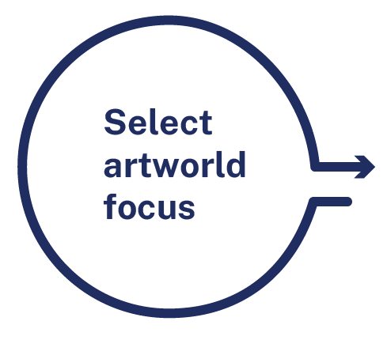
Planning step one
Click on the circles in present mode for ideas
Specific artist/s
My artworld focus is
[insert response here]
An exhibition
Artworld issue
Once you have chosen an artworld focus, move onto Planning step 2

Slide 7
Specific artist/s
Contemporary arts focus
You can consider artist/s:
with established practice/s who have produced works in the last 5 to 10 years
with newly established practice/s
who are part of a collective
who are Aboriginal and/or Torres Strait Islander, Australian or international
designers and/or architects.
Back

Slide 8
An exhibition
Past, current and future exhibitions
Consider recent exhibitions at:
national institutions such as the National Gallery of Australia
state institutions such as the Art Gallery of NSW
regional and public directory of galleries — RPGNSW
artist run galleries
other non-commercial arts spaces
commercial galleries representing contemporary artists
visual arts festivals, fairs, prizes, annual exhibitions and events
Australian and regional biennales and triennials.
Many institutions publish newsletters, journals and exhibition catalogues that may be useful sources for images and critical readings.
Back

Slide 9
Artworld issue
You could consider:
exploration of material practice in a specific expressive form
a topic with a subjective, cultural or postmodern focus
an examination of the relationship between 2 or more conceptual framework agencies
how artists follow or reject established conventions
artworld issues explored through an exhibition or critical and historical account.
Back

Slide 10
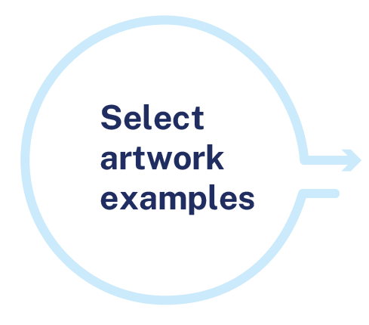
Planning step 2
Guidelines for selecting artworks
Select up to 3 key artworks for critical and historical investigation.
The artworks should have been made in the last 5 to 10 years.
The artworks should have a relationship to the artworld focus you have selected.

Slide 11
Your artwork selections
Artwork 1
Artwork 2
Artwork 3
[insert image or link here]
[insert image or link here]
[insert image or link here]
[Insert citation here]
[Insert citation here]
[Insert citation here]

Slide 12
Planning step 3
Collect resources that can be used in the classroom to support student learning. For example, readings, videos and quotes.
Readings
Videos
Quotes

Slide 13
Resource collection ideas
The lists below may support you with ideas for supporting resources.
Readings
Videos
Quotes
Education kits
Catalogue essays
Journal articles
Art magazines
Newspaper articles
Auction house historical descriptions
Artist websites
Interviews with the artist or exhibition curator
Exhibition walk-through
Artmaking process
Artist quote about their own practice
Critical or historical quotes
Quotes about the artwork
Quotes about the artist
Audience response

Slide 14
Your resource selections
Readings
Videos
Quotes
[Save your links here]
[Save your links here]
[Save your links/quotes here]

Slide 15
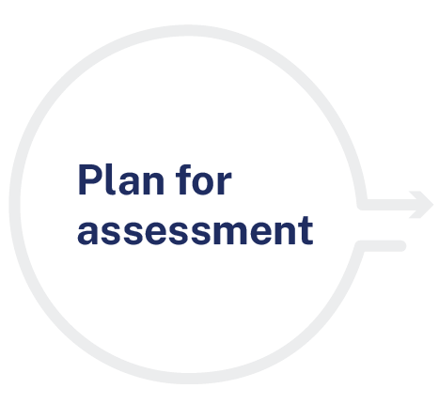
Planning step 4
Plan an assessment task related to the resources you have gathered today.
Select a content focus area and related artmaking and critical/historical outcomes from the Visual arts 7–10 Syllabus or Visual arts Stage 6 Syllabus such as the frames, conceptual framework or practice.
Selected outcome/s
[insert outcomes here]

Slide 16
Planning for assessment
Review the related learn about and learn to information in the Visual arts 7–10 Syllabus.
Identify the aim or essential question/s the unit of work intends to achieve/answer.
Make connections between the syllabus content and aim/essential question and the key ideas in the resources you have collected. Develop up to 3 big ideas that will be overarching throughout the unit of work. Record the big ideas in the box provided.
The big ideas are:

Slide 17
Evidence for assessment
Formative and summative
4. Decide what evidence is needed to assess the students’ ability to meet each selected artmaking and critical/historical outcome. Consider if it will be collected through formative and/or summative assessment.
Outcome | Evidence | Type of assessment

Slide 18
Where to from here?
The next steps to developing a program using the resources and ideas captured in this session.
Consider the activities that will support students to develop the skills, knowledge and understanding to generate the evidence you need to assess the outcomes.
Develop a program by sequencing the learning activities in an order that introduces the ideas, models the skills and application of knowledge, offers opportunities for group and guided practise and then provides individual application opportunities.

Slide 19
Useful resources (1 of 2)
Lighten your load
Explore the existing resources available on the Visual arts 7–10 and Visual arts 11–12 creative arts curriculum web pages and Creative arts statewide staffroom.

Slide 20
Useful resources (2 of 2)
Creative arts curriculum team
Fostering critical and creative thinking in visual arts 7–10 – teaching and learning strategies and the accompanying lesson sequence, reflects the findings of an evidence-based investigation of critical and creative thinking in visual arts classrooms in NSW.
Programming for the frames – this resource provides examples of how each frame can be used to explore the function of the ‘agencies of the artworld’ and the relationships between them.
Mapping memory – Badger Bates – a 10-week Stage 4 unit of work with accompanying workbook, investigates the artmaking practice of Barkindji printmaker Badger Bates.
Ctrl + Alt + Shift – a digital resource package that provides Stage 5 students with opportunities to investigate and interpret contemporary intersections between art, technology, storytelling, social change and collaboration by focusing on the practice of 5 Australian artists.

Slide 21
Stay in touch
Sign up for our Creative arts e-NEWS
Regular updates on professional learning and resources, curriculum news and more
Join us in the Creative arts statewide staffroom
Direct support from curriculum officers, advisors, and the community
Join our statewide meetings
Tune in to the ‘Creative cast’ podcast
Contact creativearts7–12@det.nsw.edu.au

Slide 22
References (1 of 2)
This presentation contains NSW Curriculum and syllabus content. The NSW Curriculum is developed by the NSW Education Standards Authority. This content is prepared by NESA for and on behalf of the Crown in the right of the State of New South Wales. The material is protected by Crown copyright.
Please refer to the NESA Copyright Disclaimer for more information https://educationstandards.nsw.edu.au/wps/portal/nesa/mini-footer/copyright.
NESA holds the only official and up-to-date versions of the NSW Curriculum and syllabus documents. Please visit the NSW Education Standards Authority (NESA) website https://educationstandards.nsw.edu.au/wps/portal/nesa/home and the NSW Curriculum website https://curriculum.nsw.edu.au.
Visual arts 7–10 © Syllabus NSW Education Standards Authority (NESA) for and on behalf of the Crown in right of the State of New South Wales, [2023].
Australian Institute for teaching and school leadership (2023) Teacher standards (website) accessed 10/11/2023
Art Gallery of NSW (2023) Art Gallery of NSW [website] accessed 17/11/2023
Museums and galleries of NSW (2023) Places [website] accessed 17/11/2023
National Gallery of Australia (2023) National Gallery of Australia [website] accessed 17/11/2023
Regional and public directory of galleries inc (2023) Regional and public directory of galleries accessed 17/11/2023

Slide 23
References (2 of 2)
This presentation contains NSW Curriculum and syllabus content. The NSW Curriculum is developed by the NSW Education Standards Authority. This content is prepared by NESA for and on behalf of the Crown in the right of the State of New South Wales. The material is protected by Crown copyright.
Please refer to the NESA Copyright Disclaimer for more information https://educationstandards.nsw.edu.au/wps/portal/nesa/mini-footer/copyright.
NESA holds the only official and up-to-date versions of the NSW Curriculum and syllabus documents. Please visit the NSW Education Standards Authority (NESA) website https://educationstandards.nsw.edu.au/wps/portal/nesa/home and the NSW Curriculum website https://curriculum.nsw.edu.au.
Department of Education (2023) visual arts 7–10 [website] accessed 17/11/2023.
Department of Education (2023) visual arts 11–12 [website] accessed 17/11/2023.
Department of Education (2023) Fostering critical and creative thinking in visual arts 7–10 [website] accessed 17/11/2023
Department of Education (2023) Programming for the frames [website] accessed 17/11/2023
Department of Education (2023) Mapping memory – Badger Bates [resource] accessed 17/11/2023
Department of Education (2023) Ctrl + Alt + Shift [website] accessed 17/11/2023

Slide 24
Copyright
© State of New South Wales (Department of Education), 2023
The copyright material published in this resource is subject to the Copyright Act 1968 (Cth) and is owned by the NSW Department of Education or, where indicated, by a party other than the NSW Department of Education (third-party material).
Copyright material available in this resource and owned by the NSW Department of Education is licensed under a Creative Commons Attribution 4.0 International (CC BY 4.0) licence.
This licence allows you to share and adapt the material for any purpose, even commercially.
Attribution should be given to © State of New South Wales (Department of Education), 2023.
Material in this resource not available under a Creative Commons licence:
the NSW Department of Education logo, other logos and trademark-protected material
Material owned by a third party that has been reproduced with permission. You will need to obtain permission from the third party to reuse its material.
Links to third-party material and websites
Please note that the provided (reading/viewing material/list/links/texts) are a suggestion only and implies no endorsement, by the New South Wales Department of Education, of any author, publisher, or book title. School principals and teachers are best placed to assess the suitability of resources that would complement the curriculum and reflect the needs and interests of their students.
If you use the links provided in this document to access a third party’s website, you acknowledge that the terms of use, including licence terms set out on the third-party’s website apply to the use which may be made of the materials on that third-party website or where permitted by the Copyright Act 1968 (Cth). The department accepts no responsibility for content on third-party websites.

