Slide 1
Poetic purpose
Sample podcast – audio file and listening activity
Notes:
Teacher instructions
This sample podcast audio file is not a standalone resource. It has been created for use by teachers in connection to the program ‘Poetic purpose’ and is attached to the sample assessment notification and student work sample that supports this program.
All resources connected with this sample can be found on the department’s webpage, Planning, programming and assessing English 7-10: https://education.nsw.gov.au/teaching-and-learning/curriculum/english/planning-programming-and-assessing-english-7-10
Unpacking the assessment task
Phase 1, activity 4 – engaging with the assessment task notification is designed to support students to gain an understanding of the assessment requirements. Teachers should play the sample podcast audio file during this activity and can return to the sample podcast audio file at any stage during the program.
Use Phase 6, resource 1 – structural conventions of a podcast and Phase 1, activity 2 – podcast transitions template OR Core formative task 5 – podcast script during the listening activity. This approach guides students to engage with the structural conventions of a typical podcast and map where these are used in the sample.

Slide 2
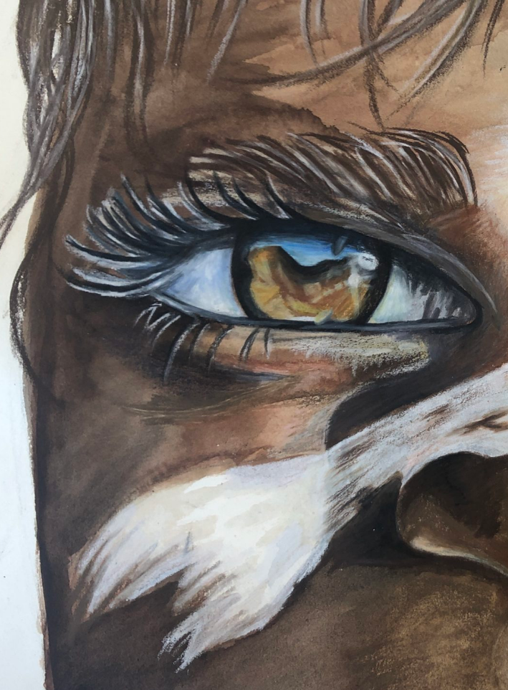
Acknowledgement of Country
We recognise the Ongoing Custodians of the lands and waterways where we work and live. We pay respect to Elders past and present as ongoing teachers of knowledge, songlines and stories.
We strive to ensure every Aboriginal and Torres Strait Islander learner in NSW achieves their potential through education.
‘Ochre Eyes’ created by Lilianna from Winmalee High School on Darug Country as part of 2020 Schools Reconciliation Challenge.

Slide 3
Activity 1
Sample podcast – audio and transcript
First listen – listen to the sample podcast audio file.
Second listen – listen to the sample podcast (you might like to use the transcript to support your listening) and complete Phase 1, activity 2 – podcast transitions template OR Core formative task 5 – podcast script. You might like to refer to Phase 6, resource 1 – structural conventions of a podcast to assist you with the task.
Third listen – listen to the sample and examine the annotated transcript. Make necessary adjustments to your annotations.

Slide 4
What makes poetry powerful?
Episode #6 – The poetry of Jazz Money and Ali Cobby Eckermann
Producers and presenters: Taylor and Parker.

Slide 5
Activity 2
Sample podcast – audio and transcript
Outline how your thinking has changed. Complete the thinking routine ‘I used to think … Now I think …’ and explain how your understanding of the assessment and how to create a podcast for this purpose has developed.
Reflection – how would you improve this podcast if you were the author?

Slide 6
What next…
Poetic purpose
You can refer to the ‘Steps for success’ in the sample assessment notification. In addition, a range of activities and resources have been created to support students when creating their podcasts:
Phase 6, activity 1 – engaging with a podcast
Phase 6, activity 2 – podcast writing guide
Phase 6, resource 1 – structural conventions of a podcast
Core formative assessment task 5 – podcast script
Phase 6, resource 6 – podcast script writing conventions
Phase 6, resource 8 – production devices
Phase 6, activity 10 – podcast recording self-assessment.
Additional resources
The Student Podcaster
Notes:
https://t4l.schools.nsw.gov.au/resources/teaching-and-learning-resources/the-student-podcaster.html

Slide 7
References
This presentation contains NSW Curriculum and syllabus content. The NSW Curriculum is developed by the NSW Education Standards Authority. This content is prepared by NESA for and on behalf of the Crown in the right of the State of New South Wales. The material is protected by Crown copyright.
Please refer to the NESA Copyright Disclaimer for more information https://educationstandards.nsw.edu.au/wps/portal/nesa/mini-footer/copyright.
NESA holds the only official and up-to-date versions of the NSW Curriculum and syllabus documents. Please visit the NSW Education Standards Authority (NESA) website https://educationstandards.nsw.edu.au/wps/portal/nesa/home and the NSW Curriculum website https://curriculum.nsw.edu.au.
State of New South Wales (Department of Education) (n.d.) ‘The Student Podcaster’, Technology 4 Learning, NSW Department of Education website, accessed 6 October 2023.

Slide 8
Copyright
© State of New South Wales (Department of Education), 2023
The copyright material published in this resource is subject to the Copyright Act 1968 (Cth) and is owned by the NSW Department of Education or, where indicated, by a party other than the NSW Department of Education (third-party material).
Copyright material available in this resource and owned by the NSW Department of Education is licensed under a Creative Commons Attribution 4.0 International (CC BY 4.0) licence.
This licence allows you to share and adapt the material for any purpose, even commercially.
Attribution should be given to © State of New South Wales (Department of Education), 2023.
Material in this resource not available under a Creative Commons licence:
the NSW Department of Education logo, other logos and trademark-protected material
material owned by a third party that has been reproduced with permission. You will need to obtain permission from the third party to reuse its material.
Links to third-party material and websites
Please note that the provided (reading/viewing material/list/links/texts) are a suggestion only and implies no endorsement, by the New South Wales Department of Education, of any author, publisher, or book title. School principals and teachers are best placed to assess the suitability of resources that would complement the curriculum and reflect the needs and interests of their students.
If you use the links provided in this document to access a third-party's website, you acknowledge that the terms of use, including licence terms set out on the third-party's website apply to the use which may be made of the materials on that third-party website or where permitted by the Copyright Act 1968 (Cth). The department accepts no responsibility for content on third-party websites.
Notes:
Slide not shared

