Slide 1

Jeopardy game
Questions and answers with German food and drink
Notes:
Jeopardy game created using ‘What’s the question?’ from Digital Learning Selector, DoE NSW

Slide 2
Instructions
The Jeopardy game board displays different point values on tiles. Behind each tile is a word or an image of food or drink.
Students play the game in 2 teams, with students in each team taking a turn to answer. Teams take turns to come up with a question containing the word (or the word corresponding to the image) behind each tile. For example, if the image is ham, the student whose turn it is could create one of these questions:
Isst du gern Schinken?
Ist das Schinken?
If the question is correct, the student’s team gets the tile points. Next, a student from the other team gets the chance to win the same points for their team by answering the question with a correct German sentence. For example:
Ja, ich esse gern Schinken.
Nein, ich esse nicht gern Schinken.
Ja, das ist Schinken.
The team with the most points when all tiles have been selected is the winner. The game can continue by starting over and requiring a different question than what was asked in the previous round.

Slide 3

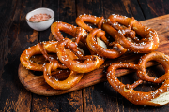
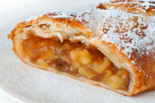

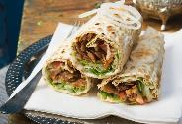
Jeopardy (1 of 2)
Press the spacebar or tap on the
screen to begin.
Gemüse
Lieblingsessen
5 points
10 points
40 points
Eis
15 points
30 points
Brötchen
20 points
50 points
60 points
Frühstück
80 points
90 points
100 points
70 points
Abendessen
150 points
Obst
400 points
Currywurst
200 points
250 points
Brot
350 points
Frankfurter
300 points
450 points
600 points
Schokolade
500 points
Fleish
700 points
Wasser
Fisch
550 points
800 points
3
Notes:
Jeopardy game created using What’s the question? from Digital Learning Selector, DoE NSW

Slide 4
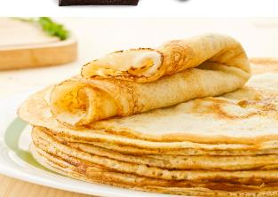
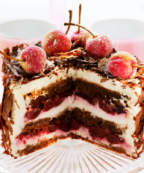
Jeopardy (2 of 2)
Click the spacebar or tap on the
screen to begin.
1000 points
1000 points
1000 points
2000 points
2000 points
4

Slide 5
Copyright
© State of New South Wales (Department of Education), 2023
The copyright material published in this resource is subject to the Copyright Act 1968 (Cth) and is owned by the NSW Department of Education or, where indicated, by a party other than the NSW Department of Education (third-party material).
Copyright material available in this resource and owned by the NSW Department of Education is licensed under a Creative Commons Attribution 4.0 International (CC BY 4.0) licence.
This licence allows you to share and adapt the material for any purpose, even commercially.
Attribution should be given to © State of New South Wales (Department of Education), 2023.
Material in this resource not available under a Creative Commons licence:
the NSW Department of Education logo, other logos and trademark-protected material
material owned by a third party that has been reproduced with permission. You will need to obtain permission from the third party to reuse its material.
Links to third-party material and websites
Please note that the provided (reading/viewing material/list/links/texts) are a suggestion only and implies no endorsement, by the New South Wales Department of Education, of any author, publisher, or book title. School principals and teachers are best placed to assess the suitability of resources that would complement the curriculum and reflect the needs and interests of their students.
If you use the links provided in this document to access a third-party's website, you acknowledge that the terms of use, including licence terms set out on the third-party's website apply to the use which may be made of the materials on that third-party website or where permitted by the Copyright Act 1968 (Cth). The department accepts no responsibility for content on third-party websites.
Notes:
Slide not shared

