Slide 1
Translation activity

Slide 2
Instructions
Part 1
On each slide is a photo of a person with information about them, including their name, age, what foods they like and dislike, and what they eat for breakfast, lunch and dinner.
In pairs, write how you would introduce yourself in German if you were that person – one of you posts it to the class Padlet.
The first pair to post about every slide with no errors is the winner.
Part 2
Display the final slide again and ask pairs to work out the questions that could be asked to elicit the information.

Slide 3
Tobias
Name – Tobias
Age – 6
Like – chocolate
Dislike – vegetables
Breakfast – toast
Lunch – schnitzel, chips
Dinner – sausages

Slide 4
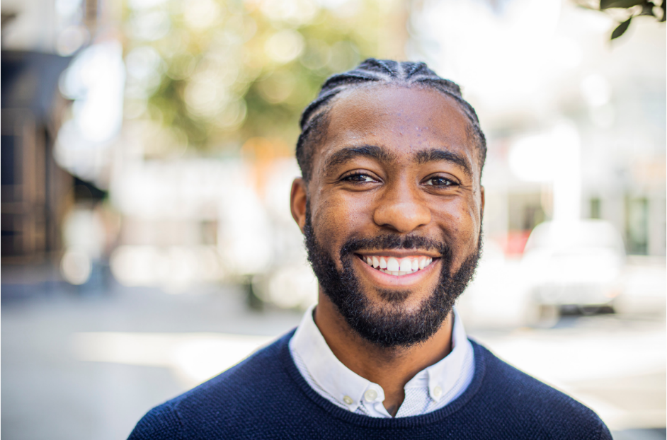
Sebastian
Name – Sebastian
Age – 25
Like – kebabs
Dislike – sauerkraut
Breakfast – toast, coffee
Lunch – sandwiches
Dinner – kebabs

Slide 5
Alexander
Name – Alexander
Age – 35
Like – schnitzel
Dislike – fish
Breakfast – bread, tea
Lunch – salad
Dinner – schnitzel, chips

Slide 6
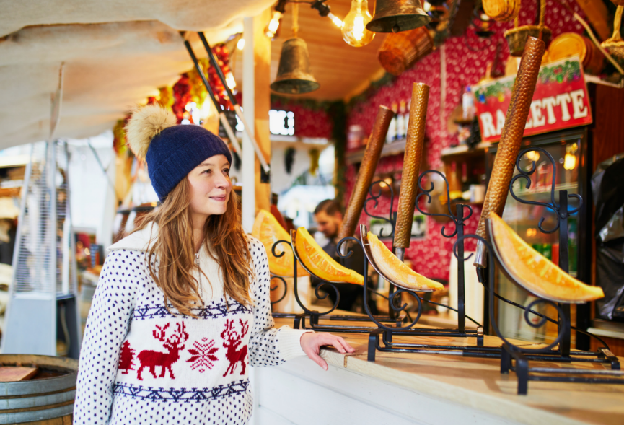
Anna
Name – Anna
Age – 21
Like – fruit
Dislike – chips
Breakfast – pancakes
Lunch – sandwiches
Dinner – frankfurters, bread

Slide 7
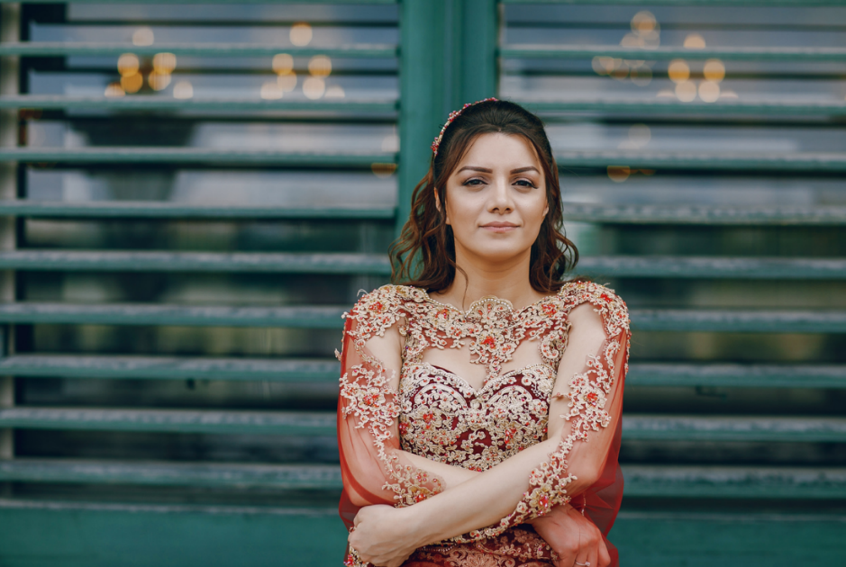
Esra
Name – Esra
Age – 22
Like – apple strudel
Dislike – potatoes
Breakfast – muesli
Lunch – hamburgers
Dinner – pasta

Slide 8
Christoph
Name – Christoph
Age – 73
Like – pretzels
Dislike – potato salad
Breakfast – fruit, muesli
Lunch – steak, vegetables
Dinner – fish, bread

Slide 9
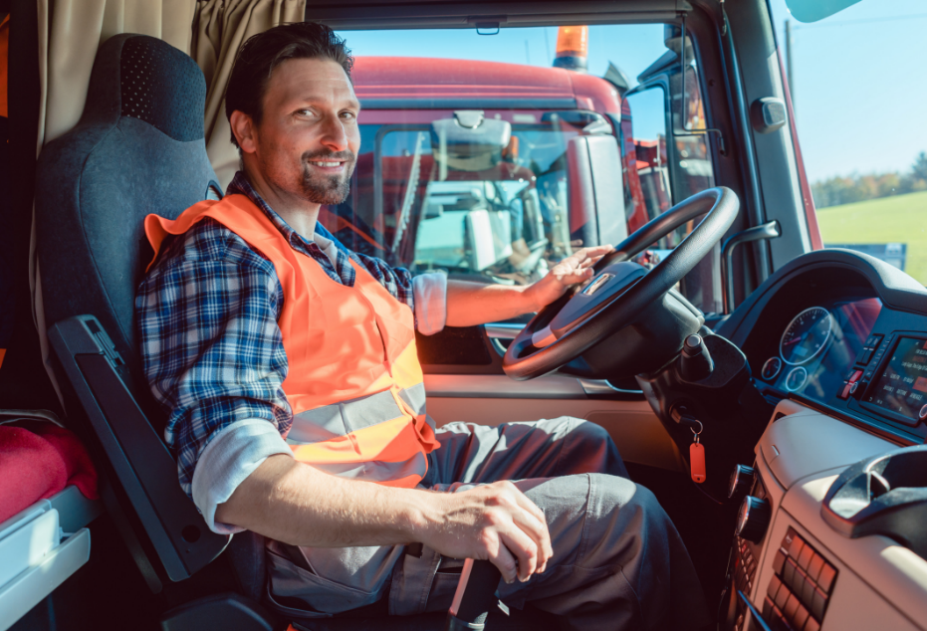
Fabian
Name – Fabian
Age – 37
Like – hamburgers
Dislike – kebabs
Breakfast – toast, coffee
Lunch – sausages, sauerkraut
Dinner – hamburgers

Slide 10
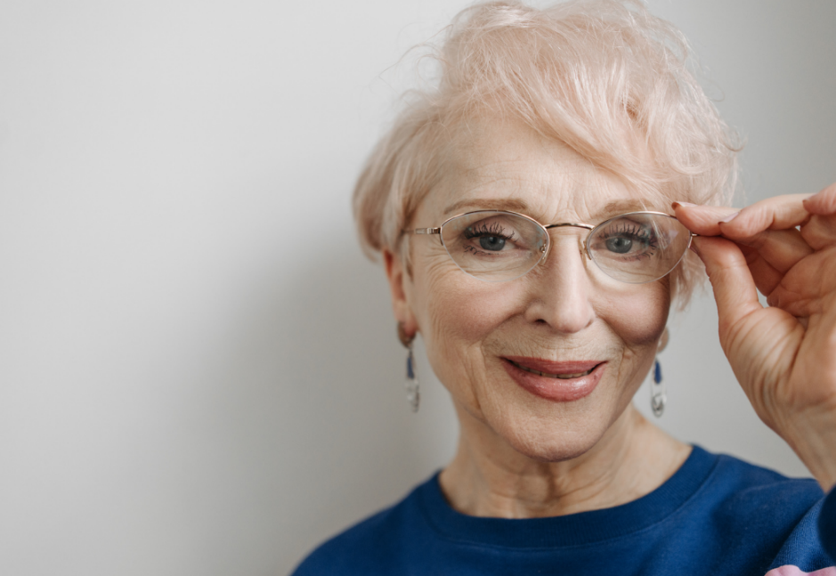
Katharina
Name – Katharina
Age – 72
Like – chicken
Dislike – milk
Breakfast – fruit, yoghurt
Lunch – chicken, salad
Dinner – sausages, sauerkraut

Slide 11
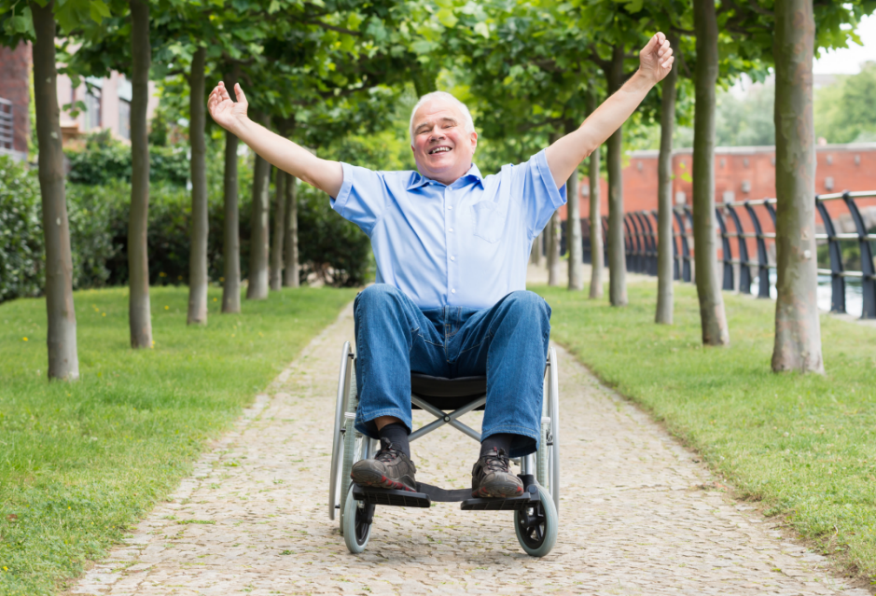
Thomas
Name – Thomas
Age – 50
Like – potato salad
Dislike – sausages
Breakfast – toast, tea
Lunch – meatballs, potato salad
Dinner – hamburgers

Slide 12
Melanie
Name – Melanie
Age – 18
Like – yoghurt
Dislike – rice
Breakfast – muesli, yoghurt
Lunch – schnitzel, salad
Dinner – chicken, potato salad

Slide 13
Copyright
© State of New South Wales (Department of Education), 2024
The copyright material published in this resource is subject to the Copyright Act 1968 (Cth) and is owned by the NSW Department of Education or, where indicated, by a party other than the NSW Department of Education (third-party material).
Copyright material available in this resource and owned by the NSW Department of Education is licensed under a Creative Commons Attribution 4.0 International (CC BY 4.0) licence.
This licence allows you to share and adapt the material for any purpose, even commercially.
Attribution should be given to © State of New South Wales (Department of Education), 2024.
Material in this resource not available under a Creative Commons licence:
the NSW Department of Education logo, other logos and trademark-protected material
material owned by a third party that has been reproduced with permission. You will need to obtain permission from the third party to reuse its material.
Links to third-party material and websites
Please note that the provided (reading/viewing material/list/links/texts) are a suggestion only and implies no endorsement, by the New South Wales Department of Education, of any author, publisher, or book title. School principals and teachers are best placed to assess the suitability of resources that would complement the curriculum and reflect the needs and interests of their students.
If you use the links provided in this document to access a third-party's website, you acknowledge that the terms of use, including licence terms set out on the third-party's website apply to the use which may be made of the materials on that third-party website or where permitted by the Copyright Act 1968 (Cth). The department accepts no responsibility for content on third-party websites.
Notes:
Slide not shared

