Slide 1
Uncovering shape secrets

Slide 2
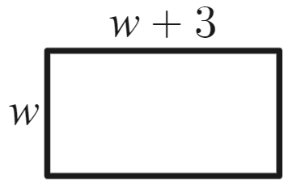
Launch
Rectangle
The perimeter of this rectangle is 66 units.
Find the value of $w$.

Slide 3
Explore (1 of 7)
Rectangle equation
The perimeter of this rectangle is 66 units.
Find the value of $w$.
Kyran’s approach
Try w=10.
Side lengths are 10 and 10 + 3 Perimeter
= 10 + 10 + 13 + 13
= 46
So, the value must be higher.

Slide 4
Explore (2 of 7)
Rectangle equation
The perimeter of this rectangle is 66 units.
Find the value of $w$.
Alex’s approach
$$Perimeter=w+\left(w+3\right)+w+\left(w+3\right)=4w+6$$
$\text{Perimeter}$: $4w+6=66$

Slide 5
Explore (3 of 7)
Expressions and equations
Expressions
Equations
$$3x + 7$$
$$\frac{4}{a} + 2b$$
$$10p−3q$$
$$2x+5=11$$
​$\frac{1}{a}+4b=3$
$$2p−3q=8$$

Slide 6
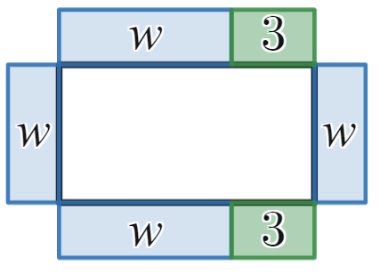
Explore (4 of 7)
Lengths as bars
$$4w+6=66$$
Image created using Desmos and is licensed under the Desmos Terms of Service.

Slide 7
Explore (5 of 7)
Bar models
$$4w+6=66$$
Image created using Desmos and is licensed under the Desmos Terms of Service.

Slide 8
Explore (6 of 7)
Bar model compared
Images created using Desmos and is licensed under the Desmos Terms of Service.

Slide 9
Explore (7 of 7)
Solving with a bar model
Images created using Desmos and is licensed under the Desmos Terms of Service.

Slide 10
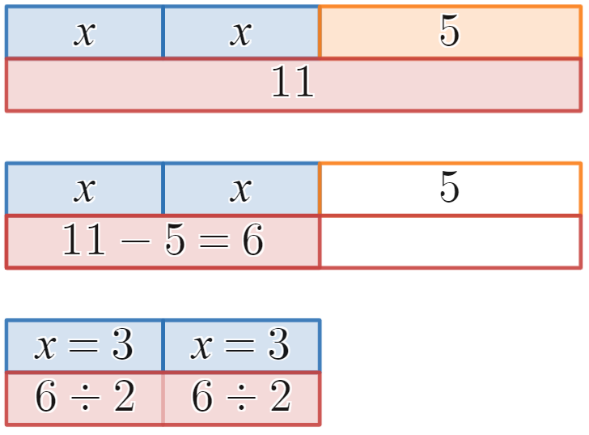
Summarise (1 of 8)
Worked example
Solve $2x+5=11$.
$$2x+5=11$$
$$−5 −5$$
$$2x=6$$
$$÷2 ÷2$$
$$x=3$$
Images created using Desmos and is licensed under the Desmos Terms of Service.

Slide 11
Summarise (2 of 8)
Self-explanation prompts
Solve $2x+5=11$.
$$2x+5=11$$
$$−5 −5$$
$$2x=6$$
$$÷2 ÷2$$
$$x=3$$
How do we know this is 6? How is it shown using inverses?
Images created using Desmos and is licensed under the Desmos Terms of Service.
Why did we separate these into 2?

Slide 12
Summarise (3 of 8)
Your turn
Solve $4x+7=39$.

Slide 13
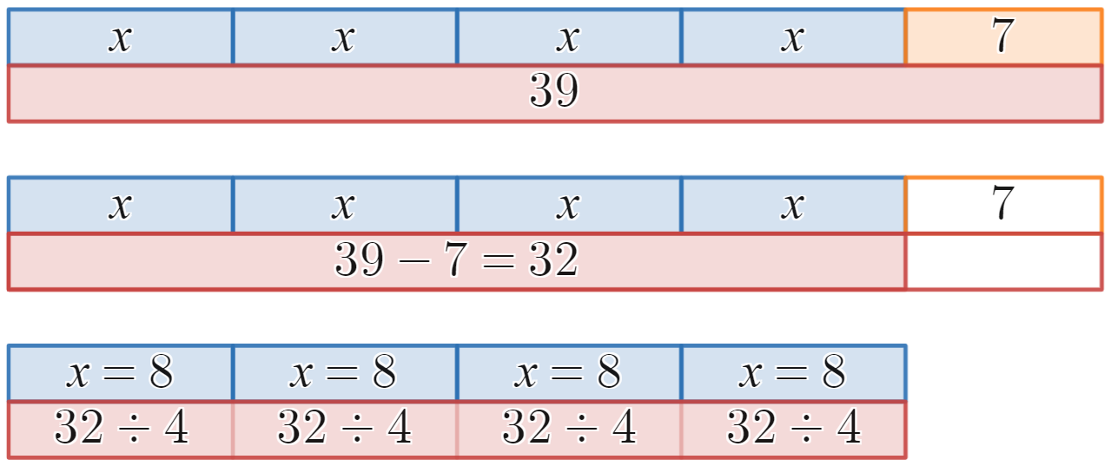
Summarise (4 of 8)
Solution
Solve $4x+7=39$.
$$4x+7=39$$
$$−7 −7$$
$$4x=32$$
$$÷4 ÷4$$
$$x=8$$
Images created using Desmos and is licensed under the Desmos Terms of Service.

Slide 14
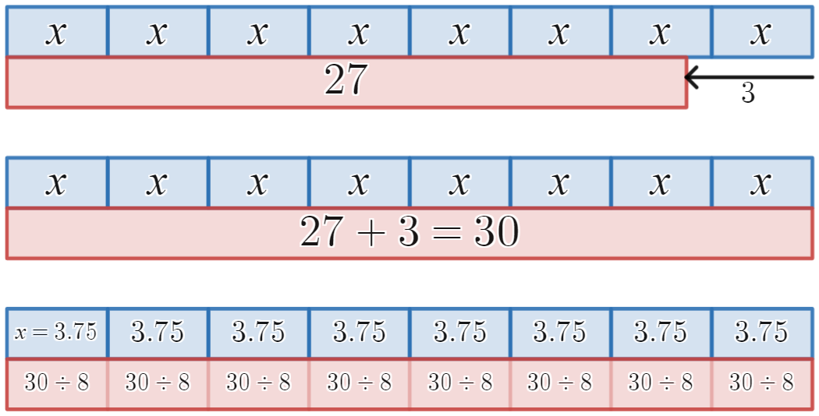
Summarise (5 of 8)
Worked example
Solve $8x−3=27$.
$$8x−3=27$$
$$+3+3$$
$$8x=30$$
$$÷8 ÷8$$
$$x=3.75$$
Images created using Desmos and is licensed under the Desmos Terms of Service.

Slide 15
Summarise (6 of 8)
How is the -3 represented?
Self-explanation prompts
Solve $8x−3=27$.
$$8x−3=27$$
$$+3+3$$
$$8x=30$$
$$÷8 ÷8$$
$$x=3.75$$
Why do we divide by 8?
Images created using Desmos and is licensed under the Desmos Terms of Service.

Slide 16
Summarise (7 of 8)
Your turn
Solve $4x−9=39$.

Slide 17
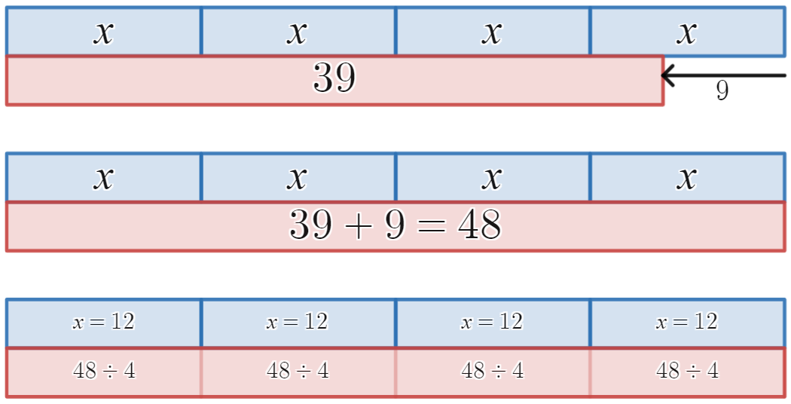
Summarise (8 of 8)
Solution
Solve $4x−9=39$.
$$4x−9=39$$
$$+9+9$$
$$4x=48$$
$$÷4 ÷4$$
$$x=12$$
Images created using Desmos and is licensed under the Desmos Terms of Service.

Slide 18
Copyright
© State of New South Wales (Department of Education), 2024
The copyright material published in this resource is subject to the Copyright Act 1968 (Cth) and is owned by the NSW Department of Education or, where indicated, by a party other than the NSW Department of Education (third-party material).
Copyright material available in this resource and owned by the NSW Department of Education is licensed under a Creative Commons Attribution 4.0 International (CC BY 4.0) licence.
This licence allows you to share and adapt the material for any purpose, even commercially.
Attribution should be given to © State of New South Wales (Department of Education), 2023.
Material in this resource not available under a Creative Commons licence:
the NSW Department of Education logo, other logos and trademark-protected material
Material owned by a third party that has been reproduced with permission. You will need to obtain permission from the third party to reuse its material.
Links to third-party material and websites
Please note that the provided (reading/viewing material/list/links/texts) are a suggestion only and implies no endorsement, by the New South Wales Department of Education, of any author, publisher, or book title. School principals and teachers are best placed to assess the suitability of resources that would complement the curriculum and reflect the needs and interests of their students.
If you use the links provided in this document to access a third party’s website, you acknowledge that the terms of use, including licence terms set out on the third-party’s website apply to the use which may be made of the materials on that third-party website or where permitted by the Copyright Act 1968 (Cth). The department accepts no responsibility for content on third-party websites.

