Slide 1
Which way is up?
Explicit teaching

Slide 2
Launch

Slide 3
Blockout (1 of 2)
How to play
A roll of 4 and 7.

Slide 4
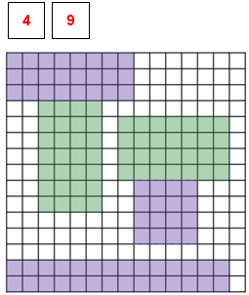
Blockout (2 of 2)
How to play
A roll that cannot be played.

Slide 5
Explore

Slide 6
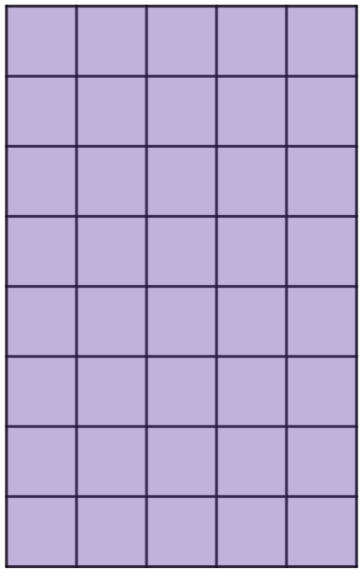
What is the height of the rectangle?
Which way is up
Do our labels change if the rectangle is tilted?
b
b
a
What would we call a and b in each case?
a
b
a

Slide 7
Area of a rectangle formula
A formula is an equation.
_{Area = length x breadth}
_{A=} $lb$

Slide 8
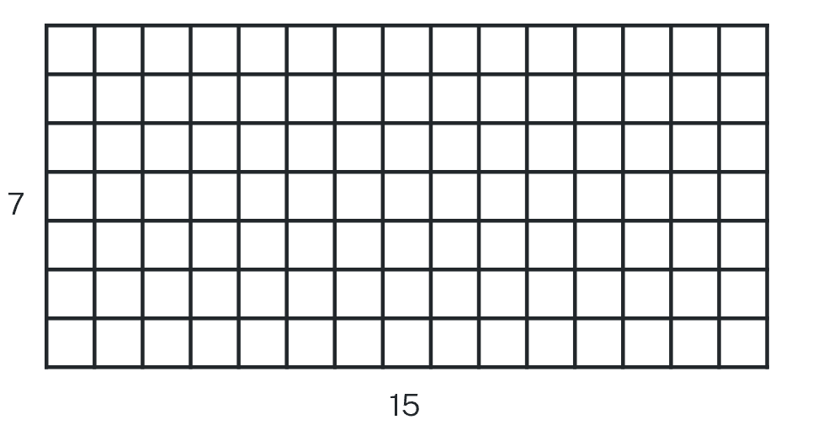
Using the formula (1 of 8)
Example 1
Calculate the area of the following rectangle.
7 m
15 m
Solution:
$$A=lb$$
$$A=15×7$$
$$=105$$
Area is $105 m^{2}$.

Slide 9
Using the formula (2 of 8)
Example 1 – self-explanation prompts
Calculate the area of the following rectangle.
7 m
15 m
Solution:
$$A=lb$$
$$A=15×7$$
$$=105$$
Area is $105 m^{2}$.
Would it matter if we said the length was 7?
What does the $m^{2}$ mean?

Slide 10
Using the formula (3 of 8)
Your turn – question 1
Calculate the area of the following rectangle.
10 m
21 m

Slide 11
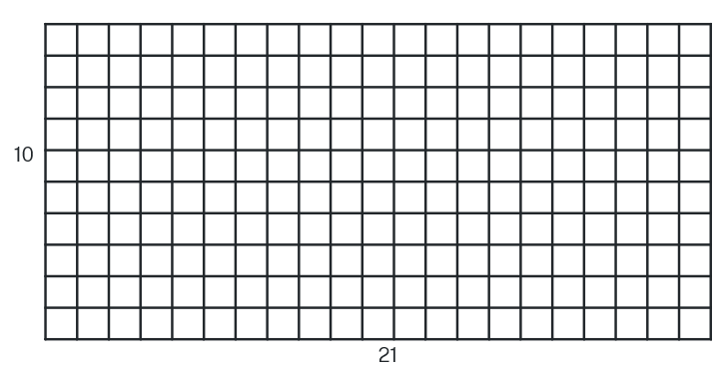
Using the formula (4 of 8)
Your turn – solution 1
Calculate the area of the following rectangle.
10 m
21 m
Solution:
$$A=lb$$
$$A=21×10$$
$$=210$$
Area is $210 m^{2}$.

Slide 12
Using the formula (5 of 8)
Example 2
The area of a rectangle with a length of 12 m is $96 m^{2}.$
How long is the other side?
$$96 m^{2}$$
$$12 m$$
Solution:
$$A=lb$$
$$96=12×b$$
$$b=\frac{96}{12}$$
$$b=8$$
The other side is $8 m$ long.

Slide 13
Using the formula (6 of 8)
Example 2
The area of a rectangle with a length of 12 m is $96 m^{2}.$
How long is the other side?
$$96 m^{2}$$
$$12 m$$
Solution:
$$A=lb$$
$$96=12×b$$
$$b=\frac{96}{12}$$
$$b=8$$
The other side is $8 m$ long.
Why is the 96 on the left?
How else could we write this?
Why did the $b$ swap sides?

Slide 14
Using the formula (7 of 8)
Your turn – question 2
The area of a rectangle with a length of $6.5 cm$is $60 {cm}^{2}.$
How long is the other side?
$$60 m^{2}$$
$$6 m$$

Slide 15
Using the formula (8 of 8)
Your turn – solution 2
The area of a rectangle with a length of $6.5 cm$is $60 {cm}^{2}.$
How long is the other side?
$$60 m^{2}$$
Solution:
$$A=lb$$
$$60=4×b$$
$$\frac{60}{4}=b$$
$$b=15$$
The other side is $15 cm$ long.
$$6 m$$

Slide 16
Copyright
© State of New South Wales (Department of Education), 2023
The copyright material published in this resource is subject to the Copyright Act 1968 (Cth) and is owned by the NSW Department of Education or, where indicated, by a party other than the NSW Department of Education (third-party material).
Copyright material available in this resource and owned by the NSW Department of Education is licensed under a Creative Commons Attribution 4.0 International (CC BY 4.0) licence.
This licence allows you to share and adapt the material for any purpose, even commercially.
Attribution should be given to © State of New South Wales (Department of Education), 2023.
Material in this resource not available under a Creative Commons licence:
the NSW Department of Education logo, other logos and trademark-protected material
Material owned by a third party that has been reproduced with permission. You will need to obtain permission from the third party to reuse its material.
Links to third-party material and websites
Please note that the provided (reading/viewing material/list/links/texts) are a suggestion only and implies no endorsement, by the New South Wales Department of Education, of any author, publisher, or book title. School principals and teachers are best placed to assess the suitability of resources that would complement the curriculum and reflect the needs and interests of their students.
If you use the links provided in this document to access a third party’s website, you acknowledge that the terms of use, including licence terms set out on the third-party’s website apply to the use which may be made of the materials on that third-party website or where permitted by the Copyright Act 1968 (Cth). The department accepts no responsibility for content on third-party websites.

