Slide 1
Too clever by half

Slide 2
Warm up

Slide 3
Two truths and a lie (1 of 2)
Which one is the lie?
$$2×3×5=\left(2×3\right)×\left(2×5\right)$$
$$2×3×5=3×5×2$$
$$2×3×5=2×5×3$$

Slide 4
Two truths and a lie (2 of 2)
Which one is the lie?
$$\frac{1}{2}×4×6=\frac{1}{2}×24$$
$$\frac{1}{2}×4×6=2×3$$
$$\frac{1}{2}×4×6=3×4$$

Slide 5
Launch

Slide 6
Which is bigger?
Which triangle has the bigger area?
'Area of triangles’ by Chris McGrane is sourced from ‘Starting Point Maths’.
Which triangle looks bigger, $∆$FHE, $∆$FHG or $∆$FHI?
Which triangle has the largest area? Explain

Slide 7
Summarise

Slide 8
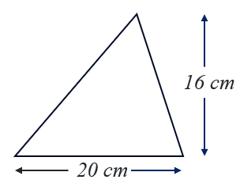
Too clever by half (1 of 8)
Example 1
Find the area of the triangle.
Solution
$$A=\frac{1}{2}bh$$
$$A=\frac{1}{2}×20×16$$
$$A=160$$
The area is $160 {cm}^{2}$.

Slide 9
Too clever by half (2 of 8)
Example 1 – self-explanation prompts
Find the area of the triangle.
Solution
$$A=\frac{1}{2}bh$$
$$A=\frac{1}{2}×20×16$$
$$A=160$$
The area is $160 {cm}^{2}$.
Where do these numbers come from?
Why is the answer given in ${cm}^{2}$?

Slide 10
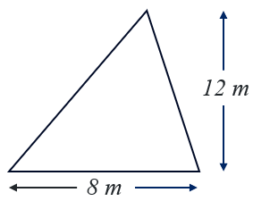
Too clever by half (3 of 8)
Your turn – example 1
Find the area of the triangle.

Slide 11
Too clever by half (4 of 8)
Your turn – solution 1
Find the area of the triangle.
Solution
$$A=\frac{1}{2}bh$$
$$A=\frac{1}{2}×8×12$$
$$A=48$$
The area is $48 m^{2}$.

Slide 12
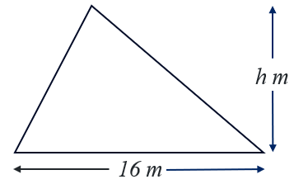
Too clever by half (5 of 8)
Example 3
The triangle has a base length of 16 m and an area of $96 m^{2}.$
Find the height of the triangle.
Solution
$$96=\frac{1}{2}×16×h$$
$$96=8h$$
$$h=\frac{96}{8}$$
$$h=12$$
The height is $12 m$.

Slide 13
Too clever by half (6 of 8)
Example 3 – self-explanation prompts
The triangle has a base length of 16 m and an area of $96 m^{2}.$
Find the height of the triangle.
Solution
$$96=\frac{1}{2}×16×h$$
$$96=8h$$
$$h=\frac{96}{8}$$
$$h=12$$
The height is $12 m$.
How is this shown in the bar model?
Is there another way we could write this?

Slide 14
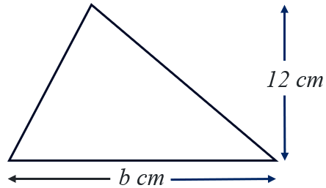
Too clever by half (7 of 8)
Your turn – example 3
The triangle has a height of 12 cm and an area of $60 {cm}^{2}.$
Find the length of the base of the triangle.

Slide 15
Too clever by half (8 of 8)
Your turn – solution 3
The triangle has a height of 12 cm and an area of $60 {cm}^{2}.$
Find the length of the base of the triangle.
Solution
$$60=\frac{1}{2}×b×12$$
$$60=6b$$
$$b=\frac{60}{6}$$
$$b=10$$
The height is $10 cm$.

Slide 16
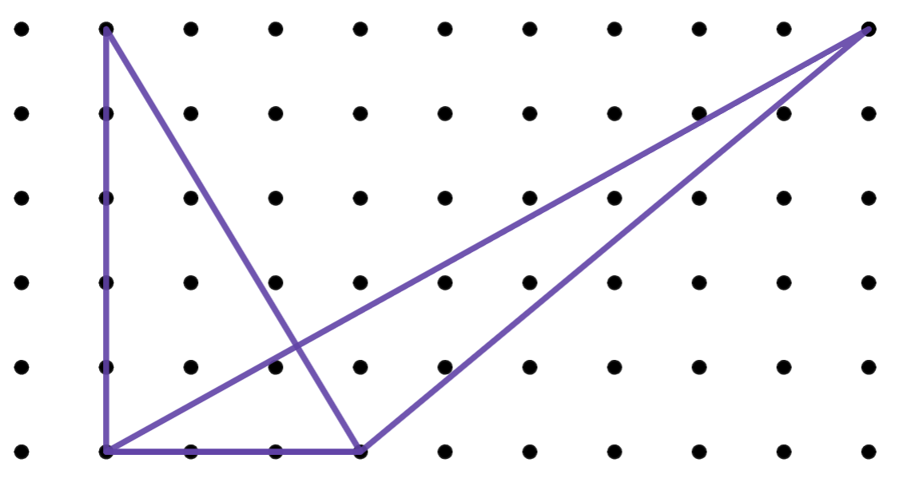
Area of a triangle (1 of 3)
Which triangle is bigger?

Slide 17
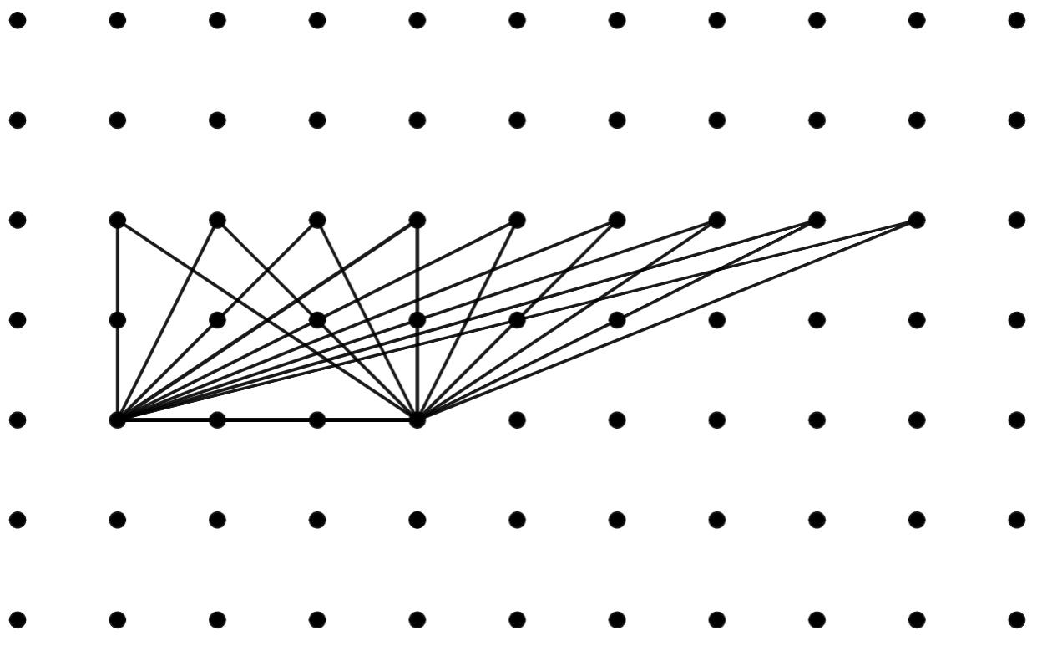
Area of a triangle (2 of 3)
What happens to the area of a triangle as its vertex moves to the right?
What is the base and height of these triangles?

Slide 18
Area of a triangle (3 of 3)
What happens to the area of a triangle as its top point moves up?
How can we investigate this to find out?

Slide 19
Copyright
© State of New South Wales (Department of Education), 2024
The copyright material published in this resource is subject to the Copyright Act 1968 (Cth) and is owned by the NSW Department of Education or, where indicated, by a party other than the NSW Department of Education (third-party material).
Copyright material available in this resource and owned by the NSW Department of Education is licensed under a Creative Commons Attribution 4.0 International (CC BY 4.0) licence.
This licence allows you to share and adapt the material for any purpose, even commercially.
Attribution should be given to © State of New South Wales (Department of Education), 2024.
Material in this resource not available under a Creative Commons licence:
the NSW Department of Education logo, other logos and trademark-protected material
Material owned by a third party that has been reproduced with permission. You will need to obtain permission from the third party to reuse its material.
Links to third-party material and websites
Please note that the provided (reading/viewing material/list/links/texts) are a suggestion only and implies no endorsement, by the New South Wales Department of Education, of any author, publisher, or book title. School principals and teachers are best placed to assess the suitability of resources that would complement the curriculum and reflect the needs and interests of their students.
If you use the links provided in this document to access a third party’s website, you acknowledge that the terms of use, including licence terms set out on the third-party’s website apply to the use which may be made of the materials on that third-party website or where permitted by the Copyright Act 1968 (Cth). The department accepts no responsibility for content on third-party websites.

