Slide 1
Graphing stories
Explicit teaching

Slide 2
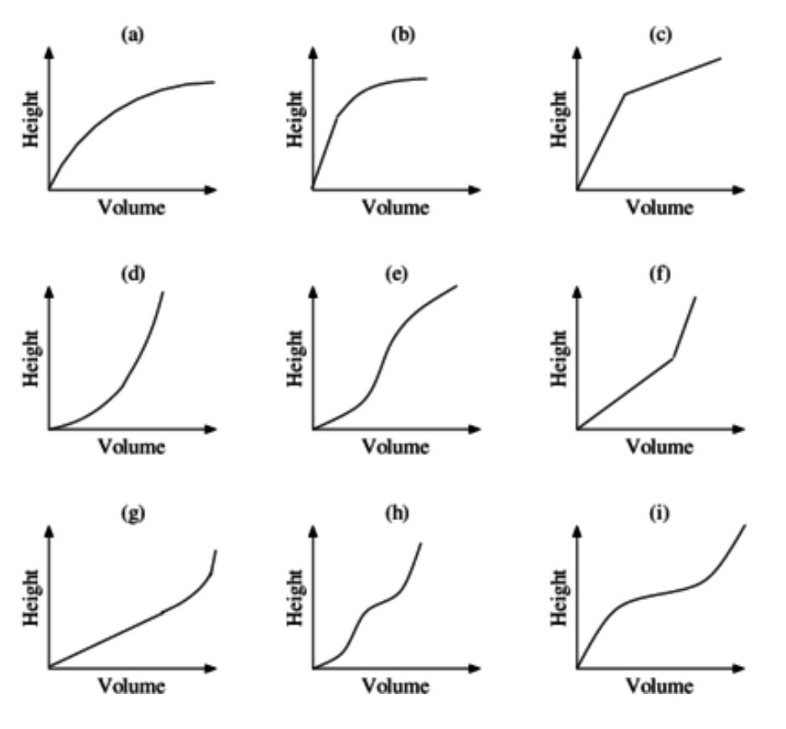
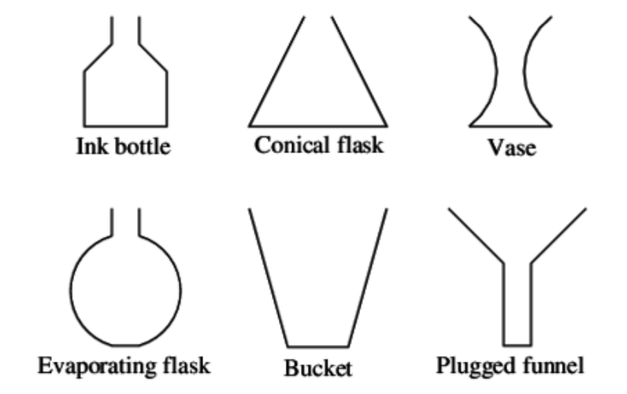
Matching graphs and containers
Apply
‘Containers’ by Illustrative Mathematics is licensed under CC BY-NC-SA 4.0

Slide 3
Copyright
© State of New South Wales (Department of Education), 2023

