Slide 1
Graph-ity falls
Explicit teaching

Slide 2
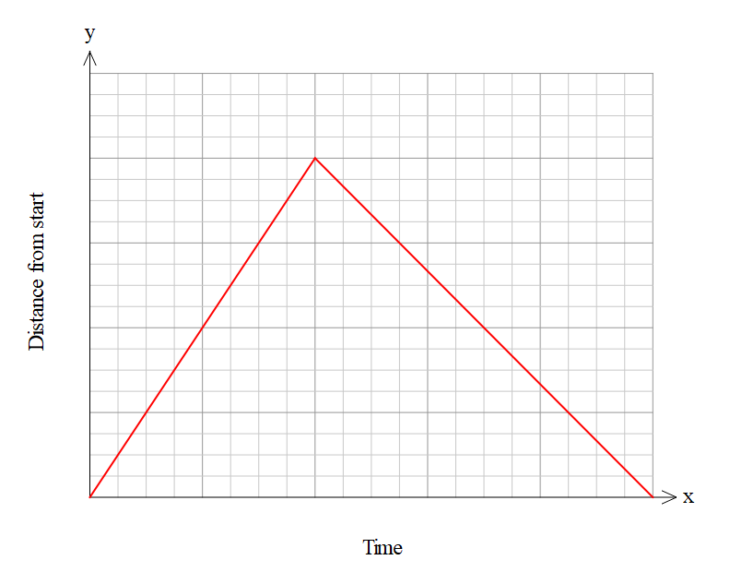
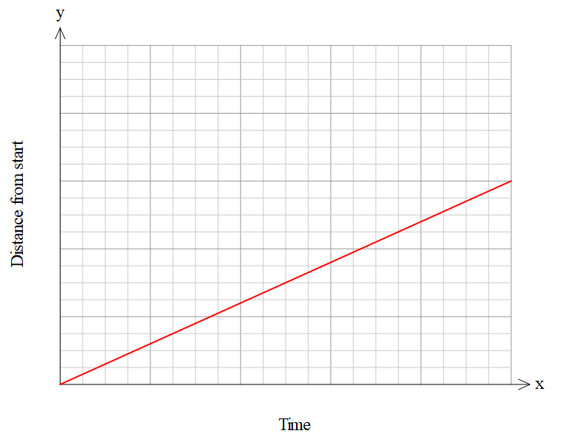
Explore – activity 1
Guided match the graph to the story
Notes:
Students match the story to the graph.

Slide 3
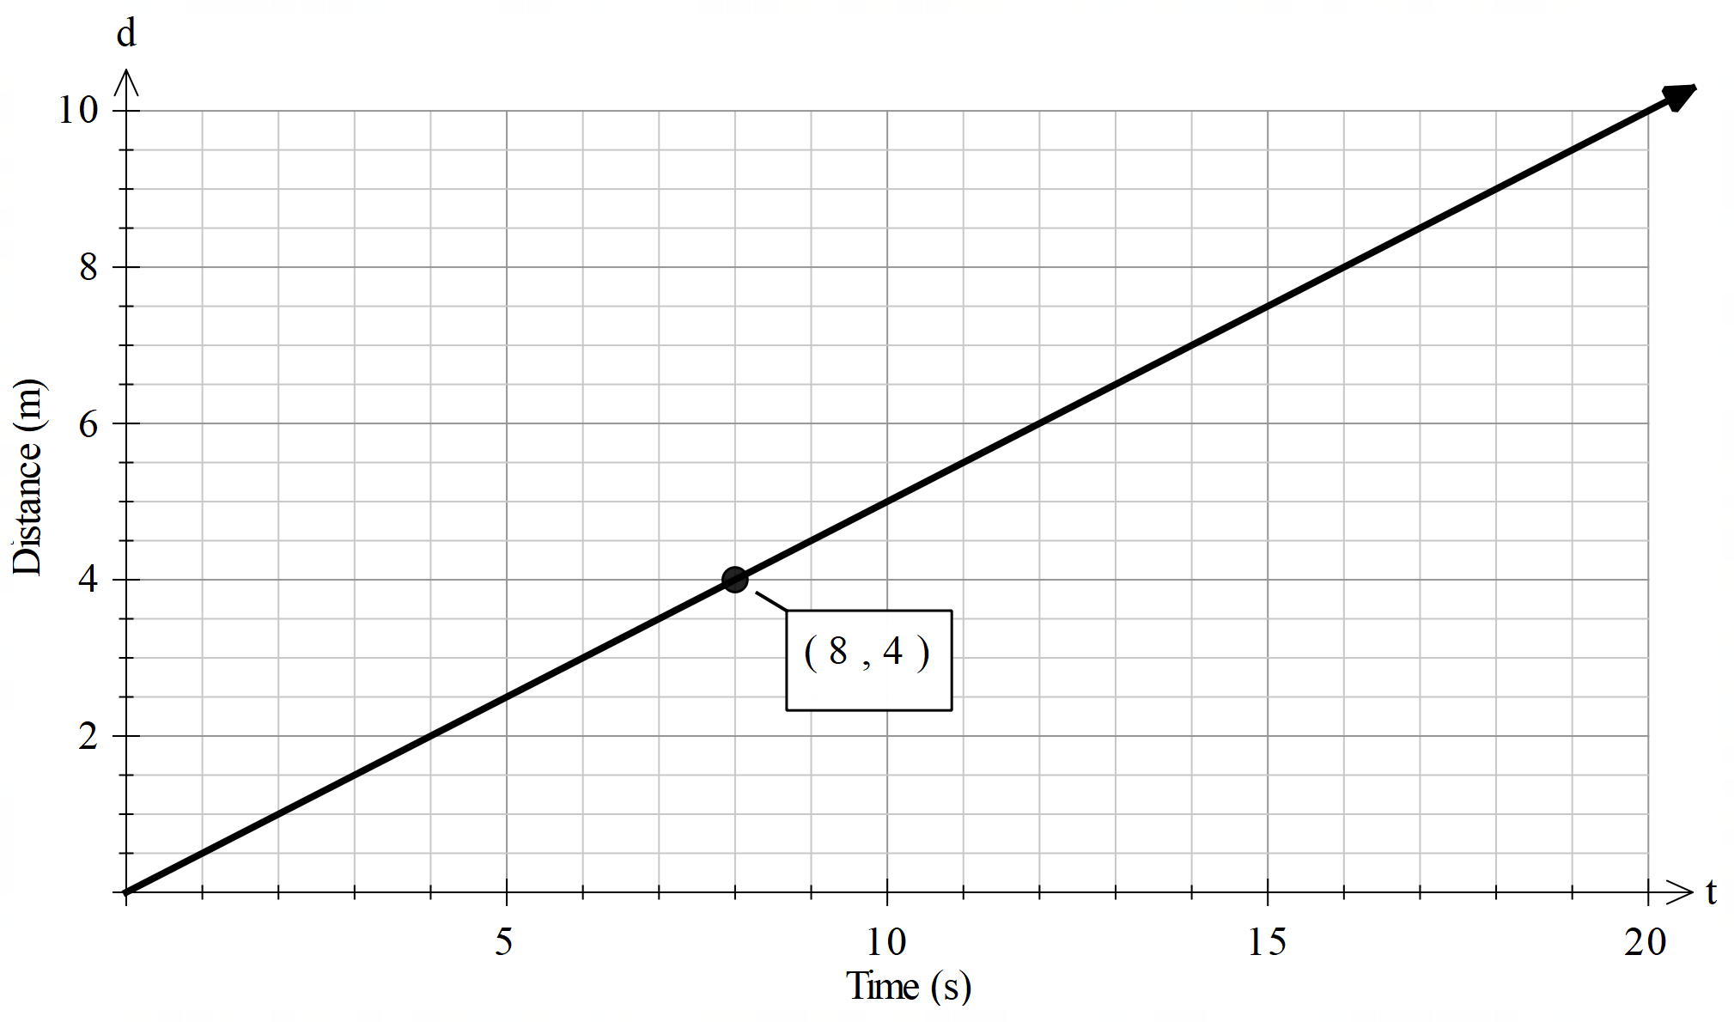
Summarise (1 of 8)
Distance–time graph 1
Find the speed travelled:
Speed = $\frac{4−0}{8−0}$
Speed = $\frac{1}{2} m/s$

Slide 4
Summarise (2 of 8)
Distance–time graph 1 – self explanation prompts
Find the speed travelled:
Speed = $\frac{4−0}{8−0}$
Speed = $\frac{1}{2} m/s$
In the equation $y=\frac{1}{2}x$, what does $\frac{1}{2}$ represent?
Is this the only point we could use to find the speed?

Slide 5
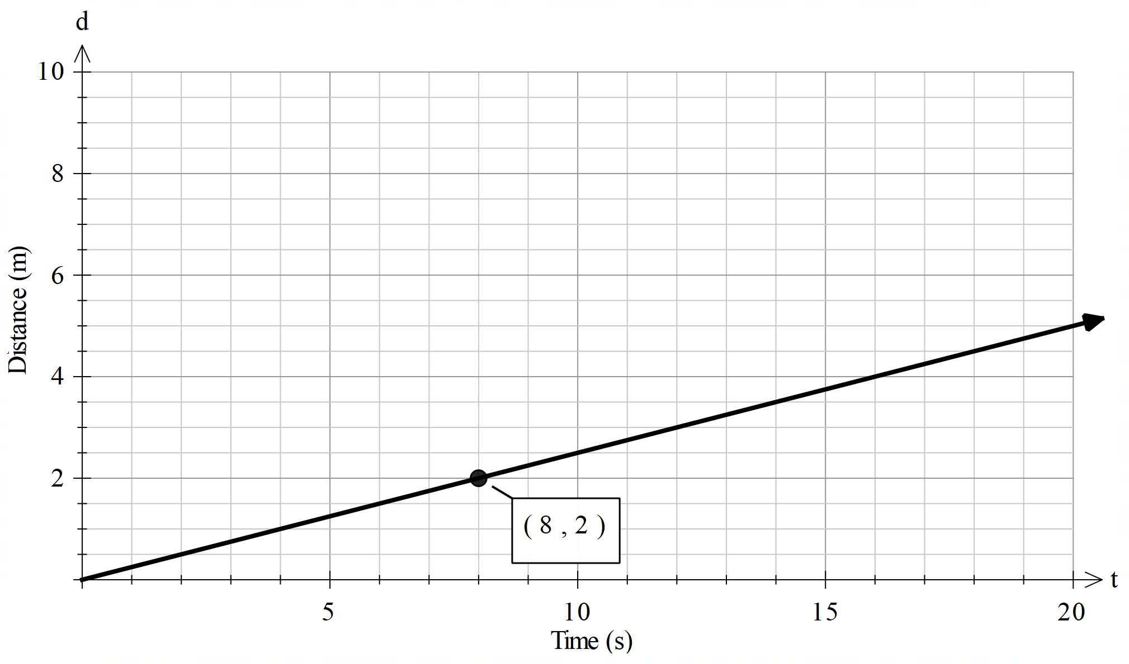
Summarise (3 of 8)
Your turn 1
Find the speed travelled:

Slide 6
Summarise (4 of 8)
Your turn 1 – solution
Find the speed travelled:
Speed = $\frac{2−0}{8−0}$
Speed = $\frac{2}{8} m/s$

Slide 7
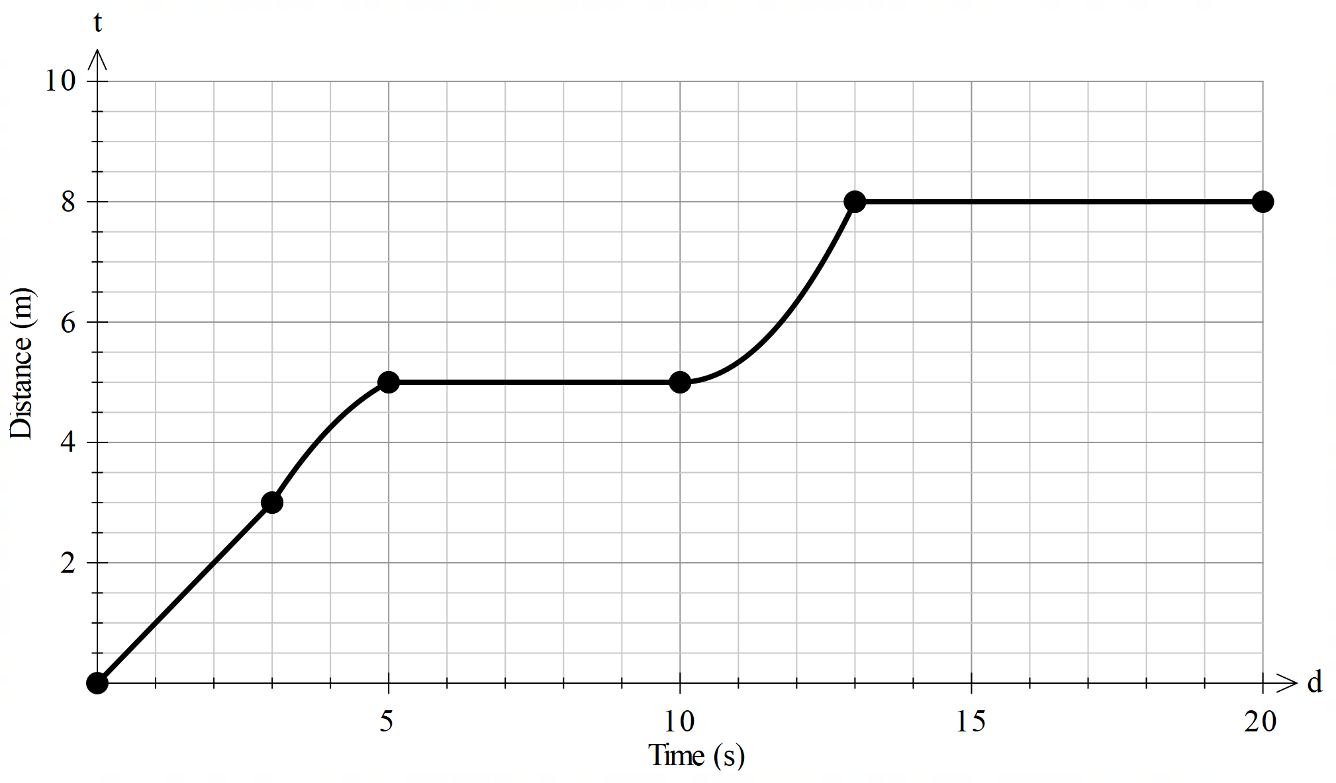
Summarise (5 of 8)
Distance–time graph 2
Describe the rate of change for each segment of the graph:
0 to 3 seconds: $1 m/s$.
3 to 5 seconds: increasing at a decreasing rate.
5 to 10 seconds: stationary.
10 to 13 seconds: increasing at an increasing rate.
13 to 20 seconds: stationary.

Slide 8
Summarise (6 of 8)
Distance–time graph 2 – self explanation prompts
Describe the rate of change for each segment of the graph:
0 to 3 seconds: $1 m/s$.
3 to 5 seconds: increasing at a decreasing rate.
5 to 10 seconds: stationary.
10 to 13 seconds: increasing at an increasing rate.
13 to 20 seconds: stationary.
What does increasing at an increasing rate mean?
Why does this segment of the graph represent a single numerical value?

Slide 9
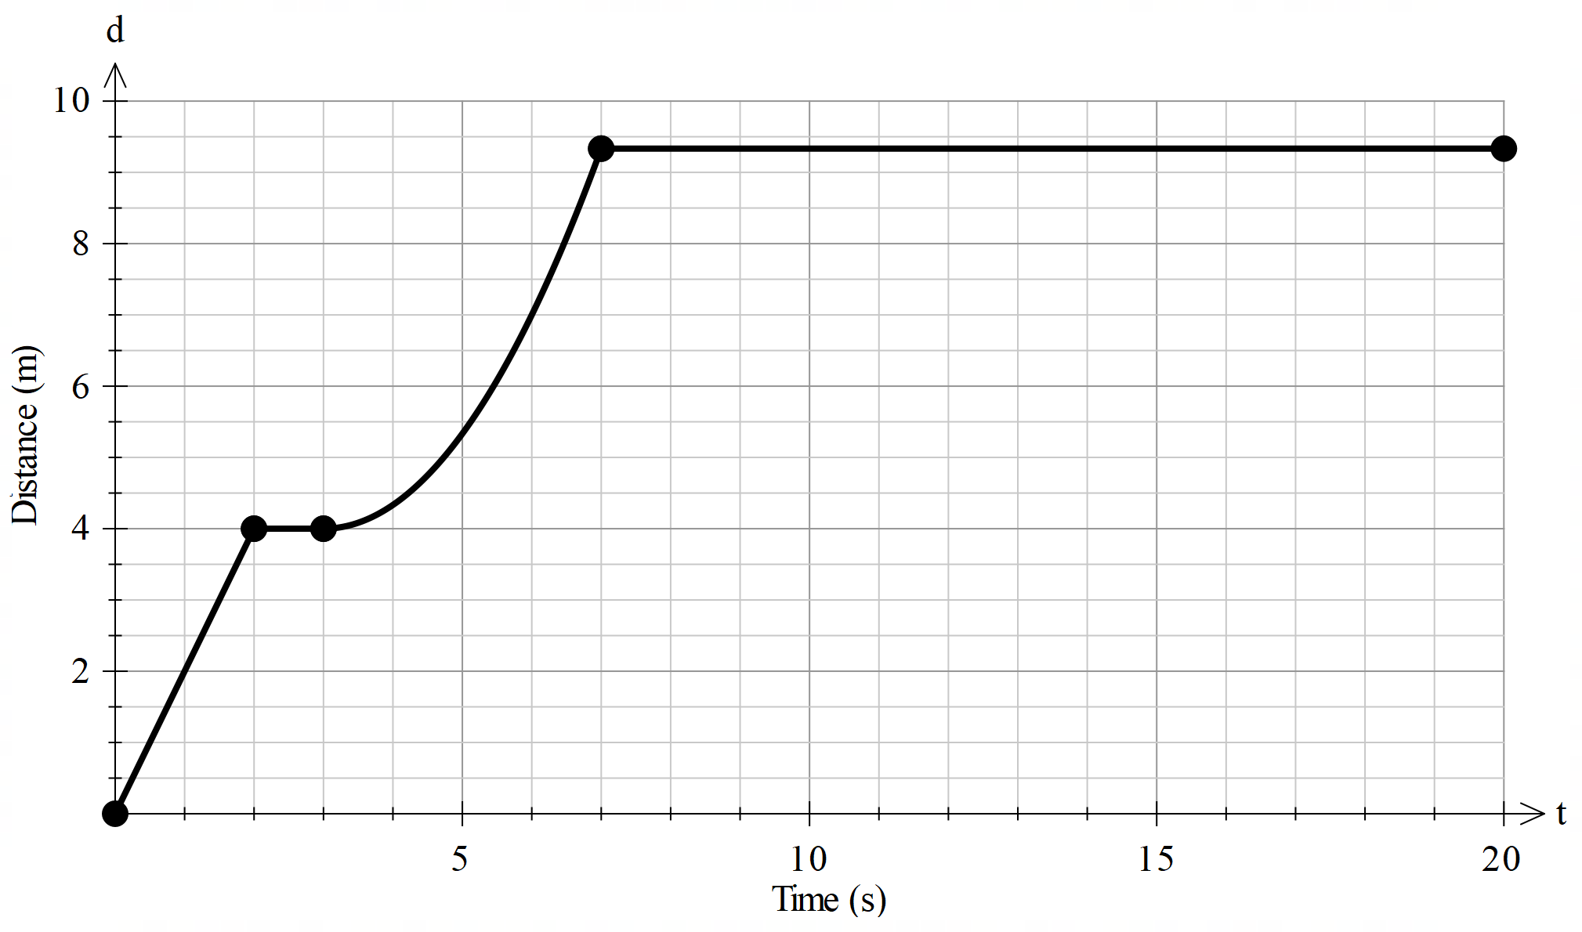
Summarise (7 of 8)
Your turn 2
Describe the rate of change for each segment of the graph:

Slide 10
Summarise (8 of 8)
Your turn 2 $−$ solution
Describe the rate of change for each segment of the graph:
0 to 2 seconds: $2 m/s$.
2 to 3 seconds: stationary.
3 to 7 seconds: increasing at an increasing rate.
7 to 20 seconds: stationary.

Slide 11
Copyright
© State of New South Wales (Department of Education), 2023

