Slide 1
Direct variation
Explicit teaching

Slide 2
Summarise (1 of 10)
Worked example 1
$y∝x$. When $x=30, y=10.$
Find $y$ when $x=60$.
$$y=kx$$
$$10=30k$$
$$k=\frac{1}{3}$$
$$y=\frac{1}{3}x$$
$y=\frac{1}{3}(60)$
$$y=20$$
Notes:
Students could use a graphing calculator such as Desmos or GeoGebra to ‘verify graphically’ or students could draw their own graphs and use a ruler or graph paper to line up the values.

Slide 3
Summarise (2 of 10)
Self-explanation prompts 1
$y∝x$. When $x=30, y=10.$
Find $y$ when $x=60$.
How would you say ‘$y∝x$’ aloud?
$$y=kx$$
$$10=30k$$
$$k=\frac{1}{3}$$
$$y=\frac{1}{3}x$$
$y=\frac{1}{3}(60)$
$$y=20$$
Why did we need to find $k$ before $y?$
Notes:
Students could use a graphing calculator such as Desmos or GeoGebra to ‘verify graphically’ or students could draw their own graphs and use a ruler or graph paper to line up the values.

Slide 4
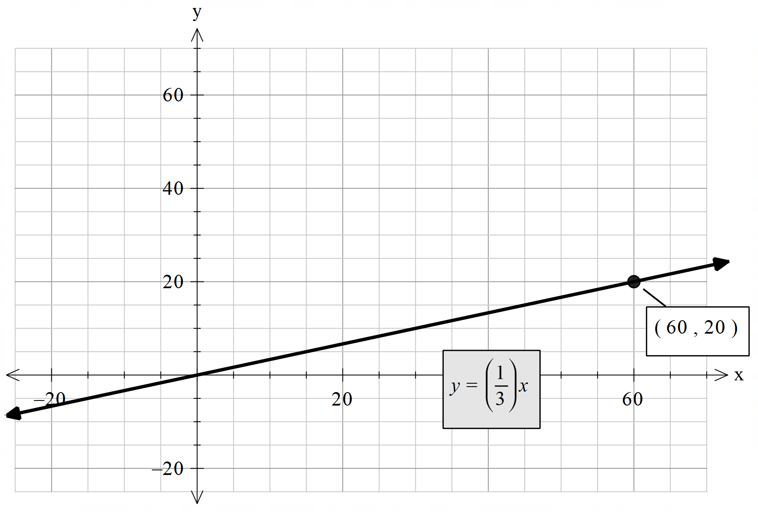
Summarise (3 of 10)
$y=\frac{1}{3}x$ passes through the point $\left(60,20\right)$
Worked example 1
$y∝x$. When $x=30, y=10.$
Verify your answer graphically.
Notes:
Students could use a graphing calculator such as Desmos or GeoGebra to ‘verify graphically’ or students could draw their own graphs and use a ruler or graph paper to line up the values.

Slide 5
Summarise (4 of 10)
$y=\frac{1}{3}x$ passes through the point $\left(60,20\right)$
Self-explanation prompts 1
$y∝x$. When $x=30, y=10.$
Verify your answer graphically.
What does $k$ represent in the graph?
How does the graph ‘verify’ that $y=20$ when $x=60$ ?
Notes:
Students could use a graphing calculator such as Desmos or GeoGebra to ‘verify graphically’ or students could draw their own graphs and use a ruler or graph paper to line up the values.

Slide 6
Summarise (5 of 10)
Your turn 1
$y∝x$. When $x=15, y=60.$
Find $y$ when $x=10$.
Verify your answer graphically.

Slide 7
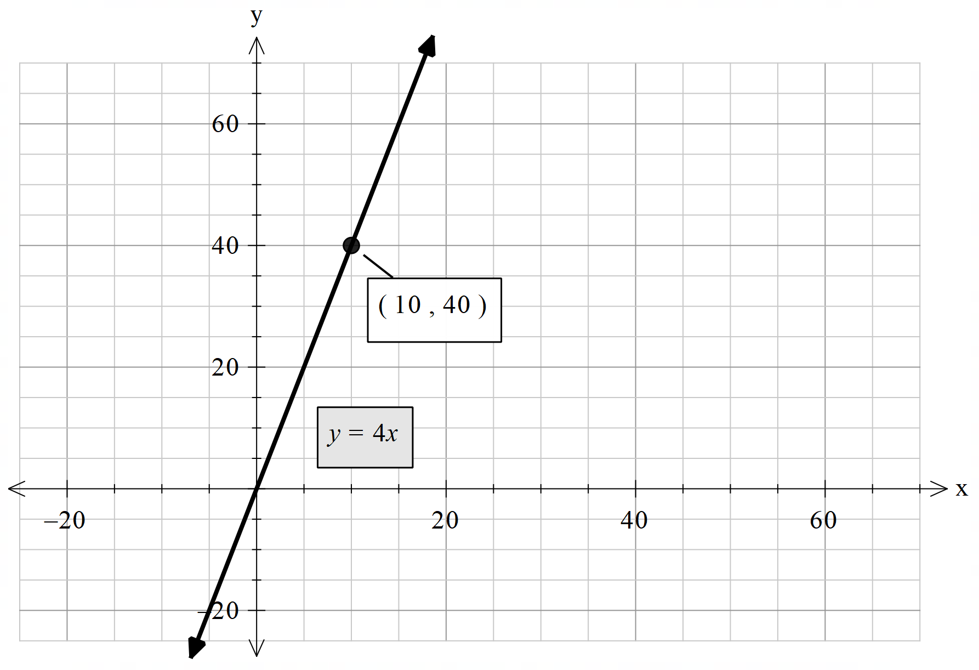
Summarise (6 of 10)
Your turn 1 – solution
$y∝x$. When $x=15, y=60.$
Find $y$ when $x=10$.
Verify your answer graphically.
Part b) solution:
Part a) solution:
$$y=kx$$
$$60=15k$$
$$k=4$$
$$y=4x$$
$y=4\left(10\right)$
$$y=40$$

Slide 8
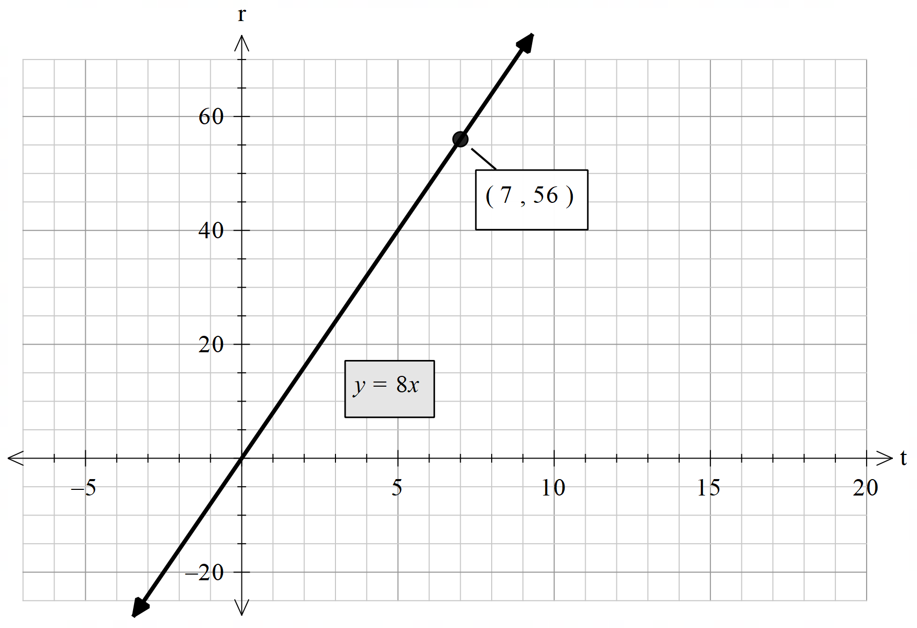
Summarise (7 of 10)
Worked example 2
The number of revolutions a wheel makes varies directly with the distance it rolls.
If a skateboard wheel completes 40 revolutions in 5 seconds, how many revolutions will the wheel complete in 7 seconds?
Verify your answer graphically.
Let $r=$ revolutions, $t=$ time (in seconds).
$$r=kt$$
$$40=5k$$
$$k=8$$
$$r=8t$$
$$r=8\left(7\right)$$
$r=56$ revolutions

Slide 9
Summarise (8 of 10)
Worked example 2 – self explanation prompts
The number of revolutions a wheel makes varies directly with the distance it rolls.
If a skateboard wheel completes 40 revolutions in 5 seconds, how many revolutions will the wheel complete in 7 seconds?
Verify your answer graphically.
Let $r=$ revolutions, $t=$ time (in seconds).
$$r=kt$$
$$40=5k$$
$$k=8$$
$$r=8t$$
$$r=8\left(7\right)$$
$r=56$ revolutions
In the equation $y=8x$, what does $8$ represent?
Could you use the graph to find the time taken for 30 revolutions?

Slide 10
Summarise (9 of 10)
Your turn 2
The number of revolutions a wheel makes varies directly with the distance it rolls.
If a bicycle wheel completes 12 revolutions in 3 seconds, how many revolutions will the wheel complete in 12 seconds?
Verify your answer graphically.

Slide 11
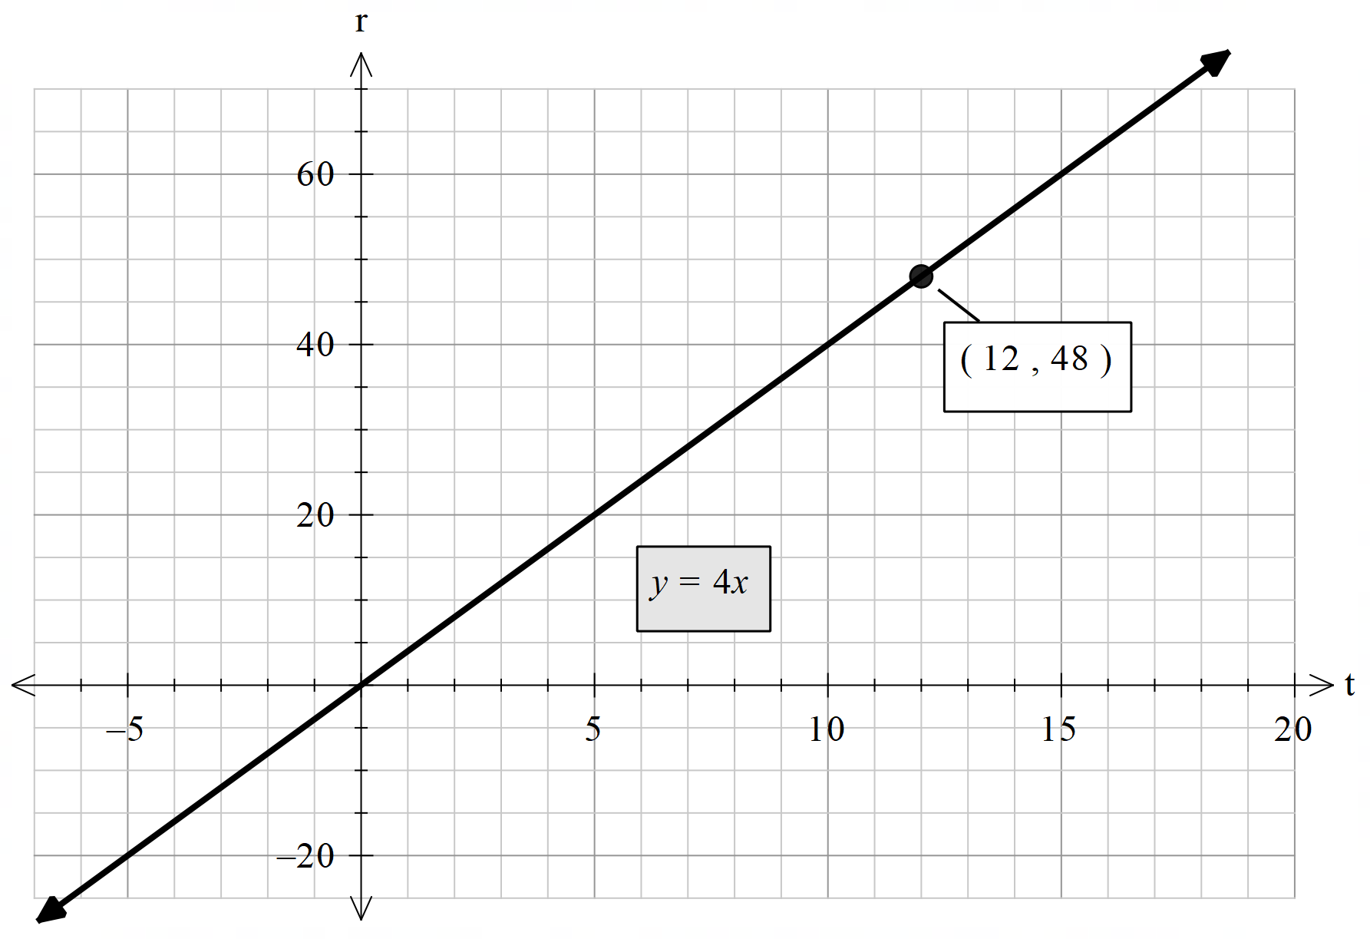
Summarise (10 of 10)
Your turn 2 $−$ solution
The number of revolutions a wheel makes varies directly with the distance it rolls.
If a bicycle wheel completes 12 revolutions in 3 seconds, how many revolutions will the wheel complete in 12 seconds?
Verify your answer graphically.
Let $r=$ revolutions, $t=$ time (in seconds).
$$r=kt$$
$$12=3k$$
$$k=4$$
$$r=4t$$
$$r=4\left(12\right)$$
$r=48$ revolutions

Slide 12
Copyright
© State of New South Wales (Department of Education), 2023

