Slide 1
Random relay
Explicit teaching

Slide 2
Launch

Slide 3
Random relay events
Choose your event
Flip heads on a coin 3 times in a row
Roll an even number 3 times in a row
Draw 3 consecutive red counters from a bag with 15 red counters and 5 yellow counters, with replacement

Slide 4
Summarise

Slide 5
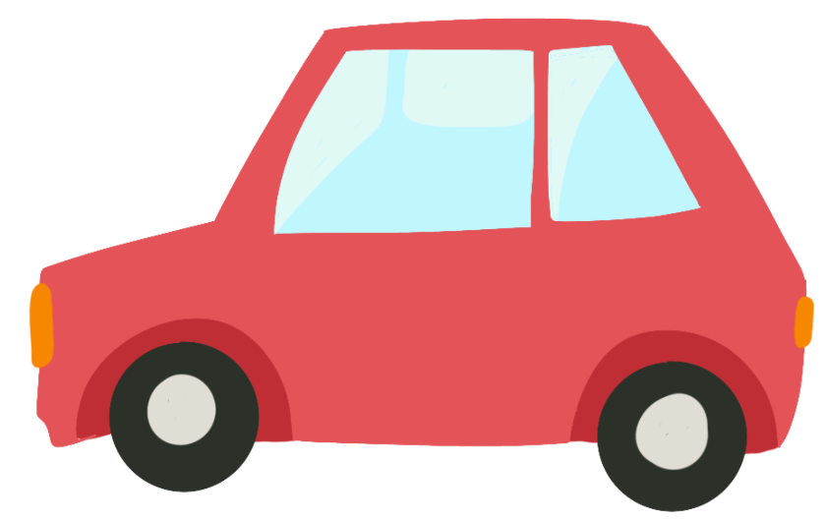
Random relay (1 of 11)
Consider driving up to a set of traffic lights

Slide 6
Random relay (2 of 11)
What are the possible outcomes?

Slide 7
Random relay (3 of 11)
Consider a second set of traffic lights
1st light
2nd light
Outcomes
Why would we list the possible outcomes at the end?

Slide 8
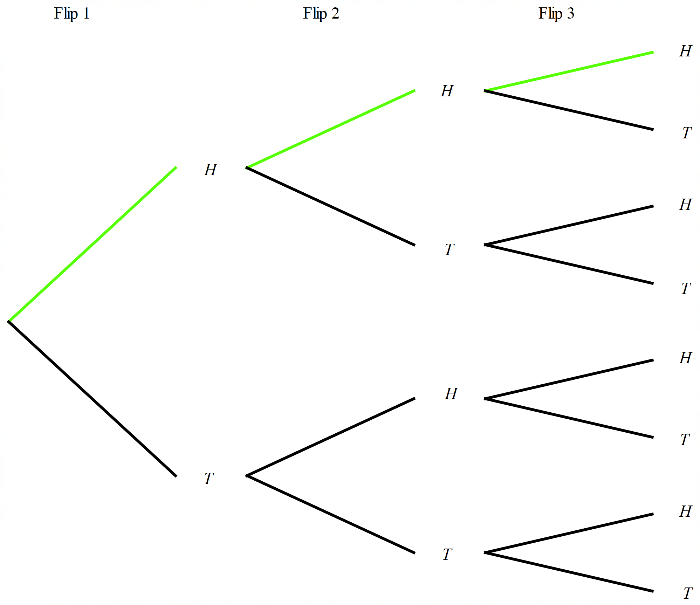
Random relay (4 of 11)
Example 1
Calculate the probability of flipping Heads on a coin 3 times in a row.
$$P\left(HHH\right)=\frac{1}{8}$$
There is one branch of HHH and 8 branches all together.

Slide 9
Random relay (5 of 11)
How does the tree diagram help to calculate the probability?
Example 1 – self explanation prompts
Calculate the probability of flipping Heads on a coin 3 times in a row.
$$P\left(HHH\right)=\frac{1}{8}$$
There is one branch of HHH and 8 branches all together.
Why would you draw the whole tree diagram if you only care about one outcome?

Slide 10
Random relay (6 of 11)
Your turn – question 1
Calculate the probability of rolling an even number 3 times in a row when rolling a standard 6-sided dice.

Slide 11
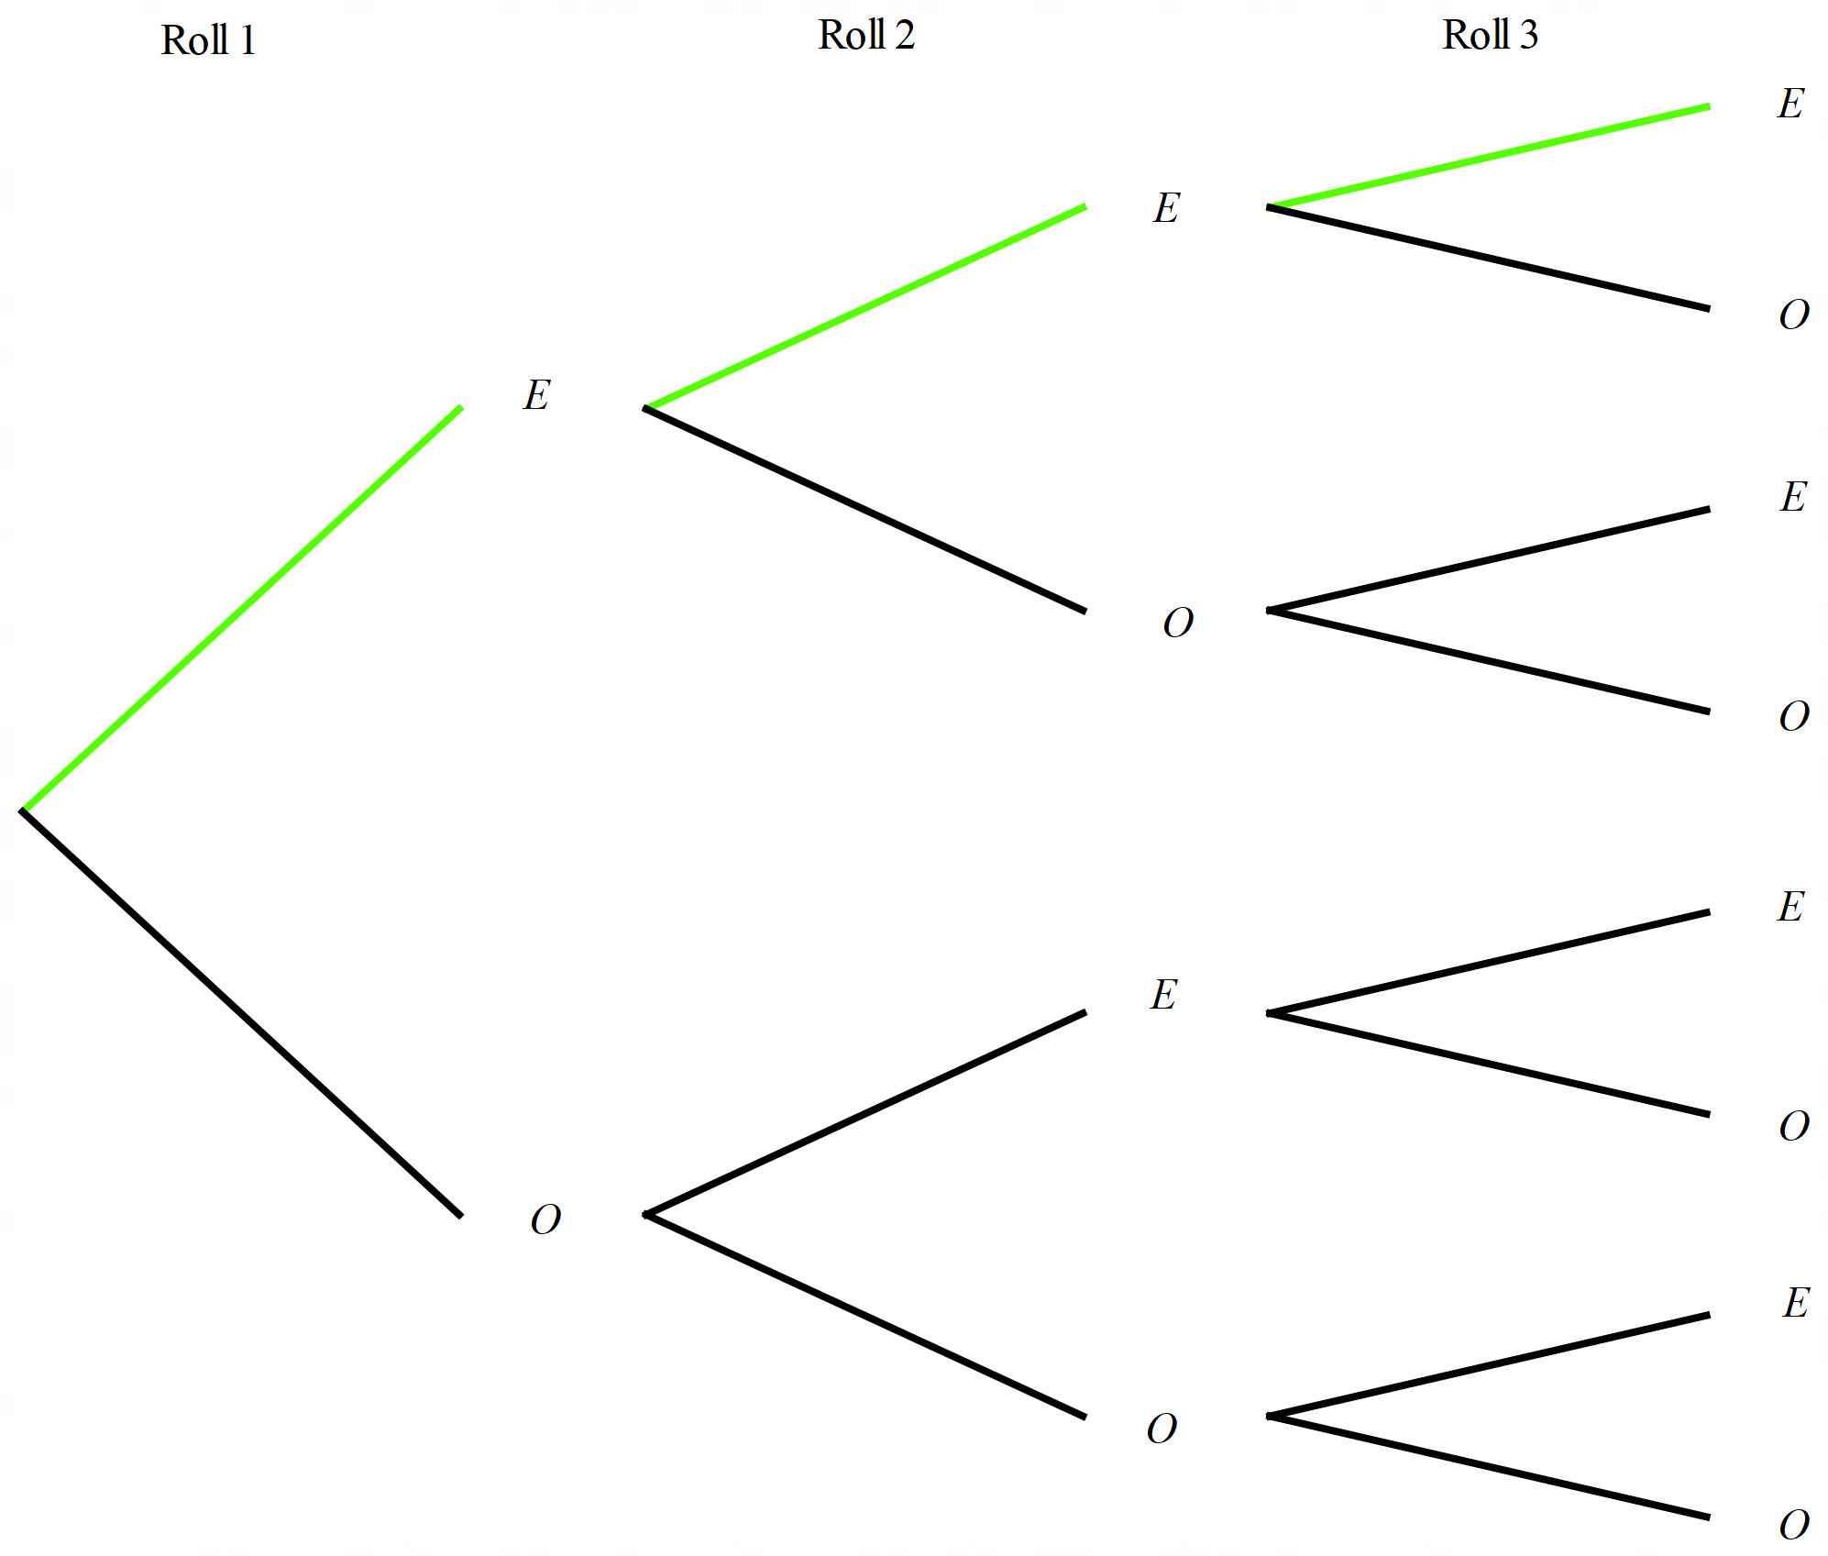
Random relay (7 of 11)
Your turn – solution 1
Calculate the probability of rolling an even number 3 times in a row when rolling a standard 6-sided dice.
$$P\left(EEE\right)=\frac{1}{8}$$
There is one branch with all even numbers and 8 branches all together.

Slide 12
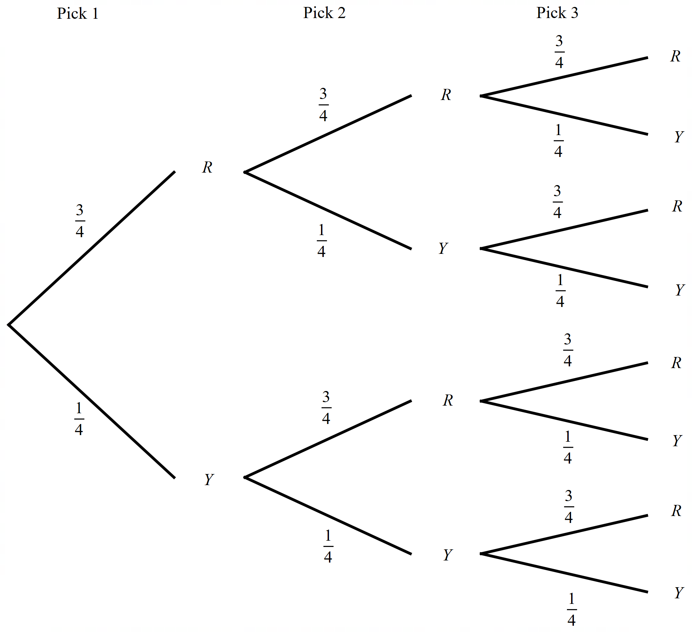
Random relay (8 of 11)
Example 2
Calculate the probability of drawing 3 consecutive red counters from a bag with 15 red counters and 5 yellow counters, with replacement.
$$P\left(RRR\right)=\frac{3}{4}×\frac{3}{4}×\frac{3}{4}$$ $=\frac{27}{64}$

Slide 13
Random relay (9 of 11)
Example 2 – self explanation prompts
Calculate the probability of drawing 3 consecutive red counters from a bag with 15 red counters and 5 yellow counters, with replacement.
$P\left(RRR\right)=\frac{3}{4}×\frac{3}{4}×\frac{3}{4}$
$$=\frac{27}{64}$$
Why is it important to say with replacement?
What do you notice about the sum of probabilities in each set of branches?

Slide 14
Random relay (10 of 11)
Your turn – question 2
Calculate the probability of drawing 3 consecutive red counters from a bag with 7 red counters and 3 yellow counters, with replacement.

Slide 15
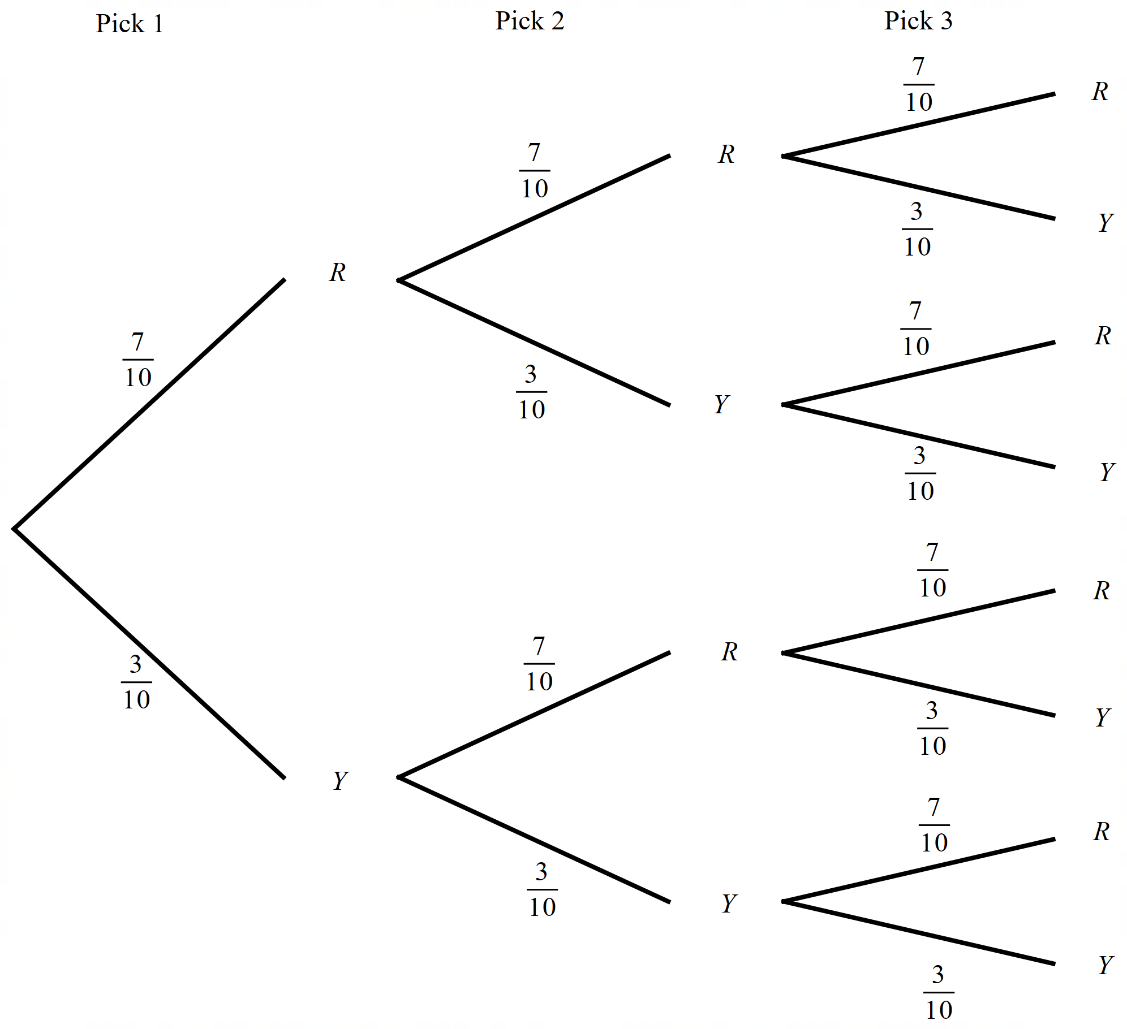
Random relay (11 of 11)
Your turn – solution 2
Calculate the probability of drawing 3 consecutive red counters from a bag with 7 red counters and 3 yellow counters, with replacement.
$P\left(RRR\right)=\frac{7}{10}×\frac{7}{10}×\frac{7}{10}$
$$=\frac{343}{1000}$$

Slide 16
Apply

Slide 17
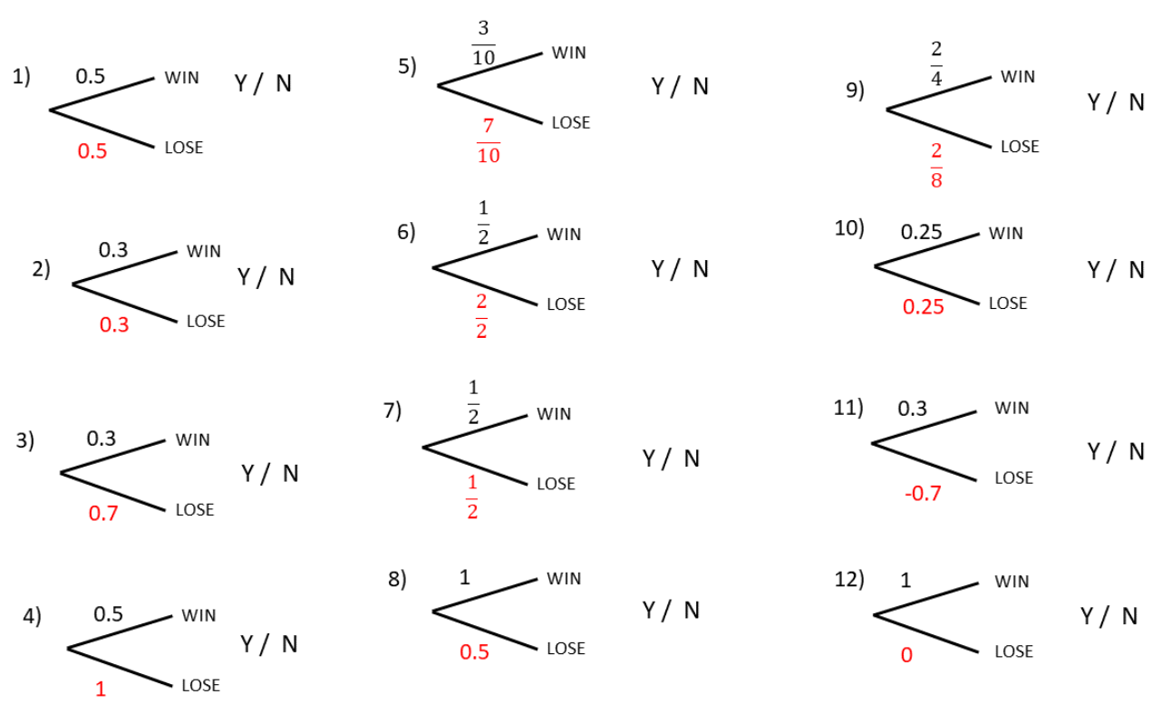
Tree diagrams (1 of 3)
Example 1

Slide 18
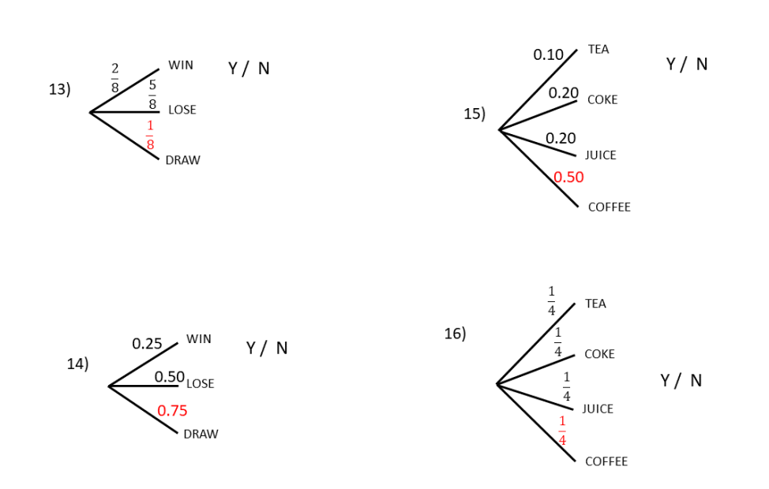
Tree diagrams (2 of 3)
Example 2

Slide 19
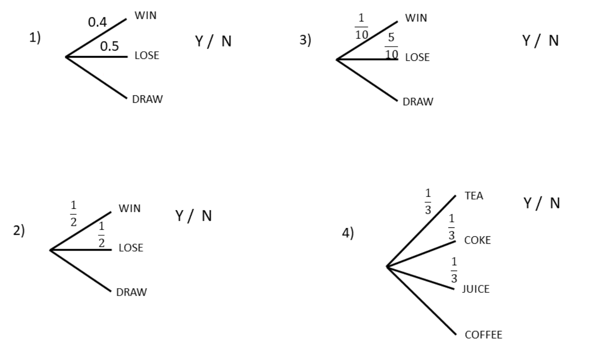
Tree diagrams (3 of 3)
Example 3

Slide 20
Copyright
© State of New South Wales (Department of Education), 2024
The copyright material published in this resource is subject to the Copyright Act 1968 (Cth) and is owned by the NSW Department of Education or, where indicated, by a party other than the NSW Department of Education (third-party material).
Copyright material available in this resource and owned by the NSW Department of Education is licensed under a Creative Commons Attribution 4.0 International (CC BY 4.0) licence.
This licence allows you to share and adapt the material for any purpose, even commercially.
Attribution should be given to © State of New South Wales (Department of Education), 2024.
Material in this resource not available under a Creative Commons licence:
the NSW Department of Education logo, other logos and trademark-protected material
Material owned by a third party that has been reproduced with permission. You will need to obtain permission from the third party to reuse its material.
Links to third-party material and websites
Please note that the provided (reading/viewing material/list/links/texts) are a suggestion only and implies no endorsement, by the New South Wales Department of Education, of any author, publisher, or book title. School principals and teachers are best placed to assess the suitability of resources that would complement the curriculum and reflect the needs and interests of their students.
If you use the links provided in this document to access a third party’s website, you acknowledge that the terms of use, including licence terms set out on the third-party’s website apply to the use which may be made of the materials on that third-party website or where permitted by the Copyright Act 1968 (Cth). The department accepts no responsibility for content on third-party websites.

