Slide 1
Goodooga Central School
Malcolm Banks, Principal

Slide 2
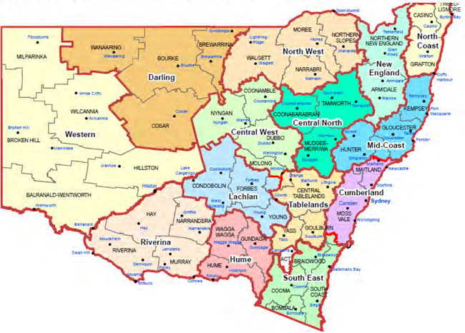
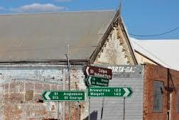
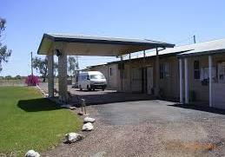
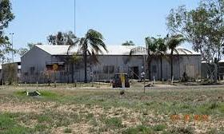
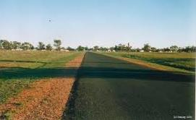
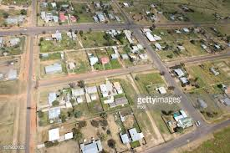
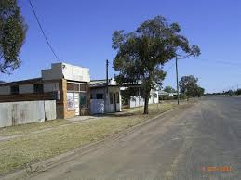
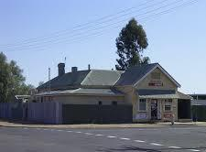
North Western NSW
GOODOOGA

Slide 3
2016 - 2020
To support students at Goodooga Central School we introduced a transition program to assist in career development. This involves providing advice and education to assist young people to make decisions that enable them to make successful transitions from school into employment as part of life long learning.
Partnerships with businesses in Lightning Ridge and Dubbo.
All Year 10 students to start a traineeship or apprenticeship from term 2.

Slide 4
Work Transition - Owning the pathway
Business networking
TAFE
Staffing
NBSA
Clothing
Shame
Funds + fundraising
Interaction with public
Transport
Community meetings
Mentoring
Gifted and talented
Accommodation
SBAT
Confidence and self-esteem

Slide 5
NINE themes were identified
Cultural, personal and professional barriers within the community influence the capacity of employers to support young people. If young people are disengaged, lack routines and structures and are disconnected from their culture it is challenging to provide support in a way that can be accepted.
Spend time building relationships with young people
Incorporate learning opportunities in social and community activities
Work with families and not just young people
Acknowledge existing strengths and interests in the community
Find local mentors and role models within communities
Strengthen partnerships between agencies
Start the transition to work program earlier: Term 4, Year 8
Develop a clear timeline for students, Year 9 to Year 12

Slide 6
Transition
Year 6: from term 2 - 2 hours a week in secondary classes
Year 7: learning expectations of secondary
Year 8: from term 4 – career internet research (7 occupations)
Year 9: enter into behaviour and attendance pre-requisites for work transition.

Slide 7
Year 9 Parent meeting: student expectations
Skills for Work and Vocational Pathways
This qualification is designed for individuals who require further foundation skills development to prepare for workforce entry or vocational training pathways.
It is suitable for individuals who require:
a pathway to employment or vocational training
reading, writing, numeracy, oral communication and learning skills at Australian Core Skills Framework (ACSF) Level 3
entry level digital literacy and employability skills
a vocational training and employment plan.

Slide 8
Engagement & Attendance
Students leaving at end of primary. Community believe in better opportunities at larger boarder schools.
2014 11
2015 9
2016 9
2017 13 (students return from boarding school)
2018 17 (all primary students entering year 7)
2019 19 (all primary students entering year 7)
2020 24 (all primary students entering year 7)

Slide 9
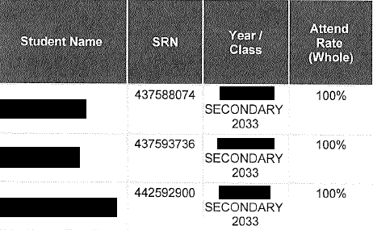
Attendance

Slide 10
Examples of modules
Use digital technology for routine workplace tasks (Core)
FSKLRG09- Use strategies to respond to routine workplace problems Use strategies to respond to routine workplace problems (Core)
FSKLRG11- Use routine strategies for work-related learning Use routine strategies for work-related learning (Core)
FSKNUM14- Calculate with whole numbers and familiar fractions, decimals and percentages for work Calculate with whole numbers and familiar fractions, decimals and percentages for work (Core)
FSKNUM15- Estimate, measure and calculate with routine metric measurements for work Estimate, measure and calculate with routine metric measurements for work (Core)
FSKOCM07- Interact effectively with others at work Interact effectively with others at work (Core)
FSKRDG10- Read and respond to routine workplace information Read and respond to routine workplace information (Core)
FSKWTG09- Write routine workplace texts Write routine workplace texts

Slide 11
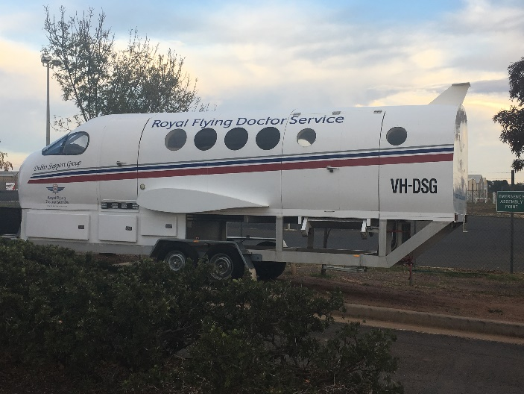
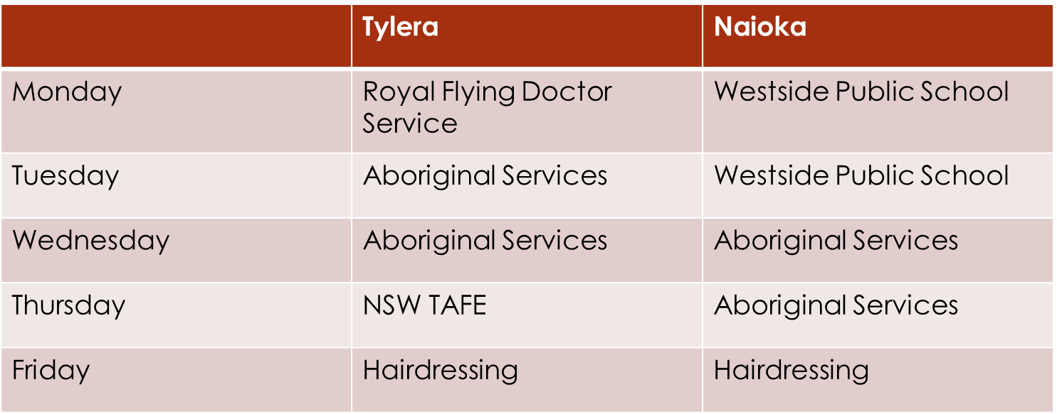
Term 1
Further extensive research on Stage 5 career pathways
Term 1, Weeks 5 -10
2 hours a week at Goodooga Post Office – EFTPOS, billing, customer service
Term 2, Week 4 – Dubbo work experience - 5 business in 5 days

Slide 12
Term 2, 3 & 4
Term 2, Weeks 6 and 8 - evaluation of work in Dubbo
Decisions for pathway
Term 3 - confirmation of 1 week of work in preferred occupation
Term 4 - information on TAFE courses and SBAT

Slide 13
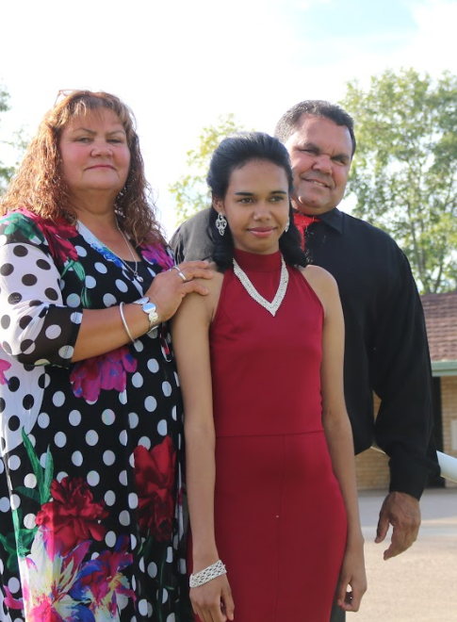
Chaperones

Slide 14
Year 10
TAFE courses selected
SBAT confirmation
HSC courses examined

Slide 15
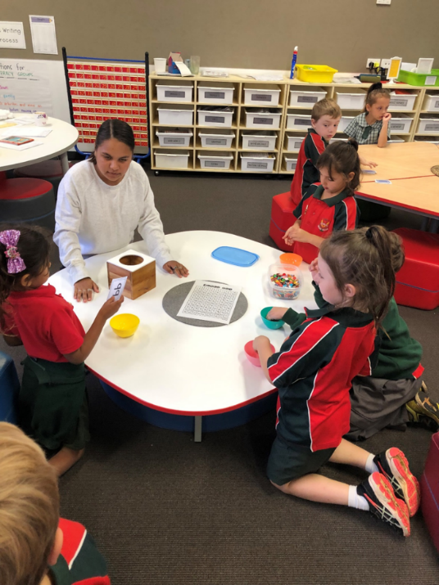
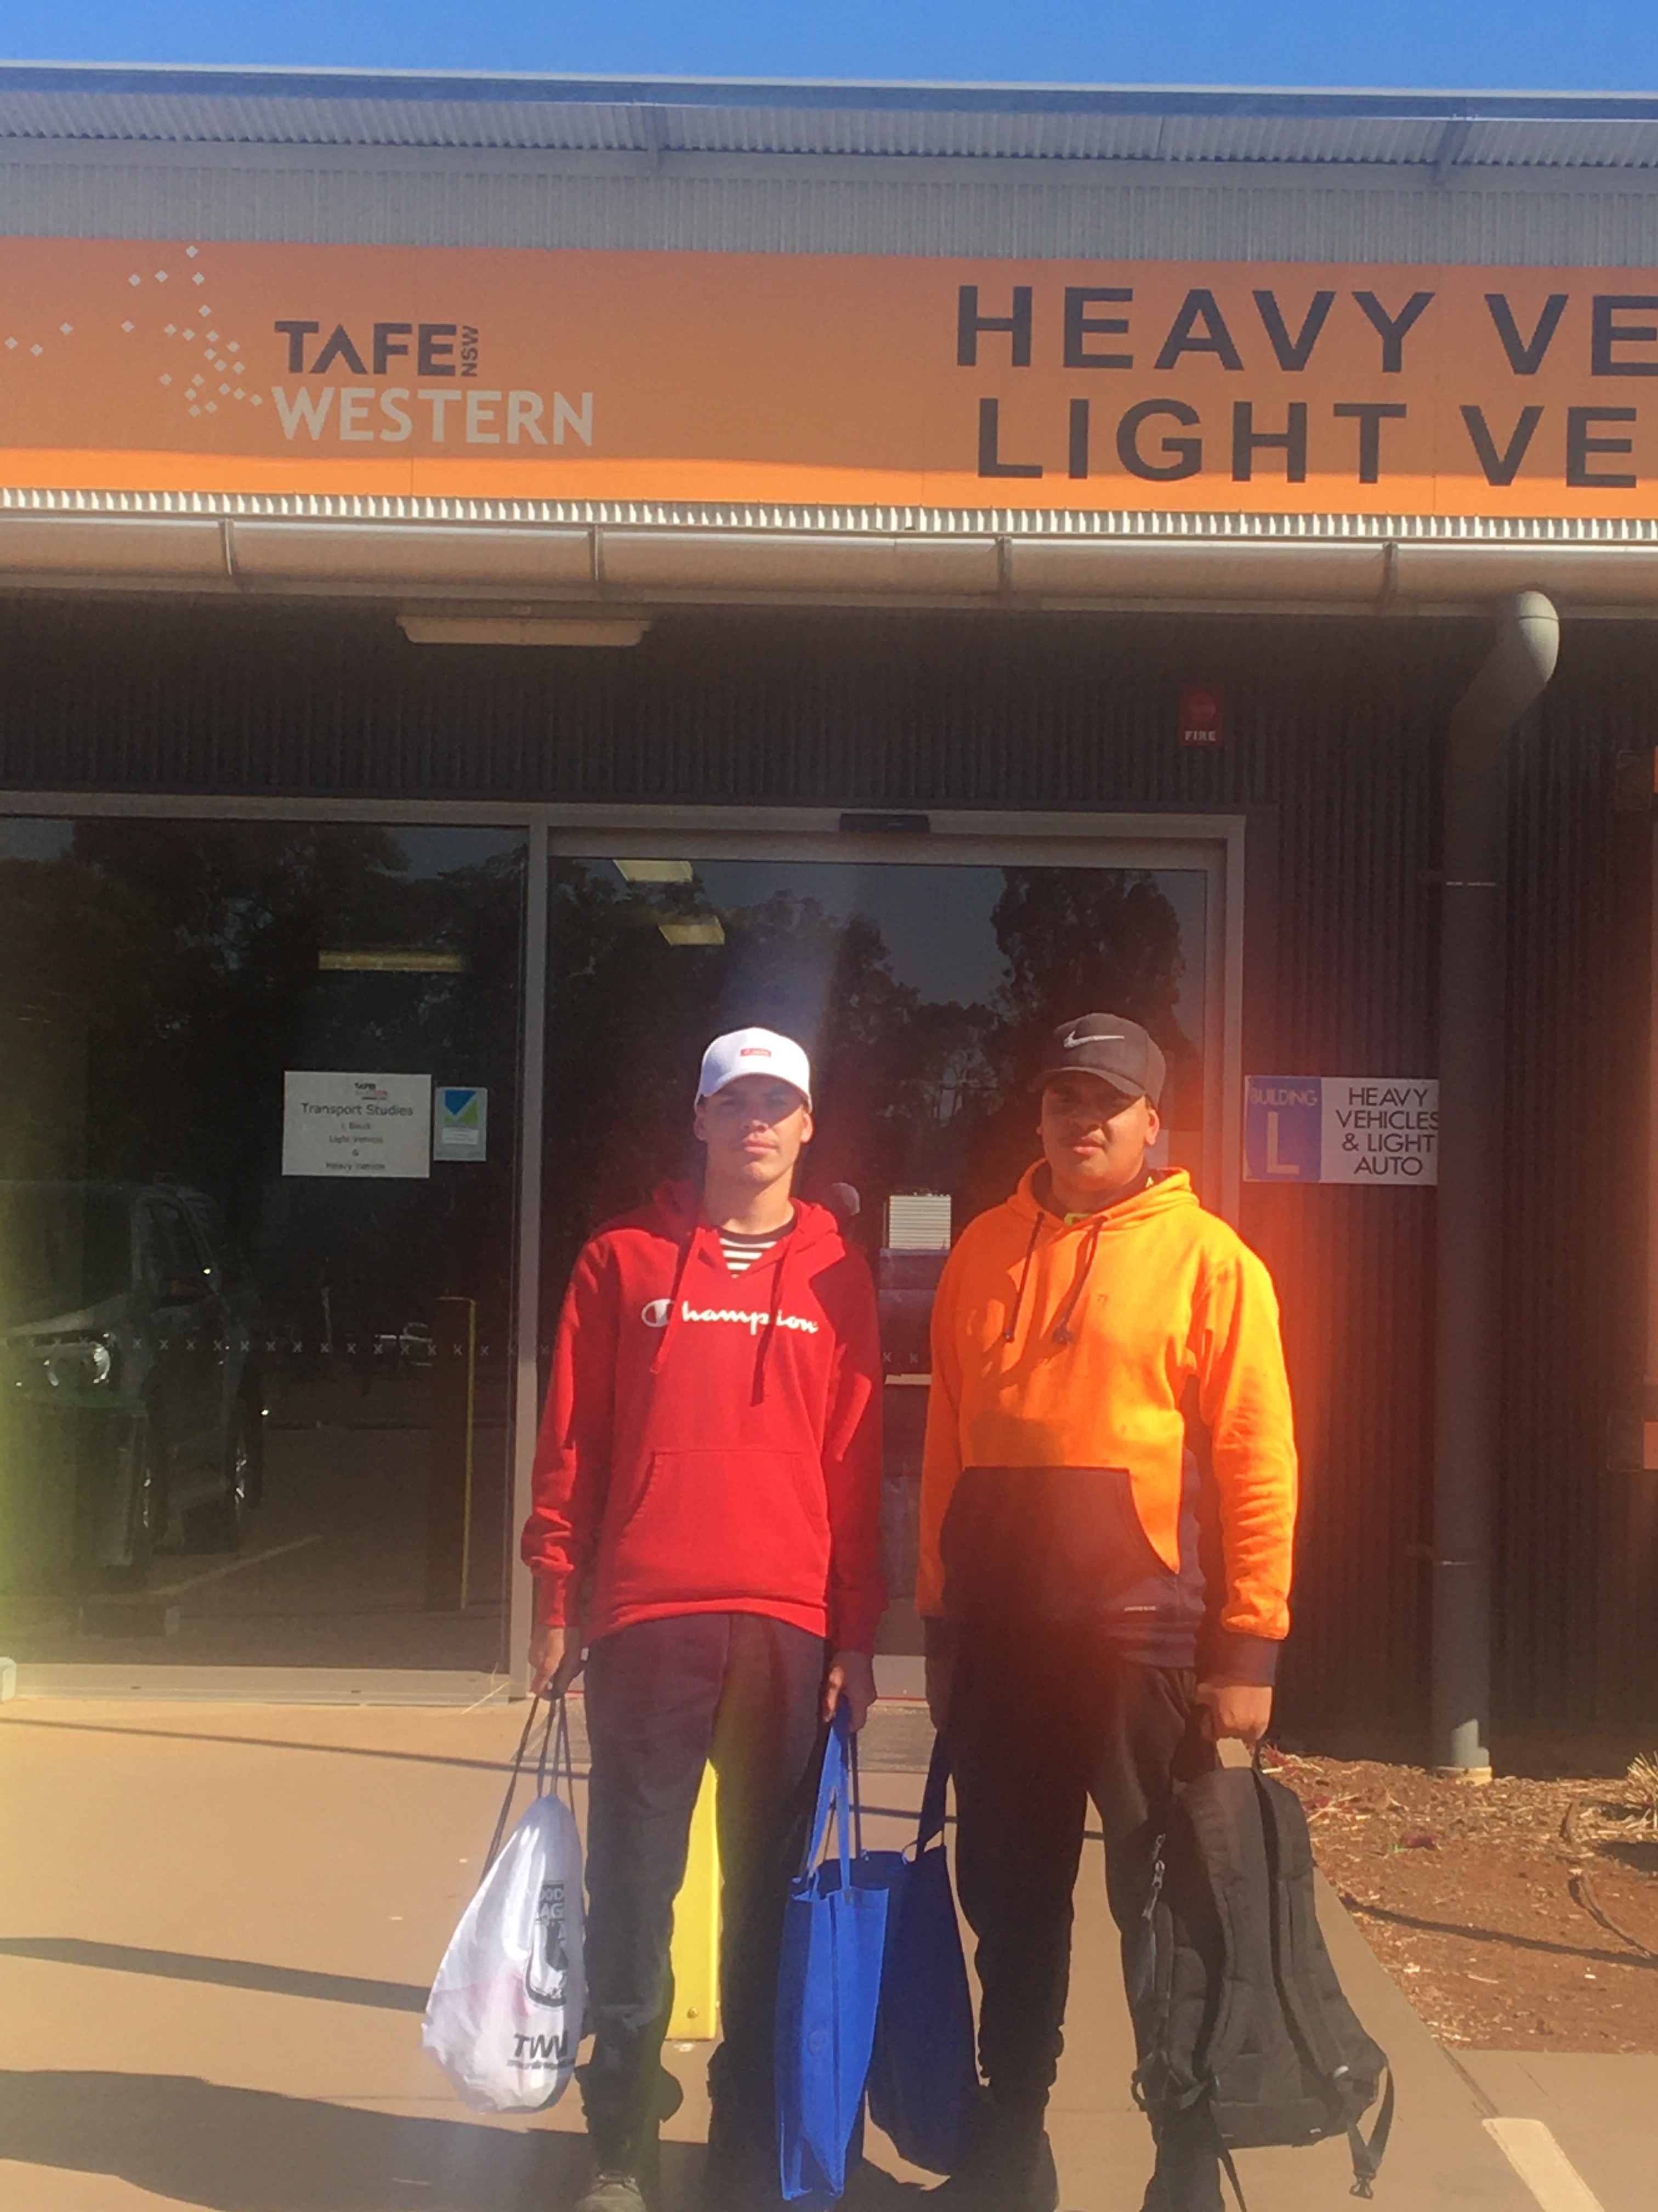
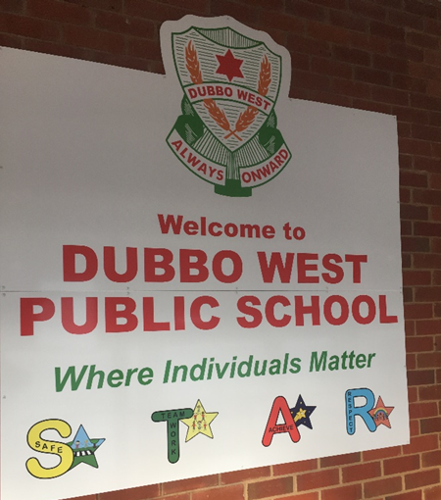
Year 10, Term 2

Slide 16
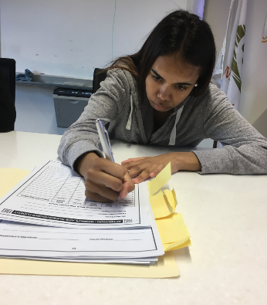
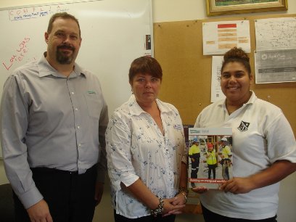
2017
Graduated 2017
High school certificate
Cert. II Business Studies
Cert. II Vocational Skills and Pathways
Cert. II Retail Studies
Finalist Western NSW Training Awards
Outstanding Achievement in TAFE Studies NSW
Graduated 2018
High school certificate
Cert. II Business Studies
Cert. II Vocational Skills and Pathways
Cert. II Retail Studies
Traineeship Hairdressing
Sign up day 2016
Healthcare Assistant – Acute Care Cert III
Traineeship NSW Health
Accepted Deacon University Nursing Degree 2018

Slide 17
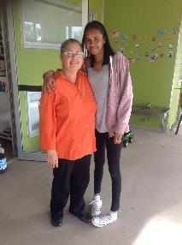
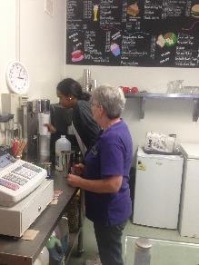
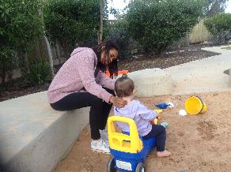
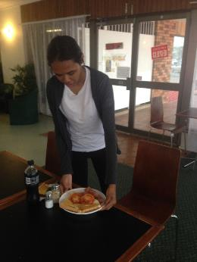
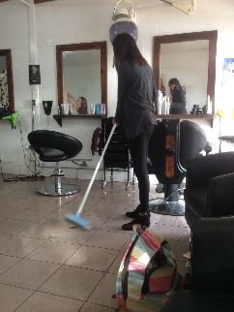
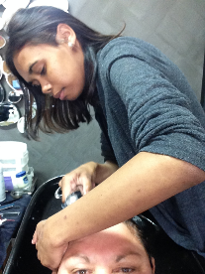
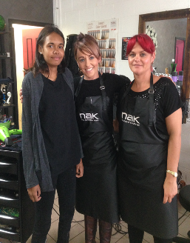
Work Transition

Slide 18
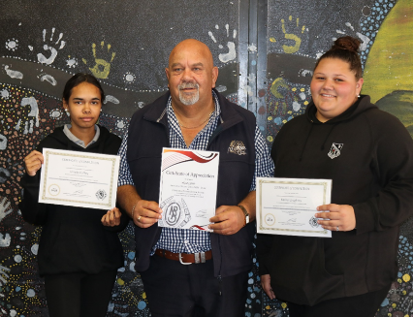
Aboriginal Services Dubbo

Slide 19
2018 - Kesha
Graduates 2019
High School Certificate
Cert. II Business Studies
Cert II Retail Studies
Cert. II Vocational Skills and Pathways
Commonwealth Bank Trainee
Public Education Scholarship Recipient
Harding Miller Scholarship Recipient
Finalist Western NSW Training Awards
Zonta Achievement Award for a Young Indigenous Woman

Slide 20
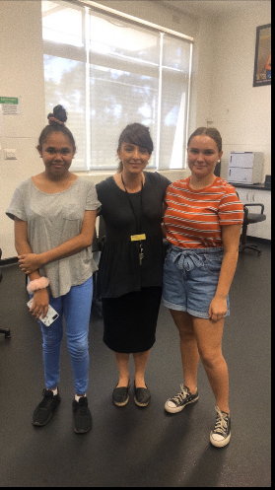
2018
NSW TAFE Hairdressing and Beauty
Child Studies
Business Traineeship – Aboriginal Services

Slide 21
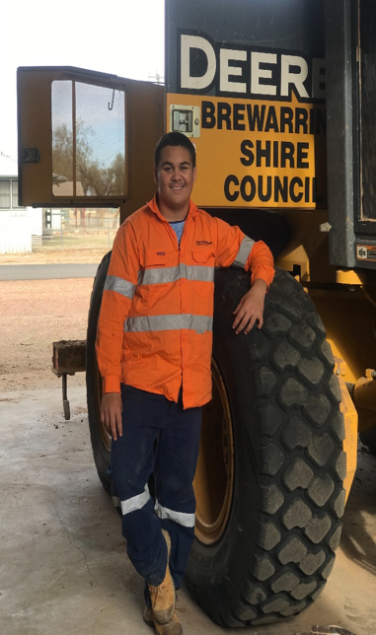
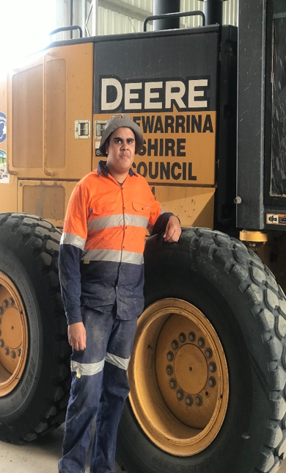
2020 - Lincoln and Daniel
Congratulations Lincoln Wood & Chris Daniel Forrester
On successfully starting a Traineeship
with Brewarrina Shire Council
Certificate II Automotive Service Technology NSW TAFE

Slide 22
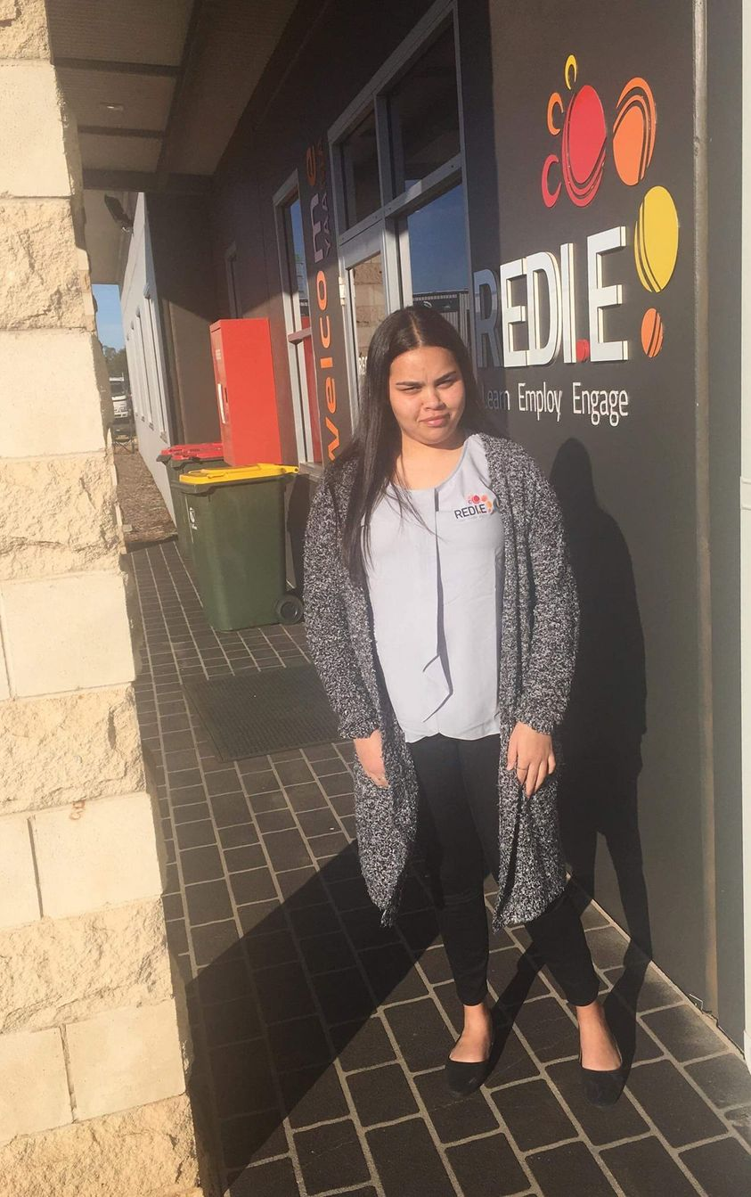
2020 - Tylera
Congratulations
Tylera Cochrane
On successfully starting a Traineeship
with
REDI-E Dubbo
Certificate II in Business

Slide 23
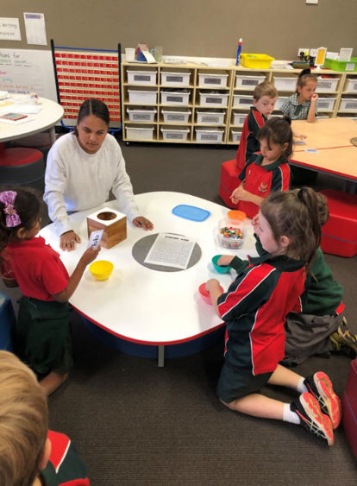
2020 - Naioka
Congratulations
Naioka Welsh
On successfully starting a Traineeship
with
Department of Education
Certificate III Education Support

Slide 24
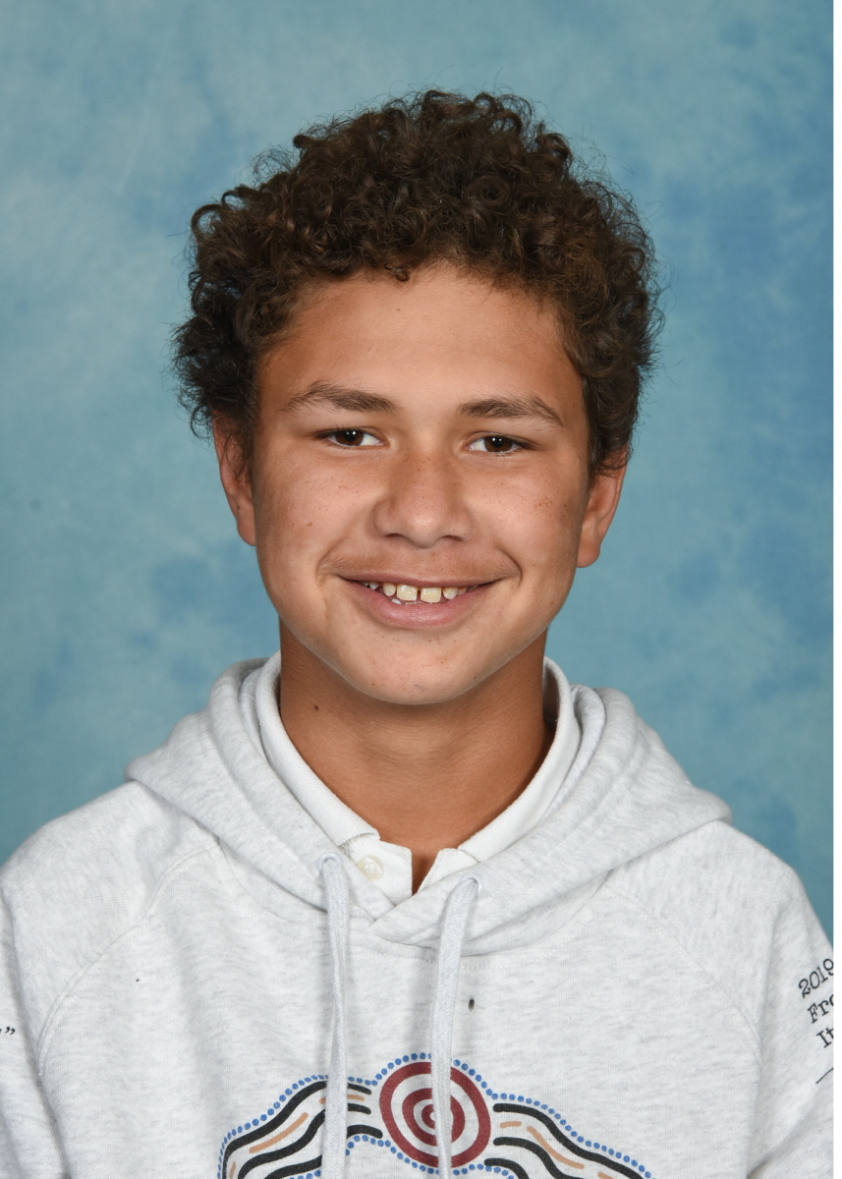
2020 - Daminan
Congratulations
Daminan Lane-Brown
On successfully starting a Traineeship
with
Land Management National
Parks and Wildlife

Slide 25
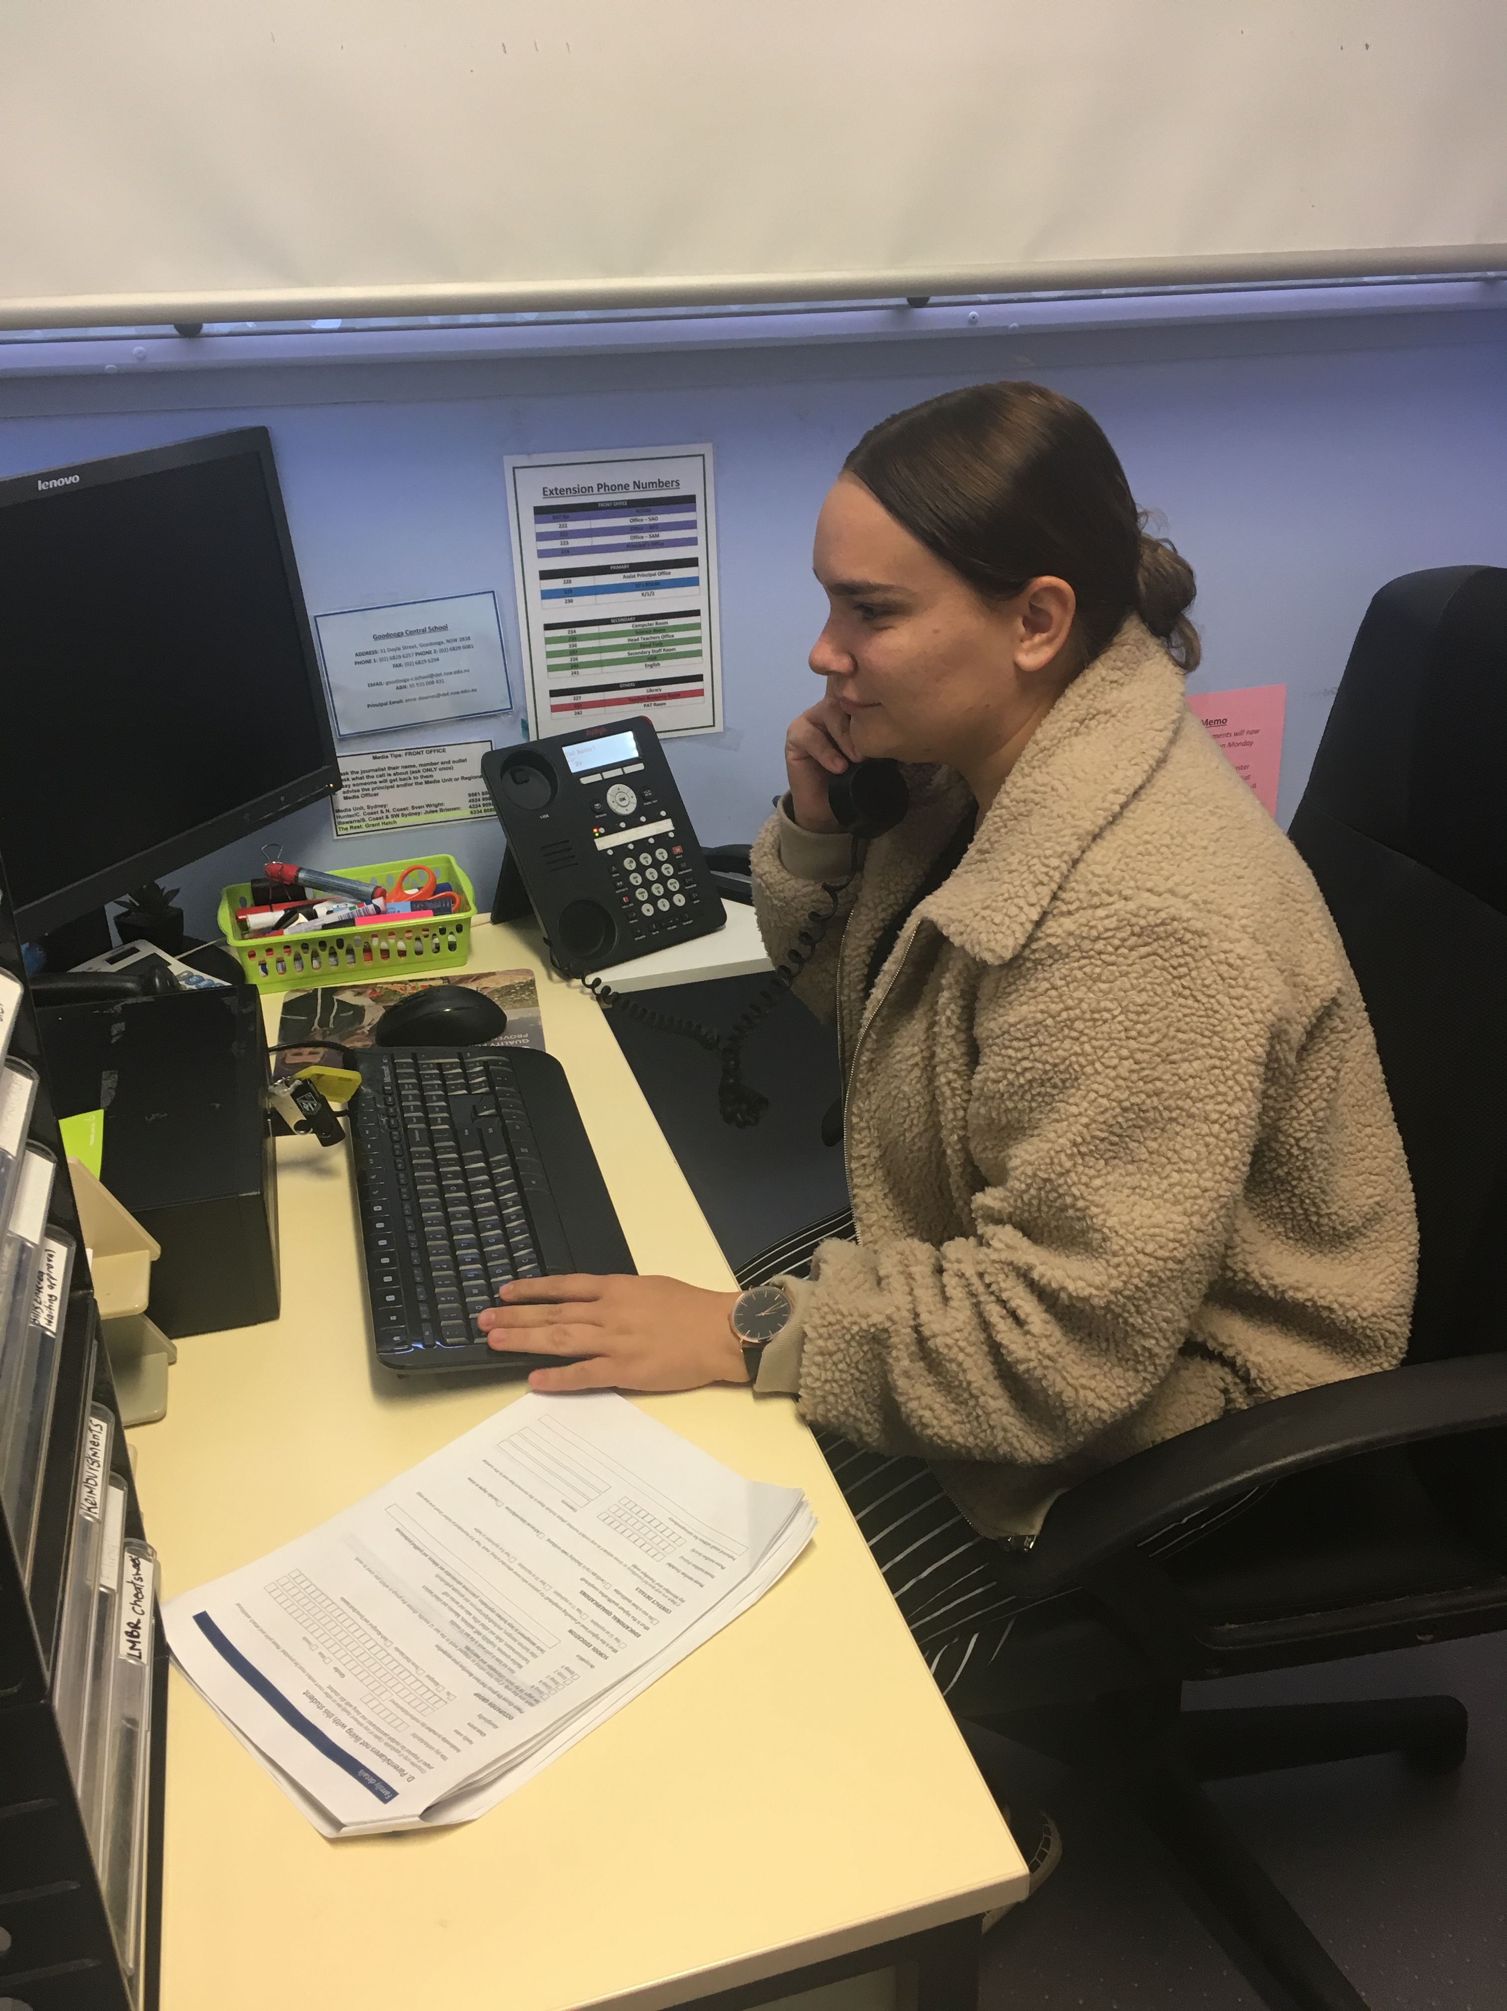
2020 - Shakira
Congratulations
Shakira Cochrane
On successfully starting a Traineeship
with Department of Education
Certificate II Business Studies
Certificate II Retail
Certificate II Community Services

Slide 26
2020 – Term 3
Evaluation of the current school direction
Funding
Community survey
Expansion of the 5 occupation in 5 days into Sydney???
Further develop partnerships with businesses
2016-2020 over 20 partnerships developed in Lightning Ridge, over 26 partnerships developed in Dubbo, and 8 partnerships developed at a NSW level

Slide 27
Acknowledgment
The Careers and Workplace Learning team would like to thank the Principal, Malcolm Banks from Goodooga Central School for his valuable input into this Illustration of Practice.
Goodooga Central School website: Goodooga Central School (nsw.gov.au)

