Slide 1
The role of narrative in the creative arts
Creative arts learning sequences
Stage 1 Student activity resources

Slide 2
Activity 1
Student resources

Slide 3
Learn a song
Learn to sing 'Issunboshi'
Learn to sing the song ‘Issunboshi' from Vocal Ease MORE (Module 1)
Use this animated score as a guide.
Pause and play to assist you to learn the song. The lyrics are also included on the next slide.
Practice keeping the beat with the animated score and following the moving score.

Slide 4
Sing a song
Learn to sing 'Issunboshi' (supporting lyrics)
'Issunboshi'
By Tracy and Paul Burjan
Spoken: Ichi, ni, san, shi, go, rok, nana, achi, kyuu, juu.
Chorus
Little Issunboshi, was no taller than your thumb,
Little Issunboshi, had the heart of a lion,
Little Issunboshi, was a brave samurai,
Was a brave, was a brave,
Was a brave samurai, little Issunboshi.
Verse 1
Long ago, in Japan,
Lived an old couple with no child.
Every day, they would pray,
For a heart to fill their home.
Chorus
Verse 2
Then one day outside their home,
Baby crying one inch long.
The old couple did feel blessed,
They called him Issunboshi.
Life passed peacefully and then,
Little man’s ambition grew,
He was only one inch tall, samurai to beat them all,
Little Issunboshi.
Chorus
Verse 3
To Kyoto he did fly,
To be by the princess side,
Defeated red demon,
Little Issunboshi
Suddenly our brave man grew,
Till he was six foot two,
General Horikawa brave samurai to beat them all,
Litle Issunboshi.
Instrumental then Chorus

Slide 5
Think about the song
Reflection questions
What parts of the music let you know that it is Japanese?
How does this add to the meaning of the narrative?
Use these instrument guides to explore the instrumental tone colours (timbres) of the Japanese instruments.
How do these instruments help tell the story?

Slide 6
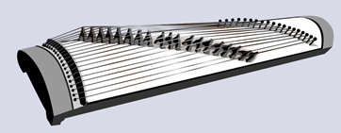
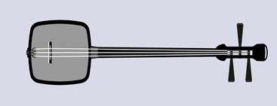
Think about the song
Japanese instrumental tone colours
Think of three adjectives to describe the sound of each of the instruments below. Write these down and add to the class online digital platform.
Koto:
Shamisen:
Shakuhachi

Slide 7
Think about the song
Listen to the pentatonic scale
'Issunboshi' is based on the E pentatonic scale. How many notes is this? How do you know?
This scale can be found in traditional Japanese music. Play or listen to scale and follow along the notes:
How does this sound add to the narrative when you sing the song?

Slide 8
Think about the narrative of the song
Reflection questions
Read through the story of ‘Issunboshi’ (‘The Inch Boy’) by Junko Murimoto.
What is happening in the story?
What other stories do we know that are similar to ‘Issunboshi’? Reflect on these stories and think about what is the same.

Slide 9
Activity 2
Student resources

Slide 10
Play some music
Write about it
Select a nursery rhyme from this list:
‘Baa, Baa, Black Sheep’
‘Itsy Bitsy Spider’
‘Little Bo Peep’
‘Star Light, Star Bright’
‘Old Mother Hubbard’
‘Little Miss Muffet’
‘Humpty Dumpty’
‘Rock-a-bye Baby’
‘A Sailor Went to Sea Sea Sea’
‘Hey Diddle Diddle’
‘Here We Go Round the Mulberry Bush’
With a household member or alone, read the nursery rhyme and mime the actions on the spot (non-locomotor). What is the rhyme about? Does it make sense? Does it tell a story? Write responses in the class digital platform including the name of the rhyme and what it is about.

Slide 11
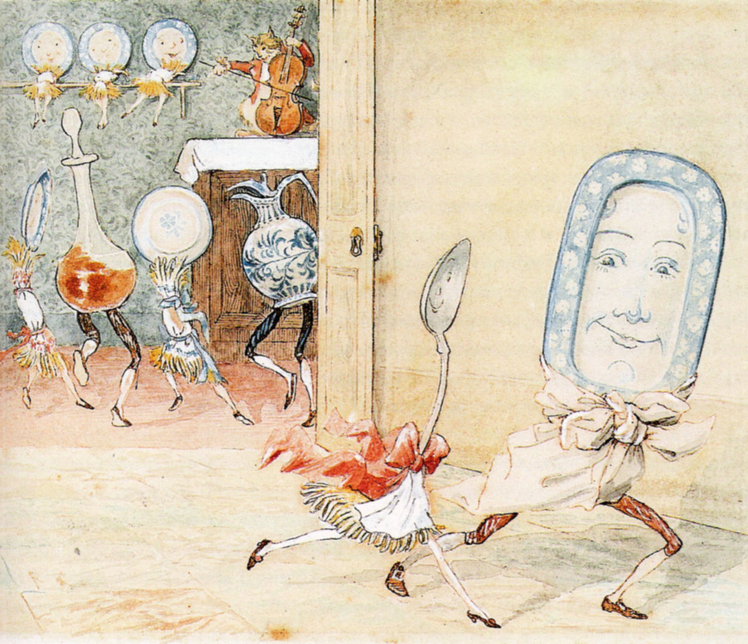
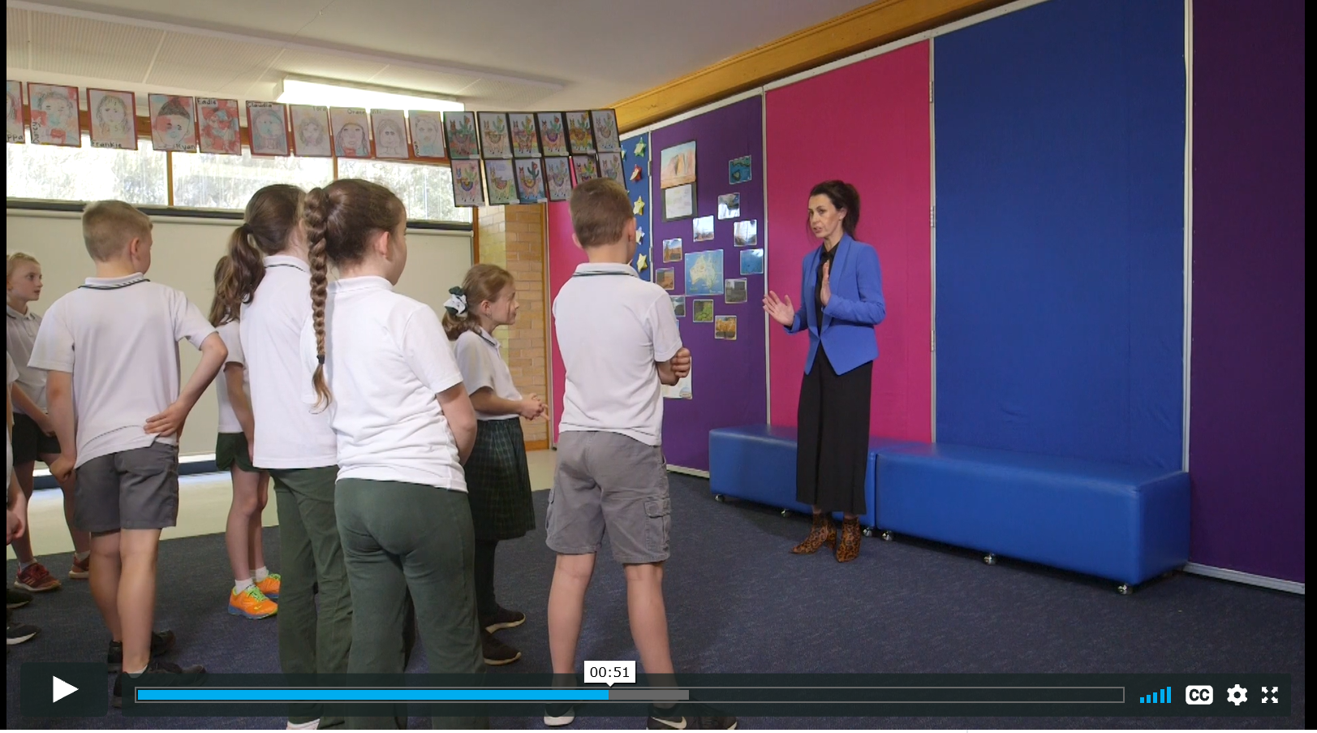
Do some drama and movement
Act and move to your nursery rhyme
Say your nursery rhyme and make yourself small like a seed in the ground.
As you read the rhyme, begin to grow into a tree with long, wide branches.
By the end of the poem you have grown into an adult tree. Slowly blow in the wind.
Say it again and melt down to the ground like a puddle.
Say it again, this time in an exaggerated manner or with a silly voice.
Move around the room (locomotor) as a character or thing from the rhyme depicting what is happening in the narrative. For example, ‘Little Miss Muffet’ being the girl or spider, sitting on a seat eating cereal, then being scared or startled or in ‘Humpty Dumpty’ being the wall, king, horse, soldier or egg, then falling, lying down or trying to put the egg back together.
Use Let’s move and freeze - Get familiar video (1 minute 48 seconds) to help get some ideas. Think about not only facial expressions and tone of voice, but also the way that the selected character would move including movements such as whether they would be light or heavy.
Freeze in a pose and have someone in the household take a photo (or have students take a selfie) and post on the class digital platform.

Slide 12
Reflecting
Think about it
How does drama help to make meaning in a rhyme?
Does changing role or expression change the meaning of the nursery rhyme?
Does it change the point of view of the characters in the rhyme?

Slide 13
Activity 3
Student resources

Slide 14
Listen to some music
How does music tell a story without words?
Listen to a piece of music that tells a story without words called ‘The Firebird’ by Igor Stravinsky.
How does the music help us to create a story? For example, in ‘The Firebird’ the tempo changes (it gets faster and more frenzied), the dynamics move between soft (‘piano’) and loud (‘forte’), the instruments’ tone colours change (such as high-pitched plucked strings and clarinets).
How does this help to tell the story?
Discuss with family what the narrative of the music could be about?
What does the music do to help us create a story?
How much does the title help us to make this choice?

Slide 15
Observe an artwork
Explore and discuss
Explore this artwork, inspired by Stravinsky’s ‘The Firebird’ by Anna Duyunova.
Discuss with household members the use of colour, pattern, line and radial features (such as the circles and spirals). How do they relate to the music?
Look at other firebird inspired artworks created by students to add meaning about what the narrative of the music could be about.

Slide 16
Write about it and share
Describe the narrative of your artwork and share it with the class
Make an artwork inspired by Stravinsky's ‘The Firebird’. Use available materials to create this work such as paper and pencils or paints or textiles to create sculptures. When making artworks, use equipment correctly such as having sharp pencils overlapping colours, using pencils softly to allow colours to blend and so on.
Write a one-sentence artist intent statement about the artwork. This should describe very briefly what the artwork is about (its narrative) as though it were next to the artwork in a gallery.
Photograph artworks and attach them to the class digital platform with the artist intent statement.

