Slide 1
Exploring stimuli

Slide 2
What we will explore
Process diary
Intent
Stimulus
Exploration

Slide 3
Process diary
A process diary is a work book that you document your experiences in. At the end of each composition class, you will be given five minutes to write down and reflect on what you developed that lesson.
Glue the attached worksheet into your process diary.
A normal entry should answer the questions below.
What did you accomplish today?
What hardships did you face?
Where will you go from here in the process?
It is a diary of:
your ideas
inspiration
music choices
your creative process
any changes made
how you are finding the process.

Slide 4
Intent
What is an intent?
What is the idea behind the dance?
What is your dance about?
What story are you trying to convey?
These all mean intent.
Notes:
Image one: http://gospelarena.org/wp-content/uploads/2017/08/Core-story.jpg

Slide 5
Stimulus
What is stimulus?
Stimulus inspires or encourages you to develop or create something.
Stimulus is defined as the starting point or incentive for creative movement.
Stimuli can be categorised into five groups:
visual – what we see
auditory – what we hear
tactile – what we touch
ideational – ideas that come to us
kinaesthetic – movement or improvisation
Notes:
Image one: http://expression.co.za/wp-content/uploads/2015/09/bigstock-Vivid-Brain-3646646-1.jpg

Slide 6
Exploration: Let’s explore the different stimuli
Visual: What we see
What can visual stimulus be? Pictures, sculptures, objects, patterns, shapes, etc.
You may think about the:
idea behind it
it’s line
it’s shape
it’s rhythm
it’s texture(s)
it’s colour.
Notes:
Image one: http://clipart-library.com/clipart/kcKn95g7i.htm

Slide 7
Exploration: Visual stimulus
In pairs, discuss and answer the questions below in your process diary.
What could this image mean?
What idea is it communicating?
What shapes can you draw from the idea?
Notes:
Image one: https://www.erikbrede.com/wp-content/uploads/2015/09/The-Asylum-Project-Empty-Bed-Final-1500px.jpg

Slide 8
Exploration: Visual stimulus
In pairs, discuss and answer the questions below in your process diary.
What could this image mean?
What idea is it communicating?
What shapes can you draw from the idea?
Notes:
Image one: https://www.skipprichard.com/wp-content/uploads/2016/08/bigstock-Promise-120546617-583x389.jpg

Slide 9
Exploration: Visual stimulus
In pairs, discuss and answer the questions below in your process diary.
What could this image mean?
What idea is it communicating?
What shapes can you draw from the idea?
Images like these can provide inspiration to develop a concept or intent for your own composition.
Notes:
Image one: https://i2.wp.com/www.wayofninja.com/wp-content/uploads/2016/12/park-690533_1280.jpg?resize=420%2C280&ssl=1

Slide 10
Exploration: Visual stimulus
Visual stimulus task
Step 1: In pairs, choose one of the three images and decide what you think it is communicating.
Step 2: Create six to eight shapes reflecting that idea. Remember to use different levels and directions.
Step 3: Link these shapes with movements allowing them to become a phrase of movement.
Step 4: Perform this phrase for the class and watch each others creations. Discuss what worked well.
Step 5: Write an entry in your process diary on the activity. Answer questions such as:
How did the images help you develop an idea for movement?
Do you think this was an easy or difficult task? Why?
Notes:
Image one: https://www.teachingenglish.org.uk/article/class-journals

Slide 11
Exploration: Let’s explore the different stimuli
Auditory: What we hear
The most obvious auditory stimuli is music. You can begin with listening to a certain piece of music, and be inspired by that piece. The music not only dictates the idea of the dance, but also the mood, style and length.
Try not to stick to the obvious. Explore what other auditory stimulus is out there…
Other auditory stimuli include:
percussive instrument sounds
human voices
words
poems
any other noise
Notes:
Image one: http://www.darrenstockford.com/wp-content/uploads/2014/06/ear-noise.jpg

Slide 12
Exploration: Auditory stimulus
Auditory stimulus task- Sounds of the environment
Step 1: In pairs, take a brief walk around the school (5 minutes max) and listen for sounds that could inspire you. What do you hear? Write these sounds into your log book/process diary. This could include: wind, running water, rain, animals, students, technology, sounds of the buildings, etc.
Step 2: In your pair, discuss the different sounds that you could use as a starting point for composition. Explore this further, and develop an intent from this sound. Remember, your intent could be anything!
Step 3: Create two to three shapes that symbolise this idea, and link these to make eight counts of movement. This is now your motif.
Step 4: Create a sequence of movement, approximately four bars of eight counts. This must begin with your motif. Manipulate the motif on a different level, using a different body part, facing a different direction, reversing the movement, etc. (We will explore how else to manipulate motif soon)
Step 5: Perform this for the class and watch each others creations. Discuss as a group what worked well and why.
Step 6: Write an entry in your process diary on the activity. Answer questions such as:
What did you like about this task?
What did you find difficult?
What would you do differently next time?
What was successful?
After watching each other groups, what worked well and why?

Slide 13
Exploration: Auditory stimulus
Auditory stimulus task- Sounds of lyrics
No bravery by James Blunt
Music plays a vital role within dance and adds many layers to a piece, including mood and emotion. Lyrics, tempo and feeling can be drawn from an auditory stimulus making it a valuable starting point when creating an intention for a work.
Step 1: Listen to the song and read the lyrics.
Step 2: Break into pairs and choose four lines from the song (on the following slide)
Step 3: Develop symbolic movement for these four lines. Think of literal representations or gestures for the lyrics.
Step 4: Do the same with another four lines, from a different part of the song.
Step 5: Link these together.
Step 6: Perform this movement to another, unrelated, piece of music, preferably an instrumental.
Step 7: Now, in your pair, one person is to change their level or direction within the phrase.
Step 8: Perform this for the class, viewing one another’s works.
Step 9: Write an entry in your process diary on the activity. Answer questions such as:
Was the task successful?
What did or didn’t work?
What did you gain from viewing what other groups produced?

Slide 14
Exploration: Auditory stimulus
There are children standing here Arms outstretched into the sky Tears drying on their face He has been here
Brothers lie in shallow graves Fathers lost without a trace A nation blind to their disgrace Since he has been here
And I see no bravery, no bravery In your eyes anymore, only sadness And I see no bravery, no bravery In your eyes anymore, only sadness Only sadness
Houses burnt beyond repair The smell of death is in the air A woman weeping in despair says He has been here
Tracer lighting up the sky It's another family's turn to die A child afraid to even cry out says He has been here
Notes:
Image one: https://upload.wikimedia.org/wikipedia/en/thumb/5/52/Nobravery.JPG/220px-Nobravery.JPG

Slide 15
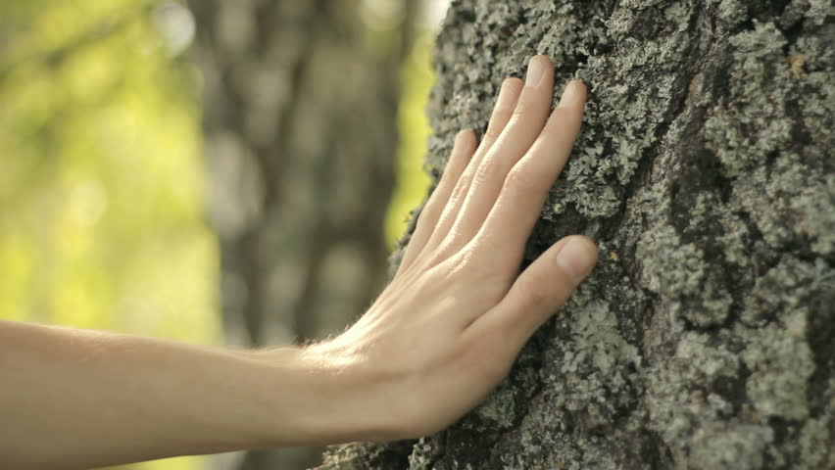
Exploration: Let’s explore the different stimuli
Tactile: What we touch
The third type of stimulus we will explore is tactile. This refers to anything you touch or feel, and how this can inspire you to generate an idea and create movement.
Explore what types of tactile stimuli there are in our environment, including:
the outside environment
the four elements: earth, water, wind, fire (or heat to be safe!)
material objects
parts of the human body such as hair, nails, bones, etc.
anything at all that you can physically touch, and be inspired by!
Notes:
Image one: https://ak7.picdn.net/shutterstock/videos/7927627/thumb/6.jpg

Slide 16
Exploration: Tactile stimulus
Tactile stimulus task:
Step 1: Students must pair up: person A and person B.
Step 2: Person A must close their eyes.
Step 3: Person B is going to lead them around the room, helping them feel the elements within the room. Eg: the cold or warmth of elements, soft and hard surfaces, little or big objects, etc. Try and lead them to a variety of tactile stimuli.
Step 4: Person A must choose one thing they felt inspired by.
Step 5: Person A and B swap roles and repeat steps one to four.
Step 6: Together, document both of your ideas in your process diary, choose one tactile element and create an idea from it.
Step 7: Develop six to eight shapes representing this idea, using different levels and directions.
Step 8: Link these shapes together.
Step 9: Change the tempo of this phrase, eg: slow down or speed up parts.
Step 10: Add in two stillness’s.
Step 11: Perform to an instrumental piece of music for the class.
Step 12: Discuss and write an entry in your process diary on the success of this exercise.
Notes:
Image one: https://www.teachingenglish.org.uk/article/class-journals

Slide 17
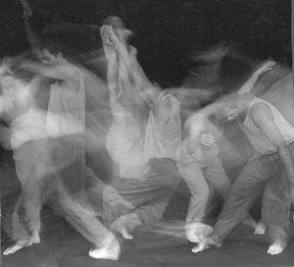
Exploration: Let’s explore the different stimuli
Ideational: What we think
When you simply think of an idea to create a work about.
This stimulus is the most common among dancers.
Explore the differences between ideational stimuli and the other types of stimuli.
Kinaesthetic: Comes from movement
When you start improvising and an idea comes to you.
Explore the possible positive and negative effects of kinaesthetic stimuli.
Notes:
Image one: http://lemerg.com/651852.html
Image two: http://nurturedance.org/Images/ken_martini_contact_improvisation_2.jpg

