Slide 1
Emojis

Slide 2
Emojis
Emoji - means picture character in Japanese.
In English it is known as a pictograph.
Similar to an emoticon it can be a facial expression, common object, animal, etc.
Notes:
http://d2trtkcohkrm90.cloudfront.net/images/emoji/apple/ios-10/256/octopus.png accessed 10/12/2017

Slide 3
Emoticons
Emoticons are graphic representations of facial expressions.
They use typographic letters, numbers, and symbols.
Notes:
https://upload.wikimedia.org/wikipedia/commons/thumb/5/53/Emoticon_Smile_Face.svg/295px-Emoticon_Smile_Face.svg.png accessed 10/12/2017

Slide 4
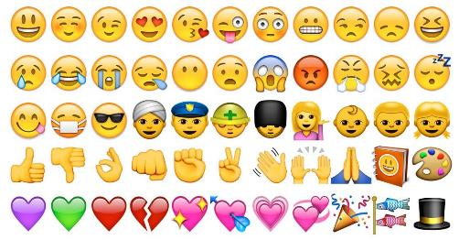
The history of Emojis
Watch the video The History of Emoji (00:04:52).
Read the article Emoji – Japan’s talking pictures.
Create a timeline in your visual design journal/blog detailing the evolvement of the emoji over time.
Notes:
https://getemoji.com/assets/og/mobile.png accessed 10/12/2017

Slide 5
Emojis use simple shapes and stylising.
They may include the whole object in profile or just a close up such as the face.
Notes:
http://all-that-is-interesting.com/wordpress/wp-content/uploads/2017/05/hobo-code-bricks.jpg accessed 10/12/2017

Slide 6
World Wildlife Fund - WWF
The WWF’s logo is one of the most iconic pictograms /emojis in the world.
They recently used emojis in an awareness campaign about endangered animals.
Activity -
Use the internet to find another company who used emojis in their advertising campaign.
Write a report on how effective it was.
Notes:
https://cdn0.tnwcdn.com/wp-content/blogs.dir/1/files/2015/05/Screen-Shot-2015-05-12-at-11.50.59-%E2%98%80%EF%B8%8F-1200x580.png accessed 10/12/2017

Slide 7
Cultural Emojis
In your visual design journal/blog, research and answer:
What are some examples of culture specific emojis?
Why are they important?
How are emojis culturally sensitive to varying skin colours and beliefs?
Could this be improved?

