Slide 1
Woven in time and place – visual resource
Creative arts curriculum team

Slide 2
Acknowledgement of Country
​The NSW Department of Education acknowledges the Traditional Owners and Custodians of the lands and waters on which we teach and learn. ​​
We pay respect to Elders past, present and future, for they hold the memories, culture, traditions and hopes of First Nations peoples. ​​
We celebrate First Nations peoples’ cultural and spiritual connection to Country. Their evolving traditions of art, music, dance and storytelling have inspired our learning and continue to enrich and guide our work.​

Slide 3
How to use this resource
This visual resource has been created to provide additional support for teachers and students in the delivery of the ‘Woven in time and place sample program’. It is designed to provide making models and samples to illustrate the intended outcome of the activities as well as tutorials for technical skill development in Adobe Photoshop image manipulation, collagraphs and weaving. Teachers are encouraged to use these samples and tutorials to support student learning. Please note the videos will only play in presentation mode.
The video tutorials are designed to provide teacher development, models and samples of the making activities to illustrate the intended outcome. It also includes tutorials for technical skill development in:
Adobe photoshop image collage
Adobe Photoshop image distortion
Setting up a loom
Weaving techniques

Slide 4
Introduction
01
Learning sequence 1

Slide 5
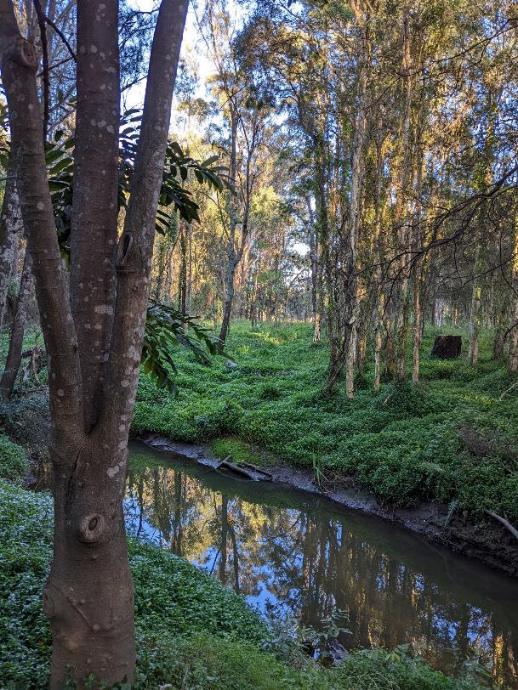
Activity 5 – Structural scavenger hunt sample 1
Guidelines
a focus on the natural environment
a focus on features of the landscape
leading diagonal lines
repetition of shape
contrasting textures
pattern of lines
emphasis of colour
a focus on compositional balance
a close up
a horizon
at least 8 different textures.

Slide 6
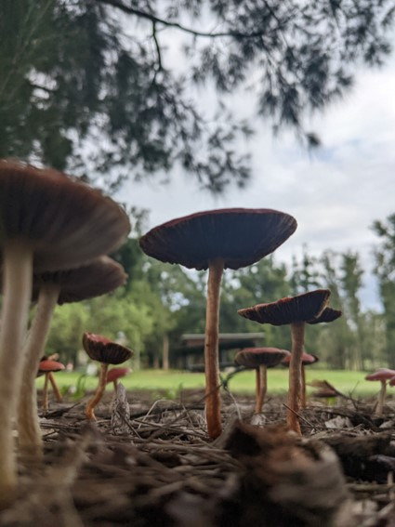
Activity 5 – Structural scavenger hunt sample 2
Guidelines
a focus on the natural environment
a focus on features of the landscape
leading diagonal lines
repetition of shape
contrasting textures
pattern of lines
emphasis of colour
a focus on compositional balance
a close up
a horizon
at least 8 different textures.

Slide 7
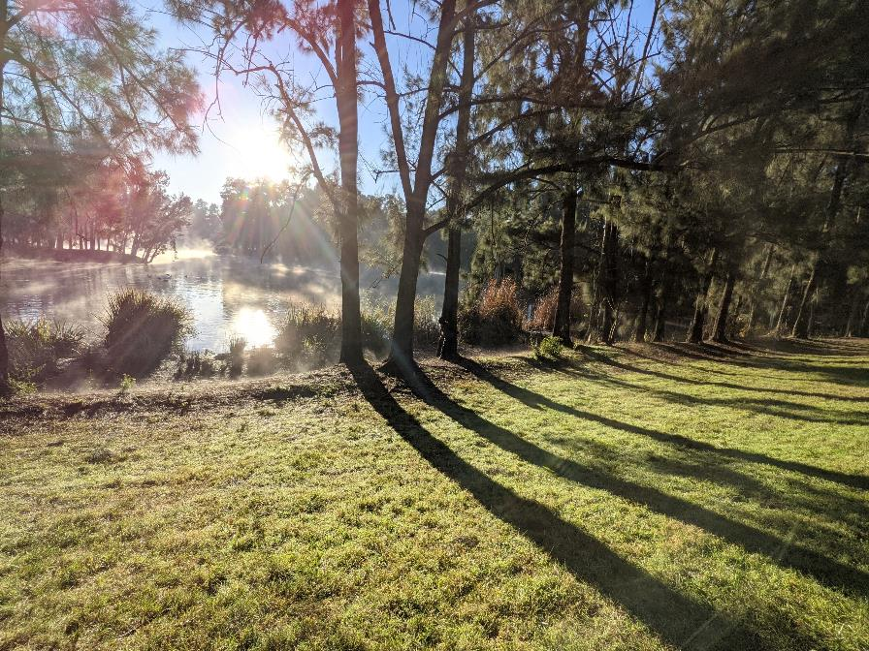
Activity 5 – Structural scavenger hunt sample 3
Guidelines
a focus on the natural environment
a focus on features of the landscape
leading diagonal lines
repetition of shape
contrasting textures
pattern of lines
emphasis of colour
a focus on compositional balance
a close up
a horizon
at least 8 different textures.

Slide 8
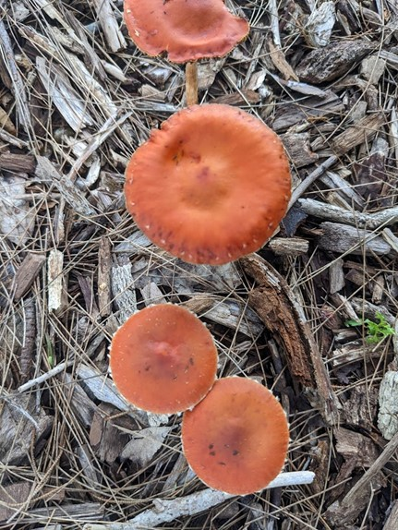
Activity 5 – Structural scavenger hunt sample 4
Guidelines
a focus on the natural environment
a focus on features of the landscape
leading diagonal lines
repetition of shape
contrasting textures
pattern of lines
emphasis of colour
a focus on compositional balance
a close up
a horizon
at least 8 different textures.

Slide 9
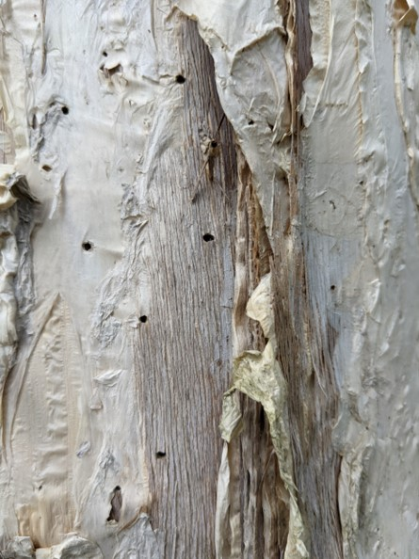
Activity 5 – Structural scavenger hunt sample 5
Guidelines
a focus on the natural environment
a focus on features of the landscape
leading diagonal lines
repetition of shape
contrasting textures
pattern of lines
emphasis of colour
a focus on compositional balance
a close up
a horizon
at least 8 different textures.

Slide 10
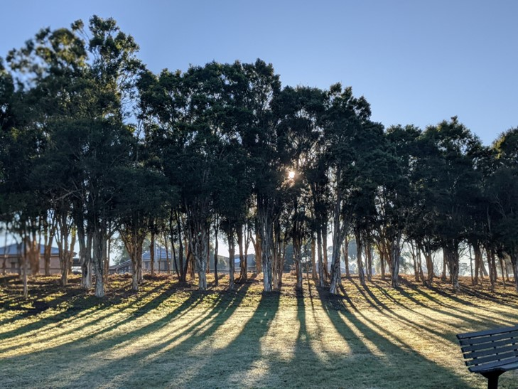
Activity 5 – Structural scavenger hunt sample 6
Guidelines
a focus on the natural environment
a focus on features of the landscape
leading diagonal lines
repetition of shape
contrasting textures
pattern of lines
emphasis of colour
a focus on compositional balance
a close up
a horizon
at least 8 different textures.

Slide 11
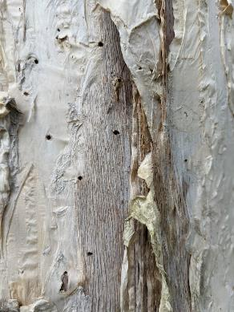
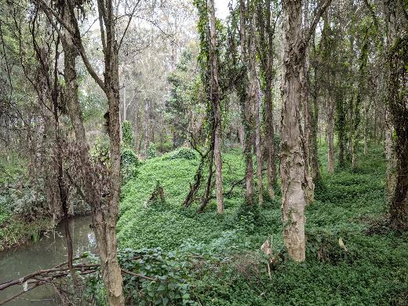
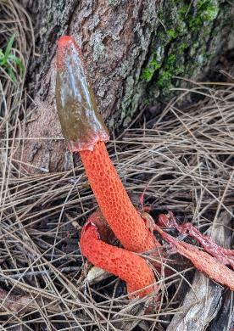
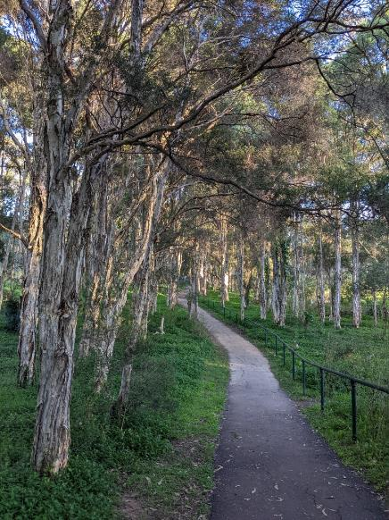
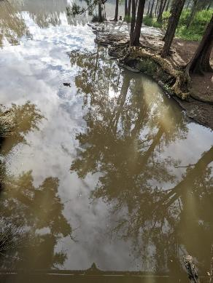
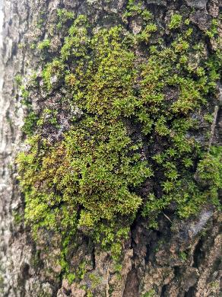
Activity 5 – Structural scavenger hunt sample 7
Guideline
At least 8 different textures

Slide 12
Distorting the landscape
02
Learning sequence 2

Slide 13
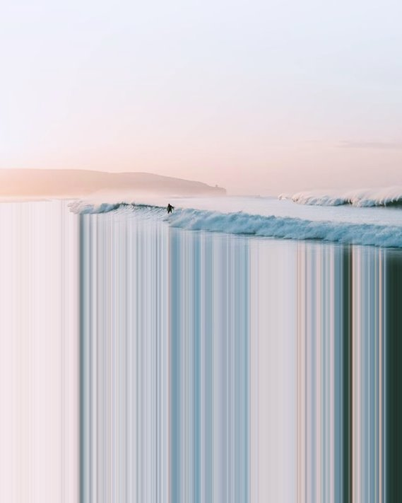
Activity 3 – Distorting images
Aim
Inspired by the digital artworks of Niall Staines, you are to create a partially distorted landscape. By blurring part of the image, you will create an abstract image of your chosen place that invites curiosity and questions from your audience.
Niall Staines (2020) B A I L [image] accessed 8/11/22

Slide 14
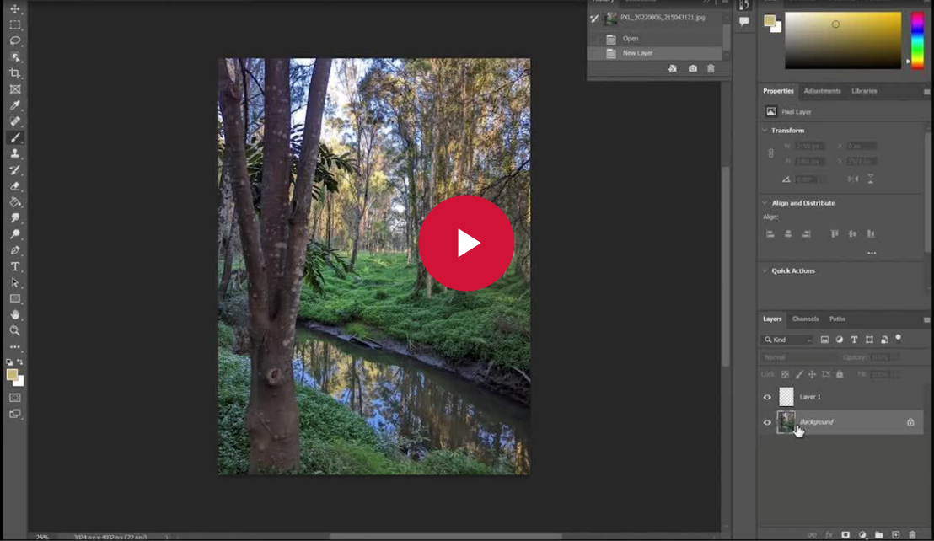
Distorted image tutorial
(duration 8:56 minutes)

Slide 15
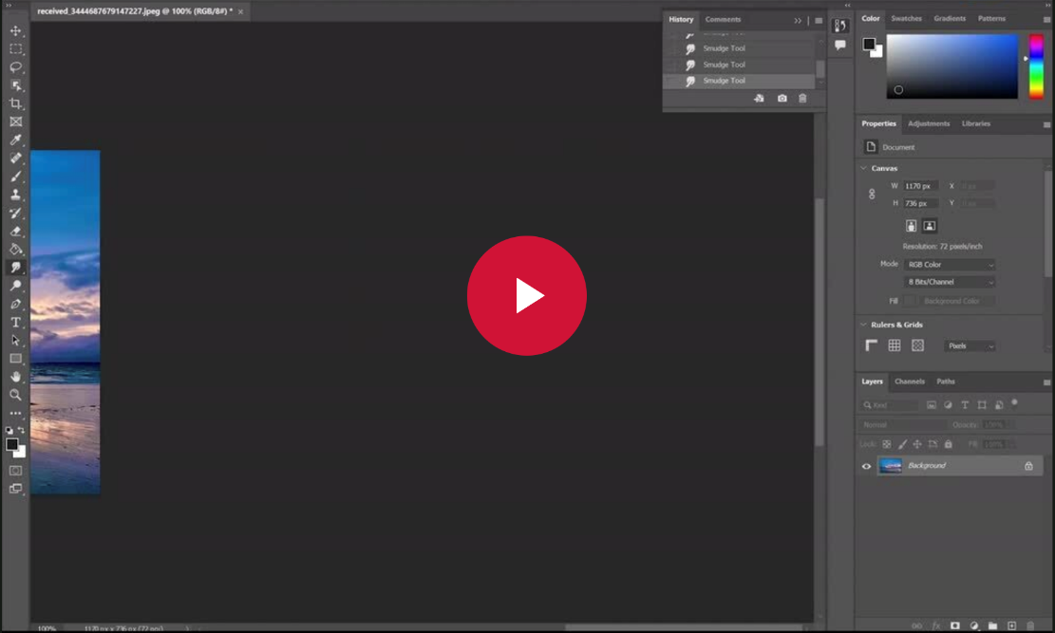
Distorted image Life skills tutorial
(duration 6:21 minutes)

Slide 16
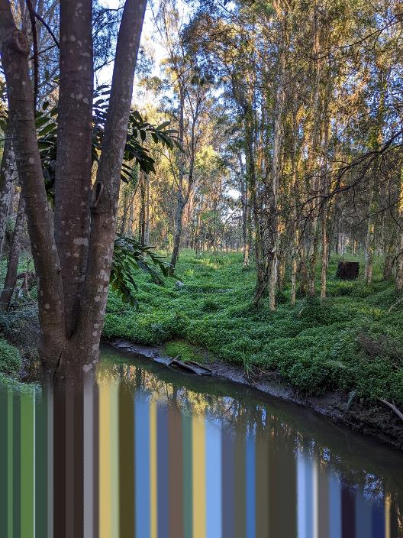
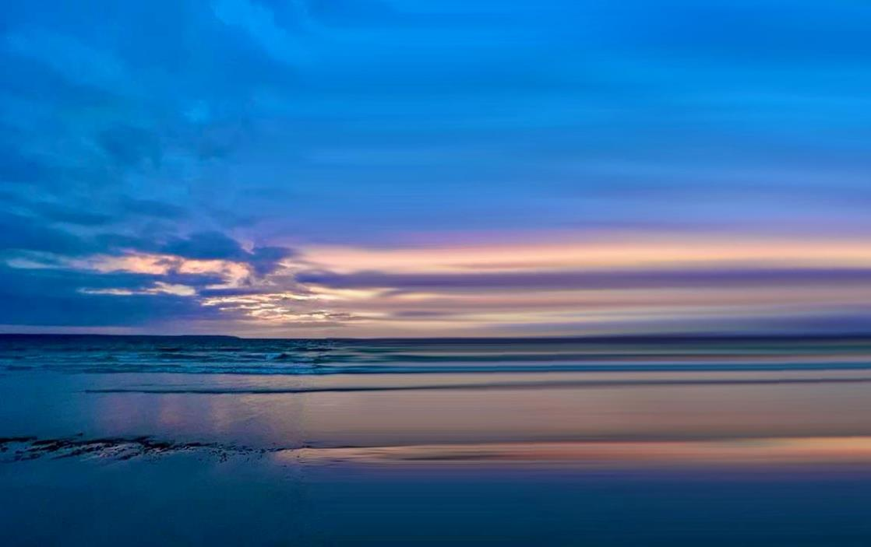
Activity 3 – Distorting images samples

Slide 17
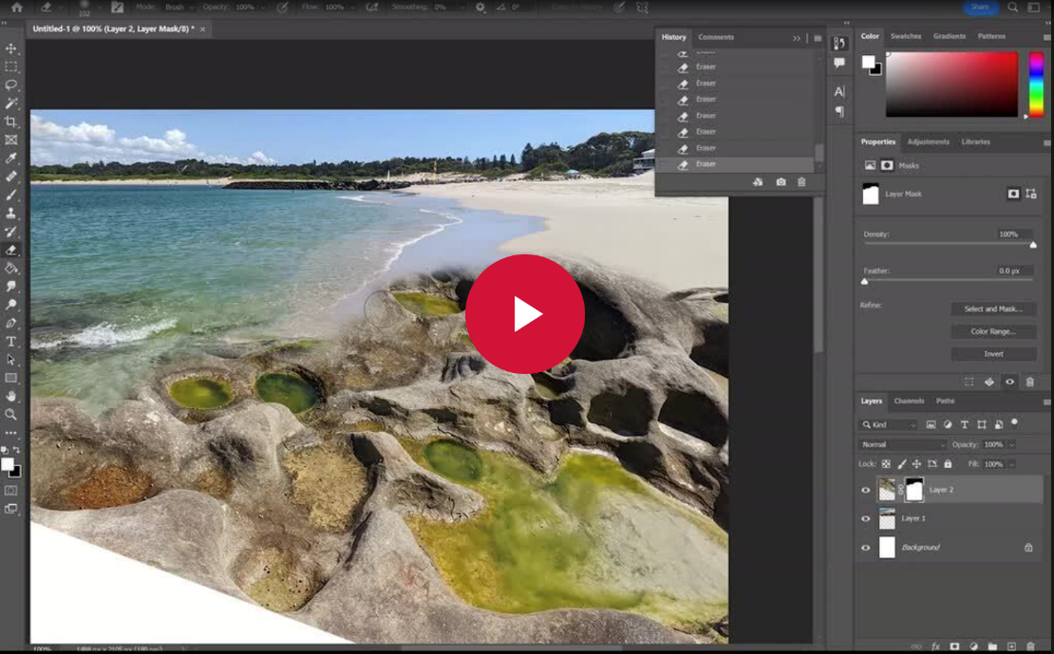
Activity 3 – Digital collage tutorial
(duration 18:37 minutes)

Slide 18
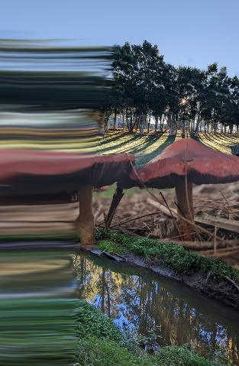
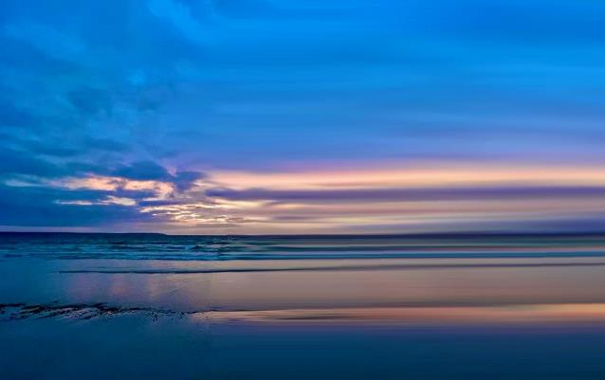
Colour palette samples
An additional activity to create colour palettes from your digital images is a great way to create and sustain colour across all of your design artworks so they work well when presented together for your assessment.
Colour palettes can easily be created during digital image manipulation. Here are 2 samples created by selecting colour pixels from the distorted images and painting a set of circles in this colour onto a new document in Adobe Photoshop.

Slide 19
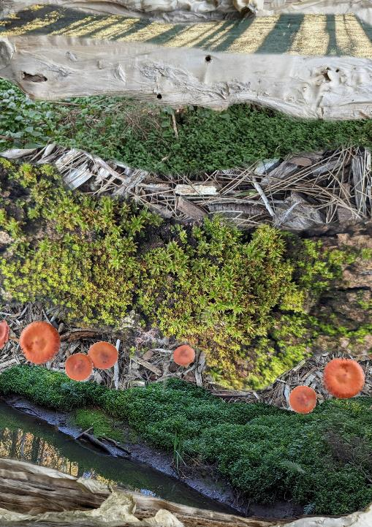
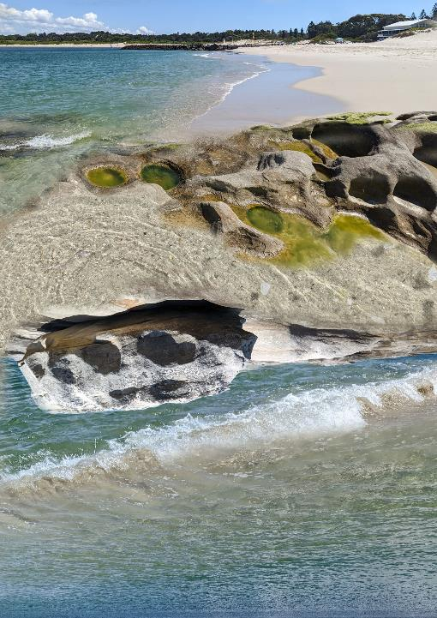
Activity 4 – Landscape collage samples

Slide 20
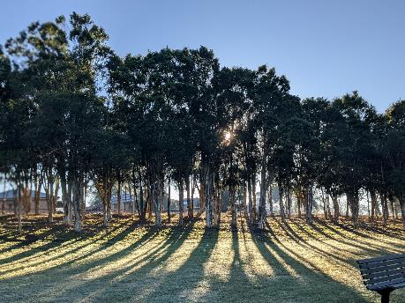
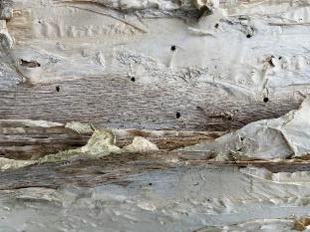
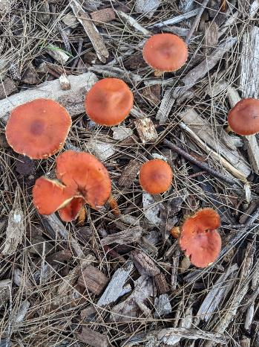
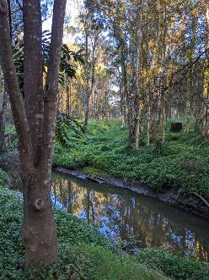
Activity 4 – Landscape collage annotated
Images repeated and rotated.

Slide 21
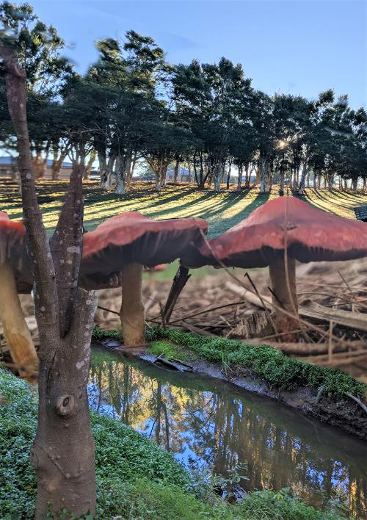
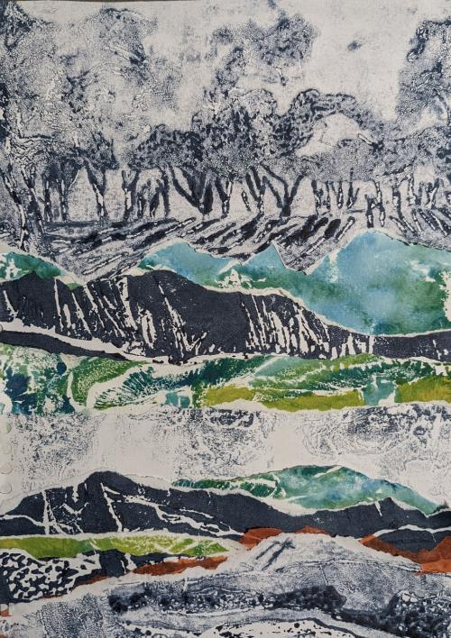
Activity 4 – Alternative collage samples
Digital collage created in Adobe Photoshop.
Paper collage created with torn up collagraph misprints and tissue paper.

Slide 22
Build and print the landscape with a collagraph
03
Learning sequence 3

Slide 23
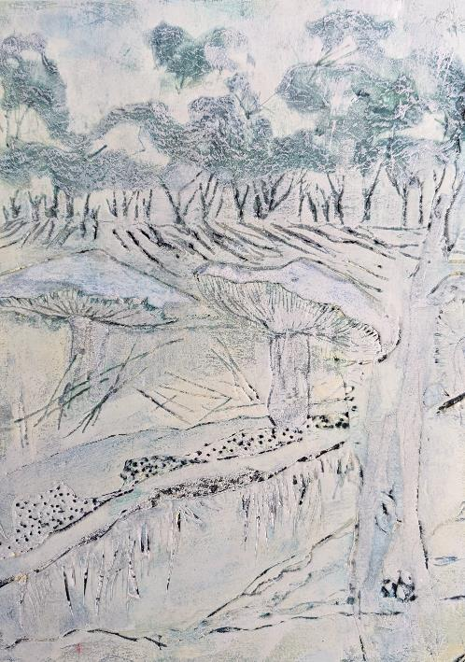
Activity 3 – Collagraph sample plate
Lines carved into foam core plate with sharp pencil.
Tree texture created with single ply toilet paper and PVA glue applied with a stiff brush in stippling motion.
Edge of shape carefully cut with scalpel and top layer of paper removed.
Ripped masking tape layered onto the foam core.
Dots created by pushing tip of sharp pencil or wooden skewer into foam core.
Top paper layer and foam removed with scalpel.

Slide 24
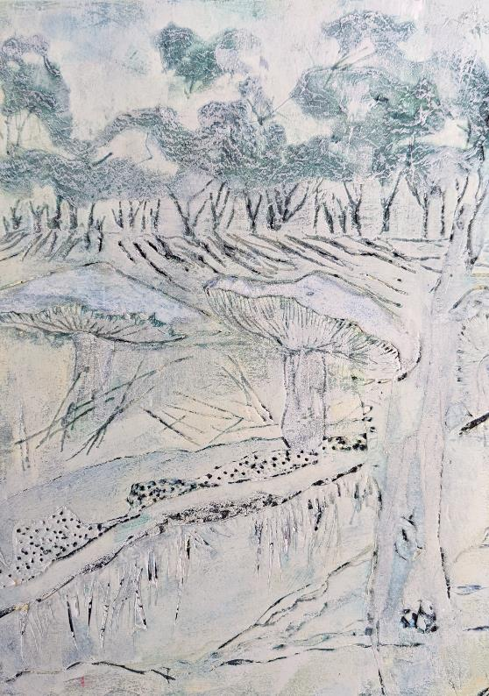
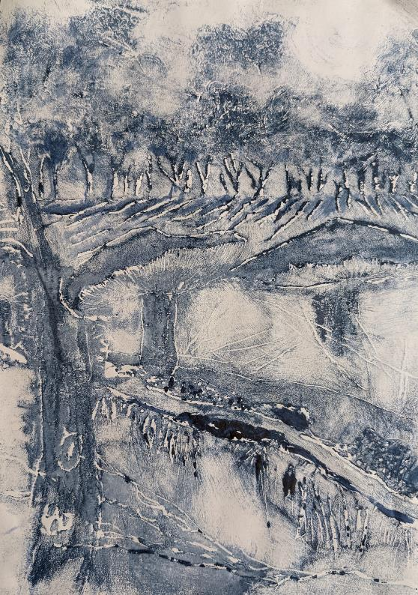
Activity 3 – Collagraph sample plate and print
To print your plate, seal with bitumen or varnish, leave to dry.
Roll plate with printing ink ensuring all crevasses are covered.
Rub the plate back with a swad of flattened newspaper/ magazine.
Dampen a heavy art paper, pat dry place on plate.
Burnish with a tool or spoon and hands and carefully remove paper from plate to reveal the print.
Foam core collagraph plate
Foam core collagraph plate print

Slide 25
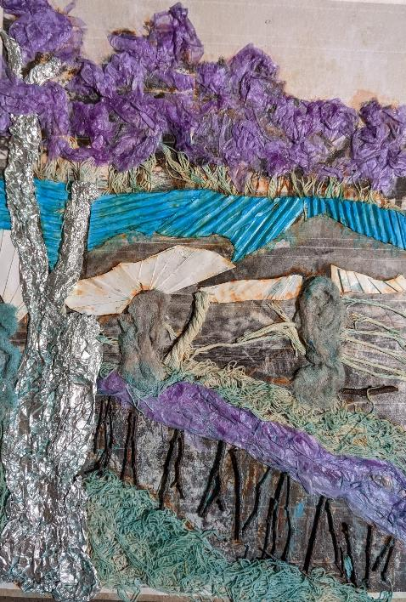
Activity 3 – Mixed Media collagraph sample plate 2
Crumpled tissue paper and PVA glue.
Cotton string.
Crumpled aluminium foil and PVA glue.
Corrugated cardboard.
Twigs from the landscape and PVA glue.
Folded paper.
Cotton netting and PVA glue.
Make sure you seal the plate with a varnish or bitumen before printing.

Slide 26
Weaving the landscape
04
Learning sequence 4

Slide 27
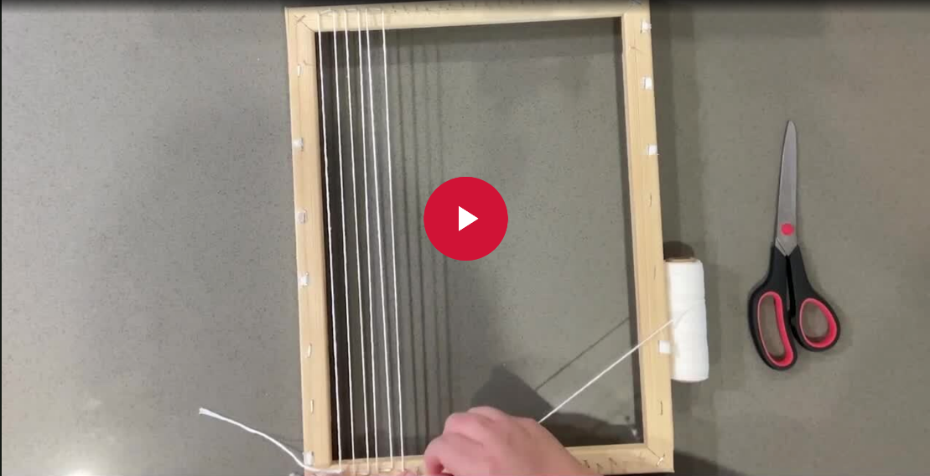
Activity 2 – Setting up a loom tutorial
(duration 3:40 minutes)

Slide 28
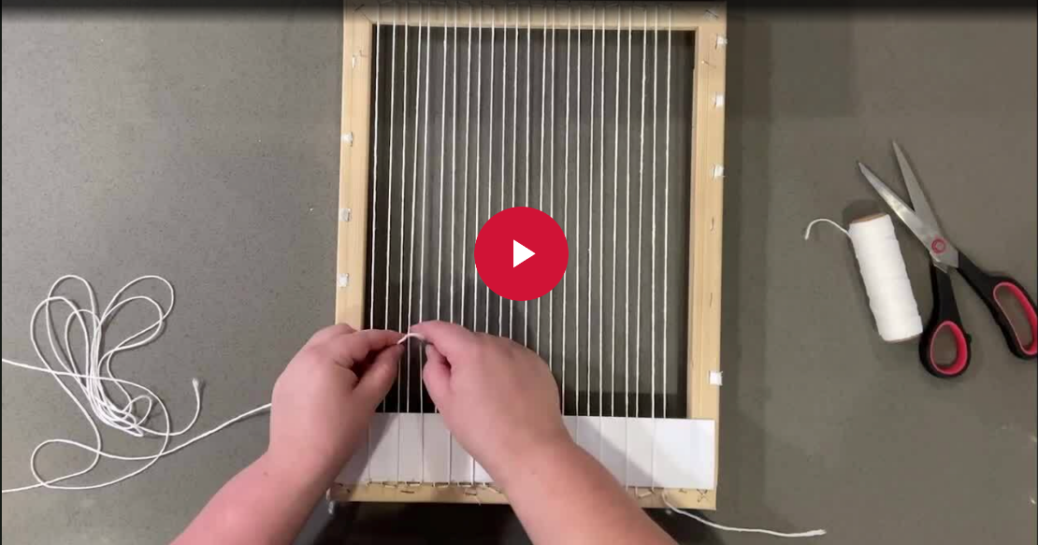
Activity 2 – Start your weaving tutorial
(duration 6:40 minutes)

Slide 29
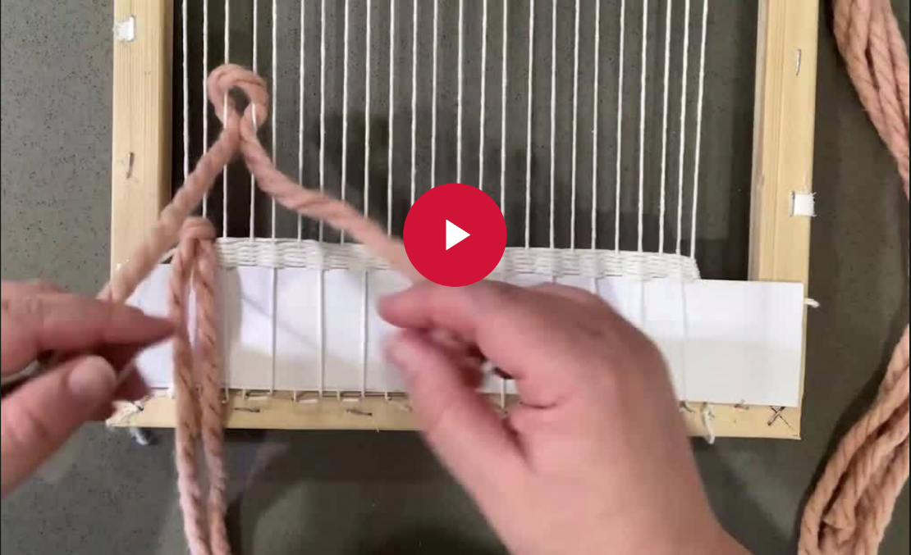
Rya knot fringe – weaving technique
(duration 5:34 minutes)

Slide 30
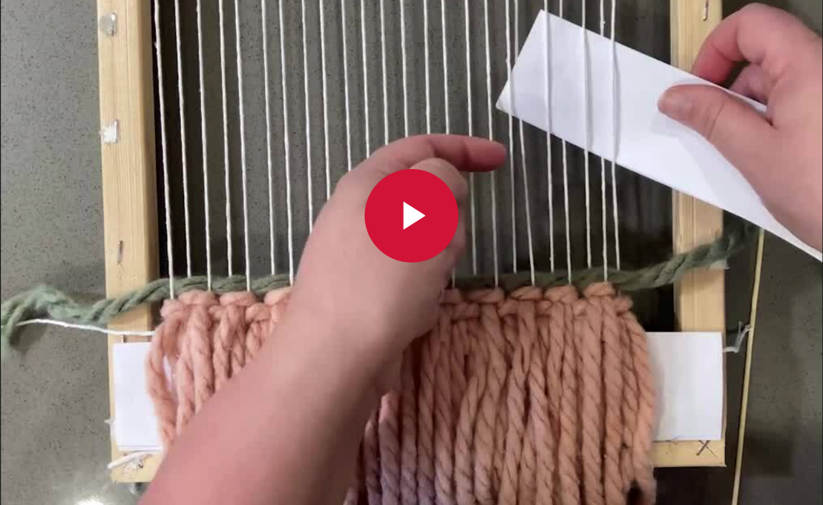
Plain or tabby stitch – weaving technique
(duration 4:06 minutes)

Slide 31
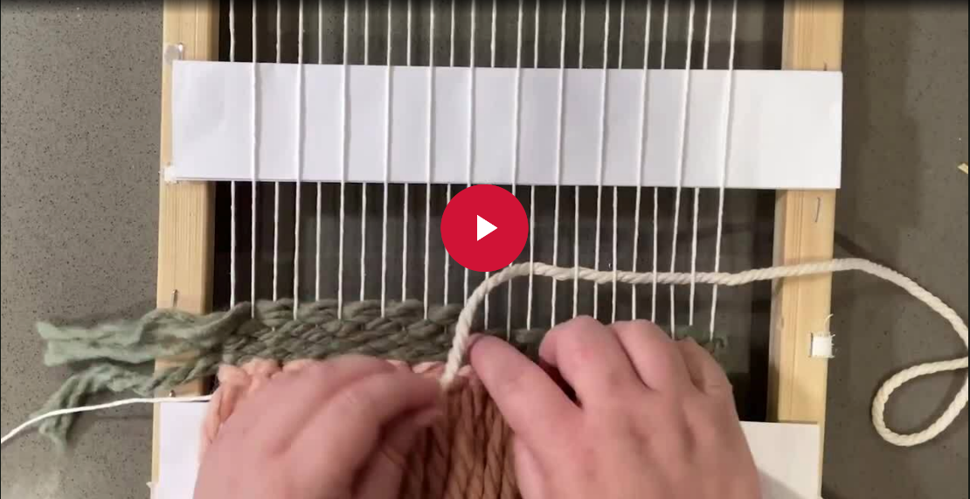
Interlocking – weaving technique
(duration 1:51 minutes)

Slide 32
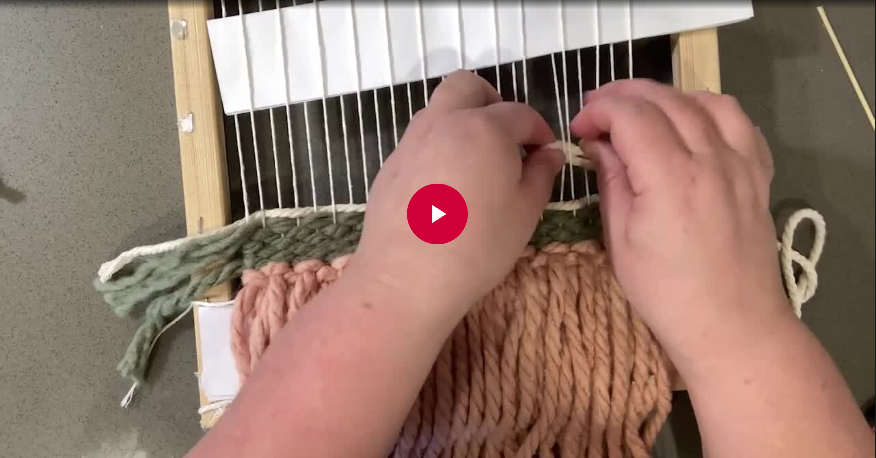
Basket stitch – weaving technique
(duration 2:40 minutes)

Slide 33
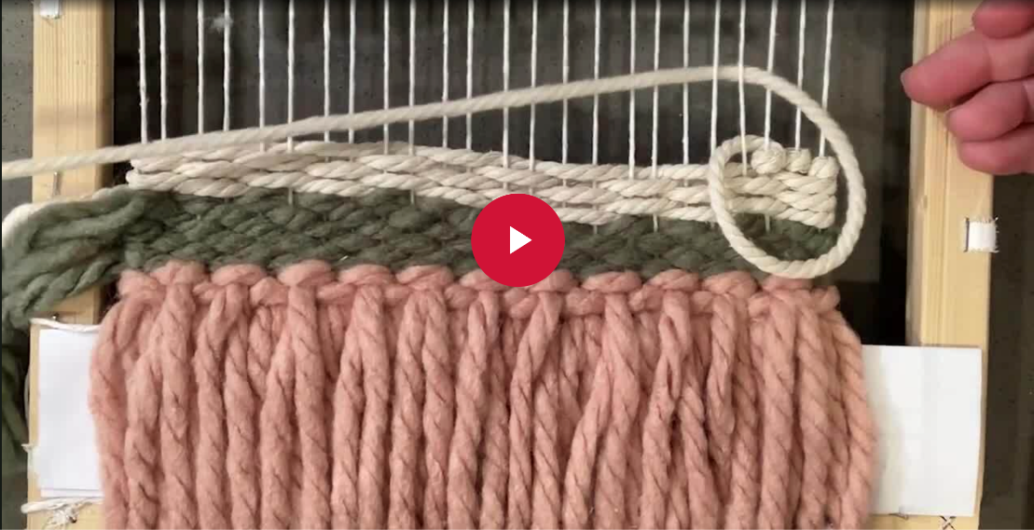
Knot stitch – weaving technique
(duration 2:59 minutes)

Slide 34
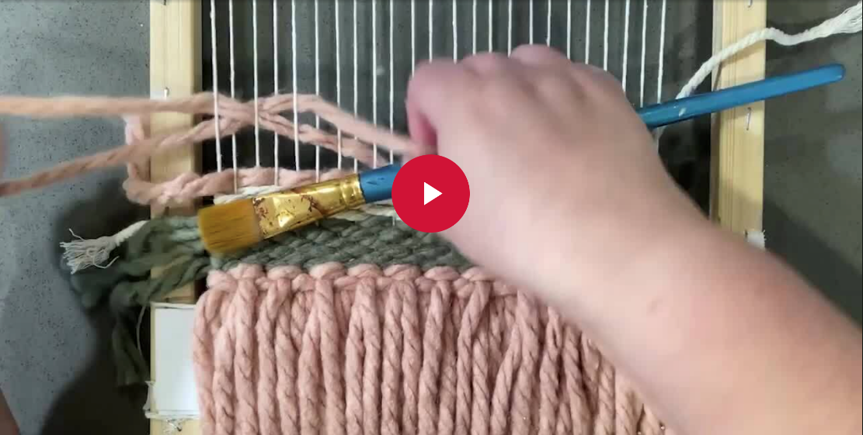
Bubble stitch – weaving technique
(duration 6:35 minutes)

Slide 35
Rya loop stitch – weaving technique
(duration 3:05 minutes)

Slide 36
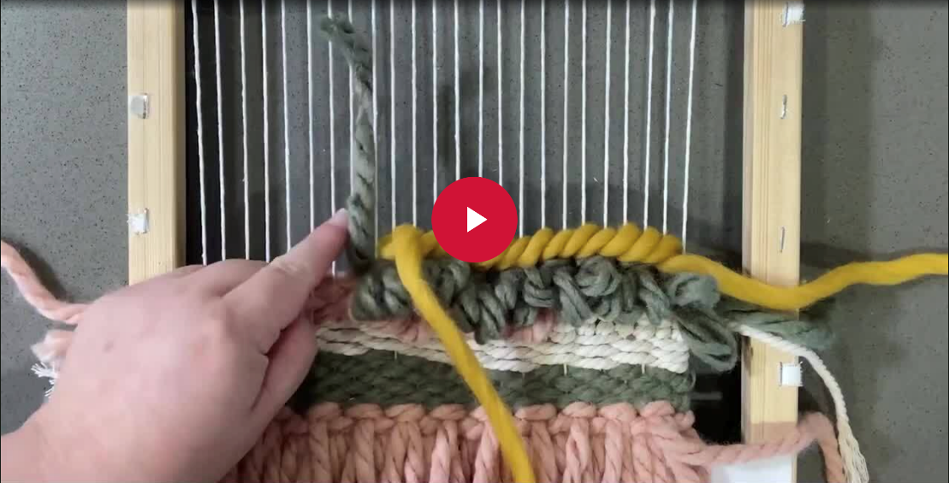
Plait stitch – weaving technique
(duration 4:30 minutes)

Slide 37
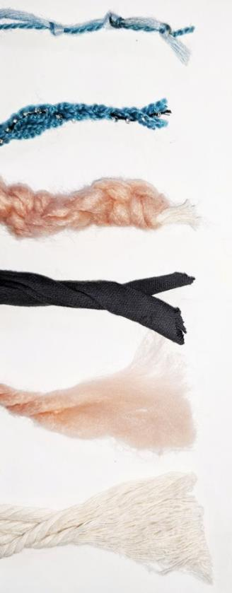
Activity 3 – Thread curation and experimentation
4 ply yarn with cotton thread, tied in knots at random intervals
2 x 4 ply yarn plated with a strand of beaded cotton
4mm macrame cord with vertical larks head knots in a thick yarn
2 x T-shirt string/yarn twisted together
Thick yarn brushed with comb until fluffy
3 x 4 mm macrame cord combed

Slide 38
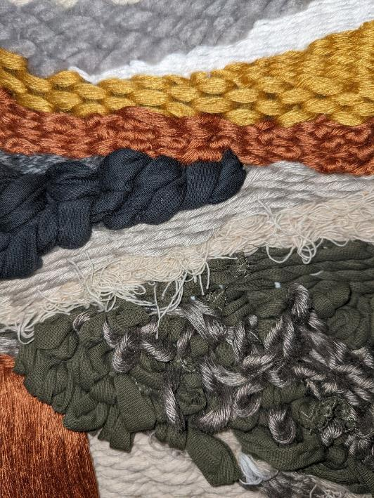
Annotated weaving sample – part 1
Plain or tabby stitch in thick yarn.
Plain or tabby stitch in cotton thread.
Plain or tabby stitch in cotton thread with knots tied at random intervals.
Plait stitch in thick t-shirt string.
Basket stitch in colon thread.
Plain stitch in cotton mesh.
Rya loop stitch in thin t-shirt string and grey cotton.
Rya knot fringe brushed in cotton thread.

Slide 39
Annotated weaving sample – part 2
Plain or tabby stitch in thick yarn.
Plain or tabby stitch in cotton thread.
Plait stitch in thick t-shirt string.
Plain or tabby stitch in cotton thread with knots tied at random intervals.
Plain stitch in cotton mesh.
Basket stitch in colon thread.
Rya knot fringe brushed in cotton thread.
Rya loop stitch in thin t-shirt string and grey cotton.

Slide 40
The weaving process
05
Sample images

Slide 41
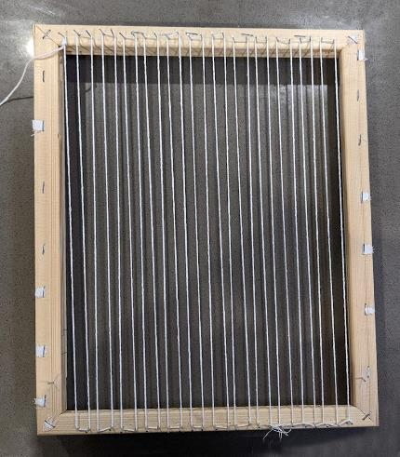
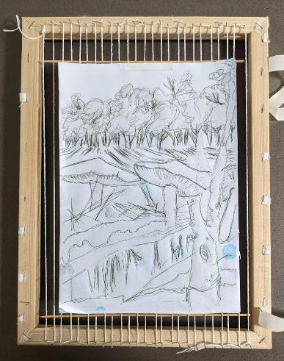
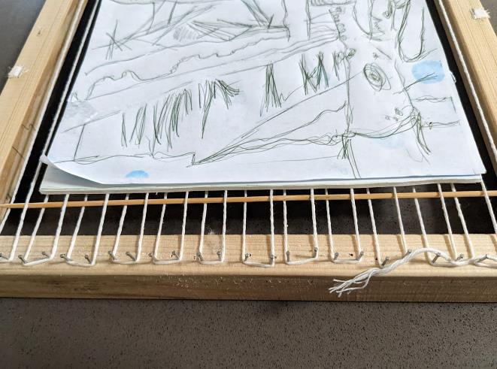
The weaving process – sample images 1
1. Prepare the loom with a non-stretching cotton thread to create the warp.
2. Use an A4 piece of paper to mark the size on your loom with cardboard or skewered held by masking tape to show the top and bottom parameters. Make sure there is enough warp left at the bottom to cut and tie off at the end of the process.
A loom with warp ready.
Loom with skewer markers woven into warp at the top and bottom of an A4 piece of paper to mark the top and bottom ends of weaving on warp.
Detail image - Loom with skewer markers woven into warp at the top and bottom of an A4 piece of paper to mark the top and bottom ends of weaving on warp.

Slide 42
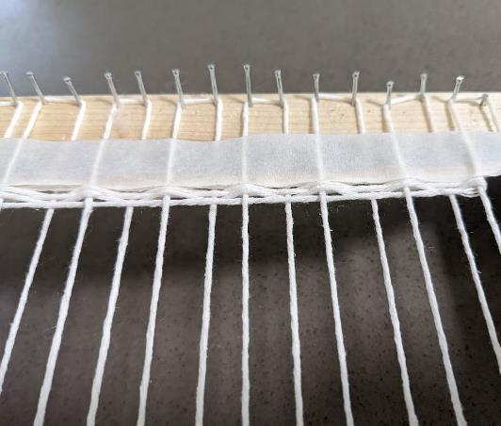
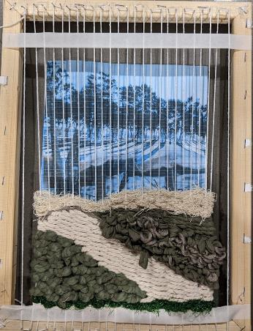
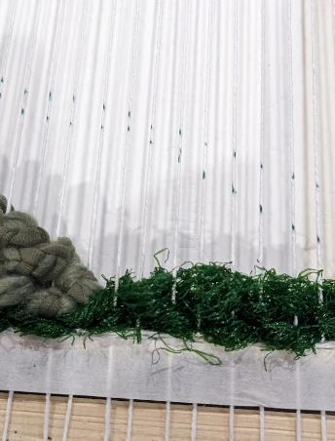
The weaving process – sample images 2
3. Complete 8-10 rows of a plain weave at the bottom of the loom, above the skewer or cardboard marker.
4. You can lay your design underneath the loom and use a marker to mark each section with guiding dots on the warp.
Close up image of masking tape holding skewer in place on loom, with rows of plain weaving stitch at the bottom.
Printout of weaving design positioned underneath loom warp, with weaving partially completed.
Detail image of warp marked with dots to indicate where the next 2 sections of weaving ends.

Slide 43
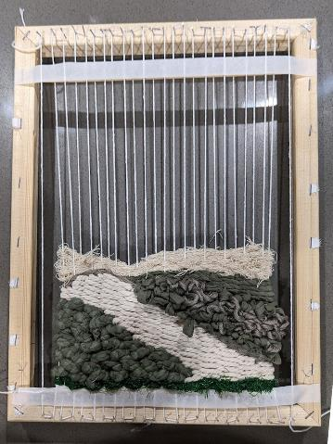
The weaving process – sample images 3
5. Add one section of weaving to your loom working from the bottom upwards. Try to avoid tight tension that pulls in warp in (middle image).
6. Errors can be undone or sections can be slide up or down the warp to create space for additional sections.
7. Finish your weaving with another 10 rows of plain weave stitch before removing from the loom.

Slide 44
Sample abstract landscape weavings

Slide 45
Assessment Part B – sample 1
Set of 3 related works representing the same landscape.

Slide 46
Assessment Part B – sample 2
Set of 3 related works representing the same landscape.

