Slide 1
Manipulating the elements of dance in composition

Slide 2
We will explore the elements of dance:
space
time
dynamics.

Slide 3
Space
Space is defined as the area in which the body moves. In dance, space refers to the personal, general and performance space used by the dancing body.
How we use the aspects of space and how we combine them makes our work unique.
The space used in a dance work needs to relate to the intent of the composition.
The use of space helps define the relationships between dancers. The spatial relationships we create gives our work meaning.

Slide 4
The areas of space
You must consider these areas of space when developing your composition.
Level
Direction
Dimension
Plane
Shape
Floor pattern
Stage space, personal space, general space.

Slide 5
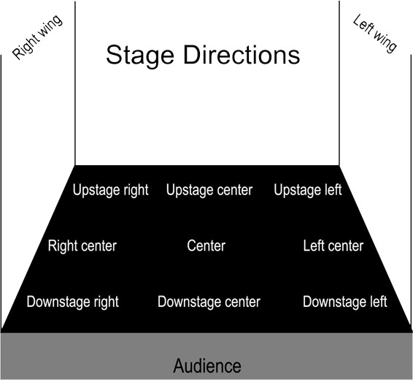
Stage space
Centre stage draws the focus of the audience and can be seen as a powerful position.
Dancers performing upstage may be viewed as a background to a focus on a dancer downstage.
A dancer performing downstage can connect more intently with an audience.
Diagonal pathways are aesthetically pleasing from an audience point of view.
Notes:
Image one: https://klmstheatre.files.wordpress.com/2013/07/stage-directions-diagram.jpg

Slide 6
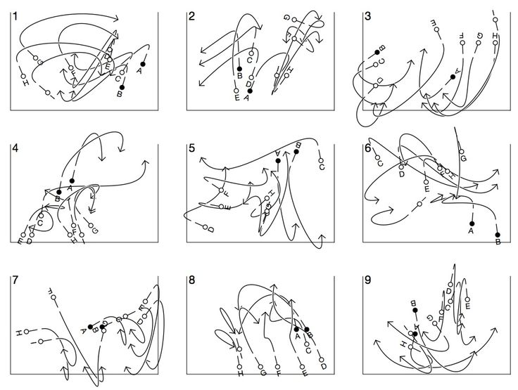
Floor pattern
In order to make a dance work interesting the choreographer needs to plan the direction of the dance and this is called a floor pattern.
The choreographer can create many possible floor plans, that help reflect their intent.
Notes:
Image one: https://i.pinimg.com/736x/91/9c/c2/919cc24a7141c5fe122f64d724ef483a--dance-choreography-contemporary-dance.jpg

Slide 7
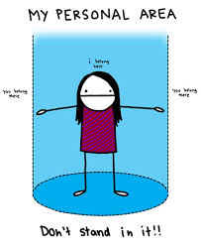
Personal, general and performance space
Personal space is the space around the body, also known as the kinesphere.
General space is the space beyond your body that you move through when you dance.
Performance space is the entire stage space in which you dance/choreograph.
Notes:
Image one: http://weknowmemes.com/wp-content/uploads/2014/06/my-personal-area.jpg

Slide 8
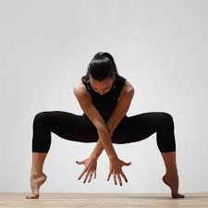
Shape
Shape in dance can refer to the individual body shapes and also group shapes or formations.
Shapes are present in all actions in dance. If you captured a movement sequence in single frame, you would see that the body moves through a number of identifiable shapes.
When composing choreography you need to consider the types of shapes that you can use. Different shapes can reflect different things or abstracted ideas.
Notes:
Image one: https://www.shape.com/sites/shape.com/files/styles/facebook_og_image/public/workout/305-dance-workout_0.jpg

Slide 9
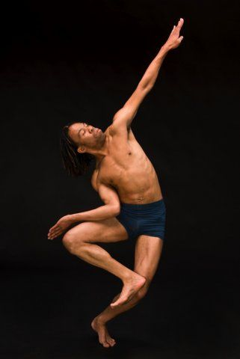
Types of shapes
Straight / Angular:
Straight and angular lines cut the kinesphere cleanly and create dramatic relationships between the body and the space. They are often open shapes.
Straight lines are not naturally assumed by the body, so what do you think straight shape could reflect?
Curved:
Curved shapes can also be referred to as organic shapes. Curving or organic shapes and lines can suggest things in nature, and create a soft and sympathetic relationship with the stage space.
Curved shapes are more naturally assumed by the body.
Notes:
Image one: https://i.pinimg.com/736x/37/bf/92/37bf9225faa7f2d5c11f4b2c0d5127b4--dance-images-dance-pictures.jpg

Slide 10
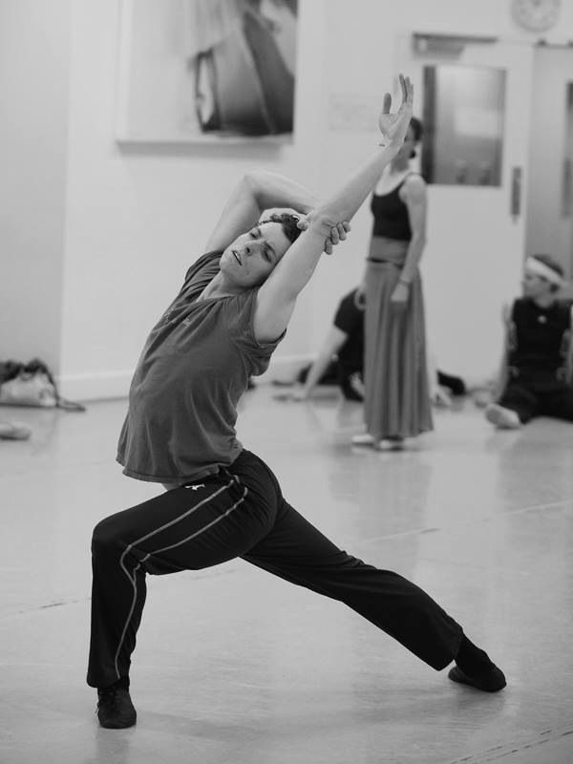
Types of shapes
Open:
Extended positions of the body create open shapes. These shapes allow the free flow of space around the body and are larger in size than closed shapes.
Open shapes suggest freedom, lack of restriction, confidence, joy, spiritedness.
Closed:
These shapes are solid and use less space within the kinesphere.
Closed shapes suggest restriction. Avoidance, shyness, cowardice.
Notes:
Image one: https://i.pinimg.com/736x/2d/2f/30/2d2f309b70033a4e3b3297b48b16d5ac--kevin-oleary-closed.jpg

Slide 11
Types of shapes
Twisted
A twisted shape is when the body or the limbs are twisted.
Asymmetrical
If the shape was split down the middle it would be different on each side.
Symmetrical
If the shape was split down the middle the shape would be identical on each side.
Watch So you think you can dance- Dead and gone and discuss the use of shape to explore the intent

Slide 12
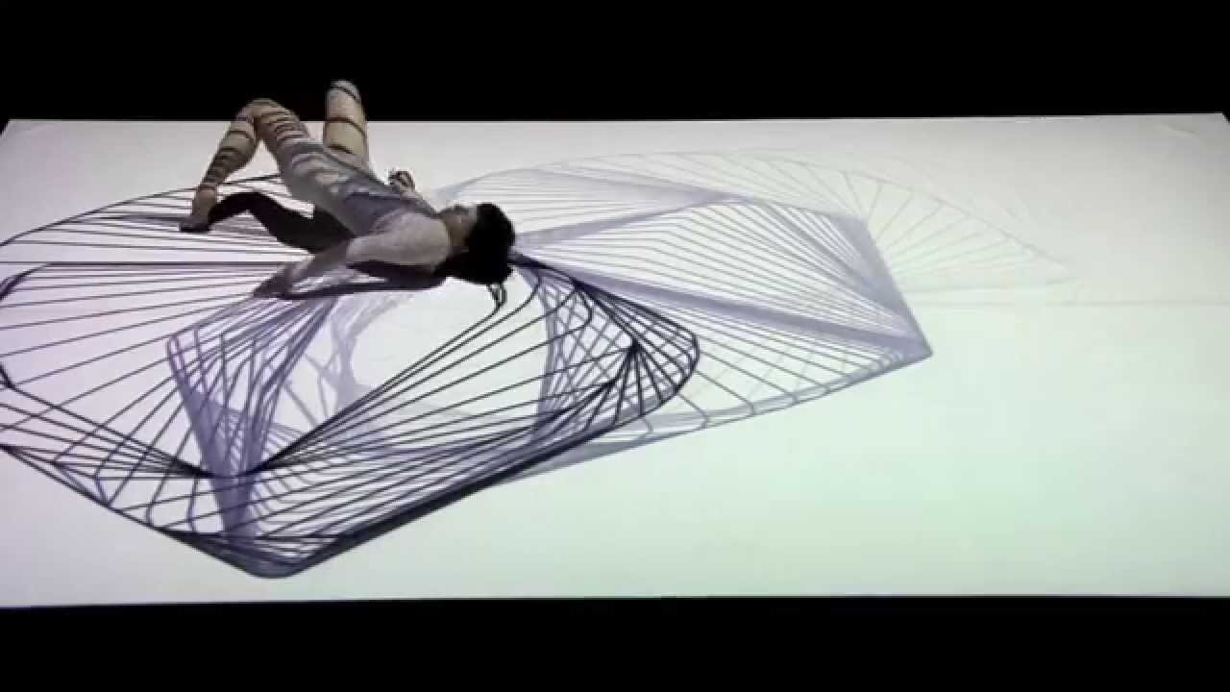
Level
Level in dance refers to where the body moves in space relative to the ground.
Low
Medium
High
Look at the work Biennale Danza by Chunky Move and write a TEEEC paragraph on how they have effectively and specifically used level and shape.
Notes:
Image one: https://i.ytimg.com/vi/2AautwIOON8/maxresdefault.jpg

Slide 13
Direction
Direction in dance is the line taken by the body.
Direction can refer to shapes, movements and sequences of movements.
Direction can create meaning, for example changing direction of a shape can create a different effect for the audience.
Notes:
Image one: https://i.ytimg.com/vi/2AautwIOON8/maxresdefault.jpg

Slide 14
Dimension
Dimension is the size of the shape of movement. It describes the height, width and depth of a body shape and movement in dance.
Aspects of dimension
Size- small, large, narrow, wide.
Planes
Use of the kinesphere- two and three dimensions.
(Two dimension means the shape can be described in terms of height and width and three dimension means the shape can be described in three dimension; height, width and depth.)
Notes:
Image one: https://i.ytimg.com/vi/2AautwIOON8/maxresdefault.jpg

Slide 15
Analysis
Watch So you think you can dance- Jar of hearts and write a TEEEC paragraph analysing the use of space in the work. Make sure you explore shape, level, direction and stage space within your analysis.

Slide 16
Time
You must consider these areas of time when developing your composition:
tempo
duration
momentum
regular/irregular
accent
natural rhythms
stillness
Discuss how you could alter these in your composition? How could you enhance the meaning of your composition by altering the aspects of time?
Perform a phrase of movement and alter the aspects of time. Perform this for the class and discuss what alterations worked and why.

Slide 17
Dynamics
Dynamics is one of the elements of dance. It gives movement life and meaning. Dynamics refers to the force, energy, effort or weight applied to movement. Consider the following dynamics when creating your work:
weight/force
release of energy.

Slide 18
Dynamics
Adjectives to describe dynamics:
sudden
slow
strong
sag
forceful
sustained
collapse
swing
List 10 more adjectives to describe dynamic movement.
Weight and Force:
weight gives movement a sense of lightness or heaviness in movement.
force is the intensity of the movement.

Slide 19
Dynamic qualities
Percussive – Sharp, forceful, staccato, abrupt, start, stop.
Sustained – Flowing, smooth, continuous.
Swinging – Swaying, circling, fall and recovery, wheeling.
Suspended – Hanging, frozen, floating, hovering, teetering.
Collapsing – Falling, contracting, sinking, giving into gravity.
Vibratory – Flickering, shaking, trembling, quivering.

Slide 20
Dynamic examples
Each of the following works successfully use dynamic qualities in their performances, however, each explore these differently.
Watch So you think you can dance- The moment I said it and discuss the successful use of the dynamic qualities, giving examples from the work.
Watch So you think you can dance- Ave Maria and write a TEEEC paragraph on how effective dynamic qualities are to a performance.
Watch So you think you can dance- Alice in Mia-Land and analyse the effectiveness of dynamic qualities to this performance.

