Slide 1
A History of the Theatre
And Realism in ‘A Doll’s House’ by Henrik Ibsen

Slide 2
GREEK THEATRE (From 7th Century B.C.E)
Greek theatre was created to celebrate religious festivals.
A chorus was used to either sing or chant the script.
It is unknown if Thespis was a playwright, an actor or a priest, but he has been credited for creating the “first actor” who broke away from the chorus and would speak to the chorus as an individual character. This is why actors are also known as “Thespians”.
This lead to the creation of character.
Masks were used to allow the actors to play more than one character.

Slide 3
Greek Theatre – The creation of Character
The following playwrights contributed to the creation of character:
Aeschylus introduced the idea of using a second and third actor which allowed for interaction between characters.
Sophocles continued the creation of character by using the chorus less, and creating more dialogue between characters.

Slide 4
ROMAN THEATRE (From approximately the 4th Century B.C.E)
The Romans were greatly influenced by Greek Theatre.
The word “play” comes from the Latin word “ludus” which means recreation or play.
The Roman playwright Terence introduced the concept of a subplot allowing the audience to contrast the reactions of different characters to the same events or circumstances.
Roman Theatre was less influenced by religion than Greek theatre.

Slide 5
ROMAN THEATRE
The audience was often loud and rude. The audience did not applaud, but rather were always shouting insults and booing.
Since the audience was so loud, much of the plays were pantomimed and repetitive.
The actors developed a code which would tell the audience about a character just by looking at them.
For example:
A black wig: the character was a young man
A red wig: the character was a slave.
A yellow robe: the character was a woman
A yellow tassel: the character was a god.

Slide 6
Medieval European Theatre (began in the 5th Century)
After the fall of the Roman Empire, cities were abandoned and Europe became increasingly more agricultural.
After several hundred years, towns re-emerged.
The Roman Catholic Church dominated religion, education and politics. It also had a strong influence on theatre.
Theatre was “reborn” as “liturgical dramas” which were written in Latin and performed by priests or church members. Plots were taken from the Christian Bible.
Performances also were held to celebrate religious festivals (as in Greek times)

Slide 7
Medieval European Theatre
Later “vernacular dramas” were written in common language (therefore everyone could understand).
These plays were performed in town squares on wagon stages.
There were three types of “vernacular dramas”:
Mystery plays – based on the Old and New Testament
Miracle plays – based on the lives of the saints
Morality plays – taught a lesson through symbolic characters representing virtues or faults.

Slide 8
Commedia Dell’Arte (began in the 14th Century)
In Italy, a unique form of theatre was created for the common people – “Commedia dell’Arte”.
Commedia dell’Arte required few props and no sets.
The plays did not come from scripts but by “scenarios” which were an outline of a plot.
The actors improvised the dialogue with comedic stunts (called lazzi).
Actors wore half masks which indicated to the audience which character they were playing (Just like the Greeks).
A Commedia troupe typically consisted of 10 to 12 members, a few of which were women
Plays were based on stock characters, for example:
Pantalone, an elderly Venetian merchant (Mr.Burns)
Arlecchino, a servant who was a trouble maker (Bart)

Slide 9
Renaissance and Reformation (began in the 15th Century)
Further contributions to Theatre were made by Italians through the development of the proscenium, or “picture frame stage”.

Slide 10
Renaissance and Reformation England’s Contribution
In England, “apron stages” were used which created a more “open” stage.
Audience members surrounded the stage, and sometimes sat on the stage.
The emphasis in plays was on the dialogue. Plays also continued to have moralistic themes.
Later, religious themes were replaced by themes of loyalty to the government.
Performers were organised into troupes or companies who developed a repertory of plays that they could perform.

Slide 11
Renaissance and Reformation England’s Experience
In the 16th Century, England’s government swung back and forth from Catholicism to Protestantism.
Playwrights who worked to revive plays written in Latin, were believed to be supporting the Catholic Church.
Playwrights who worked to revive Greek plays were associated with Protestantism.
Depending on who was in power at the time, a playwright could be put to death for reviving the “wrong” play.
Many playwrights began to avoid the revival of classic work, and wrote non-political and non-religious plays.

Slide 12
Renaissance and Reformation Theatre is Threatened
The political problems in England at the time made theatre “dangerous”.
Civil unrest could be inspired by performances.
Theatres were also associated with the temptation to spend time watching performances instead of working.
Theatres were also associated with prostitution since prostitutes would be in the area where plays were performed, and sometimes were even in the audience.
Added to the political problems, fear of the plague closed theatres.
These conditions lead to the licensing of acting companies which lead to more control of theatre by the state.

Slide 13
Elizabethan Theatre (16th Century) A Theatre “God” is Born
William Shakespeare is the most notorious playwright in the history of theatre.
During this time period, there are other notable playwrights including: Christopher Marlowe and Ben Jonson.
Shakespeare and his contemporaries encouraged a more natural style of speaking and acting. They also explored the theme of “good government”.
Shakespeare’s characters were also more “human” with both positive and negative aspects of their character being explored.
During this time, plays were still presented in open-air theatres or, at times, presented at court.

Slide 14
The Republic and The Restoration (Approximately began in the 17th Century)
In 1642, the English Parliament closed all the theatres in England.
Many English actors fled to France.
Theatre in France began to focus on scenery and creating spectacle.
Plays now included costume, dance and clever scenery which also required scene changes. These aspects of theatre were more emphasised than the acting or the plot.
Theatres also used the proscenium style of stage, where the acting took place on the forestage and the stage behind the proscenium was used to display the scenery.
The French also allowed women to perform on stage. (When Theatre returned to England in 1660, women were allowed on stage there too, due to the French influence).

Slide 15
18th Century Theatre
In the 18th Century, theatre became a popular pastime.
During the first half of the 18th century, actors assumed poses and performed their lines in a “sing-song” manner.
Actors dressed in modern, fashionable clothes.
There was a rivalry between actresses as to who would wear the finest dress.
Pantomime was still popular and promoted the development of spectacular staging, slapstick and special effects.

Slide 16
18th Century Theatre David Garrick
Garrick is one of Britain’s greatest actors and the first to be called a star. From 1741 until his retirement in 1776, he was a highly successful actor, producer and theatre manager. He wrote more than 20 plays, and adapted many more (including plays by Shakespeare)
Garrick emphasised a more natural form of speaking and acting that mimicked life.
This form of acting inspired the movement towards realism and naturalism in theatre.
Garrick “banished” the audience from the stage, and actors now performed among the furnishings and scenery.
Plays began to be written about ordinary people.
This could also explain why theatre become more commercial, since it could reach a wider audience.

Slide 17
19th Century Theatre Lighting and Stage Advancements
The Industrial Revolution of the 19th Century changed theatre as well.
Gas lighting was first introduced in 1817 in London’s Drury Lane Theatre.
By the end of the century, electrical lighting made its appearance on stage.
Elaborate mechanisms for changing scenery were developed, including fly-lofts, elevators, and revolving stages.

Slide 18
19th Century Theatre Melodrama
The poor quality of lighting and the advances in set design lead to a theatre style which emphasised action and spectacle and not acting.
Melodrama was created. The term comes from "music drama" – music was used to increase emotions or to signify characters .
Actors performed their characters using gestures and body poses to demonstrate their characters.
A simplified moral universe; good and evil are embodied in stock characters.
Many special effects were part of the performance: fires, explosions, and or earthquakes.
Traditional form: the villain poses a threat, the hero or heroine escapes, ends with a happy ending.
During the first half of the century, playwrights were poorly paid.

Slide 19
19th Century Theatre “The Era of Theatre Greats”
In the later half of the 19th Century, three incredible playwrights changed theatre.
Their work began the movement of “realism” (which was to bring “real life on stage”)
These amazing playwrights were:
George Bernard Shaw, who wrote in English
Anton Chekhov, who wrote in Russian
Henrik Ibsen, who wrote in Norwegian

Slide 20
What is Realism?
A movement that wanted to present life on stage as realistically as possible:
Settings were minimal and realistic
Characters could be imagined as people who actually existed
The problems these characters faced were depicted as those that everyday people would and could face.

Slide 21
Beginnings of the Movement:
Began in France and, by 1860, had some general rules:
truth resides in material objects we perceived to all five senses
truth is verified through science
the scientific method—observation—would solve everything
human problems were the highest were home of science
Believed that the purpose of art was to better mankind.
Society began to question religious, political and economic beliefs.

Slide 22
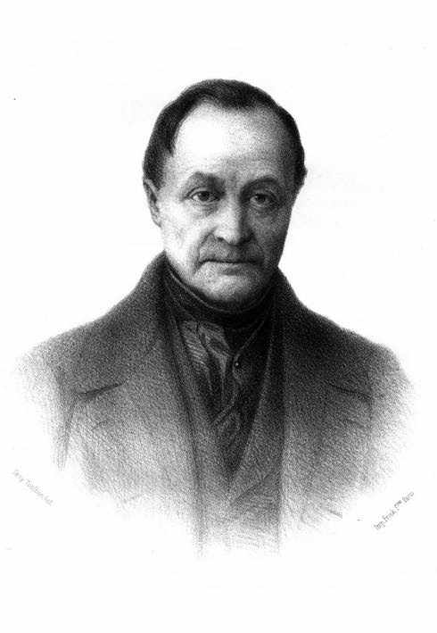
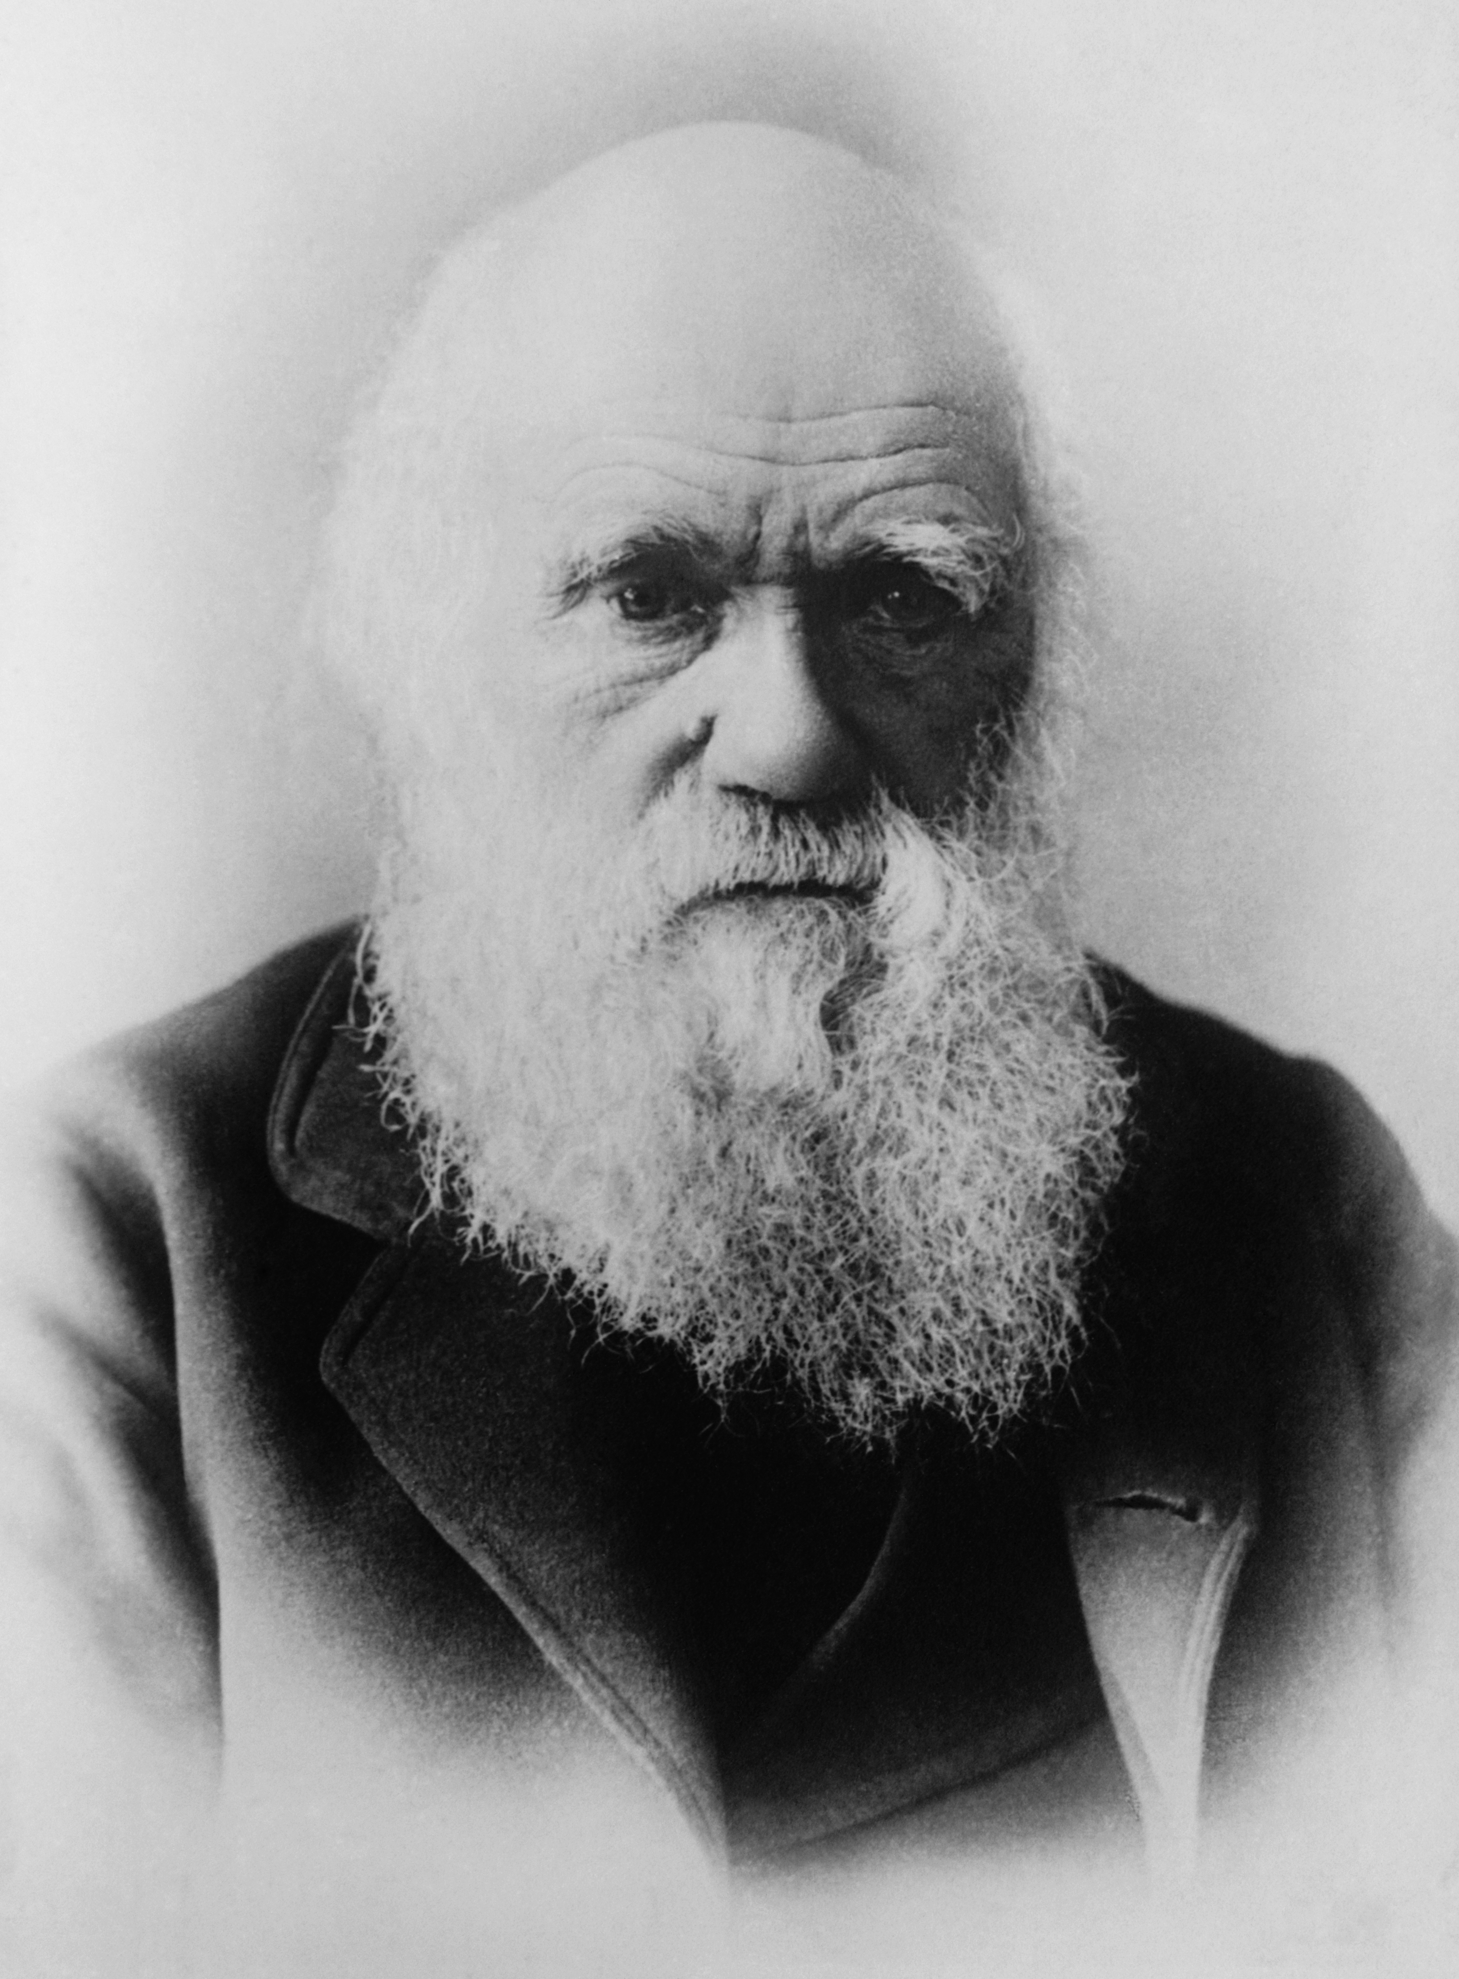
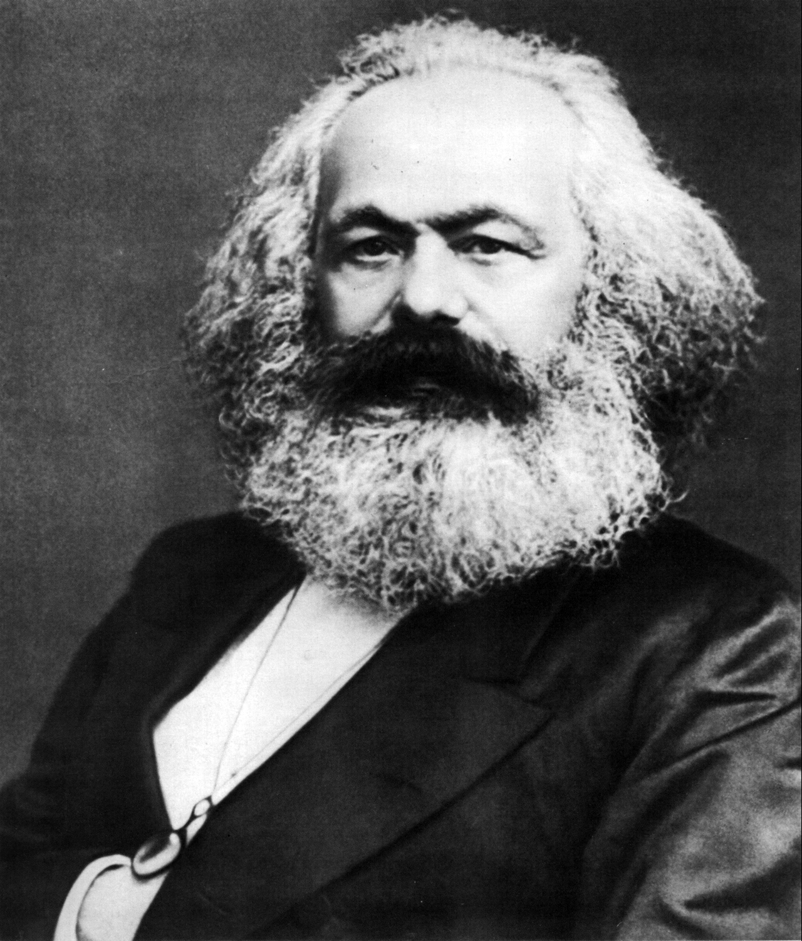
Contributors to Realism
Auguste Comte: Developed Positivism theory, encouraged one to inspect nature through precise observation
Charles Darwin: “Origin of Species”, made many people believe that science could provide the answers in life
Karl Marx: Argued against urbanization and in favour of equal distribution of wealth, founder of Communism

Slide 23
Characteristics of Realism
characters are believable, everyday types
costumes are authentic
stage settings (locations) and props are often indoors and believable
the ‘box set’ is normally used for realistic dramas on stage, consisting of three walls and an invisible ‘fourth wall’ facing the audience
settings for realistic plays are often bland (deliberately ordinary), dialogue is not heightened for effect, but that of everyday speech (vernacular)
the drama is typically psychologically driven, where the plot is secondary and primary focus is placed on the interior lives of characters, their motives, the reactions of others etc.
realistic plays often see the protagonist (main character) rise up against the odds to assert him/herself against an injustice of some kind (eg. Nora in Ibsen’s A Doll’s House)

Slide 24
Realism Seen in ‘A Doll’s House’
MRS. LINDE: "You must not forget that I had a helpless mother and two little brothers. We couldn't wait for you, Nils; your prospects seemed hopeless then." (Act 3)
This exemplifies the problems Mrs. Linde had and how she needed to do what’s best for her.
TORVALD: “Suppose, now, that I borrowed fifty pounds today, and you spent it all in the Christmas week, and then on New Year's Eve a slate fell on my head and killed me." (ACT 1)
Torvald is a pragmatist when it comes to money and finance, compared to Nora.
MRS. LINDE: "I want to be a mother to someone, and your [Krogstad's] children need a mother." (ACT 3)
In order to appeal to Krogstad, Mrs. Linde has to offer him something beneficial to his children, because he cares greatly for his kids.

Slide 25
Thematic References including Realism
“My life is so dreadfully empty and I feel so forsaken. There is not the least pleasure in working for one's self. Nils, give me someone and something to work for” (Act 3)
This displays realism because of how, in real life, people have problems.
“My poor innocent spine has to suffer for my father’s youthful amusement” (Act 2).
Even something as simple as an illness demonstrates life’s issues.
[From below, the sound of a door slamming shut] (Act 3)
The play ends with a failed relationship, as opposed to past stories that supported the idea that life is like a fairy tale. It is not.

Slide 26
Question One
Henrik Ibsen was known to be the father of theatrical realism. His realistic influence can be seen a majority of his plays. What are some realistic elements that are seen in ‘A Doll’s House’?

Slide 27
Question Two
Considering ‘A Doll’s House’ is a play with realism, how does Ibsen build the suspense in the play? What literary techniques make the play realistic and build the suspense? What is the suspense? Provide textual support.

Slide 28
Works cited
The Drama Teacher
Realism
The Realism Movement in Drama
Theatre Links
Seat Up – Overview of the history of theatre
History of Western Theatre
A Brief History of Theatre

