Slide 1
Felix, Banishment & the Isle of Noises
~ Making Connections ~

Slide 2
After reading:
how does Felix’s ‘banishment’ play out in comparison to Prospero’s?
what connections are there?
what divergences?
is this his ‘island’, or is this the boat, adrift in rough seas?

Slide 3
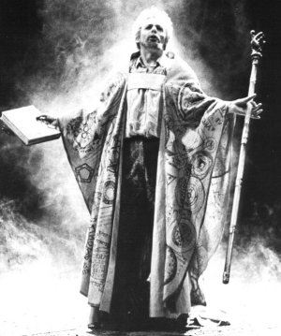
Old version of Prospero
An older theatrical version of Prospero, with book and staff

Slide 4
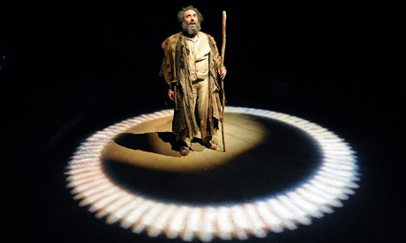
New version of prospero
A more recent theatrical version, hermit-like – ringed in by light.

Slide 5
Felix’s performance
“By choosing this shack and the privations that would come with it, he would of course be sulking. He’d be hair-shirting himself, playing the flagellant, the hermit. Watch me suffer. He recognised his own act, an act with no audience but himself. It was childish, this self-willed moping. He was not being grown-up.”
Page 31-2
Consider how this focalisation of Felix’s point of view relates to the themes of ‘life as performance’ but also ‘imprisonment’.
Is this a comment on Prospero in ‘The Tempest’? How does this performative realisation adhere here to the Postmodern notion of no story being ‘new’?
Does this realisation give Felix more authority that his predecessor, Prospero, in that he possesses more self awareness?
How can we describe the ‘Tempest’-’Hag-Seed’ convo at this point?

Slide 6
Miranda as dissonance
“And the photo of his Miranda, of course. He always kept it near him…
And now she would have to stay locked behind the glass, because, with the destruction of his Tempest, the new Miranda – the Miranda that he’d been intending to create, or possibly to resurrect – was dead in the water.”
Page 32-3
Debate why Atwood appropriates Miranda as a dead child who continues to grow as a figment of Felix’s imagination. How does this comment on the theme of imprisonment?
What changes about the narrative with Miranda becoming a memory that Felix seeks to ‘resurrect’ and perhaps ‘heal’ by staging his own ‘Tempest’?
Consider this difference as a ‘dissonance’ between the texts. Debate why Atwood strikes this point of difference—to what end?

