Slide 1
Hag-Seed
The Prologue
“The house lights dim.
The audience quiets.”

Slide 2
The opening
“The house lights dim. The audience quiets.”
- Immediately, Atwood establishes the performative nature of the novel. A sense of gravitas is established using the magic of the theatre. We know that a story is beginning, but not in the usual way. Atwood chooses to commence her novel with a dramatic script, which of course is the script version of the play that Felix and the prisoners stage later in the story. From the outset though, the importance of ‘performing’ and ‘re-performing’ stories is established.
QUESTIONS:
what is suggested by the jagged yellow lettering of the play’s title?
the announcer’s rap-style, scene-setting introduction says a lot about Atwood’s style. What can we expect?

Slide 3
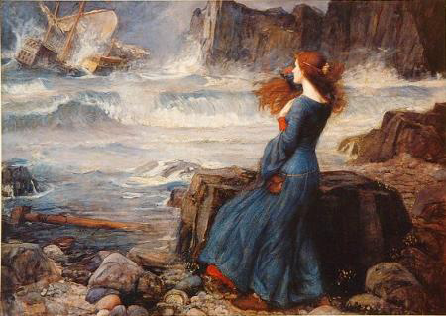
Art by John Waterhouse
An artist’s portrayal of Miranda watching Prospero’s tempest shipwreck the King’s ship. Artist: John Waterhouse, 1916

Slide 4
“Now we’re gonna start the playin’”
The Announcer signals the commencement of the prison play with these words
Consider how they relate to Shakespeare’s famous words:
“All the world’s a stage,
And all the men and women merely players;
They have their exists and their entrances,
And one man in his time plays many parts”
‘As You Like It’

Slide 5
Life as ‘performance’
Ervin Goffman was perhaps the first to consider how our lives can be understood as ‘performances’
This ‘rhymes’ in many ways with the postmodern approach to literature of acknowledging that no ‘story’ is original, and that by experimenting with and transforming stories that have already been told, we are able to tell reimagined stories about our lives
Postmodern literature tests boundaries, embraces disorder, and often plays with the act of storytelling itself
Re-read the remainder of the Prologue and discuss, in pairs or groups, how these ideas resonate in Atwood’s opening ‘act’ of the novel.

Slide 6
Writing task
Imagine you are a literary historian from far off into the future (perhaps the 50th Century)
You have just discovered a surviving copy of the Prologue to ‘Hag-Seed’. Shakespeare’s plays are still reasonably well-known, but your knowledge of ‘The Tempest’ is limited
Write a reflective journal entry about your discovery, and speculate on how this author from the 21st Century might have been ‘conversing’ with a much older work. Attempt, as your hypothetical historian self, to make sense of the Prologue’s purpose

