Slide 1
Ariel vs Birthday Letters
Are these “call and response”?

Slide 2
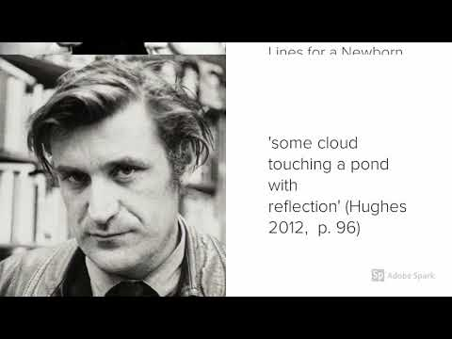
Discussion
What do you think of the opinions in this clip?
Discuss any bias etc which may sway public opinion.
Notes:
https://www.youtube.com/watch?v=v_fpSaZJewY

Slide 3
Her Husband: Hughes and Plath - a marriage
Dianne Middlebrook’s biography “Her Husband” painted a harsh picture of Hughes’ influence on Sylvia Plath, as did many Feminist texts on the subject.
Read through the various articles linked on the next slide and take notes on:
The composer’s point of view on Hughes and/ or Plath
The language used to convey that POV
Interesting facts or interpretations
Keep 1 or 2 quotes from each text
THEN decide what YOU think - Do you agree with the article? Why/why not?
Notes:
This task could be done individually or the articles could be divided up among the class and notes taken on a collaborative Google Doc.

Slide 4
Consider the varying views on Plath and Hughes in these articles...
Ted Hughes: An Introduction - ann Skea
In Dialogue with the Living and the Dead: Ted Hughes's 'Birthday Letters'- William Christie
Download from In Dialogue with the Living and the Dead: Ted Hughes's 'Birthday Letters'- William Christie
Ted Hughes Avoids the Subject In Birthday Letters by Paul Alexander
Ted Hughes's final lines to Sylvia Plath bring closure to a tragic tale
True confessions? Ted Hughes’ Birthday Letters by Barry Spurr
Sylvia Plath- A Postwar poet unafraid to confront her own despair By Anemona Hartocollis
Birthday Letters transcript Jim Lehrer
Ted HUghes: A Talented Murderer By Nadeem Azam
Feminists abused my mother's suicide, says Sylvia Plath's poet daughter

