Slide 1
Intro to Plath and Hughes
Video resources.
Notes:
NB - These videos are collected here for ease of access. Teachers may choose which they use and add questions/ slides as needed.
The Theme is deliberately plain but teachers can customise as they wish.

Slide 2
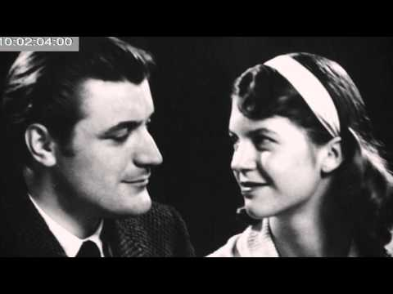
Intro to the importance of Context
Intro to the documentary “Ted Hughes: A Force of Nature”
Notes:
https://www.youtube.com/watch?v=JNdcrQDDX74
Ted Hughes: A Force of Nature https://www.youtube.com/watch?v=bCVciE4tmyI is also on last slide

Slide 3
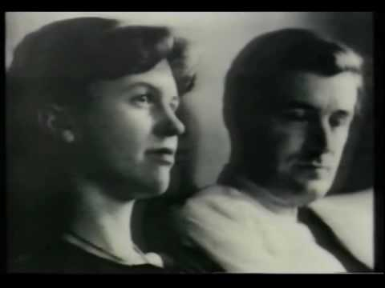
A tribute to the Poet Ted Hughes
Notes:
https://www.youtube.com/watch?v=18DdJO9Lg-s&t=3s

Slide 4
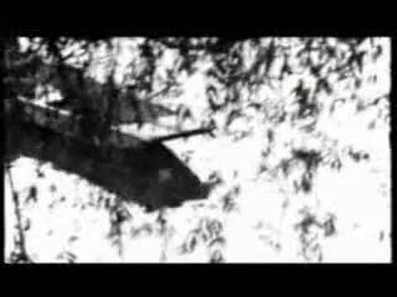
A Tribute to Sylvia Plath & Ted Hughes (Pt 1)
Notes:
https://www.youtube.com/watch?v=4gixYZrmayA

Slide 5
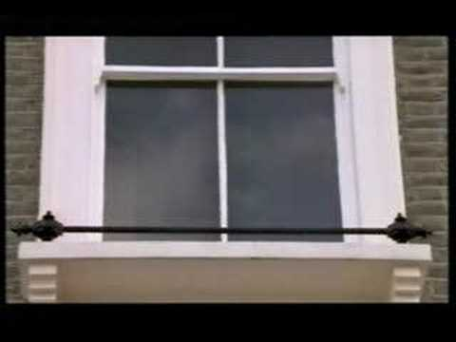
A Tribute to Sylvia Plath & Ted Hughes (Pt 2)
Notes:
https://www.youtube.com/watch?v=v3IijkIQzUY

Slide 6
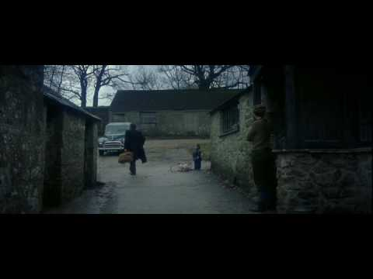
Richard Armitage reads Ted Hughes' letters
Notes:
https://www.youtube.com/watch?v=lqE0_TdsE1I

Slide 7
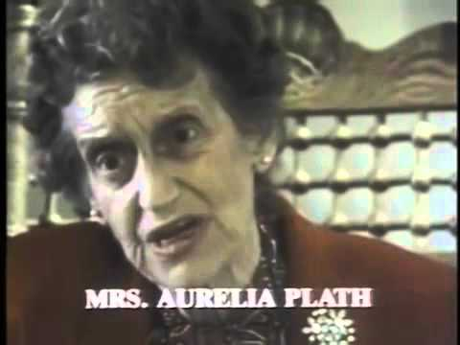
Sylvia Plath (Doco)
Notes:
https://www.youtube.com/watch?v=ZPFQOtGSr4o

Slide 8
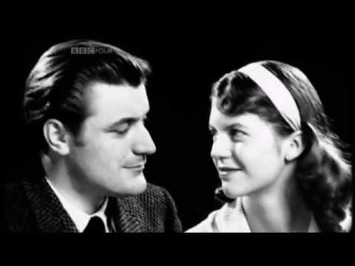
Ted Hughes: A Force of Nature (Doco)
Notes:
https://www.youtube.com/watch?v=bCVciE4tmyI&t=220s

