Slide 1
Winston Churchill – Sinews of Peace (1946)
Historical, Political and Social Contexts
of
Post WWII and Pre Cold War Era

Slide 2
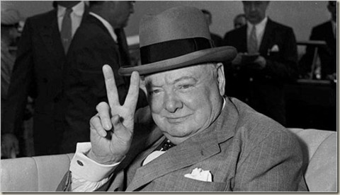
Why is Context Important?
In order to understand Churchill’s vision for the future, it is necessary to examine what was happening at the time the speech was delivered.
Historical context:
Political context:
Social context:
Winston Churchill Sinews of Peace (1946)
https://youtu.be/FoRwqKGIk9M

Slide 3
Post World War II
Devastation in Europe;
Separation of powers in Germany;
Britain’s decline of Empirical power and influence;
World on the brink of economic and social collapse.
World War II
Source 1: https://youtu.be/Q78COTwT7nE
Source 2: https://youtu.be/HUqy-OQvVtI

Slide 4
Pre Cold War
Escalating tensions between East and West;
Anxiety regarding the atomic age.
The Berlin Wall https://youtu.be/naqS-BlpfU4
Cold War https://youtu.be/wVqziNV7dGY
Nuclear Tests https://youtu.be/hPicNmkkH_g
What if the Cold War went nuclear
https://youtu.be/e3AzwBPnUxs

Slide 5
Speculative Macro-Narratives
IDEOLOGY, CULTURE & IDENTITY:
Churchill attempts to seek a commitment from the United States based upon the similarities in the political, cultural and social macro-narratives of each country.
He establishes the divide between East and West, dehumanising Communism as the rival to Capitalism and presenting it as a threat to world security.
He also attempts to shore support by galvanising both the United Kingdom and the United States through religious traditions and cultural identity.

Slide 6
The Speech:
Read and analyse the speech with regard to the way Churchill utilises the macro-narratives of each country.
Use the analysis grids and find references from the text to support your ideas.

