Slide 1
The stories we tell:
Metanarrative, Archetypes or ‘Master plots’, and Macro/Micro Narratives

Slide 2
Metanarrative
A metanarrative (also called grand narrative) is an overarching story or storyline that gives context, meaning, and purpose to all of life. A metanarrative is the “big picture” or all-encompassing theme that unites all smaller themes and individual stories.
The concept of a metanarrative is similar to a worldview—something that gives meaning to life and the individual events that take place in life. Marxism, Freudianism, Free Market Capitalism, and Enlightenment Emancipation would be examples of metanarratives in that every event in life and history is seen through one of these lenses.
Religious world views are also metanarratives. Hinduism, Buddhism, Islam and Christianity all offer metanarratives to explain various events in history and the contemporary world. A metanarrative has the power to explain and purports to be true for all of life.
The term metanarrative was brought into prominence by Jean-François Lyotard in his 1979 book The Postmodern Condition: A Report on Knowledge. In this book, the author characterises the postmodern condition as that of increasing skepticism of all metanarratives. Indeed, postmoderns generally do not accept any overarching story that gives meaning to all of life. Instead, they focus on small, individual narratives that give meaning to their own lives.
A metanarrative speaks of absolute, universal truth. An individual narrative speaks of what is “true for me” and “gives meaning to my life.” Postmodern thinking rejects metanarratives because it rejects universal truth. Postmoderns view a single narrative giving meaning to all lives as an impossibility.

Slide 3
Narrative and context
Context relates to the outside world of any narrative.
Context is anything that can provide the frame of interpretation of a focal event.
In a study of narrative there are three important contexts to consider:
Historical Context: what events had transpired, and what was happening at the time;
Political Context: how the structures in societal organisation operate;
Social Context: the activities people engaged in and how people behaved both individually and as a collective.
Personal Context: the writer’s personal experiences that may shape his/her stories
Think of any event in a narrative as a pebble being dropped into a pond. Each concentric circle adding a layer onto the effect. Context is similar in the ways that layers of meaning are created by the circles that influence and shape the text.

Slide 4
Story archetypes or ‘masterplots’
‘These are the stories we tell over and over in myriad forms and that connect vitally with our deepest wishes, values and fears. They are skeletal and adaptable, and they can recur in narrative after narrative. The rags to riches Cinderella story is one of them. Its variants can be found frequently in European and American cultures. Its constituent events elaborate a thread of neglect, injustice, rebirth and reward that responds to deeply held anxieties and desires. As such, the Cinderella masterplot has an enormous emotional capital that can be drawn on when constructing a narrative. To the extent that our values and identity are linked to a masterplot, that masterplot can have a strong rhetorical impact. We tend to give credibility to narratives that are structured by it. There are some masterplots that would appear to be universal: the quest, the story of revenge, seasonal myths of death and regeneration. But the more culturally specific the masterplot, the greater its practical force in everyday life. All national cultures have their masterplots, some of which are local variations on universal masterplots.’
- H. Porter Abbott, The Cambridge Introduction to Narrative, Cambridge University Press, 2002.

Slide 5
‘The Seven Basic Plots’
Journalist Christopher Booker identified seven story archetypes, or masterplots, in his 2004 text The Seven Basic Plots:
Overcoming the monster
Rags to riches
The quest
Voyage and return
Comedy
Tragedy
Rebirth
What do you think is the basic plot of each of these stories?
Can you think of specific narratives (novels, films, short stories) as examples of each of these masterplots?
Why do you think we tell and retell versions of these stories?

Slide 6
Macro Narratives
Cultural Stories - stories of belonging to wider customs, practices and their importance in defining communal identity;
National Stories – stories of nation building and the struggles of statehood;
Ethnicity Stories – stories of origins, heritage, family and shared experience;
Religious Stories – stories of belief structures and their influence on collective thinking.
Macro-Narratives unfold events and depict situations that lay within the wider parameters and frameworks of social and political discourses.

Slide 7
Macro narratives cont.
Read the following extract, summarise and add to your notes on how Literature represents the Macro-world:
Booker, C. The Seven Basic Plots: Why we tell stories. Continuum, New York. 2004. Pages 573-577 & 589-591.
Engage with the following texts and identify the macro narrative that is created, as well as how language is used in its creation:
Langston Hughes – Let America be America Again
Henry Lawson – Star of Australasia (extract)

Slide 8
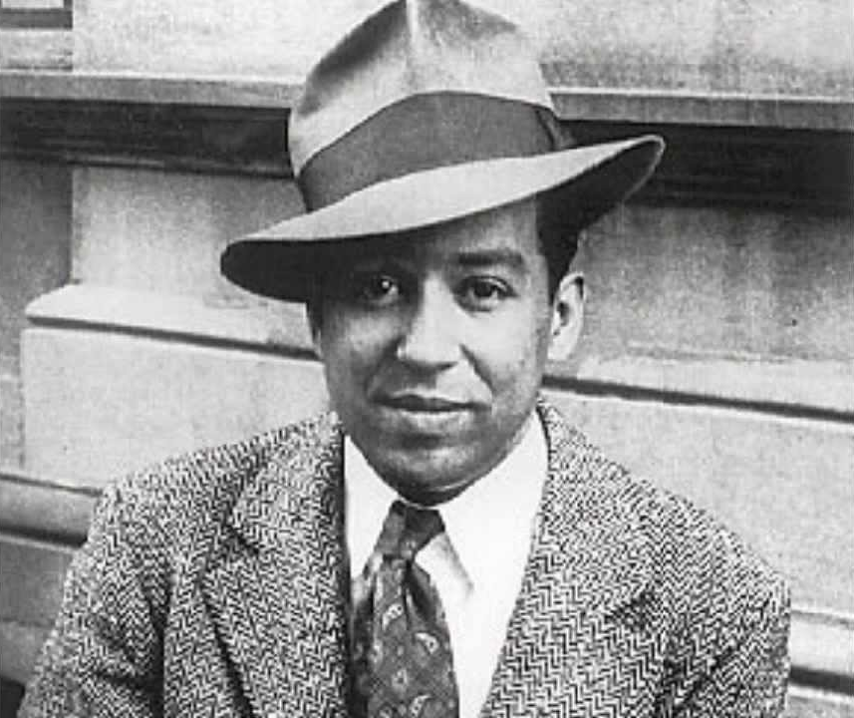
Langston Hughes – Let America be America Again(1935)
O, let my land be a land where Liberty
Is crowned with no false patriotic wreath,
But opportunity is real, and life is free,
Equality is in the air we breathe.
(There’s never been equality for me,
Nor freedom in this “homeland of the free.”)
Say, who are you that mumbles in the dark?
And who are you that draws your veil across the stars?
I am the poor white, fooled and pushed apart,
I am the Negro bearing slavery’s scars.
I am the red man driven from the land,
I am the immigrant clutching the hope I seek—
And finding only the same old stupid plan Compare with Trump Presidential slogan 2017-
Of dog eat dog, of mighty crush the weak. ‘Make America Great Again’.

Slide 9
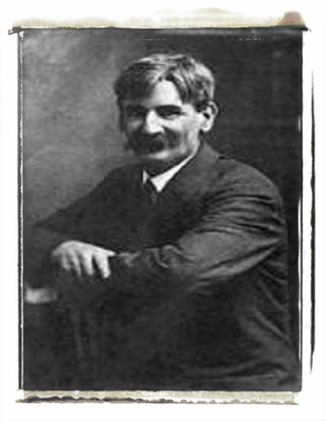
Henry Lawson – The Star of Australasia (1896)
WE boast no more of our bloodless flag, that rose from a nation's slime; Better a shred of a deep-dyed rag from the storms of the olden time. From grander clouds in our ‘peaceful skies’ than ever were there before I tell you the Star of the South shall rise — in the lurid clouds of war. It ever must be while blood is warm and the sons of men increase; For ever the nations rose in storm, to rot in a deadly peace. There comes a point that we will not yield, no matter if right or wrong, And man will fight on the battle-field while passion and pride are strong — So long as he will not kiss the rod, and his stubborn spirit sours, And the scorn of Nature and curse of God are heavy on peace like ours…

Slide 10
Micro Narratives
Stories of the Self
small, highly personalised stories that may not have any larger significance;
stories of everyday occurrences;
personal observations, responses or reactions.
Consider how the following extract from Salinger’s The Catcher in the Rye establishes a micro narrative.

Slide 11
J.D. Salinger: The Catcher in the Rye – Chapter 1
If you really want to hear about it, the first thing you’ll probably want to know is where I was born, and what my lousy childhood was like, and how my parents were occupied and all before they had me, and all that David Copperfield kind of crap, but I don’t feel like going into it, if you want to know the truth. In the first place, that stuff bores me, and in the second place, my parents would have two haemorrhages apiece if I told anything pretty personal about them. They’re quite touchy about anything like that, especially my father. They’re nice and all - I’m not saying that - but they’re also touchy as hell. Besides, I’m not going to tell you my whole goddam autobiography or anything. I’ll just tell you about this madman stuff that happened to me last Christmas just before I got pretty run-down and had to come out and take it easy.
Where I want to start is the day I left Pencey Prep. Pencey Prep is the school that’s in Agertown, Pennsylvania. You probably heard of it. You’ve probably seen the ads, anyway. They advertise in about a thousand magazines, always showing some hot-shot guy on a horse jumping over a fence. Like as if all you ever did at Pencey was play polo all the time. I never even once saw a horse anywhere near the place. And underneath the guy on the horse’s picture, it always says: ‘Since 1888 we have been molding boys into splendid, clear-thinking young men’. Strictly for the birds. They don’t do any damn more molding at Pencey than they do at any other school. And I didn’t know anybody there that was splendid and clear-thinking and all. Maybe two guys. If that many. And they probably came to Pencey that way.

Slide 12
Conclusion
An engaging narrative, one that is thought provoking, has us question the validity of the values, institutions and cultural norms that guide and give meaning to our lives, will expose the micro world of its character, and then pit them against the macro world that they live in.
View the following music video and identify:
The micro, or personal narrative
The larger, macro narrative that influences the thoughts and actions of the character
Consider how the lyrics, film and musical devices combine to create the narrative
Does the music video fit into a ‘master plot’?
‘Dig Down’ – Muse: https://www.youtube.com/watch?v=b4ozdiGys5g

