Slide 1
Politics, Speeches & Speculative Macro-narratives

Slide 2
Politics:
The activities associated with the governance of a country and the political relations between states;
A particular set of beliefs and principles;
The principles relating to or inherent in a sphere or activity, especially relating to power or status;
The competition of ideas that sets the direction for the continuation or advancement of the values that underpin any political sphere.
McLean, I. Concise Dictionary of Politics. Oxford University Press, New York. 1996.

Slide 3
Speeches:
Purpose:
A form of communication, delivered orally, usually with an intended audience;
provide information about a particular topic;
persuade an audience to the speaker’s opinion.
Speeches have a long tradition that dates back to the ancient Greeks. For millennia, people have harnessed the capacity of the spoken word to influence audiences and persuade them to the speaker’s opinion. In this sense, speeches are particularly useful in the discipline of politics, as an arena for the competition of ideas.

Slide 4
Rhetoric: Something more than just an unanswered question.
Repetition:
There is no better way to emphasise the importance of an idea than to repeat it.
Placement is everything:
Anaphora – repetition at the beginning of successive paragraphs, statements or sections.
Epistrophe – repetition at the end of successive paragraphs, statements or sections.
Anadiplosis – literally a ‘doubling back’ where repetition exists at the end and beginning
of successive clauses in a sentence.
Epanalepsis – repetition of a word at the beginning and end of a sentence.

Slide 5
Alliteration:
Speeches are verbal texts. As such, the use of language to create auditory resonance assists in reinforcing the ideas of the text. Often used in conjunction with figurative devices, but mostly to create atmosphere or mood in the text:
Plosive – the use of successive or closely placed language using /b/, /t/, /p/ or /d/ to
create an abrupt or harsh effect.
Fricative - the use of successive or closely placed language using /f/, /v/ or /th/ to
create a soft, receptive effect.
Sibilance - the use of successive or closely placed language using /s/, /z/ or soft /c/ to
create a passive or gentle effect.
Also Nasal (/m/, /n/) or Liquid (/l/, /r/)

Slide 6
Allusion:
The incorporation of knowledge that the audience has of other events and situations, either historical or cultural, to form a connection between the responder, their knowledge of the event or situation, and the ideas of the speech.
Anecdote:
A story or account that is used to personalise the ideas in the speech and form a connection with the audience.
Rhetorical Pairing:
The coupling of ideas used to either unite ideas or distance them (Binary Association or Opposition)
Figurative Devices:
Used to entertain the audience with comparative associations gained through techniques such as:
Metaphor, Metonym, Personification or Pathetic Fallacy (to name but a few).

Slide 7
Ethos, Pathos, Logos: Appealing to an audience
Aristotle: https://youtu.be/3klMM9BkW5o
How to use Rhetoric to get what you want: https://youtu.be/3klMM9BkW5o
Ethos: or ethical appeal is used to convince an audience based upon credibility, notions
of justice, moral considerations or simply what is ‘right and good’.
Pathos: or emotional appeal is created through the solicitation of an audience’s emotions – the
three most useful being sympathy, empathy and outrage.
Logos: or an appeal to logic, convinces an audience through an argument based on reason and will
usually include statistics, data, facts from experts or constructing historical or literal analogies.

Slide 8
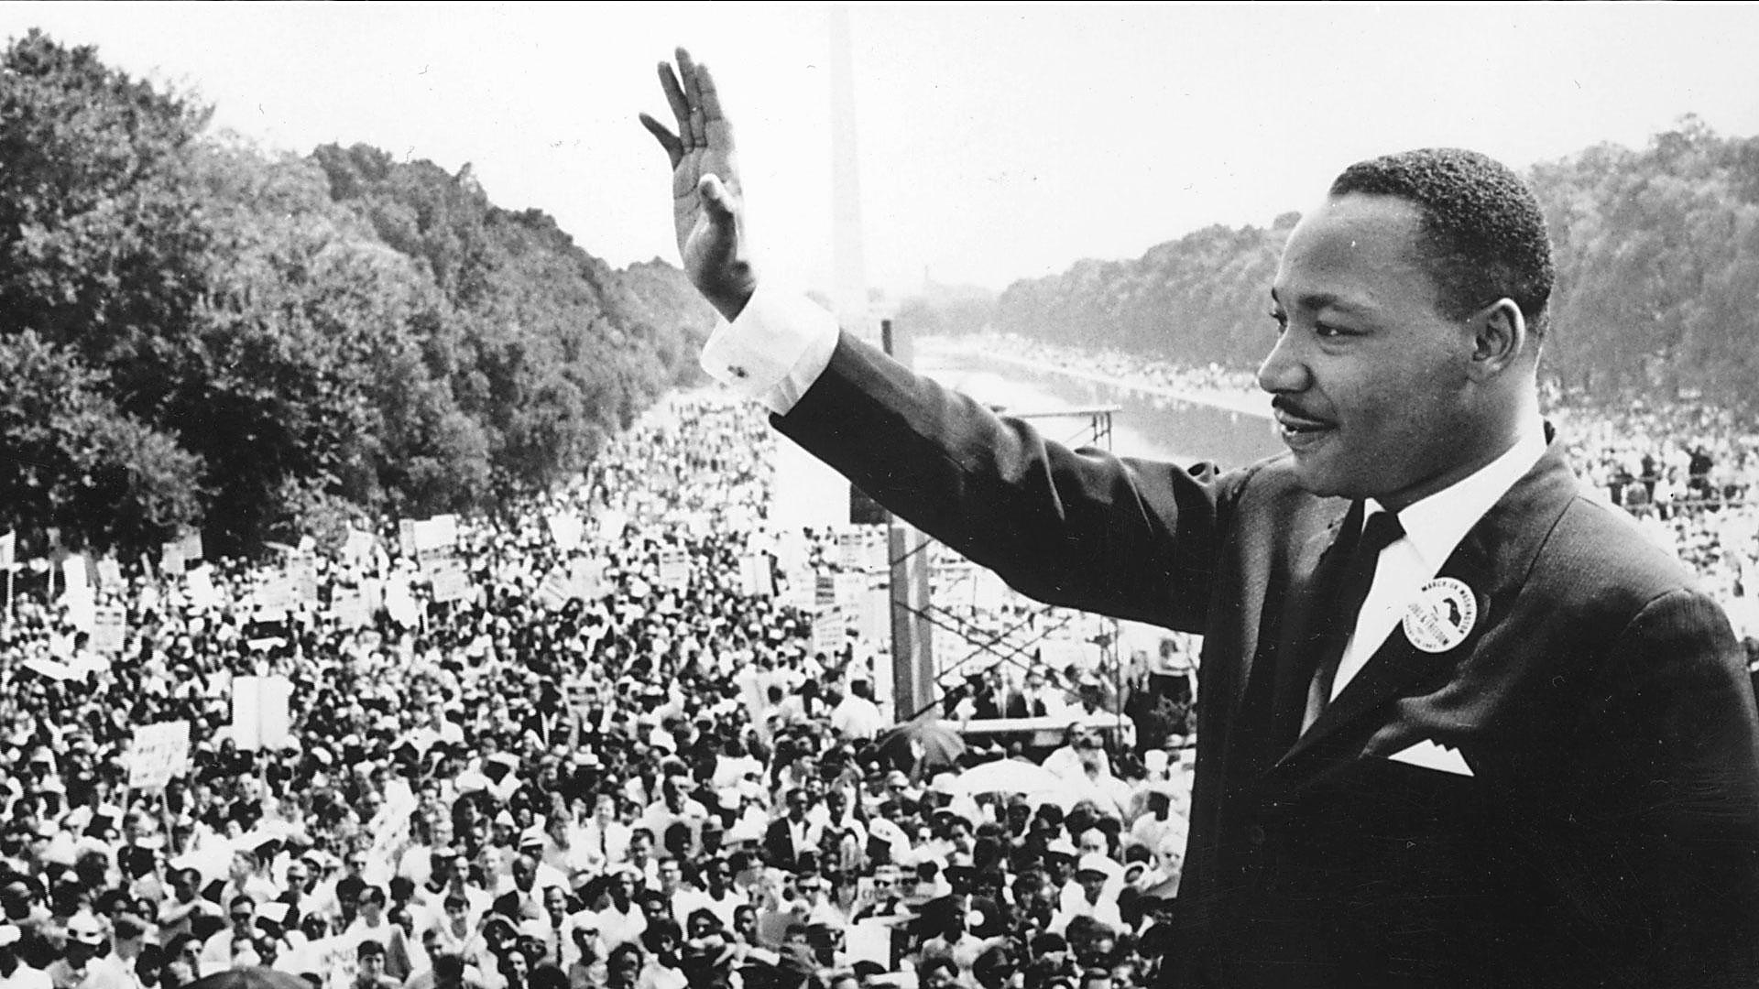
Historical Examples:
Consider the extracts and identify:
Use of rhetoric;
Appeal to ethos, pathos or logos;
Macro-narrative of context
Speculative view for the future.
Rev. Dr. Martin Luther King Jnr.
‘I Have a Dream’. (1963)
https://youtu.be/KyI1LMmV3V0

Slide 9
Martin Luther King
‘…I have a dream that one day this nation will rise up and live out the true meaning of its creed: "We hold these truths to be self-evident, that all men are created equal."
I have a dream that one day on the red hills of Georgia, the sons of former slaves and the sons of former slave owners will be able to sit down together at the table of brotherhood.
I have a dream that one day even the state of Mississippi, a state sweltering with the heat of injustice, sweltering with the heat of oppression, will be transformed into an oasis of freedom and justice.
I have a dream that my four little children will one day live in a nation where they will not be judged by the colour of their skin but by the content of their character.
I have a dream today!
I have a dream that one day every valley shall be exalted, and every hill and mountain shall be made low, the rough places will be made plain, and the crooked places will be made straight; "and the glory of the Lord shall be revealed and all flesh shall see it together.“…’

Slide 10
Speeches
Barack Obama
‘Election Victory Speech’ (2008)
https://youtu.be/V6cMalUa4KE
Kevin Rudd
‘Parliamentary Apology to Stolen Generation’ (2008)
https://youtu.be/b3TZOGpG6cM
Julia Gillard
‘Parliamentary Misogyny Speech’ (2012)
https://youtu.be/AUGTFLRxwB0

Slide 11
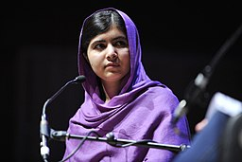
Speeches cont.
Deng Thiak Adut
‘Australia Day Address’ (2016)
https://youtu.be/xocVehUd7q4
Malala Yousafzai
‘United Nations Address’ (2013)
https://youtu.be/-_9JwI8dOS8
https://commons.wikimedia.org/wiki/File%3AMalala_Yousafzai.jpg

