Slide 1
Texts and Human Experiences
Common Module

Slide 2
The Rubric
Common Module: Texts and Human Experience

Slide 3
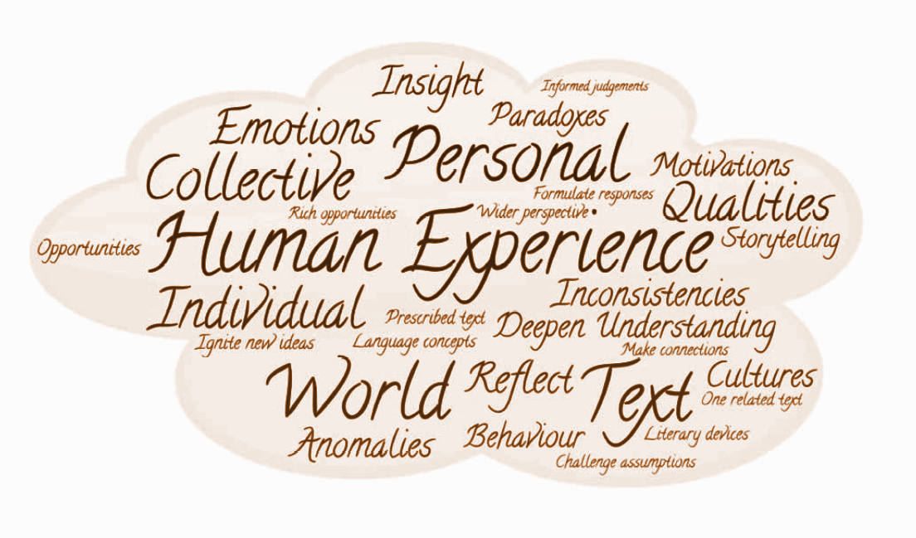
Word Cloud

Slide 4
Cloud Tasks
Discuss what you think this unit will be about based on the words from the cloud
What are five things you will have to do during this unit?
Notice three words that may need a definition. Find definitions for these words and discuss them as a group.
Work in groups to come up with a paragraph predicting what this unit will be about, incorporating the words from the cloud.
What do you think you will gain from this unit? Find words from the cloud to help you write your response.

Slide 5
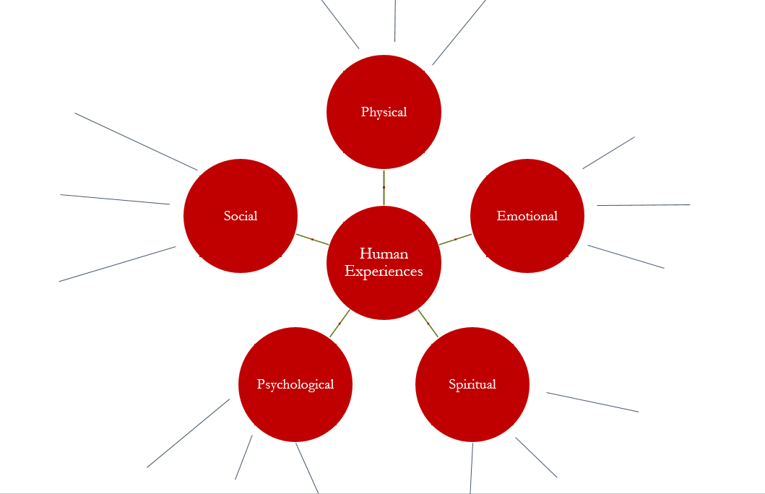
Mind Map Activity

Slide 6
Writing the human experience
Using the item you have chosen, write a short, memoir-style piece of writing about a human experience relating to this item. Be sure to explore the emotional consequences of this human experience.
Example: A stolen wallet that contained the only photo of a lost loved one
Write 250-500 words.

Slide 7
Questions to consider – What does it mean to be human?
1. What does it mean to be human?
2. What are the key factors that shape our experiences individually and collectively as humans?
3. What are Sanchez’s key messages about what makes a difference to our experiences?
4. How does she use language and delivery to convey her key messages? Identify four key language features and three ways that she engages an audience through delivery, such as pace, pause and intonation.
5. What is the concept of representation?

Slide 8
Questions to Consider – Oh Wonder
1. What was the purpose of this short film?
2. What perspectives and values of humanity are evident in this film, such as compassion, empathy and tolerance?
3. What is the key message?
4. How do the filmmakers use images, interviews, words and sound to convey their message about what it means to be human?
5. What is the meaning of the refrain?
"All we do is hide away
All we do is,
all we do is hide away
All we do is chase the day
All we do, all we do is chase the day
All we do is lie and wait”

Slide 9
‘Waste Land’-
Lucy Walker
Prescribed Text

Slide 10
Thinking about ‘the documentary’...
In 1926, the term documentary was coined by John Greerson who defined documentary as the ‘creative treatment of actuality’.
Consider the validity of the following statements:
Documentaries often cross between fact and fiction so they aren’t real.
Documentary makers use their skills to manipulate the audience towards their own views.
In a documentary we see only the view of the world that the filmmaker chooses to show.
Documentaries are important ways of understanding social issues and problems and possible solutions.
Documentary is a type of public memory.
Documentary gives an interpretation on historical issues.
Documentary "is unable to give an undistorted purely reflective picture of reality".
A documentary is a creative treatment of actuality.
Documentary presents facts for examination.
Documentary is not ever objective but takes a side.
A documentary film is about factual events.

Slide 11
If you were the director...
If a documentary were made of your own life:
Who would represent you?
Who would they interview?
What might the questions be?
Would evidence be given?
Would it include only thoughts and feeling or only facts?
Would the structure be chronological?
Where would it be filmed?

Slide 12
Before we view the film...
How does your knowledge, or lack of it, affect how you approach watching the film?
Does the title make you expect a biographical film?
Have you seen other Brazilian documentaries?
How important is the role of the interviewer in making a documentary?
Do you think it would be difficult or easy to meet someone and have them be open and honest with you about their life? Why?

Slide 13
Perspectives in the Film

Slide 14
Researching the COMPOSER- Lucy Walker

Slide 15
Researching the artist- Vik Muniz
In pairs, students research Vik Muniz, his personal journey and inspirations. Students aim to collect 10 significant facts or events from the artist’s life.

Slide 16
Viewing the film

Slide 17
Analysing Composition
Entering Rio- 10:19-12 minutes- Sample notes
Shot of Vik looking out the plane window
panning aerial shots of favelas
iconic shots of Christ the Redeemer and Copacabana Beach
Atmospheric music
jolted into reality of slums with hand-held footage of the streets, lingering on piles of rubbish
Walker’s use of titles introduce us to Fabio and Jardim Gramacho
Shot of the entry of Jardim Gramacho- we will enter with Vik and Fabio
Aerial shot of Jardim Gramacho shows viewers the scale of the site

Slide 18
Analyse the following clips:
Entering Jardim Gramacho 12:30- 17:05
Jardim Gramacho from the sky- 22:10- 23:00
Waste Land- 49:33- 5:00
Middle class trash- 50:30- 51:18
Vik’s museum speech- 52:00- 53:24
Making the artworks- 53:25- 56:07; 57:18- 59:52; 1:03:14- 1:07:07
The auction- 1:13:18- 1:15:48
Reflecting on the project- 1:17:33- 1:18:14
The Opening- 1:20:45- 1:22:40
Vik’s revelation- 1:22:41- 1:25:53

Slide 19
The Artworks
How does intertextuality, allusion and symbolism add significance to the representation of humanity in the film?

Slide 20
Add Content
Teachers can upload images of Muniz’s paintings with the original inspiration. The visuals will assist with the discussion.
As well, teachers could use this website: Vik Muniz – Pictures of Garbage

Slide 21
Writing Task
Consider the following:
“The pictures Muniz takes are all parodies of famous historical paintings or modern images and provide a 21st century critique of them; Sebastiao mimicks Marat, the French journalist who was killed for his desire for revolution in France, who himself is leading somewhat of a revolution for the rights and welfare of the Catadores in Brazil. Suellen mimicks ‘Madonna’ (Mary) holding the baby Jesus, a sacred painting, as she holds her 2 children born out of wedlock to an absent drug dealing father, on whom she describes she would be ‘screwed if she depended on him’.”
Comment on the artworks not mentioned above. Why has Muniz chosen them to parody? What do you think he is saying?

Slide 22
The role of storytelling-
introducing the subjects of the film
How does Walker use storytelling to share the experiences of the participants in her film?
View the following introductions to each participant. Comment on:
their story/background
their personality
HOW Walker has filmed them sharing their stories
Whose story do you most relate to? Why?

Slide 23
Debate
Topic: By sharing their stories in Walker’s documentary, the artwork participants’ lives were changed forever.
Affirmative: Waste land has significantly changed the participants’ live forever.
Negative: Waste Land has not significantly changed the participants’ lives.
Record your reflections. Did you agree with your ‘side’ of the argument? Why/why not?

Slide 24
Related Text
Standard English

Slide 25
Literary Devices used in J.K. Rowling’s Speech
Honest language style, revealing personal revelations and flaws
References to classical philosophers- Plutarch, Seneca
Storytelling/anecdotes to create pathos
Humour/witticism to connect to audience
Allusions to Harry Potter sprinkled throughout
Provocative language style to encourage action

Slide 26
Extended Response Question
Eleanor Roosevelt said that “People grow through experience if they meet life honestly and courageously. This is how character is built.” How have the composers of your prescribed text and one related text shown us individuals that have grown through their experiences?

Slide 27
Reflecting on the module

