Slide 1
The Podcast as a Medium

Slide 2
What is Podcasting?
Podcasting Explained*
http://www.abc.net.au/technology/techexplained/articles/2011/04/11/3158016.htm
What is Podcasting?*
https://youtu.be/oerm5Q_9u2A

Slide 3
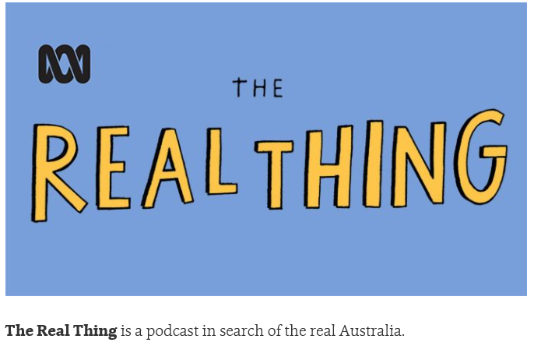
Word Up and the Real Thing - ABC Radio National (Australian Broadcasting Corporation)
Word up: Luke Johnson
The Real Thing – Ep 19 – Still Down River

