Slide 1
Module A: Contemporary Possibilities An Introduction

Slide 2
Rubric Activities
Activity One: Highlight five sentences from the rubric that you think are most important. Discuss with a classmates your five points and compare points, justifying why you have made your selection.
Activity Two: Use another colour to highlight the language you are unfamiliar with from the rubric. Use your device or a dictionary to find the definitions and create a word bank. Elevating your vocabulary is important when learning to write in academic register.

Slide 3
What does Multimodal mean?

Slide 4
The meaning systems
Written/Linguistic meaning concerns spoken and written language through use of vocabulary, generic structure and grammar
Audio meaning concerns music, sound effects, noises, ambient noise, and silence, through use of volume, pitch and rhythm
Visual meaning concerns still and moving images through use of colour, saliency, page layouts, vectors, viewpoint, screen formats, visual symbols; shot framing, subject distance and angle; camera movement, subject movement
Gestural meaning concerns movement of body, hands and eyes; facial expression, demeanours, and body language, and use of rhythm, speed, stillness and angles
Spatial meaning concerns environmental spaces and architectural spaces and use of proximity, direction, layout, position of and organisation of objects in space.
Multimodal is the combination of two or more modes in various combinations
Adapted from The New London Group, 1996/2000) Annemaree O’Brien, 2013

Slide 5
Cannon- Portraits with a Twist
“A photograph is shaped more by the person behind the camera than by what’s in front of it.” Canon says
Learning goal: Who decides what the truth is?
Canon- Portraits with a Twist (view up until 1.55 only!)
Activity: Write down the following questions to answer for each of the following images.
Identify the role of the protagonist (alcoholic, psychic, life saver, millionaire, convict, fisherman).
Explain why you have made this decision (utilising at least one visual technique for each image)

Slide 6
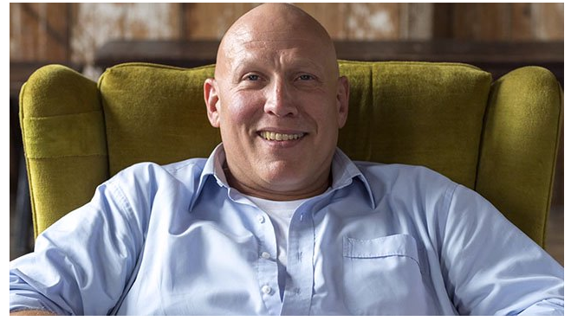
Image One: Canon- Portraits with a Twist

Slide 7
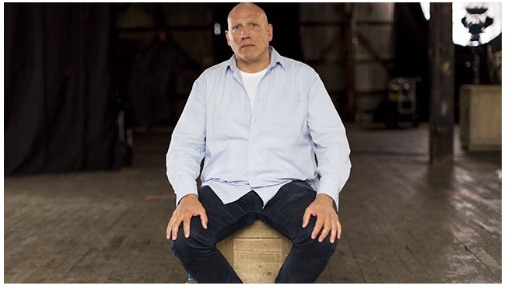
Image Two: Canon- Portraits with a Twist

Slide 8
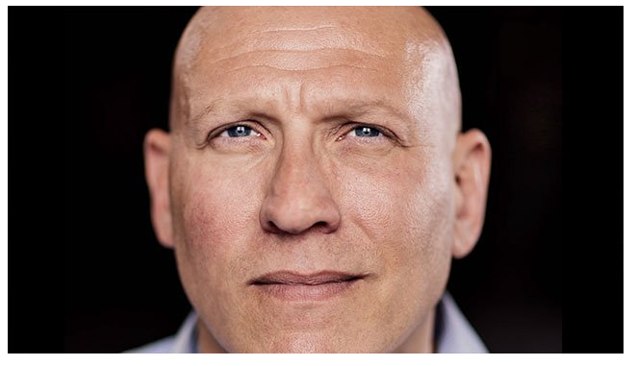
Image Three: Canon- Portraits with a Twist

Slide 9
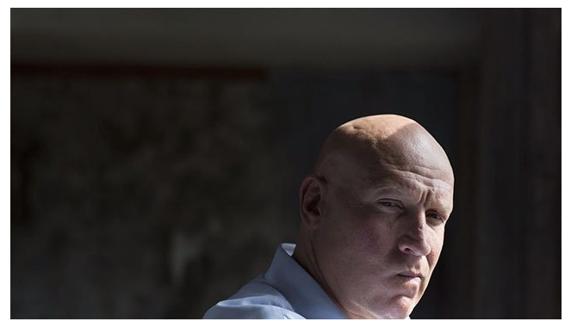
Image Four: Canon- Portraits with a Twist

Slide 10
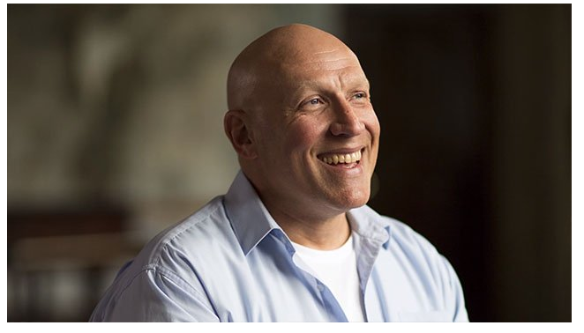
Image Five: Canon- Portraits with a Twist

Slide 11
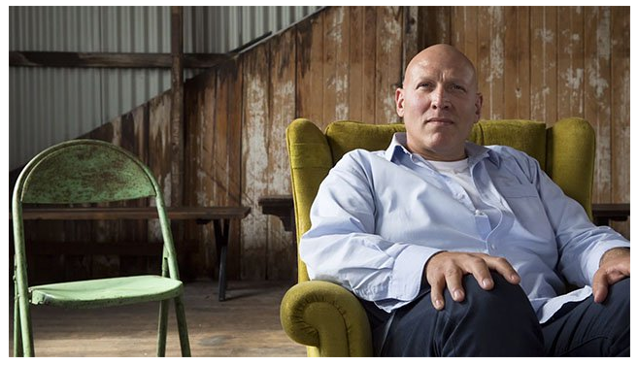
Image Six: Canon- Portraits with a Twist

Slide 12
Cannon- Portraits with a Twist Continued
We will now finish viewing the video and check how many of the images you guessed correctly.
What message can you take from this experiment?

Slide 13
Class Discussion
Write down your thoughts in dot points form in your book/device. Be ready to contribute your responses to the class.
What is the role of traditional media and social media in contemporary society?
Why would the study of this unit be significant to the individual and society?
Can you think of any organisations that use ‘new’ forms of media to change their public perception?

Slide 14
Instagram: Perceptions of Reality
Learning goal: Who has authority over a text? Who controls the meaning created in its composition and the way people respond to it?
Are you living an insta lie?

Slide 15
Instagram: Perceptions of Reality continued
On the following slides you will see images that represent ideas and lifestyles that are typically shared on social media sites. The composer has used framing and editing to present a comparison between ideals and reality, to demonstrate how the truth is often distorted to represent a reality that the user constructs to depict themselves, their ideas or their lifestyles. For each pair of slides:
Write down the ideal that is being conveyed and how the image represents this version of reality.
Compare this to the subsequent slide and the actual reality. Why would a user present the first image compared to the second?

Slide 16
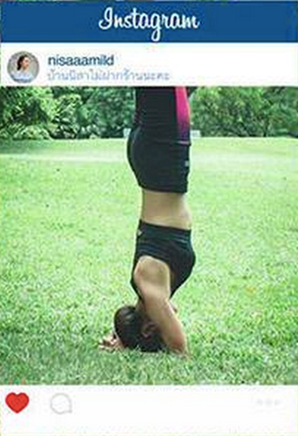
Image One:

Slide 17
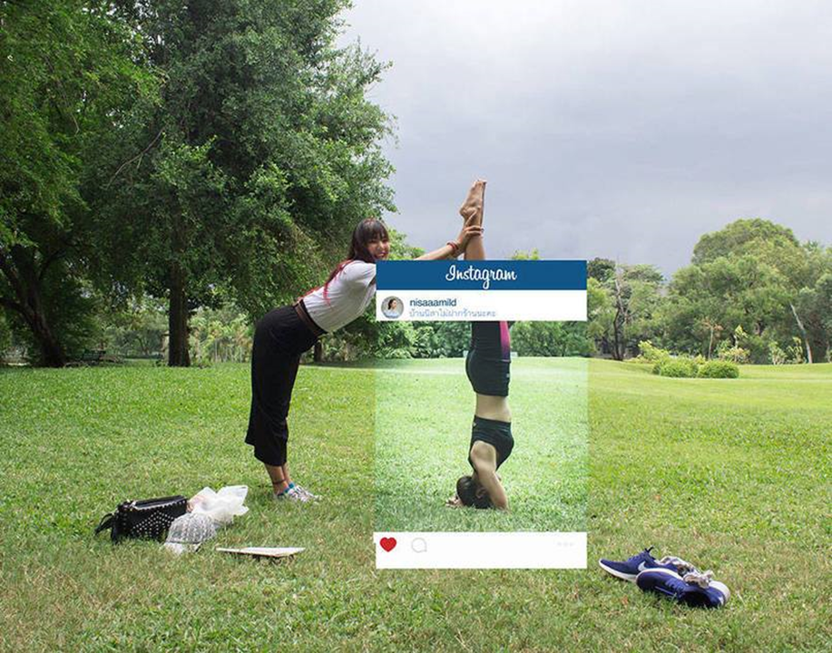
Image One:

Slide 18
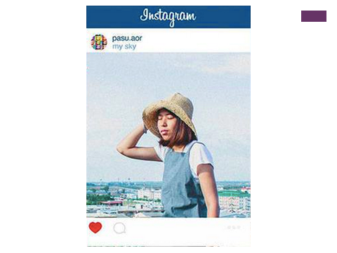
Image Two:

Slide 19
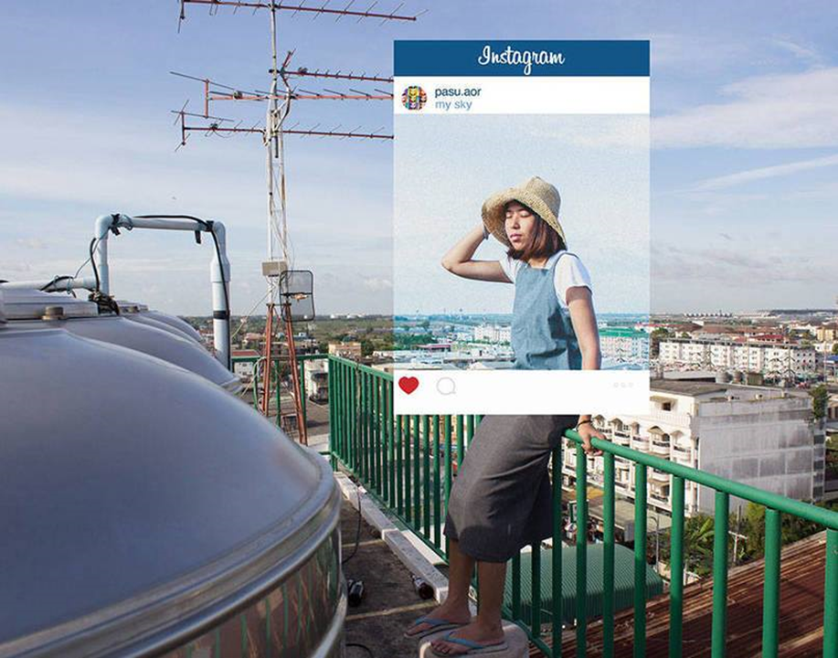
Image Two:

Slide 20
Image Three:

Slide 21
Image Three:

Slide 22
Instagram: Perceptions of Reality Continued
Reflection:
What comment is the composer of this series making about the nature of social media and society?
Assessment for learning:
In pairs, explore the school to compose your own photograph that is not an accurate perception of reality.

Slide 23
Related Text 1- American Oxygen by Rihanna
Context:
#BlackLivesMatter was created in 2012 after Trayvon Martin’s murderer, George Zimmerman, was acquitted for his crime, and dead 17-year old Trayvon was posthumously placed on trial for his own murder. #BlackLivesMatter is a call to action and a response to the virulent anti-Black racism, particularly the extrajudicial killings of Black people by police and vigilantes. When we say Black Lives Matter, we are broadening the conversation around state violence to include all of the ways in which Black people are intentionally left powerless at the hands of the state. We are talking about the ways in which Black lives are deprived of our basic human rights and dignity. (Taken from: http://blacklivesmatter.com/about/ on 11/7/17)

Slide 24
American Oxygen continued.
View American Oxygen
What are your first impressions of this text? What is your emotional response – what is your intellectual response?
What different events/personalities are represented through the archival footage?
What is this text suggesting about the treatment of African Americans throughout history?
Lyrics Analysis
How has the lyrics captured the what the American dream is about? Identify at least one example and discuss the effect.
What is the effect of the repetition of ‘American Oxygen’? What does it suggest about power in America?

Slide 25
American Oxygen continued.
Video clip analysis:
Describe the style/types of images and archival footage used in the video clip. Why do you think this choice has been made?
How is colour used within the video clip? Provide at least two examples.
Outline Rihanna’s characterisation in the clip and discuss the effect.
How does the video clip end? What does the ending symbolise?
List the Rihanna songs/video clips that you are familiar with. Why do you think this is not one of her songs that has been widely listened to/viewed? What does this say about contemporary society?

