Slide 1
Reading to Writing
Exploring and Mapping the Unknown
R.Chapman
Kooringal High School

Slide 2
Representation is symbolic
This is a painting by Belgian surrealist artist René Magritte. The text can be translated as:
“This is not a pipe”
What point is Magritte trying to make?
If this is ‘not a pipe’, what purpose does it serve?
What is he telling us about the way we ‘experience’ the world around us?
The Treachery: https://en.wikipedia.org/wiki/The_Treachery_of_Images

Slide 3

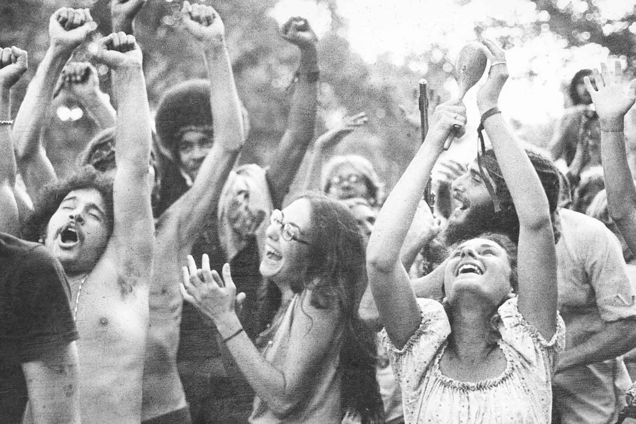
Symbol
A ‘symbol’ is something which stands for more than itself. Symbols can be visual or aural.
But this is also just a bunch of pixels which are a representation of
the ‘reality’.

Slide 4
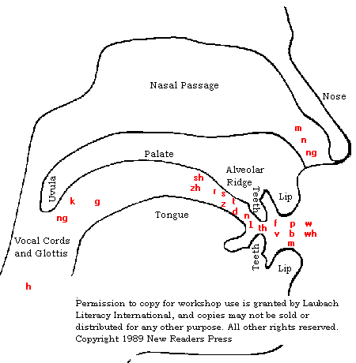
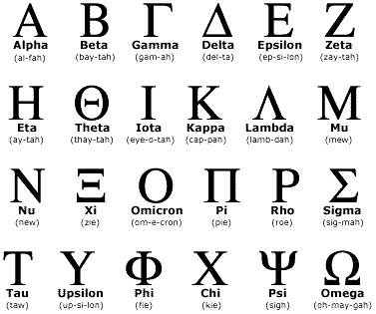
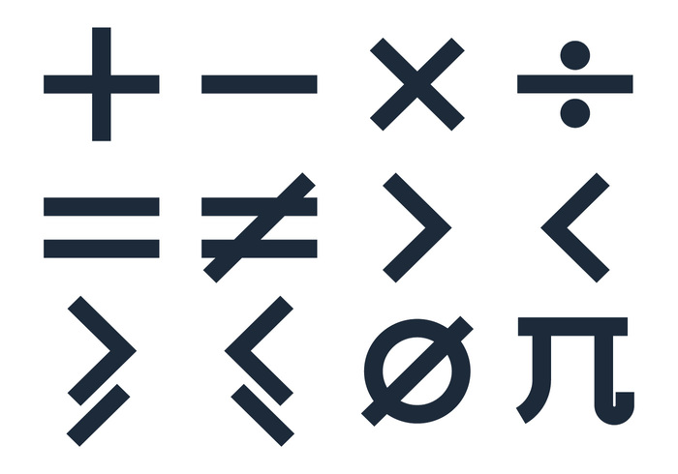
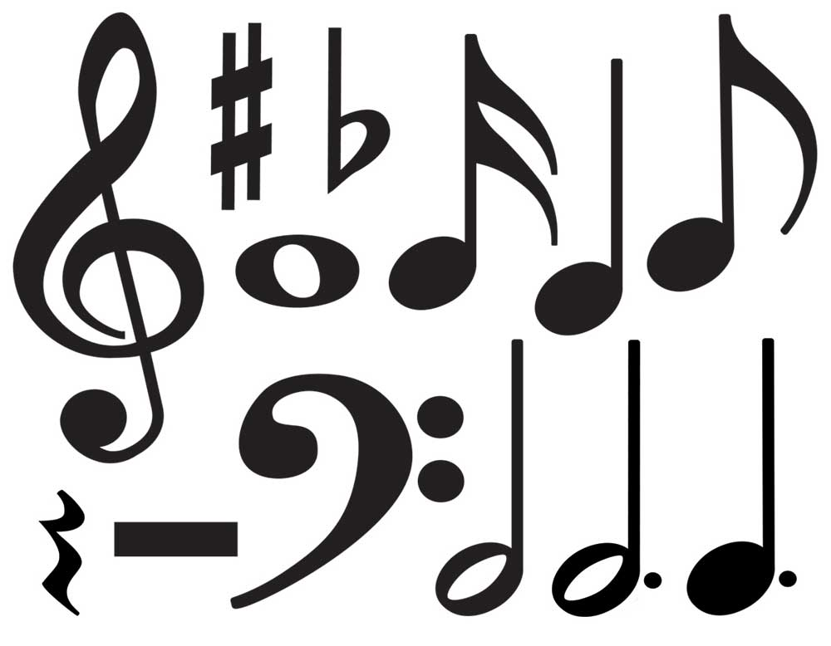
Language is symbolic
All human language systems are symbolic. When we learn to use language, we are learning the connection between the symbol and the ‘thing it represents’. This is actually very complex and sophisticated.

Slide 5
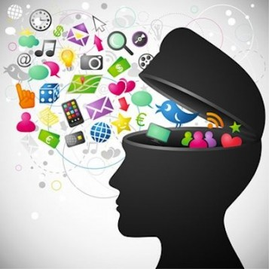
Symbolic thinking and learning
Do you think this is a good representation of:
Knowledge?
The learning process?
Explain your thinking.

Slide 6

Symbolic thinking and learning (continued)
Visit the website below and consider:
Which ‘theory of learning’ best accommodates what you have learned about the way we ‘think symbolically’.
How does these ‘theories of learning’ help you to further understand why ‘symbolic thinking’ might be important?
http://gsi.berkeley.edu/gsi-guide-contents/learning-theory-research/learning-overview/

Slide 7
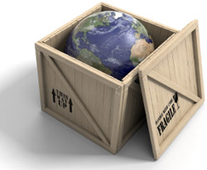
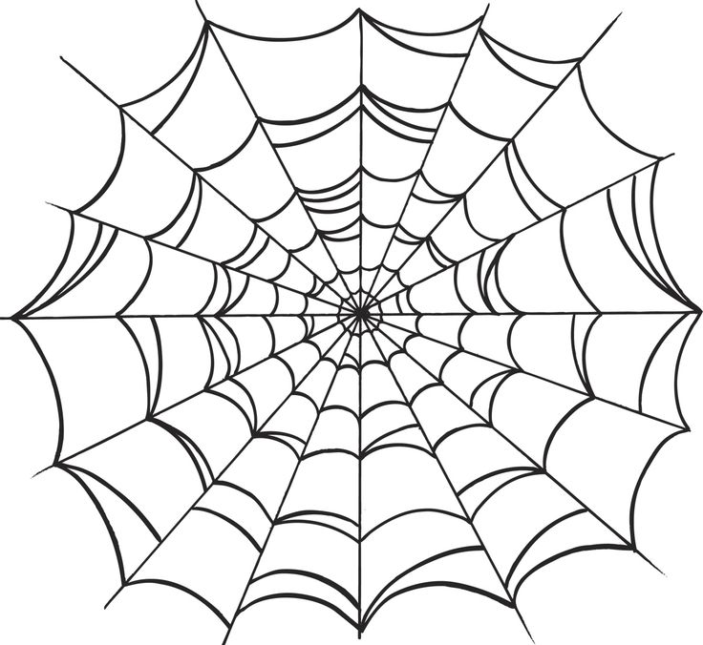
Symbols as packets and symbols as webs
Since symbols are such fundamentally interconnected things, our symbolic way of thinking allows us to:
Organise the world in an efficient way: for example, I can ‘pack up’ all the useful stuff I know about lions into a very rough symbol of a ‘lion’- this might include different contextual understandings of ‘lion’- as in the previous slide.
Make sense of new symbolic meaning through its interconnections with what we already know… Think of the way you can work out an unknown word by considering the other words in the sentence, the order of the words, the context in which the word is written or spoken.

Slide 8
Symbols and Dreams
Have you seen art like this before?
Does it remind you of anything?
What details do you notice in the image?
What might this painting be about?
‘Sleep’ by Salvador Dali
Salvador Dali Sleep 1937

Slide 9
Surrealist art
Surrealism is a cultural movement that began in the early 1920s, and is best known for its visual artworks and writings. Artists painted unnerving, illogical scenes with photographic precision…and developed painting techniques that allowed the unconscious to express itself. [Wikipedia]
The Two Fridas: (https://www.fridakahlo.org/images/paintings/the-two-fridas.jpg)
Frida Khalo
The Two Fridas, 1939

Slide 10
Symbols and learning
Or when you look at a painting and you can’t fully grasp what it means or why it’s affecting you like it is…
This is the ‘boundary area’ where symbols operate.
And as the symbols make your unconscious mind concrete, you can ‘think’ about the symbols. And after thinking about them, you can ‘articulate’ your thoughts.
And through this process, you ‘map out’ an area of the unknown, you expand your conscious mind.
Saturn Devouring his Children: http://www.19thcenturyart-facos.com/artwork/saturn-devouring-his-children
Goya- Saturn devouring his son

Slide 11
Recap
Language is symbolic- we communicate symbolically.
Symbols have meaning ‘packed into’ them.
But they also enable us to learn about the world in an interconnected way, so we can understand new information and experiences.
We think in symbols- whether they are ‘words’, ‘images’ or ‘sounds’.
Symbolic thinking is probably essential to expanding our own conscious awareness of ourselves as we grow and develop.
But… thinking about this last point... Does this mean that we all have to become expert dream interpreters if we want to get any smarter?

Slide 12
Stories as symbols
A symbol is something which stands for more than itself.
A shape, an object, a sound, a word…
But symbols can also be bigger and more complicated. Characters and stories can be seen as symbolic. Shakespeare’s characters Romeo and Juliet symbolise the intensity of young love. The story of Frankenstein symbolises the dangers of science devoid of morality.

Slide 13
Story survivors
The oldest stories within cultures have been chosen and remembered over thousands of years.
Jung might say they have been remembered because they were seen as ‘useful’. Why ‘useful’? Because they (symbolically) told some deep truth about the world.
…Even if people were not able to ‘explain’ the symbolic meaning. In a sense, they did not need to explain it- they had the story, the story ‘held’ the meaning and it could easily be passed down. (This was before English classes were invented).
Jonah and the Whale Fresco Holy Monastery of Saint Nicholas Anapausas Meteora Thessaly Greece

Slide 14
Story survivor: Jonah
This is a story which appears in the Jewish Tanakh and the Christian Old Testament. It references a time in the 8th century BCE.
Read the handout which summarises the story of Jonah and suggests some ‘archetypal’ symbols within the text.
1. What ‘important truths’ do you think this story might have told to its readers over the centuries?
2. To what extent do you think these ‘truths’ may have changed/ remained the same over time?
Jonah and the whale fresco: http://www.alamy.com/stock-photo-jonah-and-the-whale-fresco-holy-monastery-of-saint-nicholas-anapausas-65410809.html
Jonah and the Whale Fresco Holy Monastery of Saint Nicholas Anapausas Meteora Thessaly Greece

Slide 15
ACTIVITY: a) Choose at least one major symbolic element from one of the images below. b) Draft a narrative exploring the concept of transformation in which this symbol acts as a central motif. You are encouraged to be creative with your choice/ use of form.
‘Frankenstein’ Boris Karloff image search
Jonah and the Whale Fresco:
http://www.alamy.com/stock-photo-jonah-and-the-whale-fresco-holy-monastery-of-saint-nicholas-anapausas-65410809.html

