Slide 1
Mathematics learning sequence
Early Stage 1
Student activity resources

Slide 2
Activity 1
Counting book

Slide 3

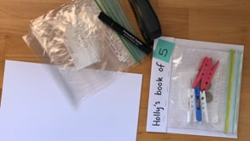
View
Watch the video to learn how to make a counting book…

Slide 4

Collect resources
You will need:
  colour pencils or markers
  5 zip-lock bags
  a stapler
  piece of cardboard

Slide 5
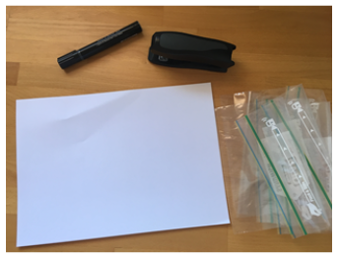

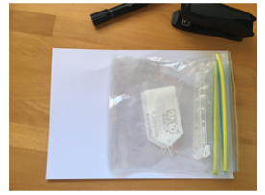
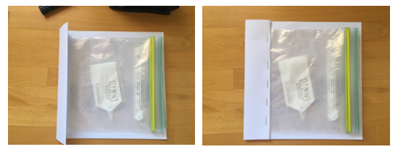
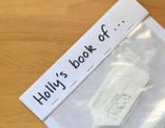
Instruction
How to make a counting book
Open the zip-lock bags.
Lay the bags on the cardboard, like pages of a book.
Take the remaining cardboard and fold it over the bags to form the spine of the book.
Staple it into place.
Finally, give the book a title!

Slide 6

Instruction
Create your book on a maths idea.
For example, you could make a book about 5.
Go on a ‘5 hunt’ to find different ways of showing 5.
Create your book about 5.
Read and share your book with someone in your family.
Draw your favourite page from the book you made in your mathematics workbook.

Slide 7
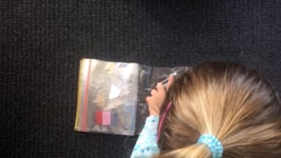
View
Watch Holly read her counting book…

Slide 8

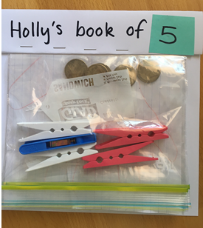
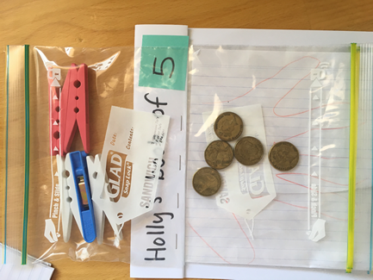
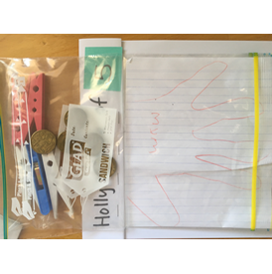
Advice for parents
Here is part of a different conversation to help illustrate what it can
sound like when talking to your child about their book…
Adult: You went on a hunt around the house to find different ways of representing 5.
Can you read your book to me?
Holly: Yes. I have 5 pegs
Adult: How do you know that is 5?
Holly: See...it’s 2 pink and the 3. That makes 5.
Adult: I see...that’s 2 and then 3, 4, 5 (touching one object for each number word that is said)
Adult: What else have you got in your book?
Holly: This one is 5 dollars... see there’s 3 here and 2 more. That’s five.
Holly: This one is my mum’s hand.
Adult: How do you know that’s five?
Holly: because she has 5 fingers on your hand
Adult: Look at all the different ways you found 5! Let’s find someone else to read it to!

Slide 9

Share / submit
Share your work with our class on our digital platform.
You may like to:​
write comments​
share pictures of your work​
comment on the work of others

Slide 10
Activity 2
Number busting

Slide 11
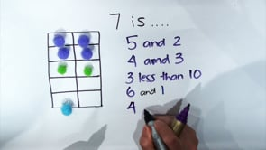
View
Watch the video to learn how to play…

Slide 12
Collect resources
You will need:
a number of the same items (for example, pasta pieces, counters, pencils or Lego)
pencils or markers
your mathematics workbook

Slide 13
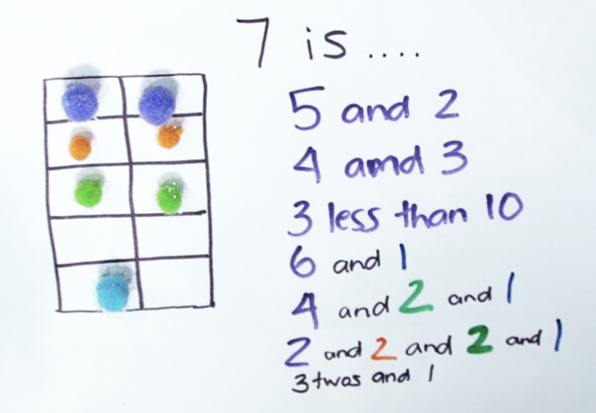
Instruction
Choose a number such as 7.
Get the amount of items for that number. (for example pasta pieces, counters or pencils)
Organise your items.
Describe your collection.
What other ways you can organise your items?
Describe your other ways.
You may like to use a mathematical structure such as a ten-frame to help you.

Slide 14
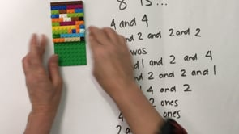
View
Here is another way we can play number busting using LEGO...

Slide 15
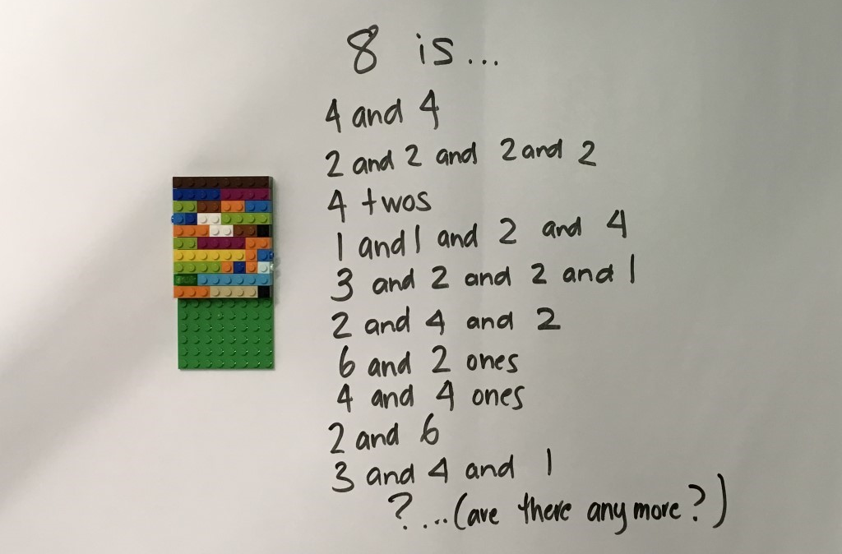
Instruction
Can you try the same activity using different equipment (like LEGO, for example)?
Draw and record 3 different ways you thought about your collection.

Slide 16

Discuss
Reflection
Were you surprised by all the different ways to make your number?
What did your structure help you notice? (for example ten frame, dice pattern)
What did you find interesting in this activity?

Slide 17
Share / submit
Share your work with our class on our digital platform.
You may like to:​
share your responses to the reflection questions
write comments​
share pictures of your work​
comment on the work of others

Slide 18
Activity 3
‘Guess my number’ and
‘Race to write’

Slide 19
Guess my number

Slide 20
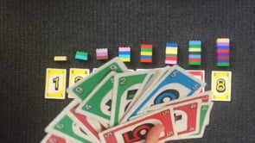
View
Watch the video to learn how to play…
(From https://www.hmhco.com/products/do-the-math/pdfs/WinWinGamesbyMarilynBurns.pdf)

Slide 21
Collect resources
You will need:
numeral cards 1-10 (optional)
Lego or blocks
pencils or markers
your mathematics workbook

Slide 22
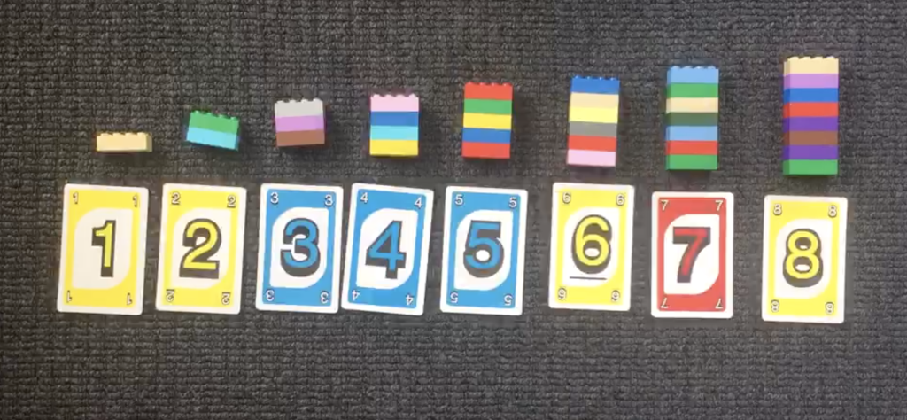
Instruction
Write the numbers from 1 to 10 (for example) on a piece of paper or
use cards to set the number range. For example, this student chose to use the numbers between 1 and 8.
Ask someone at home (the ‘secret holder’) to choose a secret number within your given range.
Guess the ‘secret' holder’s number
They will tell you whether their number is greater or less than your guess.
Try to guess the secret number in the fewest number of guesses possible, or, with only 3 guesses.

Slide 23
Advice for parents
Here is part of a conversation to help illustrate what the game can sound like.
This was a game between a teacher and a student, using the number range 1-12:
Secret holder: My number is not 7, but my number is less than 7. Can you cross any more numbers off the list?
Student: Yes! 7...8, 9, 10, 11 and 12!
Secret holder: What are the options you have left?
Student: 4, 5 or 6!
Secret holder: Take some time to think about what a good number would be to guess now.
Student: Maybe 5?
Secret holder: Why do you think that?
Student: If I choose 5...it’s in the middle. So, I will know the answer whatever happens with bigger and smaller. And it could just be 5!
Secret holder: Ok, make your first guess!
Student: 3.
Secret holder: My number is not 3.
But my number is greater than 3.
Are there any numbers you can cross off your list?
Student: It’s not 3 so I can cross that off.
Student: It’s not 2 or 1 either as they are less than 3.
Secret holder: That’s great reasoning- because my number is greater than 3, but those numbers are less than 3, they can be crossed off.
What is your next guess?
Student: 7.

Slide 24
Discuss
Reflection
What is an effective strategy to guess the number quickly?
If you played the game again tomorrow, what would you do differently? Why?

Slide 25
Share / submit
Share your work with our class on our digital platform.
You may like to:​
share your responses to the reflection questions
write comments​
share pictures of your work​
comment on the work of others

Slide 26
Race to write

Slide 27
Collect resources
You will need:
1-10 dot spinner
pencils or markers
your mathematics workbook
a partner to play the game with

Slide 28
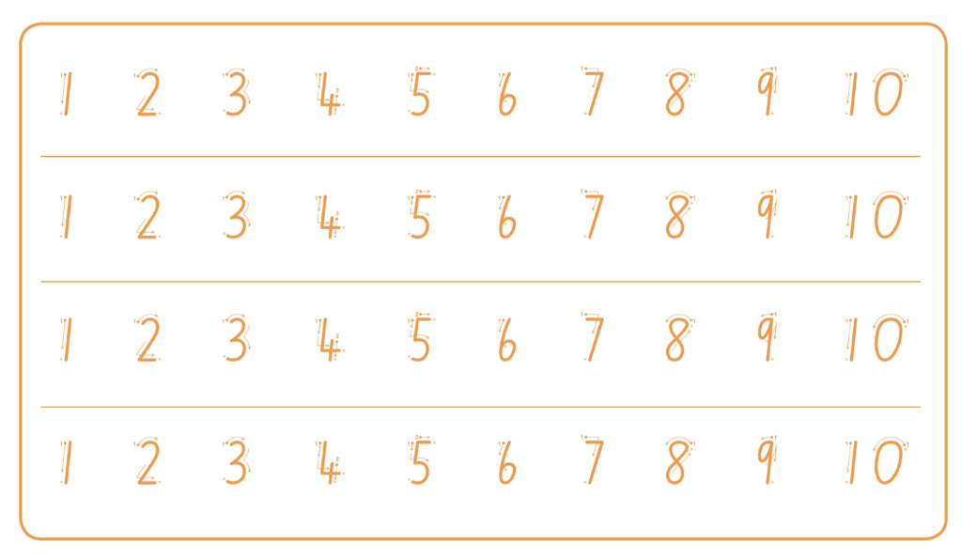
Instruction
Take turns to spin the spinner and trace over the matching numeral
on your game board. The first player to complete a full row wins the race.

Slide 29
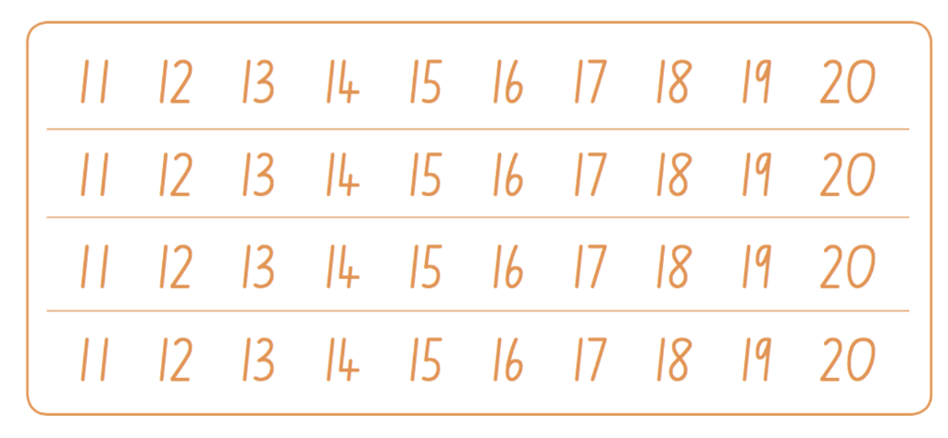
Advice to parents
Other ways to play
Provide your child with a pile of number words they flip over to determine which numeral to write. (e.g. cards that say ‘one’, ‘two’ etc.)
Have a pile of ten frames showing 1-10. Students flip over to determine which numeral to write.
Work within the range of 1-5 before progressing to 1-10.
Work with numerals 1-20 using a second game board.

Slide 30
Discuss
Reflection
If you played the game again tomorrow, what would you do differently? Why?

Slide 31
Share / submit
Share your work with our class on our digital platform.
You may like to:​
share your response to the reflection question
write comments​
share pictures of your work​
comment on the work of others

Slide 32
Activity 4
Counting with understanding

Slide 33
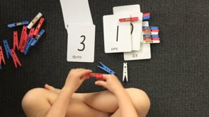
View
Watch the video to learn how to play…

Slide 34
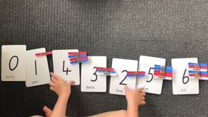
View
Watch the video to learn how to play…

Slide 35
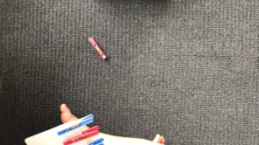
View
Watch the video to learn how to play…

Slide 36
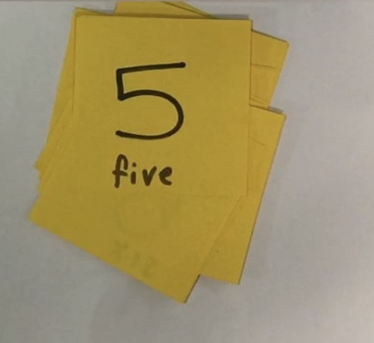
Collect resources
You will need:
some pegs or paper clips
numeral cards. You can make these using sticky-notes and a marker.
pencils or markers
your mathematics workbook

Slide 37
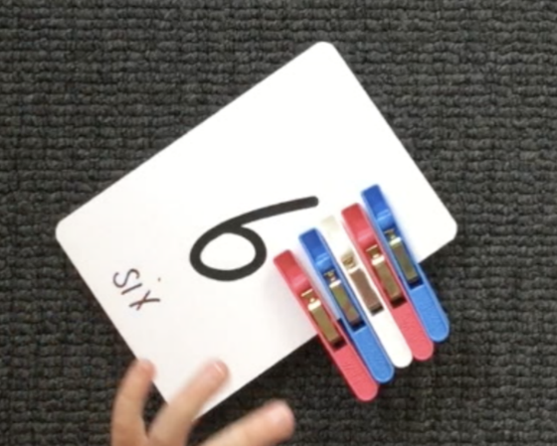
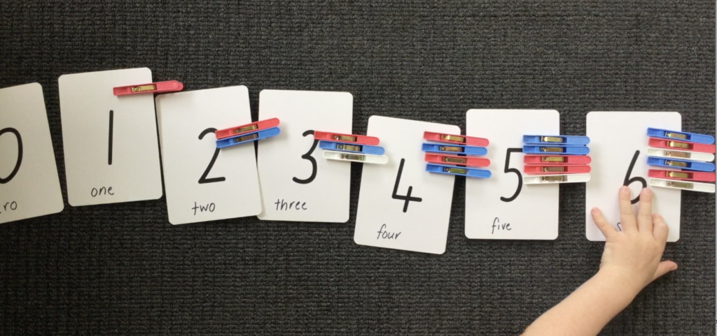
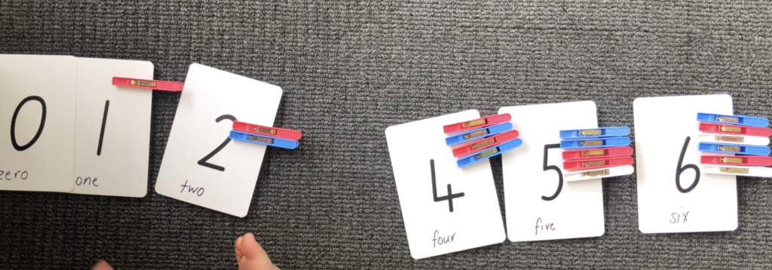
Instruction
Use a set of number cards within an appropriate number range. For this example, we are using 0-6.
Shuffle the cards.
Turn one card over at a time and read the numeral.
Match the number of pegs (or some other item) with the numeral card.
Order the cards from smallest to biggest, or, biggest to smallest.
Close your eyes as someone at home removes one of your cards.
Which card is missing?
How did you work out?

Slide 38
Advice for parents
Choose one card, for example 5.
Ask your child how many pegs are on the card in order to establish and confirm that there are 5.
Support your child’s understanding of conservation by spreading the pegs out, bringing them in close together and swapping 1 peg for a clip.
Encourage them to use reasoning to determine there are still 5 things in the collection even if they are close together or far apart, or, when one thing is swapped for another.

Slide 39
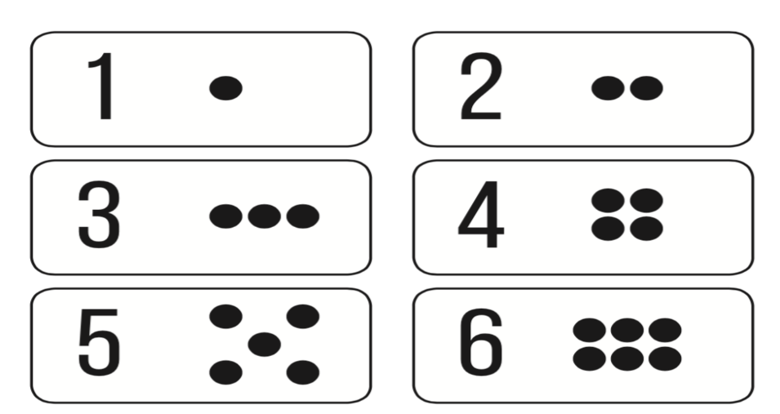
Instruction
An easier way to play
Use cards that have a numeral and matching dot pattern so you can attach one peg for each dot.

Slide 40
Instruction
Another way to play
Place a row of paper cups on the floor. Count the empty cups. Drop one counter into each cup and count the counters as they are dropped into the cups.
Remove one cup at a time to practise counting backwards.

Slide 41
Discuss
Reflection
What do you need to remember when counting?

Slide 42
Share / submit
Share your work with our class on our digital platform.
You may like to:​
share your response to the reflection question
write comments​
share pictures of your work​
comment on the work of others

Slide 43
Activity 5
‘10 or bust’ or ‘The counting game’

Slide 44
10 or bust!

Slide 45
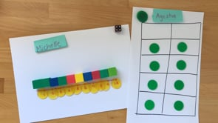
View
Watch the video to learn how to play…

Slide 46
Collect resources
You will need:
a game board (for example use a number track, a ten-frame, a drawing of 10 fingers, a drawing of a known number combination to 10)
counters (or dried beans or pasta)
a dice, spinner or numeral cards from 1-6
pencils or markers
your mathematics workbook

Slide 47
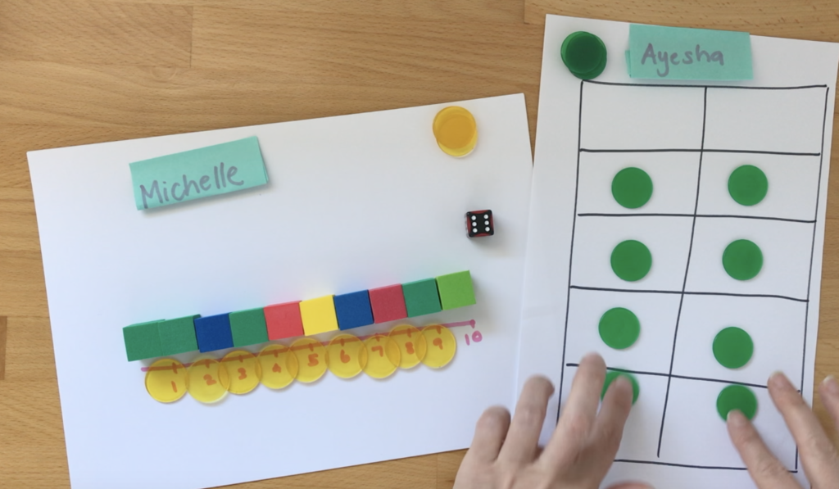
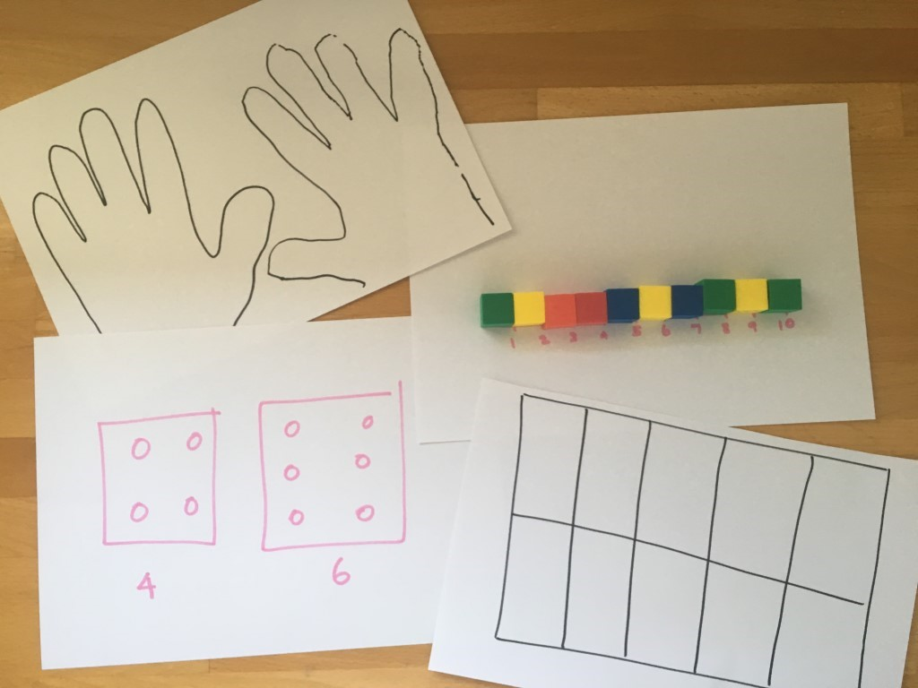
Instruction
Have 3 turns each to roll the dice and place the matching number of counters on your game board.
You can choose to miss 1 turn, but it cannot be your last roll.
If you go over 10, you have ‘busted’ and are out of the game.
The player closest to 10 after 3 rolls each is the winner.
Players can play best out of 3, playing by making up to 10 as well as backwards to 0.

Slide 48
Discuss
Reflection
How could we change the game to make it more/less challenging?
Did you work out a way to play this game so that you didn’t lose? What was your strategy? Did it work?

Slide 49
Share / submit
Share your work with our class on our digital platform.
You may like to:​
share your response to the reflection question
write comments​
share pictures of your work​
comment on the work of others

Slide 50
The counting game

Slide 51
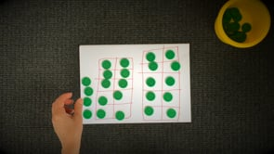
View
Watch the video to learn how to play…

Slide 52
Collect resources
You will need:
24 items (for example, pasta pieces, counters, pegs, pencils or blocks)
pencils or markers
your mathematics workbook

Slide 53
Instruction
Using 24 as a target number.
Take in turns to count on by saying the next 1, 2 or 3 number words in the sequence, placing the items into a central pile as they are counted.
Players collect a point if they say the target number.
A new target number is chosen and players play again.
Try playing forward and backward.

Slide 54
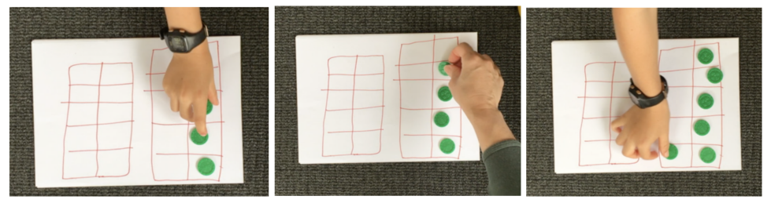
Advice for parents
An example of this game. Target number 24.
Player A: 1, 2, 3...
Player B: 4...
Player A: 5, 6...
Player B: 7, 8, 9…
Player A: 10, 11, 12...
Player B: 13…
Player A: 14...
Player B: 15, 16...
Player A: 17...
Player B: 18...
Player A: 19...
Player B: 20, 21...
Player B: 22, 23, 24!
Play again, starting at 24 and counting backwards to zero.

Slide 55
Instruction
Another way to play
Choose a different target number, such as 12.
You can also count in multiples. For example, you can start at 0 and aim for 20, counting by twos.

Slide 56
Discuss
Reflection
What would happen if I had said....instead of ...? (identify a point time, when playing the game, to ask this question)
How could we change the game to make it more/less challenging?
What did you notice about playing the game by counting backwards? Did it make your brain work harder or was it less difficult?
Did you work out a way to play this game so that you didn’t lose? What was your strategy? Did it work?

Slide 57
Share / submit
Share your work with our class on our digital platform.
You may like to:​
share your response to the reflection question
write comments​
share pictures of your work​
comment on the work of others

Slide 58
Activity 6
Basketball toss

Slide 59
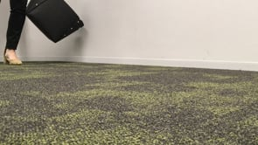
View
Watch the video to see how to play Basketball toss

Slide 60
Collect resources
You will need:
pair of socks
basket, bucket or container
a clear space
1 piece of paper
pencils or markers
10 pegs
a ten-frame
pencils or markers
your mathematics workbook

Slide 61
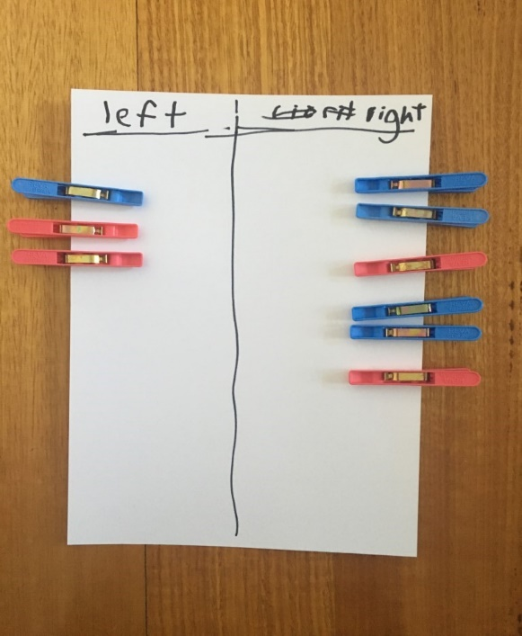
Instruction
Challenge: See how many times you can successfully shoot your
rolled up socks into the basket.
Mark a clear ‘starting line’ for your basketball toss.
Take 3 big steps from your starting line and place
a basket, bucket or container at the end.
Stand at your starting line and throw your socks with your right hand.
Each time you get a sock in the basket, clip a peg onto your chart.
Go back to your starting line and have your second throw.
Repeat this until you have thrown your socks 10 times with your right hand and then 10 times with your left hand.
Draw a picture of your chart in your mathematics workbook.

Slide 62
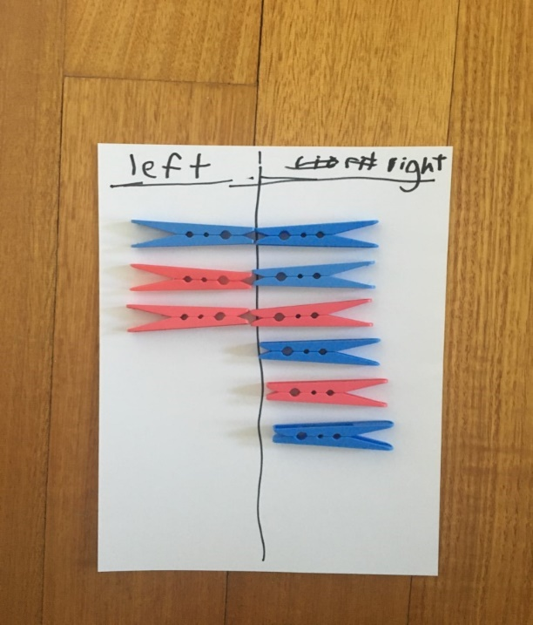
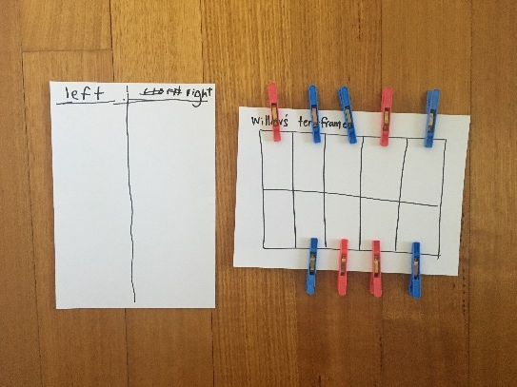
Advice for parents
You can support your child by having them use direct comparison to help them work out/prove which one had more.
Your child can also put their pegs onto a familiar structure, like a ten-frame. It’s important to have them use what they know about this structure to help them. So, if I see 1 box is left empty, I know I got 9 baskets because 1 less than 10 is 9.

Slide 63
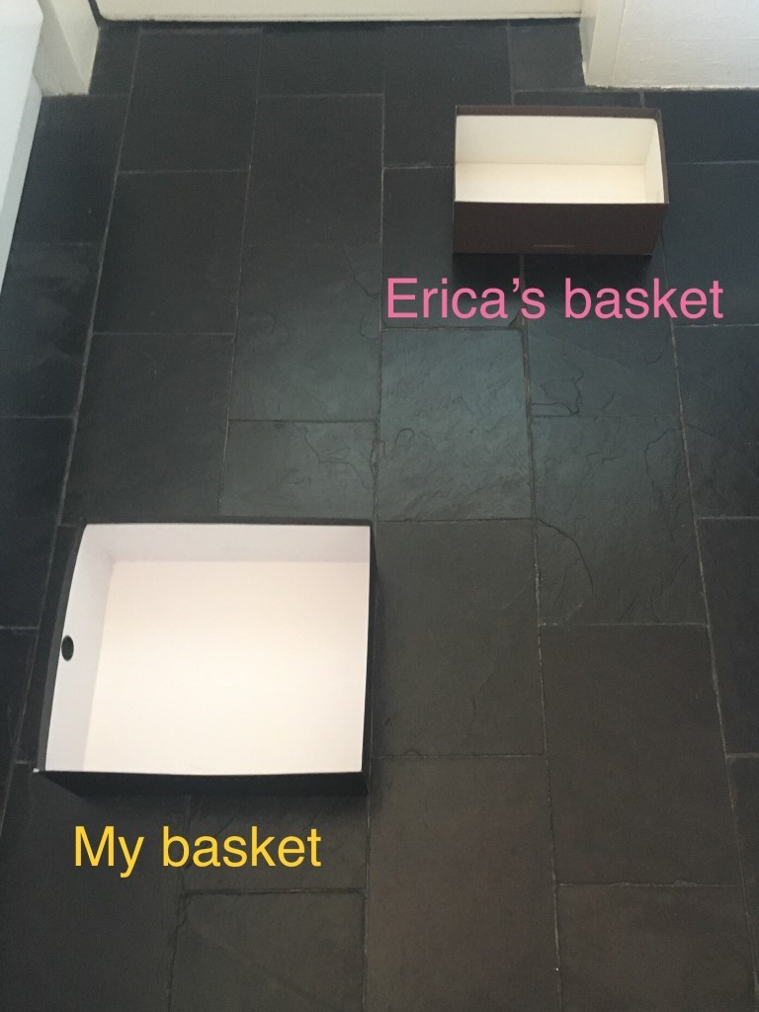
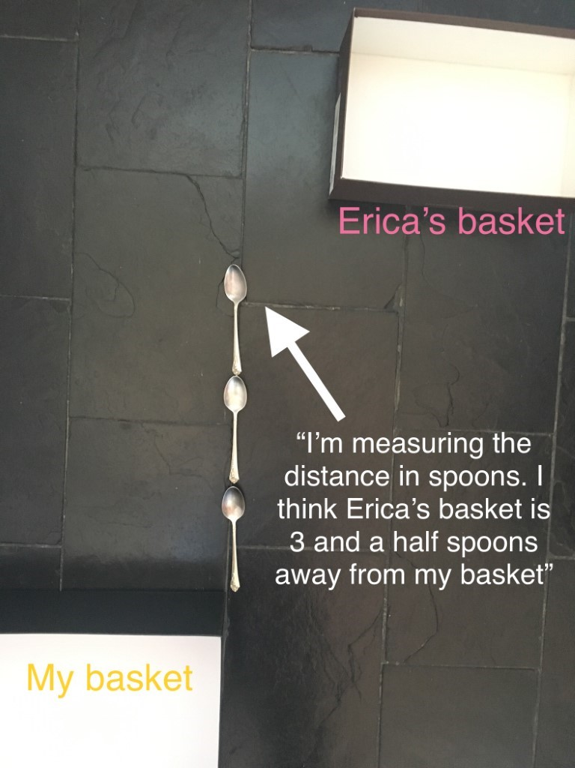
Instruction
Further investigation
Other people in your family might have been playing basketball toss today too.
If they’re taller than you, they might have had their baskets in a different spot. Using some blocks or spoons, for example, work out how far you had to throw your socks and then work out how far someone else had to throw theirs.
Draw a picture to show your measuring.
Can you create a new game your family and friends could play at home?

Slide 64
Discuss
Reflection
How many baskets did you get when you used your left hand?
How many baskets did you get when you used your right hand?
How many did you get altogether?

Slide 65
Share / submit
Share your work with our class on our digital platform.
You may like to:​
write comments​
share pictures of your work​
comment on the work of others

Slide 66
Activity 7
Long creatures!

Slide 67
Collect resources
You will need:
cardboard (cut into thin strips)
craft materials
pencils or markers
your mathematics workbook

Slide 68
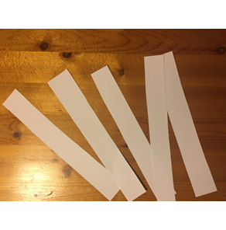
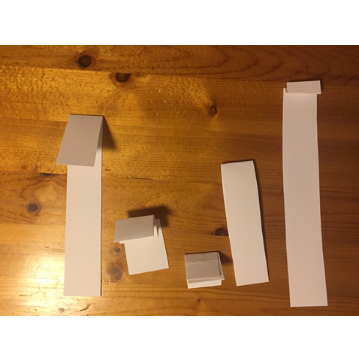
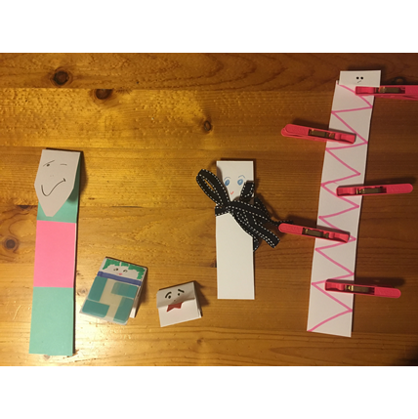
Instruction
Fold the strips into different lengths.
Decorate your cardboard strips to help them come to life!
Order your creatures from the shortest to tallest (for example).
Draw your creatures in your mathematics workbook.
(adapted from NRICH maths https://nrich.maths.org/9717)

Slide 69
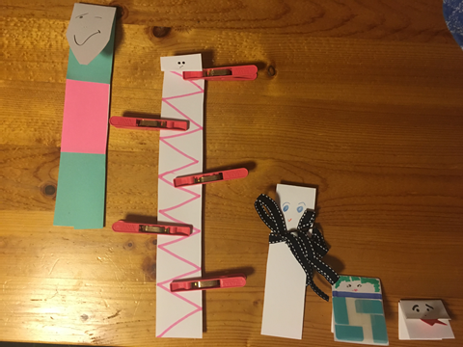
Discuss
Reflection
Do you agree with this way of ordering from tallest to shortest.
Explain why or why not?

Slide 70
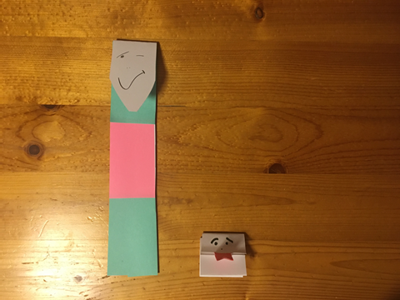
Instruction
Choose your shortest creature and one of your longer creatures.
How may short creatures are needed to be the same height as the taller creature?
Draw a picture to show you measuring how tall the creature is that you just measured.

Slide 71
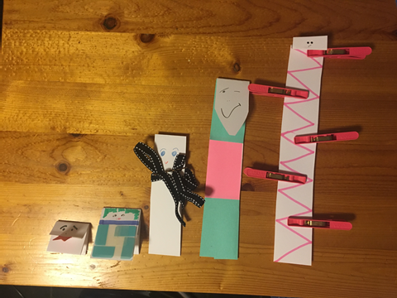
Advice for parents
Support your child in understanding that to measure accurately, we need to make sure we start measuring from the same place.

Slide 72
Share / submit
Share your work with our class on our digital platform.
You may like to:​
write comments​
share pictures of your work​
comment on the work of others

Slide 73
Activity 8
Pinch a ten

Slide 74
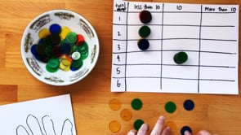
View
Watch the video to learn how to play…

Slide 75
Collect resources
You will need:
small bag of dried beans or counters
piece of paper
pencils or markers
your mathematics workbook

Slide 76
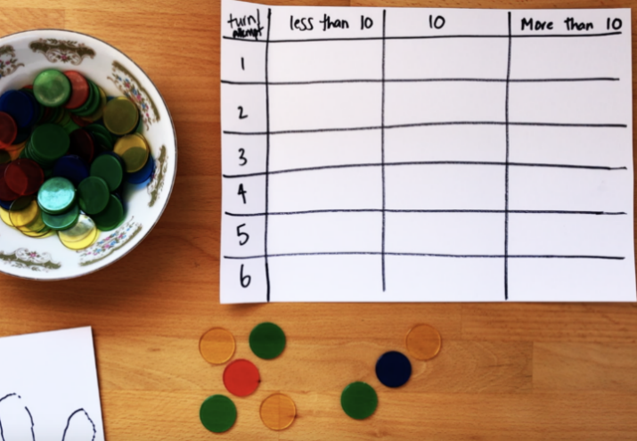
Instruction
Take a pinch of dried beans and determine how many you have in your collection. Is it:
less than 10
10
more than 10
Complete the chart.
Use what you know about numbers and counting to help you decide whether you have more than 10, less than 10, or exactly 10.
Play again 5 more times.

Slide 77
Discuss
How did you work out how many you pinched?
What do you notice about your chart?

Slide 78
Advice for parents
When playing the game on different occasions, your child should be encouraged to use different strategies for determining how many they have.
Using different objects (such as dried pasta, dried beans, blocks, etc.) will also be helpful in supporting students to get a feel for estimating quantities.

Slide 79
Share / submit
Share your work with our class on our digital platform.
You may like to:​
write comments​
share pictures of your work​
comment on the work of others

Slide 80
Activity 9
Building towers

Slide 81
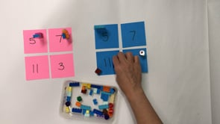
View
Watch the video to learn how to play…

Slide 82
Collect resources
You will need:
some blocks or Lego
a dice, numeral cards 1-6 or spinner
pencils or markers
your mathematics workbook

Slide 83
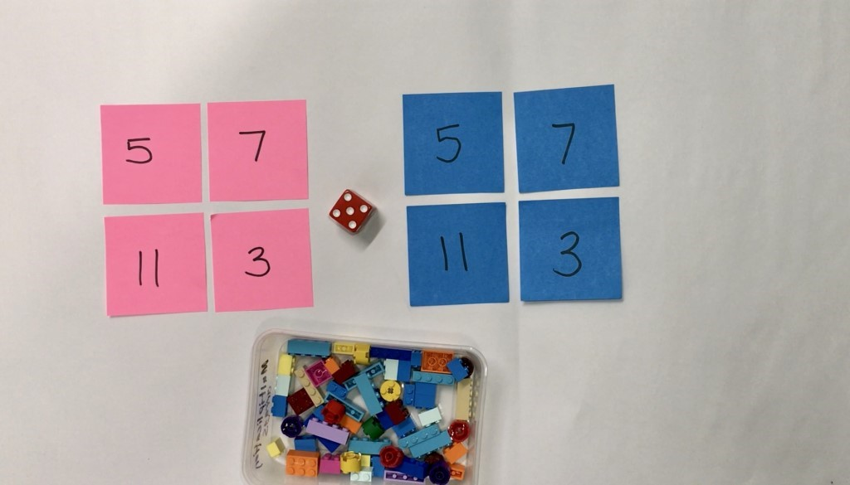
Instruction
Choose 4 numbers to build as your towers (for example, 5, 7, 11 and 3)
Take turns to roll a dice and use the number of bricks to build up your towers.
Towers can be built up in any way you choose.
Take turns to build up your towers until one player gets the exact roll to complete the last tower.
You can also play this in reverse.
Talk about how many you have, how many more you need, what strategies you are using and your thinking.

Slide 84
Instruction
Other ways to play
Build the towers and play in reverse. Taking away blocks each time until there are no blocks left.
Change the number of towers you build.
Change the number of blocks needed for each tower.

Slide 85
Discuss
Reflection
If you were to play the game again tomorrow, what is one thing you would do differently? Why?
Draw a picture in your mathematics workbook that shows the towers you built in order of shortest to tallest.

Slide 86
Share / submit
Share your work with our class on our digital platform.
You may like to:​
write comments​
share pictures of your work​
comment on the work of others

Slide 87
Activity 10
Let’s explore patterns

Slide 88
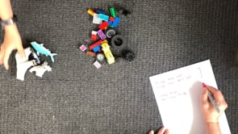
View
For adults: Watch the background video about sorting…

Slide 89
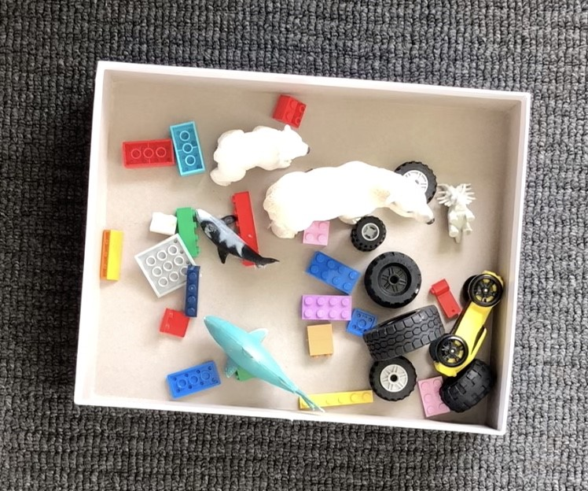
Collect resources
You will need:
a collection of objects
pencils or markers
your mathematics workbook

Slide 90
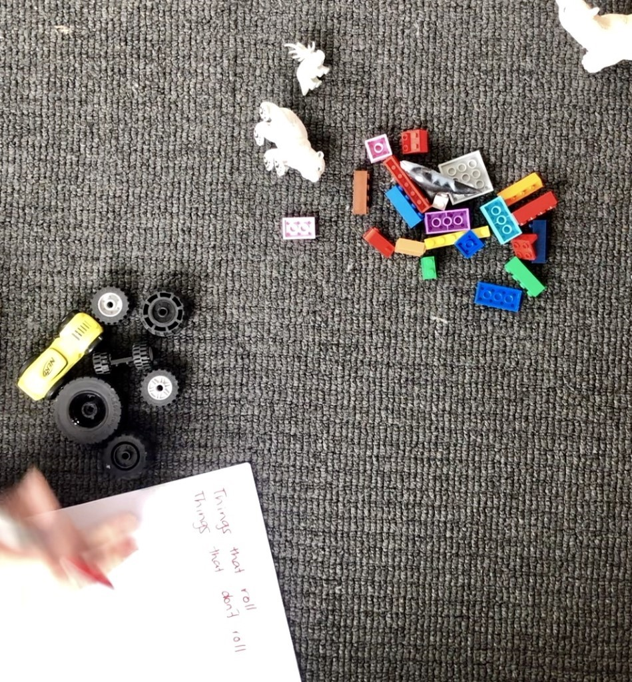
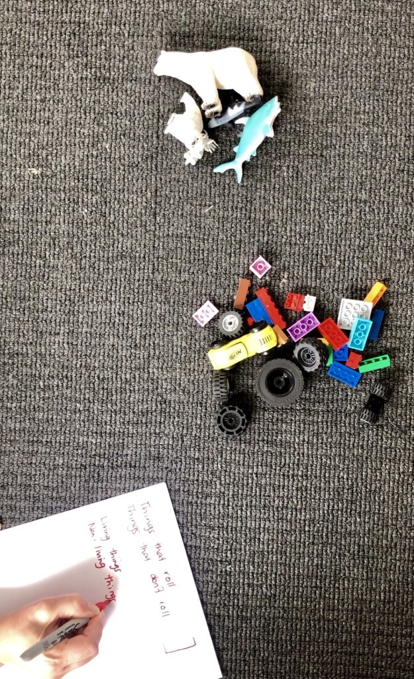

Instruction
What are some different ways to sort your collection. Someone at home could help you record your ways of thinking.

Slide 91

View
For adults: Watch the background video about patterns…

Slide 92

View
For adults: some follow up questions you might like to ask

Slide 93

View
For adults: some other follow-up questions you might like to ask

Slide 94

Instruction
Describe this pattern.
How do you know it is a pattern?
How would you describe the part that repeats?

Slide 95
Instruction
Make an AB pattern.

Slide 96

Instruction
How are these patterns the same?
How are they different?

Slide 97
Instruction
Make, copy or extend an ABB pattern.

Slide 98
Share / submit
Share your work with our class on our digital platform.
You may like to:​
write comments​
share pictures of your work​
comment on the work of others

