Slide 1
Mathematics learning sequence – Stage 1
Student activity resources

Slide 2
Activity 1
Strike it out! Let’s play

Slide 3
View
Watch the video to learn how to play…
(from NRICH Maths https://nrich.maths.org/8016)

Slide 4
Collect resources
You will need:
three colour pencils or markers
your mathematics workbook

Slide 5
Instruction
Draw a number line from 0 to 20.
The first player chooses a number on the line and crosses it out.
The same player then chooses a second number and crosses that out too.
Finally, he or she circles the sum or difference of the two numbers and writes down the calculation.
For example, the first player's go could look like this:
The second player must start by crossing off the number that player 1 has just circled.
He or she then chooses another number to cross out and then circles a third number which is the sum or difference of the two crossed-off numbers.
Player 2 also writes down their calculation.
For example, once the second player has had a turn, the game could look like this:
The winner of the game is the player who stops their opponent from being able to have a go.

Slide 6
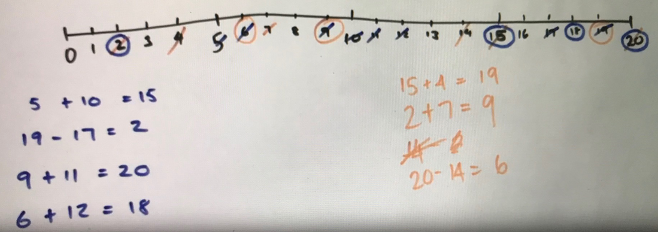
Discuss
Now that you've played, is there a way Michelle can win?
What could she have done differently on her last move?
Share your thoughts with our class on our digital platform.

Slide 7
Discuss
What is something you would do differently if you were to play the game again?

Slide 8
Share / submit
Share your work with our class on our digital platform.
You may like to:​
write comments​
share pictures of your work​
comment on the work of others

Slide 9
Activity 2
Number busting

Slide 10
View
Watch the video to learn how to play…

Slide 11
Collect resources
You will need:
26 items (for example, pasta pieces, counters or pencils)
pencils or markers
your mathematics work book

Slide 12
Instruction
Get 26 items (for example, pasta pieces, counters or pencils).
Organise and describe your collection.
Try to reorganise and describe your collection as many times as you can within the next 5 minutes.
Draw and record all of your ways of thinking about your collection.
Play Strike it out! again

Slide 13
Share / submit
Share your work with our class on our digital platform.
You may like to:​
write comments​
share pictures of your work​
comment on the work of others

Slide 14
Activity 3
101 and you’re out!

Slide 15
View
Watch the video to learn how to play…
(From https://www.hmhco.com/products/do-the-math/pdfs/WinWinGamesbyMarilynBurns.pdf)

Slide 16
Collect resources
You will need:
dice or numeral cards 1-6
pencils or markers
your mathematics workbook

Slide 17
Instruction
Make a game board by drawing a 6 x 4 table.
Label the first column as ‘tens’, the second column as ‘ones’, the third column as number and forth column as total.
Each time you roll the dice, you have to decide whether the number is representing ‘ones’ or ‘tens’. For example, if I roll a 3, I could use it as 3 ones (3) or 3 tens (which we rename as 30). If you choose to use your 3 as 3 ones, record the number in the ones column. If you choose to use your 3 as 3 tens (30), record your number in the left column.
Continue to play for six rolls.
Once you write a number, you can’t change it.
The winner is the player with the sum that is closest to 100 without going over!
Draw up 4 new game boards. Using the same numbers you rolled, use the game boards to get closer to 100 than you did in your first game.
Play again with someone at home!

Slide 18
Instruction
Other ways to play
Increase the challenge by using numbers from 0-9. You can also use playing cards, make cards or make a spinner at home.
Roll the dice 4 times and only use four lines on the game board.

Slide 19
Discuss
Did you get closer to 100 on your second go with the same numbers?
Why do you think that was?
What advice would you give to someone playing this game for the first time?

Slide 20
Share / submit
Share your work with our class on our digital platform.
You may like to:​
write comments​
share pictures of your work​
comment on the work of others

Slide 21
Activity 4
The counting game

Slide 22
View
Watch the video to learn how to play…

Slide 23
Collect resources
You will need:
collect 24 objects
pencils or markers
your mathematics workbook

Slide 24
Instruction
Collect 24 objects.
Using 24 as a target number, take it in turns to count on by saying the next 1, 2 or 3 number words in the sequence, placing objects into a pile as they are counted.
Players collect a point if they say the target number.
Choose a new target number and play again.
Try playing forward and backward.

Slide 25
Instruction
Other ways to play
Select a different target number and a starting number. For example, you might start at 35 and try to get to 51.
Count in multiples. For example, you can start at 0 and aim for 85, counting by fives.

Slide 26
Discuss
Is there a way to play so that you never lose?
What would you do differently if you were to play the game again?

Slide 27
Share / submit
Share your work with our class on our digital platform.
You may like to:​
write comments​
share pictures of your work​
comment on the work of others

Slide 28
Activity 5
The counting game multiples part 2

Slide 29
View
Watch the video to learn how to play…

Slide 30
Instruction
It’s time to test our strategies!
Start from a given number and count back, trying to be the person who says zero.
For example:
Target number 0 (starting at 110 and counting in tens)
Player A: 100...
Player B: 90, 80...
Player A: 70...
Player B: 60...
Player A: 50, 40...
Player B: 30, 20, 10...
Player A: zero!

Slide 31
Discuss
What did you notice about playing the game by counting backwards? Did it make your brain work harder or was it less difficult?
Did you work out a way to play this game so that you didn’t lose? What was your strategy? Did it work?

Slide 32
Share / submit
Share your work with our class on our digital platform.
You may like to:​
write comments​
share pictures of your work​
comment on the work of others

Slide 33
Activity 6
Basketball toss

Slide 34
View
Watch the video to see how to play Basketball toss

Slide 35
Collect resources
You will need:
a pair of socks
a clear space
basket, bucket or container
pencils or markers
your mathematics workbook

Slide 36
Instruction
Challenge: See how many times you can successfully shoot your
rolled up socks into the basket.
Mark a clear ‘starting line’ for your basketball toss
Take 3 big steps from your starting line and place a basket, bucket or container at the end.
Standing at your starting line throw your socks with your right hand.
Go back to your starting line and have your second throw.
Repeat this until you have thrown your socks 10 times with your right hand and then 10 times with your left hand.
Keep a record in your mathematics workbook.
Create a picture graph to share your results.

Slide 37
Discuss
What do you notice about your graph?
What does it tell you about your success at playing sock basketball using your left hand compared to using your right hand?
Do you think that these results will change with practice?

Slide 38
Share / submit
Share your work with our class on our digital platform.
You may like to:​
write comments​
share pictures of your work​
comment on the work of others

Slide 39
Activity 7
Sam and Holly’s problem

Slide 40
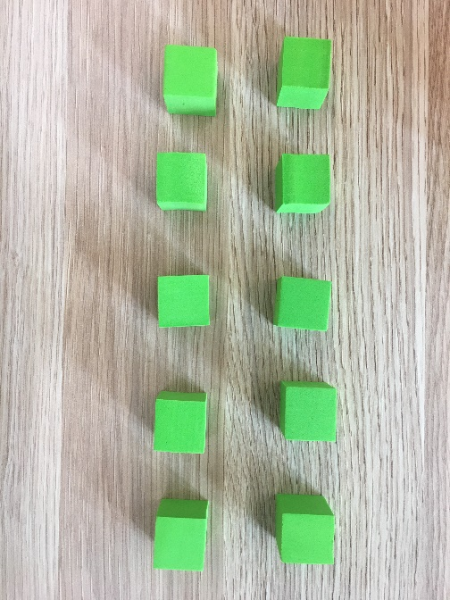
Instruction
Solve the following problem
Sam and Holly were playing with combinations of numbers that make 10. They started by getting out 10 blocks.

Slide 41
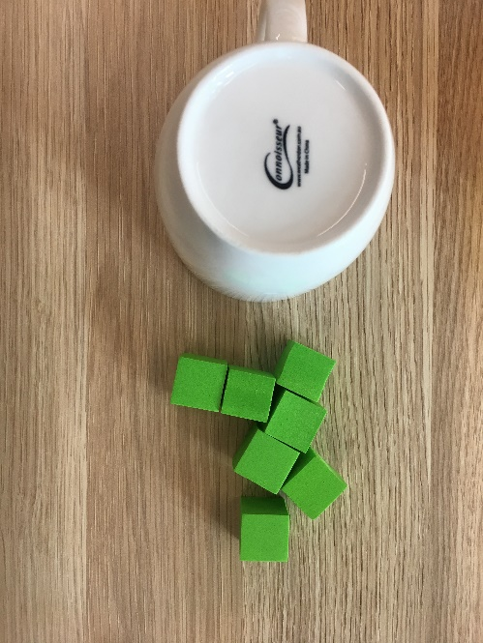
Instruction
Then, Sam covered some of the blocks and Holly had to work out how many were missing.

Slide 42
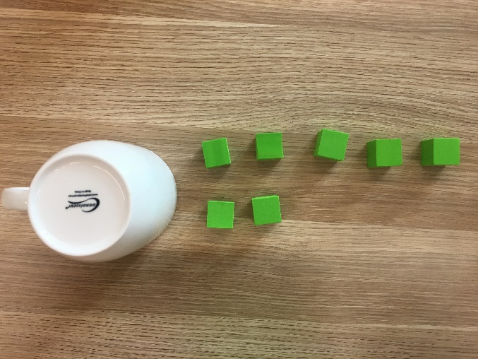
Instruction
Holly decided she to organise what she could see to help her work out what was missing.

Slide 43
Instruction
Holly decided she to organise what she could see to help her work out what was missing.
She imaged a 10-frame in her head and organised the blocks. This helped her see she needed 3 more to make 10.

Slide 44
View
Watch to see Holly's problem...
Holly and Sam kept taking turns like this until Holly asked Sam if they could make it more challenging for them...

Slide 45
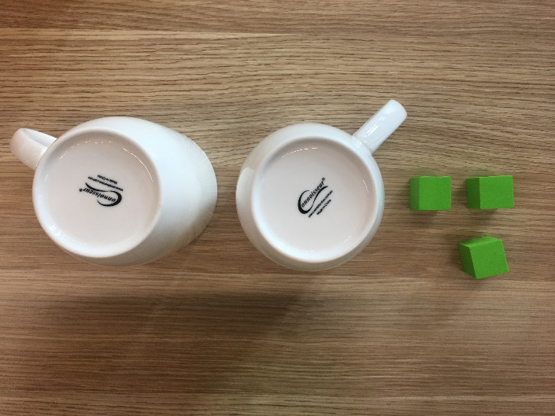
Instruction
Sam made this for Holly to think about:
Can you help Holly work out how many blocks are hidden?
Can you help her work out how many of the hidden blocks might be underneath each cup?
What are all the possibilities?

Slide 46
Discuss
What are possibilities did you find?
Could you work out what exactly Sam put under each cup for Holly?
Why? Why not?

Slide 47
Share / submit
Share your work with our class on our digital platform.
You may like to:​
write comments​
share pictures of your work​
comment on the work of others

Slide 48
Activity 8
Handfuls

Slide 49
View
Watch the video to learn how to play…
(Adapted from Ann Gervasoni, published on reSolve
https://www.resolve.edu.au/counting-handfuls )

Slide 50
Collect resources
You will need:
items such as counters, lima beans or pasta
pencils or markers
your mathematics workbook

Slide 51
Instruction
Take a handful of counters (or lima beans or pasta).
Hold the objects in your hand and imagine how many you have.
Record your estimate.
Describe what that collection might look like by visualising and imagining.
Organise your collection so that someone can determine how many items there are by looking and thinking.

Slide 52
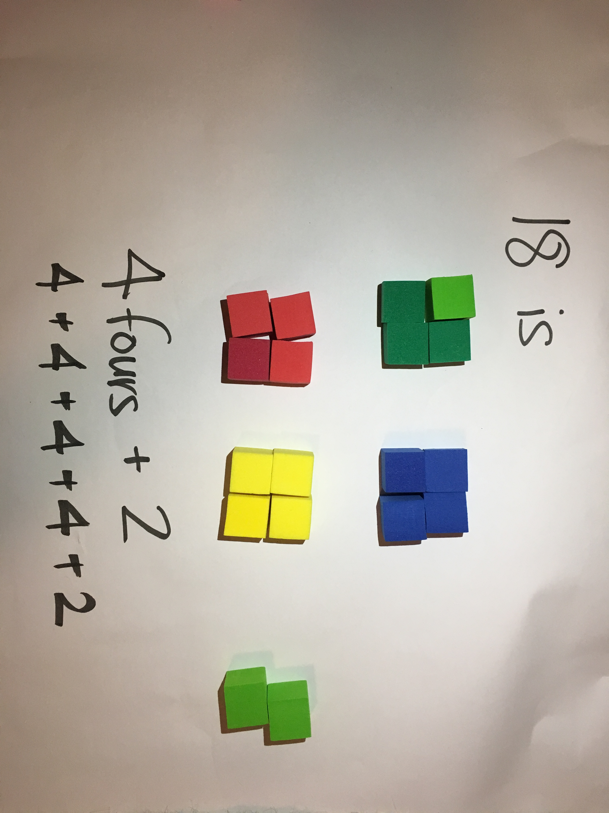
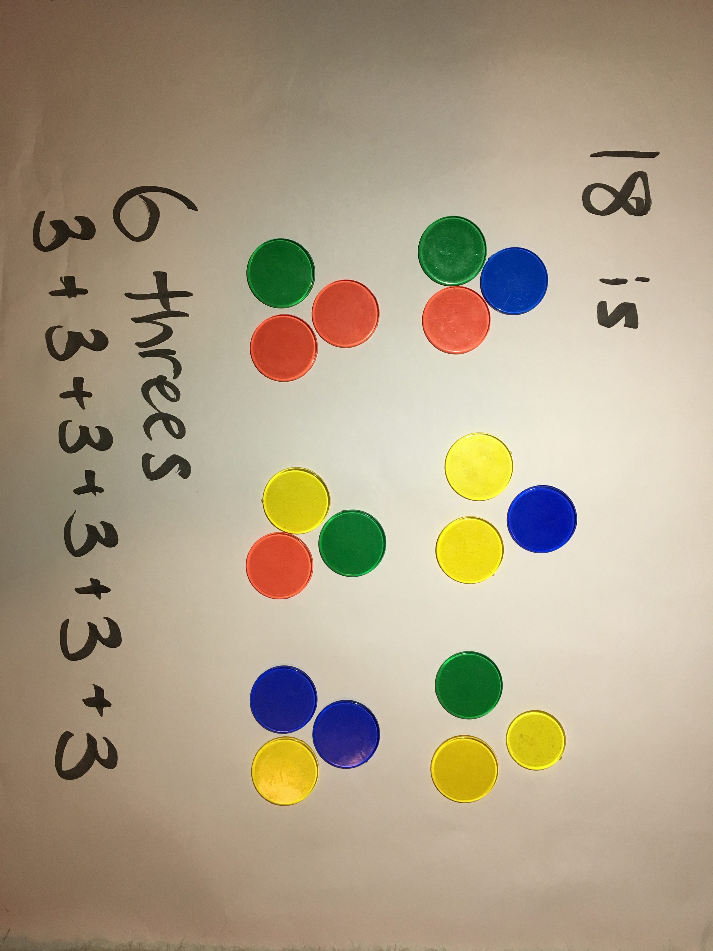
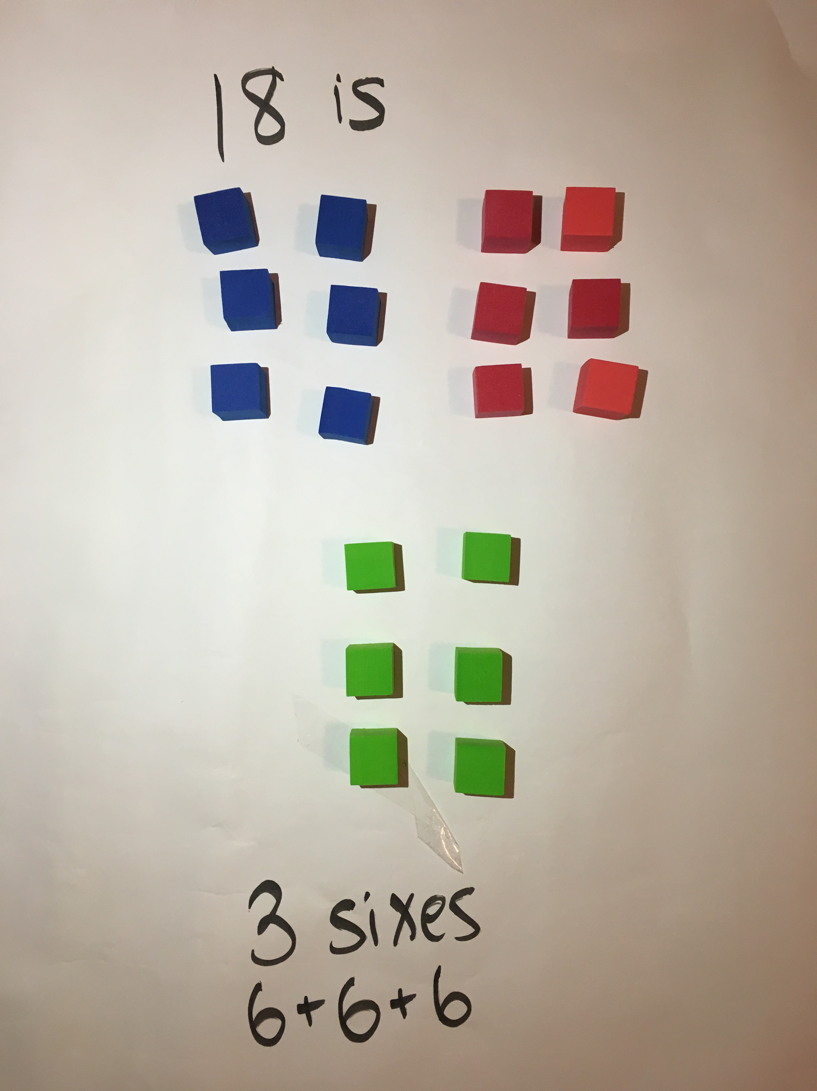
Discuss
How many do you have altogether?
How have you organised your collection?
Did you have more or less than your estimation?
Can you organise them differently? (Here is an example for 18)
How many ways can you arrange your collection so you can see how many there are by looking and thinking?

Slide 53
Instruction
Play handfuls a few times.
Draw your favourite way of organising your collection.

Slide 54
Share / submit
Share your work with our class on our digital platform.
You may like to:​
write comments​
share pictures of your work​
comment on the work of others

Slide 55
Activity 9
Building towers

Slide 56
View
Watch the video to learn how to play…

Slide 57
Collect resources
You will need:
some blocks or Lego
a dice, numeral cards 1-6 or spinner
pencils or markers
your mathematics workbook

Slide 58
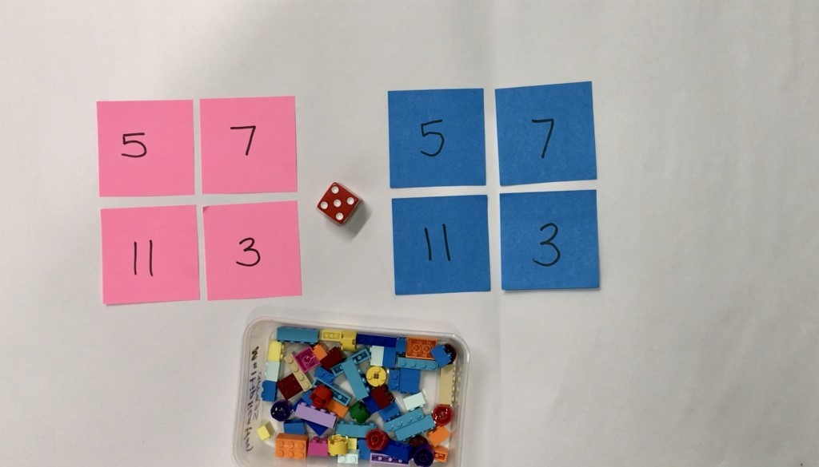
Instruction
Choose 4 numbers to build as your towers (for example, 5, 7, 11 and 3)
Take turns to roll a dice and use the number of bricks to build up your towers.
Towers can be built up in any way you choose.
Take turns to build up your towers until one player gets the exact roll to complete the last tower.
You can also play this in reverse.
Talk about how many you have, how many more you need, what strategies you are using and your thinking.

Slide 59
Instruction
Other ways to play
Build the towers and play in reverse. Taking away blocks each time until there are no blocks left.
Change the number of towers you build.
Change the number of blocks needed for each tower.

Slide 60
Discuss
Reflection
If you were to play the game again tomorrow, what is one thing you would do differently? Why?
Draw a picture in your mathematics workbook that shows the towers you built in order of shortest to tallest.

Slide 61
Share / submit
Share your work with our class on our digital platform.
You may like to:​
write comments​
share pictures of your work​
comment on the work of others

Slide 62
Activity 10
Let’s explore patterns

Slide 63
View
For adults: Watch the background video about sorting…

Slide 64
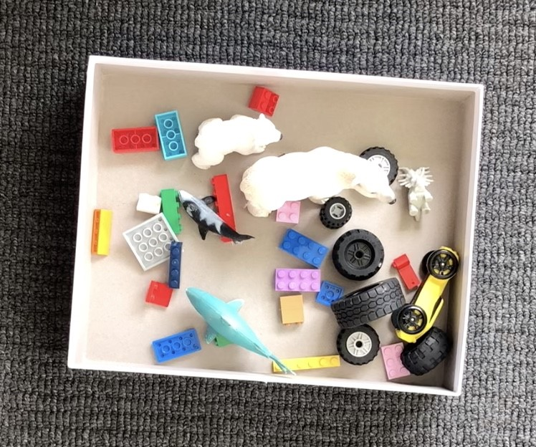
Collect resources
You will need:
a collection of objects
pencils or markers
your mathematics workbook

Slide 65
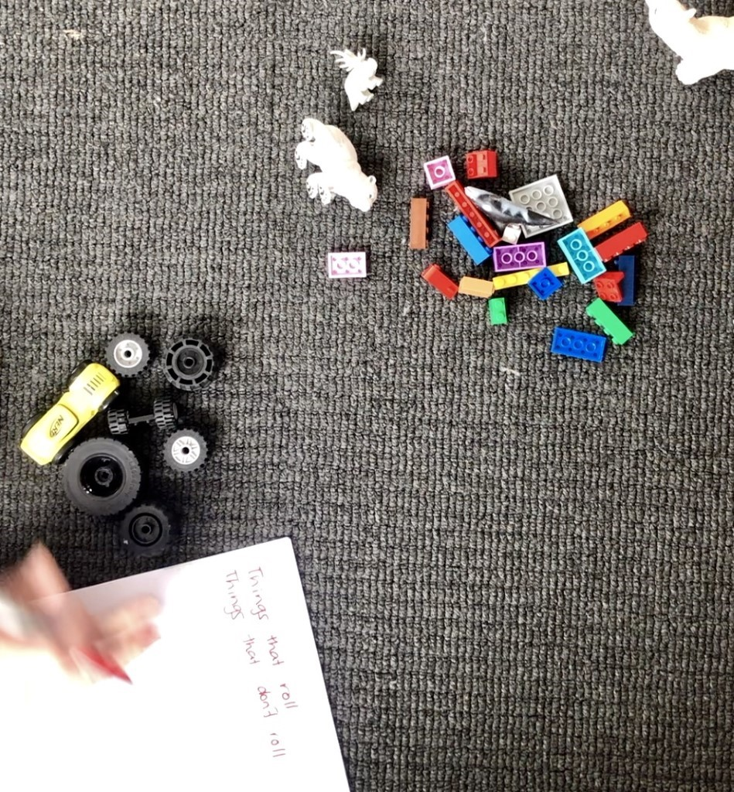
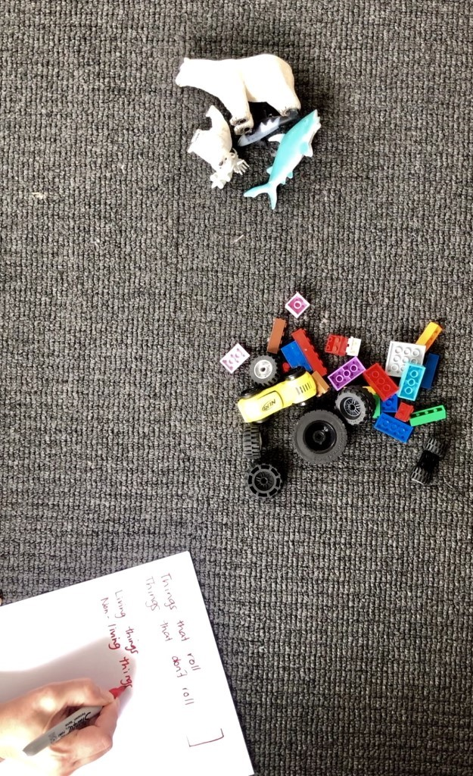
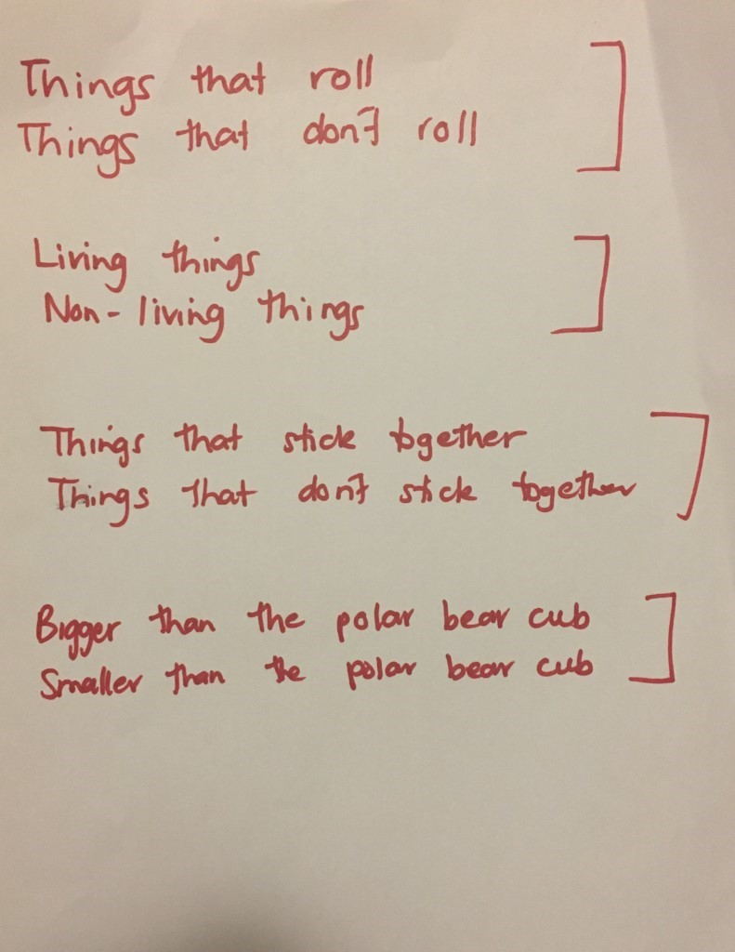
Instruction
What are some different ways to sort your collection. Someone at home could help you record your ways of thinking.

Slide 66
View
For adults: Watch the background video about patterns…

Slide 67
View
For adults: Some follow up questions you might like to ask

Slide 68
View
For adults: Some other follow up questions you might like to ask

Slide 69
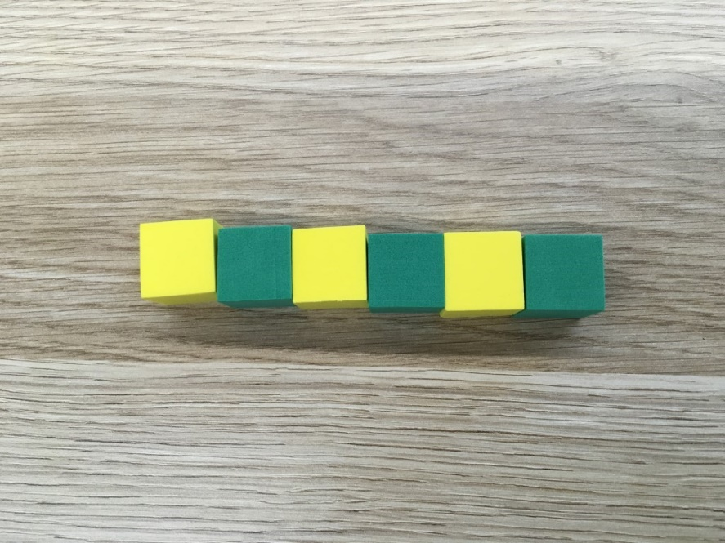
Instruction
Describe this pattern.
How do you know it is a pattern?
How would you describe the part that repeats?

Slide 70
Instruction
Make an AB pattern.

Slide 71
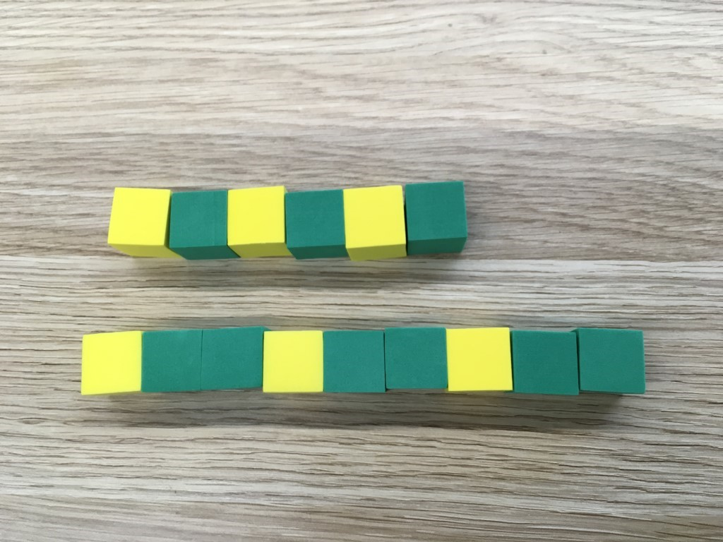
Instruction
How are these patterns the same?
How are they different?

Slide 72
Instruction
Make, copy or extend an ABB pattern.

Slide 73
Share / submit
Share your work with our class on our digital platform.
You may like to:​
write comments​
share pictures of your work​
comment on the work of others

