Slide 1
Mathematics digital student resource Stage 2
Student activity resources

Slide 2
Activity 1
Strike it out!- Let’s play!

Slide 3
View
Watch the video to learn how to play…
(from NRICH Maths https://nrich.maths.org/8016)

Slide 4
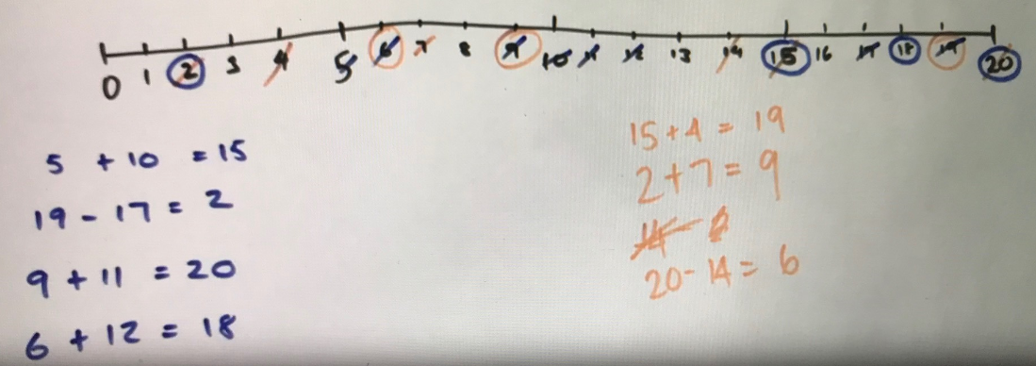
Discuss
Is there a way Michelle can possibly win?
Share what you found with our class on our digital platform.

Slide 5
Collect resources
You will need:
three colour pencils or markers
your mathematics workbook

Slide 6
Instruction
Draw a number line from 0 to 20.
The first player chooses a number on the line and crosses it out.
The same player then chooses a second number and crosses that out too.
Finally, he or she circles the sum or difference of the two numbers and writes down the calculation.
For example, the first player's go could look like this:
The second player must start by crossing off the number that player 1 has just circled.
He or she then chooses another number to cross out and then circles a third number which is the sum or difference of the two crossed-off numbers.
Player 2 also writes down their calculation.
For example, once the second player has had a turn, the game could look like this:
The winner of the game is the player who stops their opponent from being able to have a go.

Slide 7
Share / submit
Let’s share our thinking
Share your work with our class on our digital platform. ​
You may like to:​
write comments​
share pictures of your work​
comment on the work of others

Slide 8
Activity 2
Strike it out!- Let’s investigate!

Slide 9
Discuss
Play again and discuss these questions with the person you are playing with and post a response on our digital platform.
Now that you’ve had an opportunity to play a few games, what are some of the strategies you used to try to help you win?
Were you able to win every time you played?
Investigate whether all of the numbers along the number line can be used.

Slide 10
Discuss
Play again and discuss these questions with the person you are
playing with and post a response on our digital platform.
Who had the fewest numbers crossed out on their number line?
Did you win or did someone else?
What different moves could have been done to have crossed out more numbers?
Who played a game where all of the numbers were crossed out?
Can you cross out all of the numbers in one game? How do you know?

Slide 11
Discuss
Play again and discuss these questions with the person you are
playing with and post a response on our digital platform.
Did you notice anything about 0?
What if the number line went from 0- 19, or, from 1-20…could all the numbers be crossed out then? What could the game look like…what could the moves be?
What if you could use multiplication and division…test it out and see how that changes the game.

Slide 12
Activity 3
It’s time to get magical!

Slide 13
Collect resources
You will need:
pencils or markers
your mathematics workbook

Slide 14
Choose any number on the grid. Write it down.
1 | 2 | 3 | 4
5 | 6 | 7 | 8
9 | 10 | 11 | 12
13 | 14 | 15 | 16
Write down a second number…BUT…it has to be a different row and different column to your first number.
Record a third number…it has to be a different row and different column to your first two numbers.
Write down a forth number…it has to be a different row and different column to your first three numbers.

Slide 15
Your sum is….
1 | 2 | 3 | 4
5 | 6 | 7 | 8
9 | 10 | 11 | 12
13 | 14 | 15 | 16
34!
What?
How did you do that?

Slide 16
Is it always 34?
1 | 2 | 3 | 4
5 | 6 | 7 | 8
9 | 10 | 11 | 12
13 | 14 | 15 | 16
1 | 2 | 3 | 4
5 | 6 | 7 | 8
9 | 10 | 11 | 12
13 | 14 | 15 | 16

Slide 17
Is it always 34?
What’s our conjecture?
1 | 2 | 3 | 4
5 | 6 | 7 | 8
9 | 10 | 11 | 12
13 | 14 | 15 | 16
What are some possible combinations we could test?
1, 6, 11, 16
1, 6, 12, 15
1, 7, 10, 16
1, 7, 12, 14
1, 8, 10, 15
1, 8, 11, 14

Slide 18
Share / submit
Let’s share our thinking
Share your work with our class on our digital platform. ​
You may like to:​
write comments​
share pictures of your work​
comment on the work of others

Slide 19
Activity 4
The counting game: multiples

Slide 20
View
Watch the video to learn how to play The counting game: multiples

Slide 21
Collect resources
You will need:
pencils / markers
your mathematics workbook

Slide 22
Instruction
It’s time to test out your strategies!
Select a target number, e.g. 85. Then, select a unit value, e.g. fives.
The goal is to be the player who says the target number. Players can count on by saying the next 1, 2 or 3 number words in the fives sequence. Players collect a counter (or a tally mark) if they say the target number. A new target number is chosen and players play again. For example:
Target number 85
Player A : 5, 10,
Player B: 15, 20, 25...
Player A: 30, 35, 40...
Player B: 45...
Player A: 50, 55
Player B: 60
Player A: 65,
Player B: 70, 80, 85!
Player B collects a counter (or tally mark!)

Slide 23
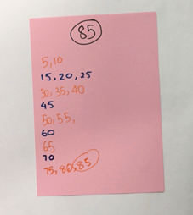
Discuss
Discuss these questions with the person you are playing with
on our digital platform.
Is there a way to play so that you never lose?
I wonder if Michelle could have changed her moves in any way to win. Could you give Michelle some advice? If she had said different number words, how could she have won?

Slide 24
Activity 5
The counting game: multiples part 2
Let’s do it counting back

Slide 25
View
Watch the video to see how you can play counting game part 2

Slide 26
Collect resources
You will need:
pencils / markers
your mathematics workbook

Slide 27
Instruction
It’s time to test our your strategies!
This time staring from a given number and counting back, trying to be the person who says zero. For example,
Target number 0 (starting at 110 and counting in tens)
Player A: 100...
Player B: 90, 80...
Player A: 70...
Player B: 60...
Player A: 50, 40...
Player B: 30, 20, 10...
Player A: zero!

Slide 28
Share / submit
Let’s share our thinking
Share your work with our class on our digital platform. ​
You may like to:​
write comments​
share pictures of your work​
comment on the work of others

Slide 29
Activity 6
Basketball toss

Slide 30
View
Watch the video to see how to play Basketball toss

Slide 31
Collect resources
You will need:
a bucket, basket or container
pair of socks
a pencil
your mathematics workbook
a clear space

Slide 32
Instruction
Do you have a hand that’s a better shot?
Mark a clear ‘starting line’.
Take 3 big steps forward and place a basket at the end
Go back to your starting line and throw your rolled up socks or scrunched up paper 10 times with your right hand and 10 times with your left hand.
Graph your results.

Slide 33
Share / submit
Let’s share our thinking
Share your work with our class on our digital platform.
Post your graph on the digital platform.
- What do you notice about your performance?
- Do you think this would change with practice? ​​
You may like to:​​
write comments​​
share pictures of your work​​
comment on the work of others

Slide 34
Activity 7
Sam’s money challenge

Slide 35
Collect resources
You will need:
pencils/ markers
your mathematics workbook

Slide 36
Instruction
Answer this question:
Sam bought some lunch for his family which cost $13.65. He paid using this note:
How much change will he receive?
a. $6.35
b. $6.45
c. $7.35
d. $7.45

Slide 37
Brainstorm/think
Time to investigate
As Sam put his change in his pocket, he realised he had been given 1 note and 4 coins. How wondered....what other quantities could I make with one $5 note and 4 more coins?
What’s the smallest amount I might have?
What's the largest amount I might have?
How many possibilities are there?

Slide 38
Share / submit
Let’s share our thinking
Share your work with our class on our digital platform.
Post your favourite answers to this question on our digital platform.
You may like to:​
write comments​
share pictures of your work​
comment on the work of others

Slide 39
Activity 8
Two handfuls

Slide 40
View
Watch the video to see how to play Two handfuls
(from A Gervasoni, Monash University)

Slide 41
View
Watch the video to see how to play Two handfuls part 2

Slide 42
Collect resources
You will need:
pencils/ markers
your mathematics workbook
pasta, counters, marbles or dried beans

Slide 43
Instruction
Take 2 handfuls and estimate how many you think you might have.
Organise the collection so that someone can see how many there are without having to count everything by ones.
Determine how many items you have by ‘looking and thinking’.

Slide 44
Instruction
Use this for a student task
Draw a picture of your work and use words and symbols to describe your thinking.
Is there another way you could arrange your object?
- Arrange them in a different way so you can see how many you have by looking and thinking. Draw a picture of your work and use words and symbols to describe your thinking.
Compare the different ways you can arrange the collections:
- Write down 3 things that are the same about the way you organised your collections.
- Write down 3 things that are different.

Slide 45
Share / submit
Let’s share our thinking
Share your work with our class on our digital platform.
Post your pictures or drawings of the way you arranged your items and comment on the arrangements of others.

Slide 46
Activity 9
Two handfuls: part 2

Slide 47
Collect resources
You will need:
pencils/ markers
your mathematics workbook
pasta, counters, marbles or dried beans

Slide 48
Instruction
Play handfuls again
Grab 2 handfuls of dried pasta (or another item). Use what you learnt yesterday to help you estimate how many pieces of pasta you might have in your handfuls today.
Determine how many you have by looking and thinking.

Slide 49
View
Watch the video about 36 counters
(from A Gervasoni, Monash University)
(developed by A Gervasoni, Monash University. Shared here https://www.resolve.edu.au/counting-handfuls

Slide 50
Instruction
Exploring arrays
Take 36 objects.
Form them into a rectangular structure so that you have equal rows and columns. We call this an array. Draw and describe your array using words and symbols.
Re-organise your pasta pieces so it forms a different rectangle. Draw and describe your array using words and symbols.
Keep re-organising your pasta pieces until there are no more arrays you can make. Draw and record all of your arrays.
Pick your favourite array and describe it using both multiplication and division. Record your thinking in your notebook.
Post the pictures of your arrays and share your thinking on our digital platform.

Slide 51
Share / submit
Let’s share our thinking
Post your pictures or drawings on our digital platform and comment on the arrangements of others

Slide 52
Activity 10
Multiplication toss

Slide 53
View
Watch the video to see how to play multiplication toss
(from D Siemon, RMIT University)

Slide 54
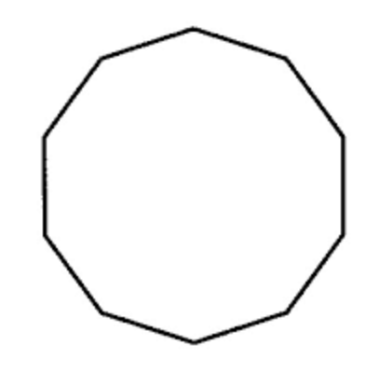
Collect resources
You will need:
1cm square grid paper in student mathematics workbook
different coloured pencils or markers
two spinners (see mathematics workbook)
paper clip for spinner

Slide 55
Instruction
Players take turns to spin the spinners. If a 3 and 6 are spun, players can enclose either a block out of 3 rows of 6 (3 sixes) or 6 rows of 3 (6 threes).
The game continues with no overlapping areas.
The winner is the player with the largest area blocked out after 10 spins.
Eventually the space on the grid paper gets really small.
Then, you have to think:
What if my 3 sixes won’t fit as 3 sixes or as 6 threes? Players can partition to help them! So, for example, I can rename 3 sixes as 2 sixes and 1 six (if that helps me fit the block into my game board).

Slide 56
View
Watch the video to see multiplication toss follow up video 1
(from D Siemon, RMIT University)

Slide 57
View
Watch the video to see how to play multiplication toss follow up 2
(from D Siemon, RMIT University)

Slide 58
Share / submit
Let’s share our thinking
Share your work with our class on our digital platform.
You may like to:
write comments
share picture of your work
comment on the work of others

