Slide 1
Mathematics learning sequence Stage 3
Student activity resources

Slide 2
Activity 1
Closest to 100

Slide 3
View
Watch the video to learn how to play…

Slide 4
Collect resources
You will need:
Playing cards from Ace to 9 (where Ace = 1) or a 4 sets of 1-9 cards you’ve made at home.

Slide 5
Instruction
Players shuffle the cards and put them in a central pile. One person takes 6 cards and places them face up for everyone to see.
The goal is to use addition and subtraction to get as close to a total of 100 as possible.
Each card can only be used once. It can be used to form a 1- or 2-digit number.
Players score 0 points if they are able to reach exactly 100. Otherwise, they work out their points based on the difference between their total and 100. For example, if a team created a total of 98, they would score 2 points.
Keep a cumulative total of their difference to 100. The winner is the team to have the lowest points score at the end.

Slide 6
Share / submit
Let’s share our thinking
Share your work with our class on our digital platform.
You may like to:
write comments
share pictures of your work
comment on the work of others

Slide 7
View
Watch Sam's variation of Closest to 100

Slide 8
Activity 2
Multiplication toss

Slide 9
View
Watch the video to see how to play multiplication toss
(from D Siemon, RMIT University)

Slide 10
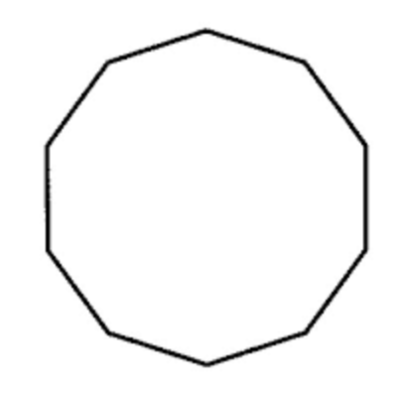
Collect resources
You will need:
1cm square grid paper in your mathematics workbook
different coloured pencils or markers
two spinners (see mathematics workbook)
paper clip for spinner

Slide 11
Instruction
Players take turns to spin the spinners. If a 3 and 6 are spun, players can enclose either a block out of 3 rows of 6 (3 sixes) or 6 rows of 3 (6 threes).
The game continues with no overlapping areas.
The winner is the player with the largest area blocked out after 10 spins.
Eventually the space on the grid paper gets really small.
Then, you have to think:
What if my 3 sixes won’t fit as 3 sixes or as 6 threes? Players can partition to help them! So, for example, I can rename 3 sixes as 2 sixes and 1 six (if that helps me fit the block into my game board).

Slide 12
View
Watch the video to see multiplication toss follow up video 1
(from D Siemon, RMIT University)

Slide 13
Discuss
Now that you’ve played this game once, what could you do differently next time to increase your chances of filling in 100 squares?

Slide 14
Share / submit
Let’s share our thinking
Share your work with our class on our digital platform.
You may like to:
write comments
share pictures of your work
comment on the work of others

Slide 15
Activity 3
Multiplication toss- part 2

Slide 16
View
View the video to see how to play multiplication toss follow up 2
(from D Siemon, RMIT University)

Slide 17
Collect resources
You will need:
1cm square grid paper in your student mathematics workbook
different coloured pencils or markers
two spinners (see mathematics workbook)
paper clip for spinner

Slide 18
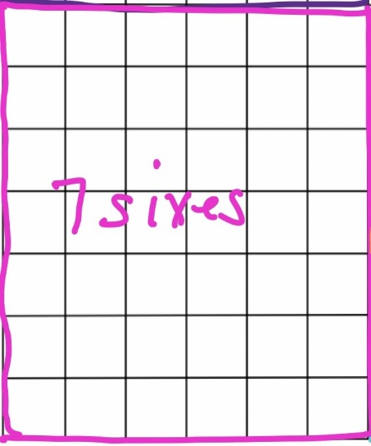
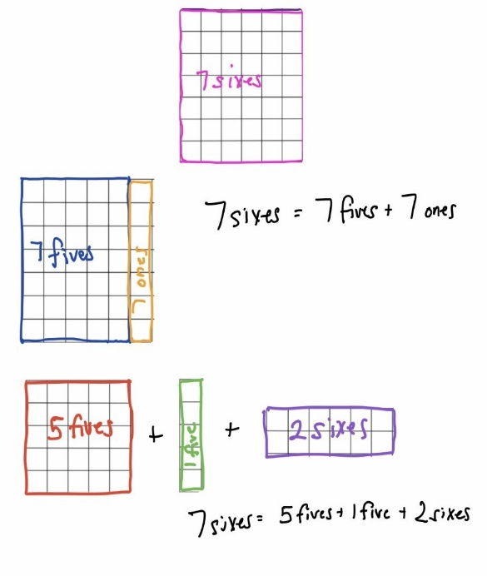
Instruction
Play multiplication toss again.
Choose a selected area to investigate partitioning of composite units and explore equivalent areas.
Draw and label all of the different ways that area can be partitioned and renamed.

Slide 19
Discuss
How many different ways did you find to partition your selected area?
What does this reveal to you about how flexibly mathematicians can think about situations involving area, multiplication and division?
How could you use this knowledge to help you in the future?

Slide 20
Share / submit
Let’s share our thinking
Share your work with our class on our digital platform.
You may like to:
write comments
share pictures of your work
comment on the work of others

Slide 21
Activity 4
Colouring in fractions

Slide 22
View
Watch the video to learn how to play…
(From: D. Clarke and A. Roche, Engaging Maths:
25 Favourite Maths Lessons, 2014)

Slide 23
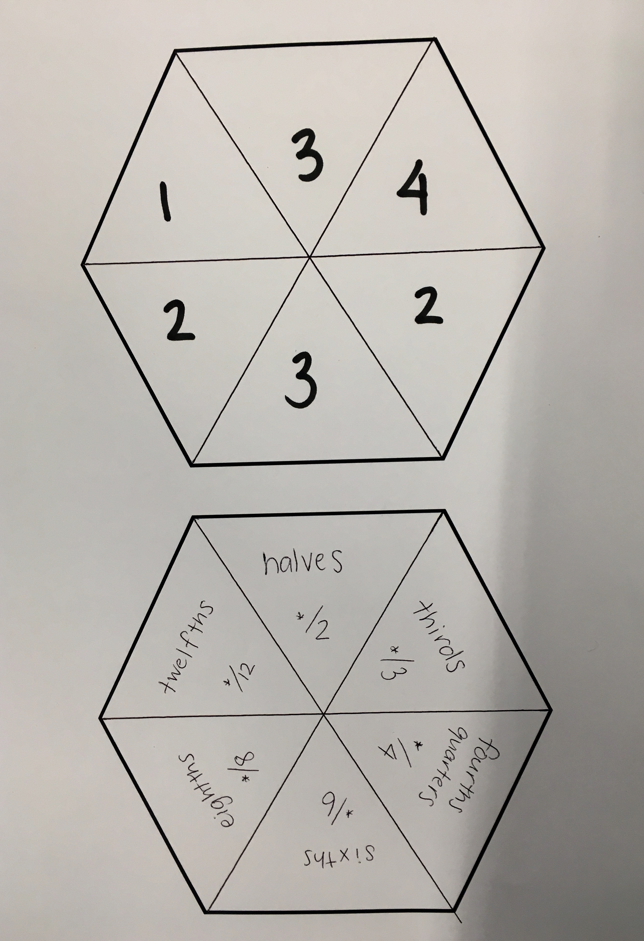
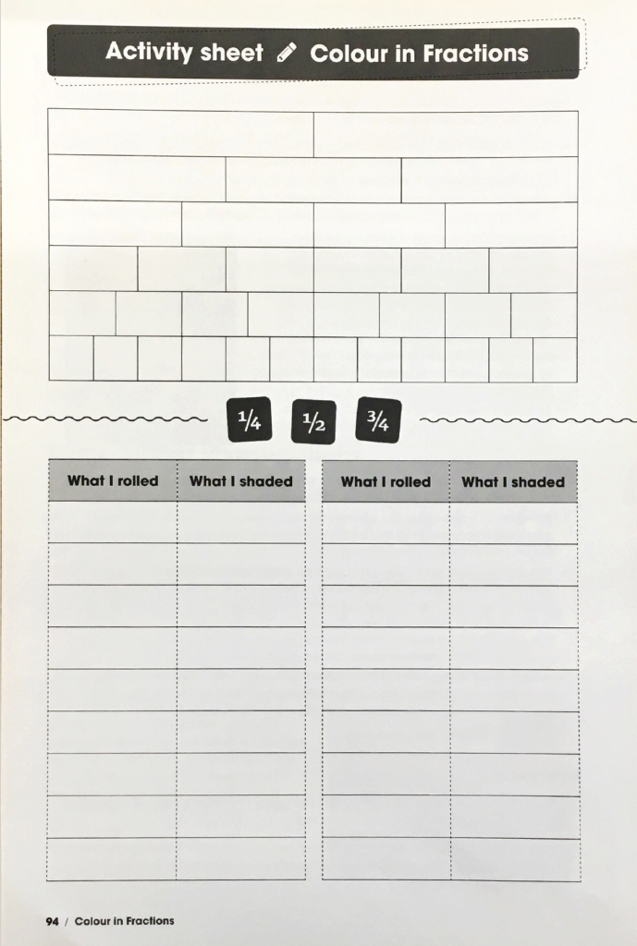
Collect resources
You will need:
one die labelled 1, 2, 2, 3, 3, 4 in one colour or created on a spinner
another die labelled *2 ,*3 ,*4 ,*6 ,*8 ,*12 in another colour or created on a spinner
a fraction wall (game board) in your mathematics workbook
coloured pencils or markers

Slide 24
Instruction
Players take turns to throw both dice or have a spin on their spinners. They make a fraction, the first die or spinner being the numerator. They then colour the equivalent of the fraction shown. For example, if a player rolls a 2 and *4 (or spins 2 and quarters) then they can colour in $\frac{2}{4}$ of one line, or $\frac{4}{8}$ of one line, or $\frac{1}{4}$of one line and $\frac{2}{8}$ of another, or any other combination that is the same as $\frac{2}{4}$.
For each roll or spin, the student should use a different colour pencil or marker.
If a player is unable to use their turn, they “pass.”
Students take it in turns to roll or spin and make fractions, marking them on their fraction wall. If the fraction rolled or its equivalence cannot be shaded, they miss a turn. This becomes more frequent later in the game.
Students are not allowed to break up a “brick.”
In finishing off the game, the student must have had 18 turns or have filled your wall. A larger fraction is not acceptable to finish.
The first player who colours in their whole wall is the winner, but the other player is encouraged to keep going (with the support of the first player) to fill their fraction wall, or the greatest number of wholes. If after 18 turns neither player colours in their whole wall, the player with the greatest number or wholes wins!

Slide 25
Discuss
If you played the game tomorrow, what would you do differently?
If you were giving some hints to a younger brother or sister who was about to play the game, what would you say to him or her to help them win?

Slide 26
Share / submit
Let’s share our thinking
Share your work with our class on our digital platform.
You may like to:
write comments
share pictures of your work
comment on the work of others

Slide 27
Activity 5
Colouring in fractions part 2

Slide 28
View
Watch the video to explore ideas further…
(From: D. Clarke and A. Roche, Engaging Maths:
25 Favourite Maths Lessons, 2014)

Slide 29
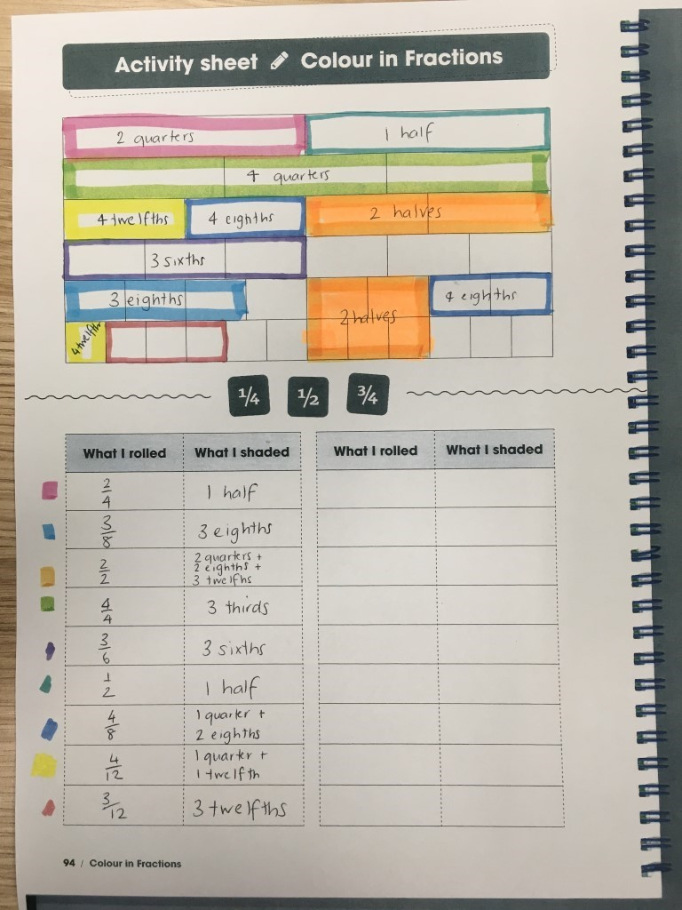
View and discuss
Michelle recorded $\frac{2}{2}$ as 2 quarters + 2 eighths + 3 twelfths.

Slide 30
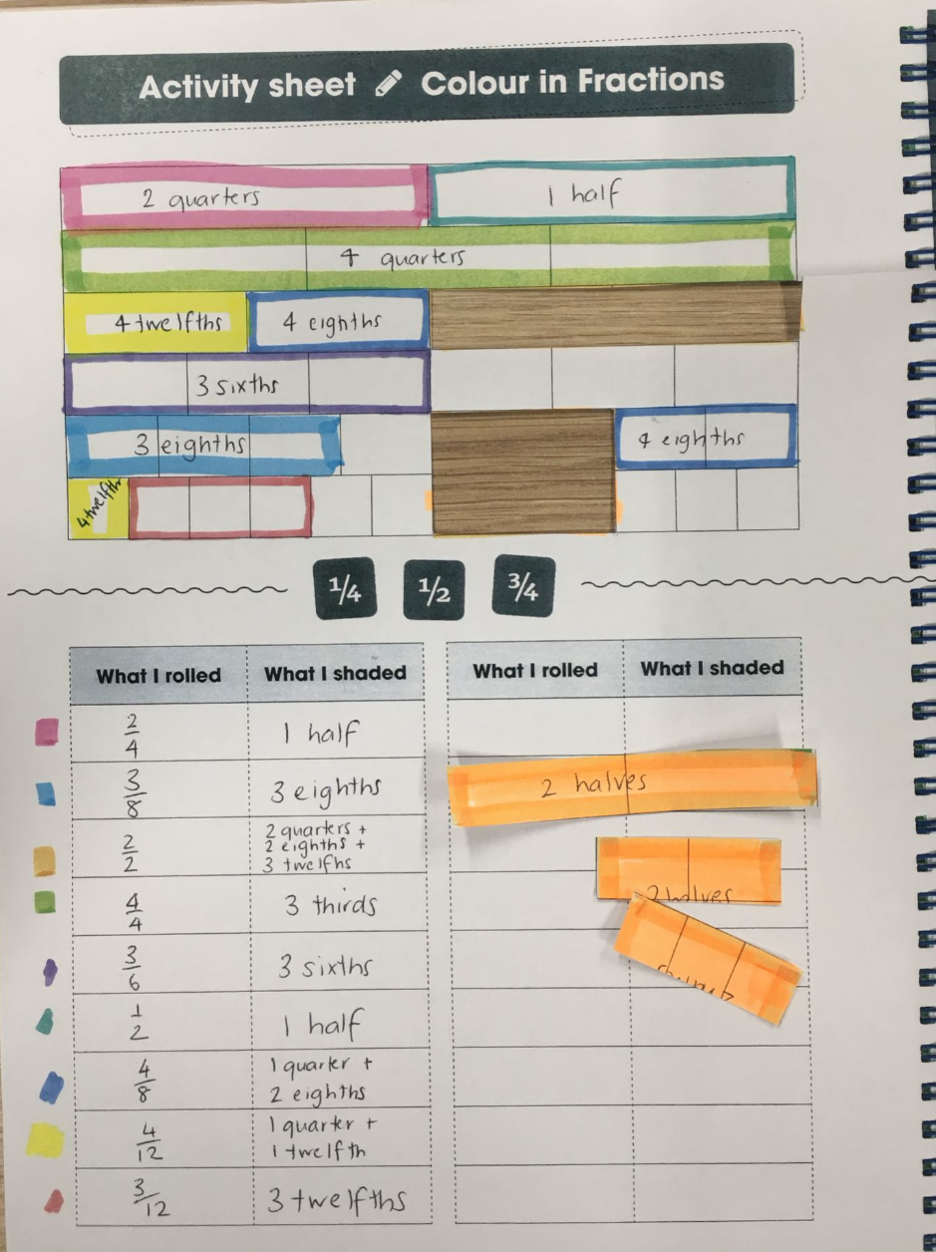
View and discuss

Slide 31
View and discuss
She wondered...
how many other ways can we rename $\frac{2}{2}$?

Slide 32
Collect resources
You will need:
your fraction wall (game board) completed in your mathematics workbook

Slide 33
Instruction
Now, explore your own game board to investigate equivalent fractions. What equivalent fractions can you investigate using your gameboard?
You may like to play Colouring in fractions again and investigate equivalent fractions again on this gameboard.

Slide 34
Discuss
What is something interesting that you discovered when exploring equivalent fractions today?

Slide 35
Share / submit
Let’s share our thinking
Share your work with our class on our digital platform.
You may like to:
write comments
share pictures of your work
comment on the work of others

Slide 36
Activity 6
Basketball toss

Slide 37
View
Watch the video to learn how to play…

Slide 38
Collect resources
You will need:
a bucket, basket or container
pairs of socks
a pencil
your student mathematics workbook
a clear space

Slide 39
Instruction
Your challenge: See how many times you can successfully shoot
your rolled up socks into the basket.
Mark a clear ‘starting line’ for your Basketball toss
Take 3 big steps from your starting line and place a bucket, basket or container at the end.
Stand at your starting line and throw your socks with your right hand.
Go back to your starting line and have your second throw. Repeat this until you have thrown your socks 10 times with your right hand.
Repeat the process with your left hand, with your eyes closed (using any hand you like) and trying backwards.
Keep a record of your baskets and graph your results

Slide 40
Share / submit
Let’s share our thinking
Share your work and respond to these questions on our digital platform.
What do you notice about your performance?
Do you think this would change with practice?
You may like to:
write comments
share pictures of your work
comment on the work of others

Slide 41
Activity 7
Paul’s basketball challenge

Slide 42
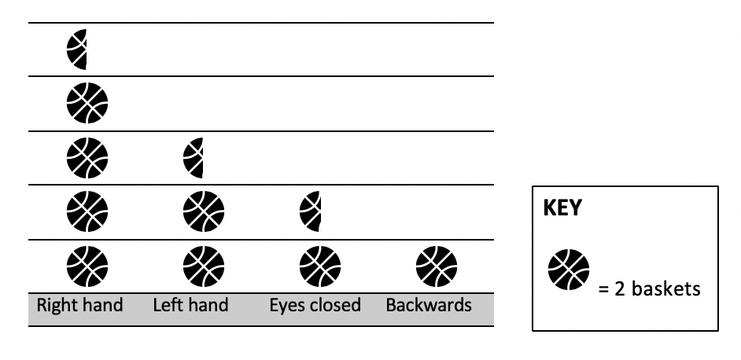
Investigate
This graph shows the number of baskets Paul scored when he was
playing basketball toss with his sister.
How many points did Paul score in total?
9 and a half
19
16
8

Slide 43
Discuss
Paul decided that he wanted to improve his score and beat his sister the next time they played. He spent a lot of time practising using his left hand, playing backwards and with his eyes closed.
When he competed against his sister the next time, his efforts had worked! He had improved his score and he beat his sister! He scored 33 baskets. Paul had the same success with his right hand and improved by 1 with his eyes closed.
How many baskets might he have scored with his left hand and backwards? What are all the possibilities?

Slide 44
Share / submit
Let’s share our thinking
Share your work with our class on our digital platform.
You may like to:
write comments
comment on the work of others

Slide 45
Activity 8
Let’s get magical!

Slide 46
View
Watch the video to learn how to play…
A version this can be found on NRICH maths https://nrich.maths.org/11014/note)

Slide 47
Collect resources
You will need:
your mathematics workbook
pencil

Slide 48
Instruction
Choose a 3-digit number where the each digit is smaller than the previous one (but they don’t have to be in order. For example, 982 or 531.)
Then, reverse the digits and subtract the second number from the first one. So, if I had chosen 531, I would now work out 531 – 135. The answer is 396. (If you get 99, record your answer as 099.)
Next, reverse your new number. For example, from 396 I can make 639.
Finally, add these last two numbers together. For example, 396 + 639.
Here comes the magic...
The answer is 1089!

Slide 49
Instruction
Try another starting number and test it out again...is the final answer still 1089?
Explore what happens if you use the same process, starting with a 2-digit number or a 4-digit number...
What do you notice about the final answer?
Why do you think this might be happening?

Slide 50
Share / submit
Let’s share our thinking
Share your work with our class on our digital platform.
You may like to:
write comments
share pictures of your work
comment on the work of others

Slide 51
Activity 9
Reaction time test

Slide 52
View
Watch the video to learn how to play…
(Adapted from reSolve: Maths by Inquiry https://www.resolve.edu.au/authentic-problems-reaction-time)

Slide 53
Collect resources
You will need:
your mathematics workbook
pencil
ruler

Slide 54
Instruction
Investigate your reaction times using the ruler drop test.
To conduct the test, one person holds the ruler up reasonably high. The zero mark on the ruler is at the bottom.
The reacting person places finger and thumb at the bottom of the ruler, not touching but ready to grab.
At an unpredictable time, the first person drops the ruler.
The reacting person catches it between their finger and thumb, and reads the distance below the thumb.
Conduct the test 5 times and record the results.
Convert the data into times using the ruler drop reaction time chart.

Slide 55
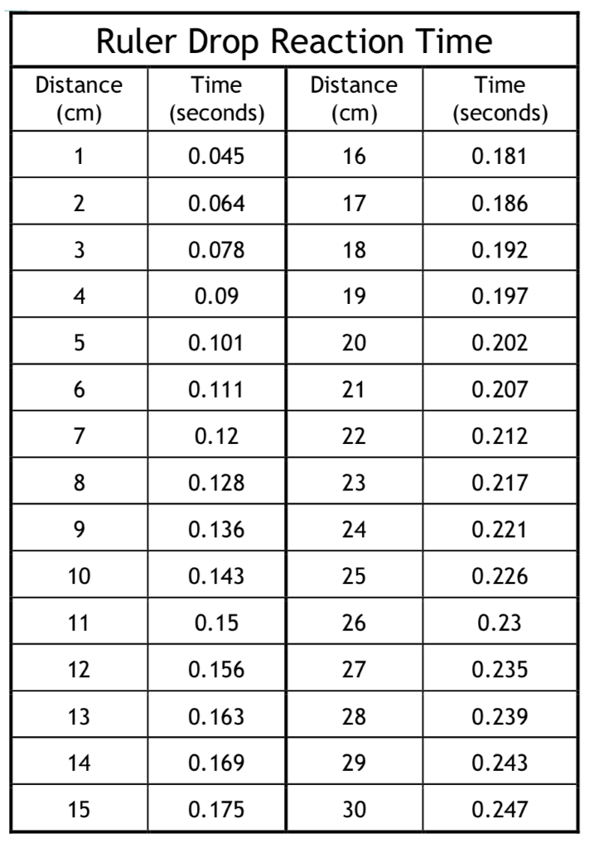
Instruction
Ruler drop reaction time chart

Slide 56
Discuss
Draw a number line showing the reactions times.
Circle your fastest and slowest reaction times.
What is the difference between them?
Explore how does your reaction time compare with other people in your family?

Slide 57
Share / submit
Let’s share our thinking
Share your work with our class on our digital platform.
You may like to:
write comments
share pictures of your work
comment on the work of others

Slide 58
Activity 10
Raindrops

Slide 59
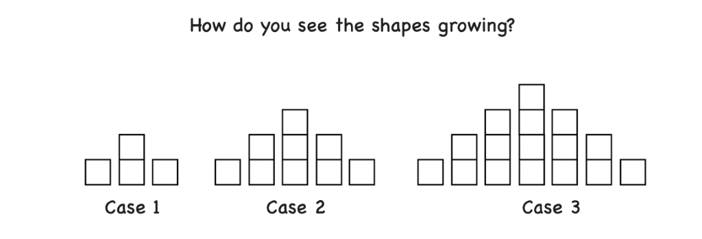
View
What do you notice when you see this image?
(from YouCubed https://www.youcubed.org/wp-content/uploads/2018/09/Raindrop-Task-final-copy.pdf)

Slide 60
Discuss
You might have noticed things like
In case 2 there are more cubes than in case 1, and in case 3 there are more cubes again.
Where do you see the extra cubes adding each time?
There are many ways to answer this question as people see the cases in lots of different ways. How does your class see them?

Slide 61
View
Here are 3 different ways of thinking…
(from YouCubed https://www.youcubed.org/wp-content/uploads/2018/09/Raindrop-Task-final-copy.pdf)

Slide 62
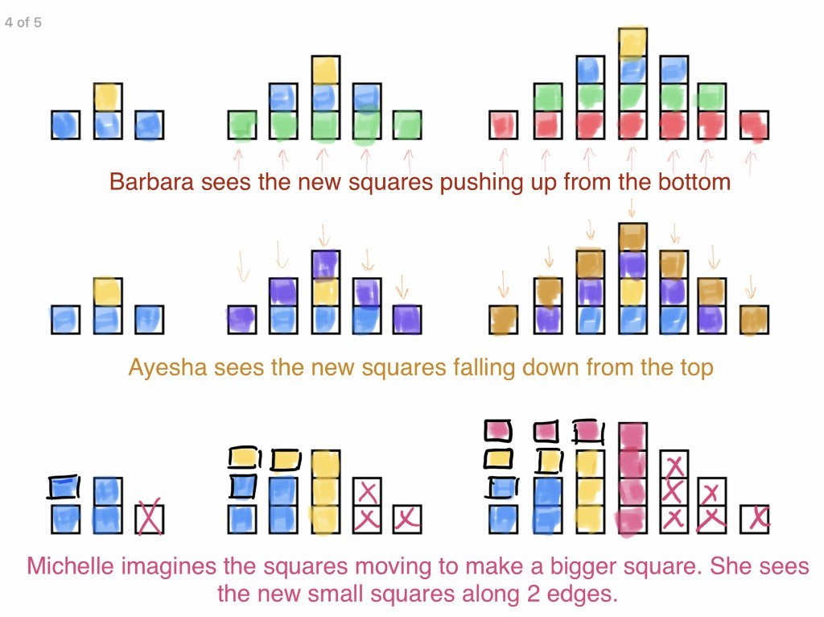

Slide 63
Collect resources
You will need:
your mathematics workbook
pencil
ruler

Slide 64
Instruction
What will the fourth case look like? Draw it in your workbook.
Mathematicians often like to draw diagrams and use tables to help them identify patterns. Can you use these strategies to help you work out what the 10th case would look like?

Slide 65
Share / submit
Let’s share our thinking
Share your work with our class on our digital platform.
You may like to:
write comments
share pictures of your work
comment on the work of others

