Slide 1
PDHPE Stage 1 How can we solve problems when moving?
Lessons 1 and 2
Student activity resources

Slide 2
Lesson 1
Snakes alive

Slide 3

Lesson 1
Snakes alive
Select 5 soft objects that are safe to throw.
Create or find a playing area for you to safely throw your object.
Choose a ‘starting point’ where you will throw the objects from.

Slide 4

Lesson 1
Snakes alive
Underarm throw one object at a time, aiming to place each object behind the previous one. This will form a ‘snake’.
a. Underarm throw the first object and mark where it lands. This creates the ‘head’ of the snake.
b. Underarm throw the next object so it lands before the ‘head’.
Repeat the underarm throws with your remaining throwing objects.

Slide 5
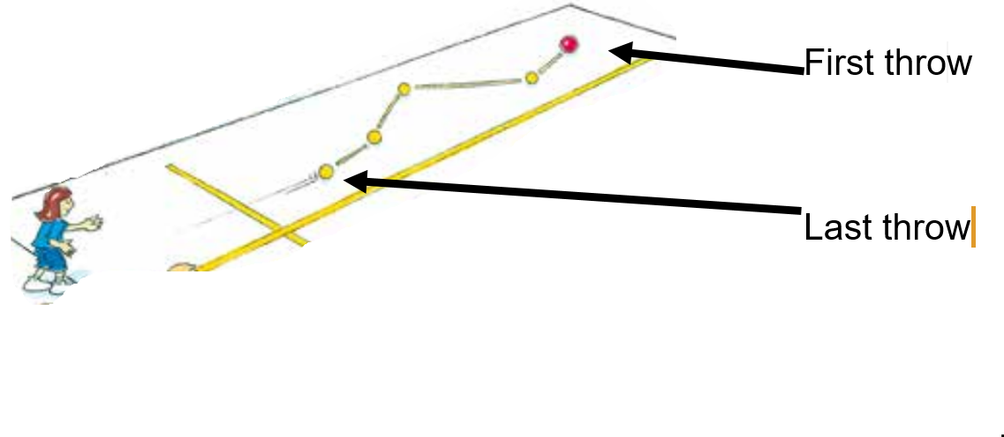
Lesson 1
Snakes alive
Refer to ‘Snakes alive’ game card for suggestions of what this activity could look like. (Sport Australia, 2019. Playing for life)
Sport Australia 2019, Playing for life

Slide 6

Lesson 1
Snakes alive
Discuss the following reflective questions with your teacher or parent/caregiver.
What type of throw was easier? Why?
What type of throw was harder? Why?
Which object was easier to throw? Why?
Which object was harder to throw? Why?

Slide 7
Lesson 1
Snakes alive
Repeat the game using an overarm throw.
Repeat the game using a throwing style of your choice.
Repeat the game 3 times for each throwing style.

Slide 8
Lesson 2
Snakes alive challenge

Slide 9
Lesson 2
Snakes alive challenge
Choose a safe playing area where you can throw a number of soft objects.
Select 5 different soft objects to throw.

Slide 10
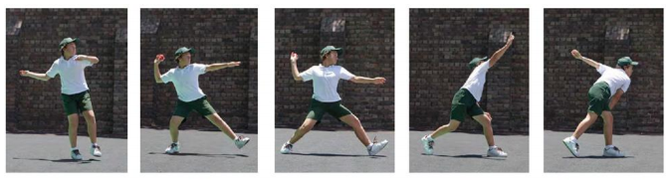
Lesson 2
Snakes alive challenge
EYES (Eyes focused on target area throughout the throw.)
SIDE-ON (Stand side-on to target area.)
STEP FORWARD (Step towards target area with opposite foot to throwing arm.)
FOLLOW THROUGH (Throwing arm follows through, down and across the body.)

Slide 11
Lesson 2
Snakes alive challenge
Play ‘Snakes alive’ using a variety of throws depending on distance (one handed underarm, two handed underarm or overarm)
Discuss the following reflective questions with your teacher or parent/caregiver.
Which object was easier to throw? Why?
Which object was harder to throw? Why?

