Slide 1
STEM Sustainable practices – Stage 2
Student activity resources
Your name:
Your class:

Slide 2
Overview
You learn about how the things that people do effect the Earth’s surface. You will design an innovative way to reduce these effects by focusing on physical activity. Your study will involve you doing daily exercise and measuring the impact of this on yourself and on an outside environment.

Slide 3
Resources
Activity 1
access to an outdoor space to exercise
you will need to use exactly the same space every day
you will need to exercise in that space every day that you are working on your STEM learning (unless it is raining)
you can exercise at any time of the day
a timer – for example an analogue watch that has a second hand, a digital watch or a timer app on a mobile device
a pencil
Activity 2
an oven tray
garden soil
sand
some small branches or plants (to be the trees)
a small jug
water
a few books

Slide 4
Resources
Activities 3 - 6
Activity 3
marbles (or round lollies/chocolates as a treat)
paper towel or toilet roll cylinders (3)
large sheet of paper
tape
scissors
small container (to catch the marbles)
Activity 4
pencils
Activity 5
pencils
Activity 6
pencils
a sheet of A4 paper
a timer - for example an analogue watch that has a seconds hand, a digital watch or a timer app on a mobile device

Slide 5
Resources
Activities 7 and 8
Activity 7
a making box: containing materials found at home or school such as cardboard boxes, cylinders, tape, glue, pipe cleaners, materials, empty PET bottles
Activity 8
showcase space
table
display materials

Slide 6
Activity 1
Student resources

Slide 7
How do you impact on the Earth’s surface?

Slide 8
Take your pulse
PDHPE activity
Do you know how to find your pulse? It’s easy- watch this video. But if you can’t find it, ask an adult for help until you’re confident.
Record your resting pulse on the next slide.
Notes:
Watch How to take your pulse. https://www.youtube.com/watch?v=wzdVUSVObOw
Practise on yourself by finding your pulse in your wrist.
Remember to:
Sit down and relax to take a resting pulse
Place two fingers on the inside of your wrist
Feel for a strong pulse an count the beats for 30 seconds
Multiply that number by two to get the beats per minute
If you can’t feel a pulse on your wrist, try checking under your jaw.
When you have found a steady beat, count how many beats in 60 seconds (use a watch or clock with a second hand, or use a timer on your device).

Slide 9
My daily pulse
PDHPE activity
Day | Resting pulse for 60 seconds | Active pulse for 60 seconds
1
2
3
4
5
6
7
8
9
10
Notes:
Daily task
record resting pulse
Do your 10x10 circuit
Record active pulse

Slide 10
Go outside
PDHPE activity
Go outside into your backyard, the park or your school playground
Look around you
Where is your space? Is it in your backyard, the park or your school playground, or somewhere different?
What are the natural features of the Earth’s surface that you can see? For example, is there a hill, a creek or a flat, open space.
What are the man-made features?
Notes:
Go outside into your backyard, the park or your school playground. Look around you.
What are the natural features of the Earth’s surface that you can see? For example, it could be a hill, a creek or a flat, open space.
What are the man-made features?
Record answers on the next slide

Slide 11
About my space
Where is your space? | What are the natural features? | What are the man-made features?

Slide 12
About my exercise space
PDHPE activity
Find a space where you can easily run around in your space on the natural surfaces such as grass or soil.
Measure an exercise space that is about 10 large steps on each side, mark each corner with a found object (for example a small stick, a large leaf or a small stone).
Take a photo of your exercise space
Add photo here:
Notes:
This is a daily activity and you will need access to an outdoor space to exercise (unless it is raining). NOTE: you will need to use exactly the same space every day.

Slide 13
About my exercise
Complete a 10 x10 activity circuit in your exercise space
1 | Walk around the edges of the space 10 times
2 | Run around the edges of the space 10 times
3 | Stand in one corner, do 10 star jumps
4 | In the same corner, hop on the spot for 10 seconds
5 | In the same corner, do 10 fast hops and 10 slow jumps
6 | Walk backwards around the edges of the space 10 times
7 | Skip around the edges of the space 10 times
8 | Sidestep around the edges of the space 10 times
9 | Take giant steps around the edges of the space 10 times
10 | Stand in the same corner again for 10 seconds
Notes:
Complete this circuit daily.
Change the activities if you like but always try to stay on the outside track and one corner.

Slide 14
Take you pulse (again) and complete this table
Enter your active pulse rate on Slide 4 then answer these questions
How do you feel? | What went well? | What would you like to achieve?
Notes:
Now take active pulse and record it in STEM S2 student workbook or student PowerPoint.
Respond to the questions about your feelings of satisfaction and achievement

Slide 15
Impact of your activity
Science activity
Sit down and look at the impact of your activity on the Earth’s surface.
What do you notice?
Has your exercise made any impact on the grass or the soil today?
Are there any places where there is a track starting to show?
.
Add your photo here
Notes:
Sit down and look at the impact of your activity on the Earth’s surface.
Take another photo of the space showing the impact.
What do you notice?
Describe exercise routine and impact on the next slide in your student PowerPoint.

Slide 16
Impact of your activity
. Science activity
Sit down and look at the impact of your activity on the Earth’s surface
Write a paragraph that describes your exercise routine today and the impact that it has had on the Earth’s surface
Notes:
Sit down and look at the impact of your activity on the Earth’s surface.
Take another photo of the space showing the impact.
What do you notice?
Describe exercise routine and impact in your student PowerPoint.

Slide 17
Activity 2
Student resources

Slide 18
Don’t forget to do your 10x10 activity circuit every day that you are doing STEM!

Slide 19
Natural processes that change the Earth’s surface over time
Science activity
Look at the Zoom Earth interactive site
Focus on the surface of the Earth
Answer the questions on the next 3 slides

Slide 20
Natural processes that change the Earth’s surface over time
Science activity
What part of the Earth is it’s surface?
List the features that you think make up the Earth’s surface
How do you think the Earth’s surface changes?
Notes:
Only six per cent of the Australian landmass is arable. Large volumes of water are required from both surface and groundwater supplies. Australian soils are highly dependent upon vegetation cover to generate nutrients and for stability.

Slide 21
The Earth’s surface
Science activity
The Earth’s surface changes very slowly over time. It happens so slowly that we usually do not notice it.
Australia has some of the oldest land surface on Earth.
Australia's soils and seas are among the most nutrient poor and unproductive in the world.

Slide 22
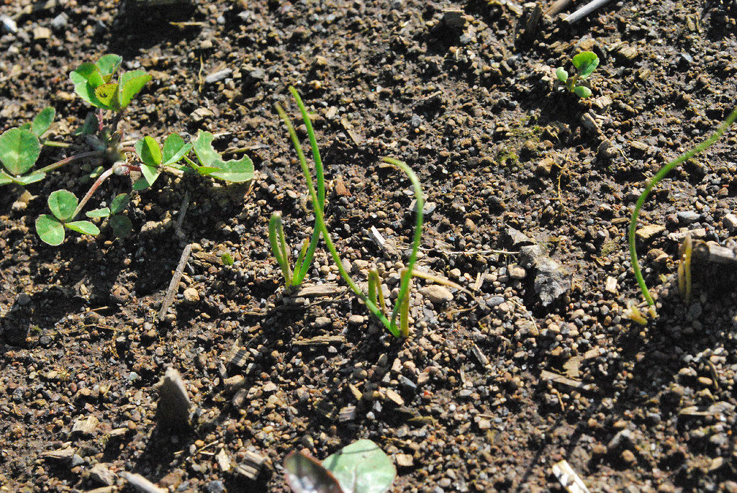
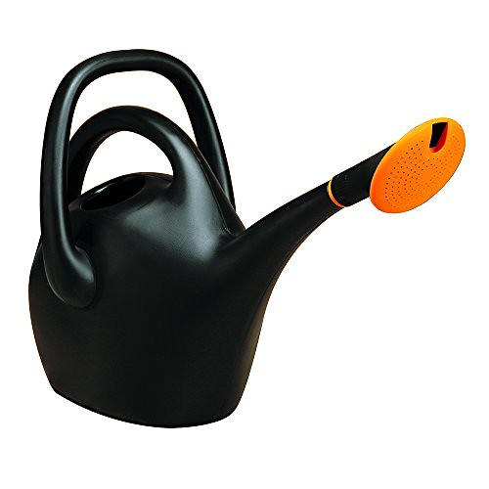
Experiment 1
Science activity
Gather your resources
You will need:
an oven tray
garden soil
some small branches or plants (to be the trees)
a small jug
a pile of books (to support the trays)
"Allium cernuum" by collomia is licensed under CC BY-SA 2.0
"Bloem Easy Pour Watering Can, 2.6 Gallon, Black (20-47287CP)" by shop8447 is marked with CC0 1.0

Slide 23
Experiment 1 - Erosion
Science activity
Half fill the tray with soil
Carefully pat the soil down and shape it to be a landscape – perhaps add a hill or a flat plain
Create a landscape by adding the small branches or plants to be the trees
Lean one end of the tray on a pile of books to make an acute angle.
Carefully and gently pour water from your jug onto a corner of the tray
Watch where the water creates tracks. This is called erosion.
Take a photo of your experiment
Insert it onto the next slide
Add labels to explain what you found out.

Slide 24
Photo – experiment 1
Science activity
Insert labelled photo here

Slide 25
Experiment 2- Erosion
Science activity
Half fill the tray with soil
Carefully pat the soil down and shape it to be a landscape – perhaps add a hill or a flat plain
Create a landscape by adding the small branches or plants to be the trees
Now, cover your landscape with a layer of sand.
Lean one end of the tray on a pile of books to make an acute angle.
Carefully and gently pour water from your jug onto a corner of the tray
Watch where the water creates tracks. This is called erosion.
Take a video of your experiment
Record yourself explaining how water can affect the Earth’s crust
Insert onto next slide

Slide 26
Photo – experiment 2
Science activity
Video with explanation how water can effect the Earth's surface
Notes:
Record a statement that explains how water can affect the Earth’s surface

Slide 27
Activity 3
Student resources

Slide 28
Don’t forget to do your 10x10 activity circuit every day that you are doing STEM!

Slide 29
Angles of the track
Mathematics activity
Name of angle | description | draw
Acute angle | less than 90°; a sharp angle
Right angel | equal to 90°
Obtuse angle | Between 90° and 180°; a blunt angle
Straight angle | equal to 180°
draw the angles using the shapes tool
Notes:
In your previous experiments, you tilted the erosion experiment tray at an acute angle. Let’s remember what the angles are named and draw them.
Use the Shapes tool to draw the angles

Slide 30
Angles of the track
Mathematics activity
Make a marble run that shows acute angles
Collect your resources
Marbles (or round lollies or chocolates – yum!!)
3x paper towel or toilet roll cylinders or small cardboard boxes
large sheet of paper,
tape
small container/basket (to catch the marbles)
Notes:
Make a marble run
Collect your resources
Marbles (or round lollies or chocolates)
3x paper towel or toilet roll cylinders or small cardboard boxes,
large sheet of paper,
tape,
small container/basket (to catch the marbles)

Slide 31
Angles of the track
Mathematics activity
Find an empty wall or space that you can easily reach (even the refrigerator door)
Attach the large sheet of paper to it
Cut your cylinders or small cardboard boxes in half lengthwise – you can decorate them if you wish.
Label the top left hand corner START
Tape your first half cylinder onto the paper at the START using an acute angle
Tape the second cylinder below the first one to create a zig-zag pattern as you move down the sheet
Notes:
Find an empty wall or space that you can easily reach (even the refrigerator door)
Attach the large sheet of paper to it
Cut your cylinders or small cardboard boxes in half lengthwise – you can decorate them if you wish.
Label the top left hand corner START
Tape your first half cylinder onto the paper at the START using an acute angle
Tape the second cylinder below the first one to create a zig-zag pattern as you move down the sheet

Slide 32
Angles of the track
Mathematics activity
Try your marble run: drop the marble at the START. Does the marble move from one cylinder to the next? If not, adjust your run. Try using round lollies or chocolates – yummy!
Continue to position your cylinders onto the paper and trial your run until they are all in place
Demonstrate your understanding of acute angles by drawing the 2 arms that meet at the vertex and labelling them.
Take a photo of your run – add it to the next slide
Notes:
Try your marble run: drop the marble at the START. Does the marble move from one cylinder to the next? If not, adjust your run. Try using round lollies or chocolates – yummy!
Continue to position your cylinders onto the paper and trial your run until they are all in place
Demonstrate your understanding of acute angles by drawing the 2 arms that meet at the vertex and labelling them.
Take a photo of your run.

Slide 33
Angles of the track
Mathematics activity
My marble run

Slide 34
Activity 4
Student resources

Slide 35
Don’t forget to do your 10x10 activity circuit every day that you are doing STEM!

Slide 36
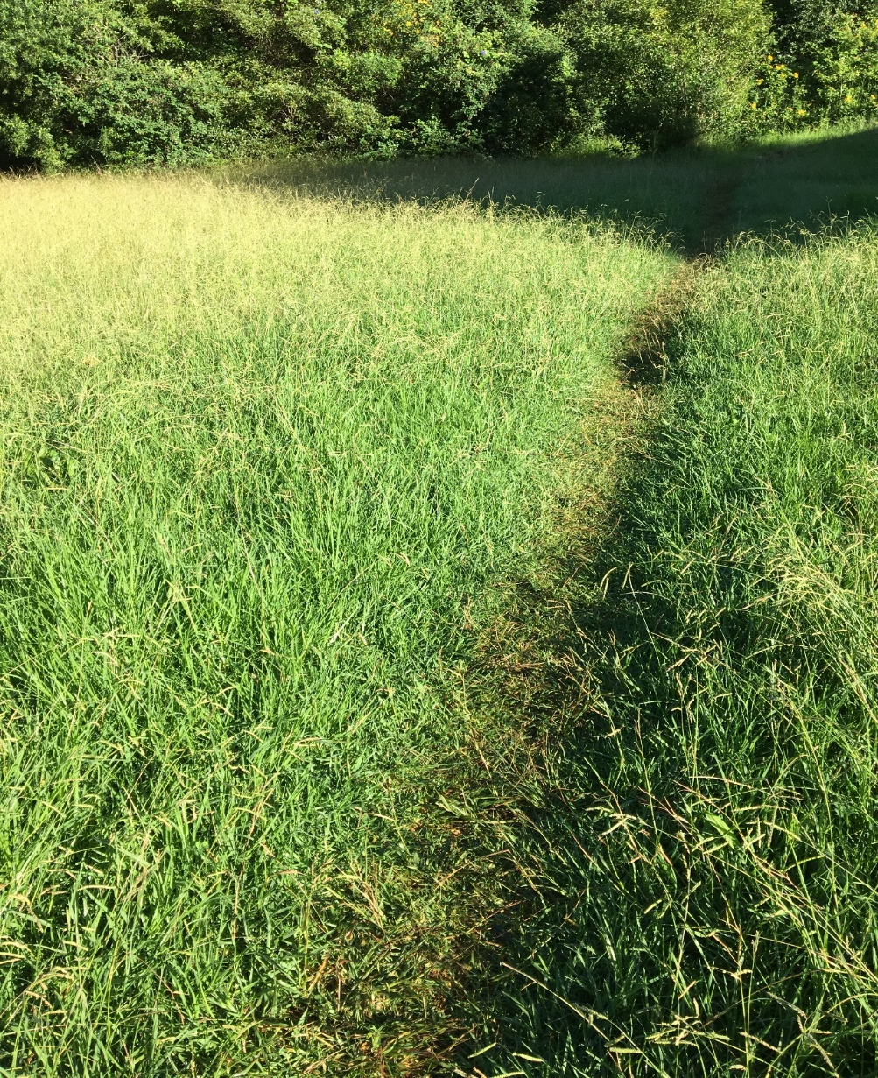
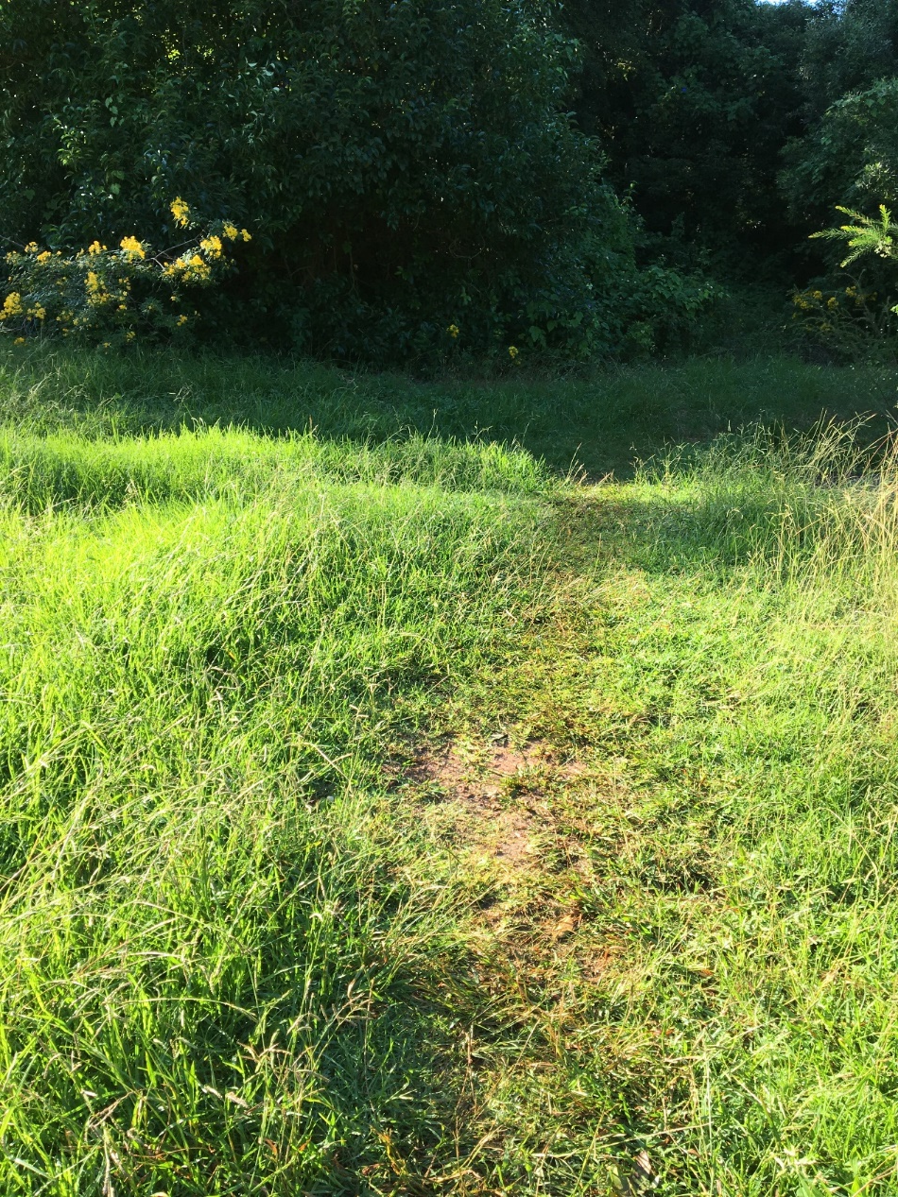
Human actions that change the Earth’s surface
How are people impacting on the environment. Add labels
Science activity
Notes:
In this activity you will find out about how people have changed and are still changing the Earth’s surface.
Look at these photos. How are people impacting the natural environment? Add a label to explain your answer.

Slide 37
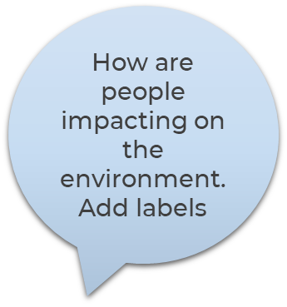
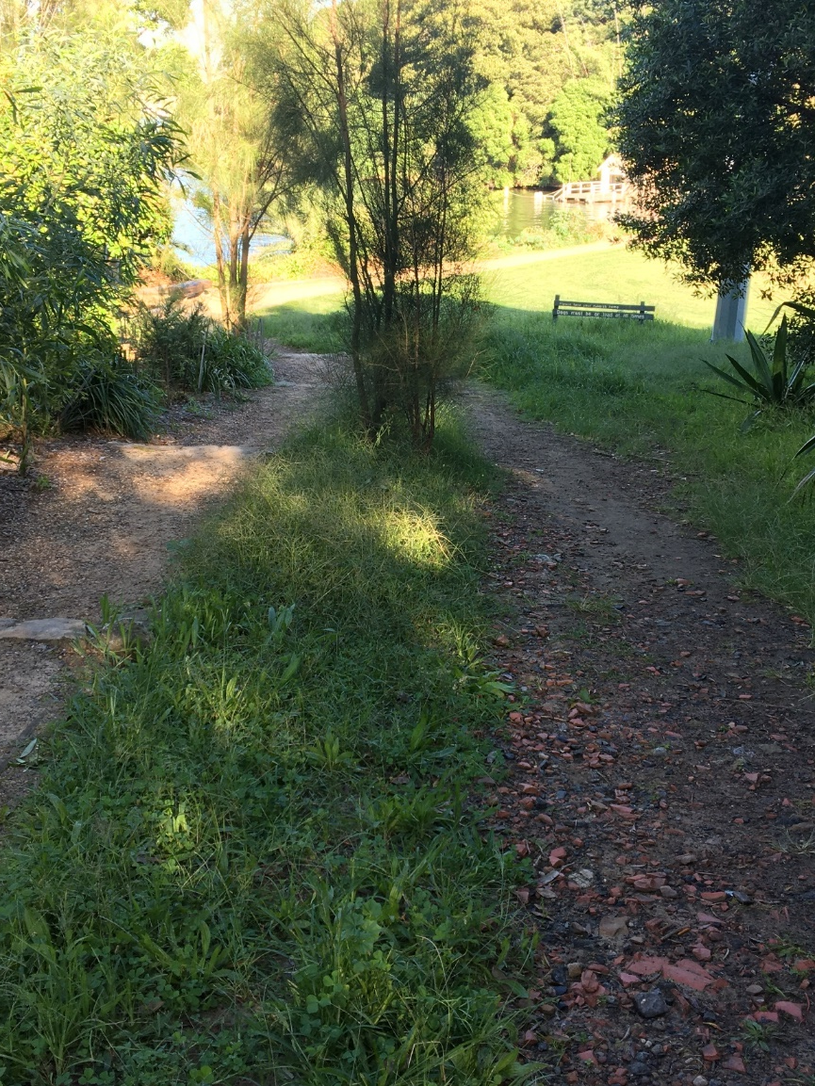
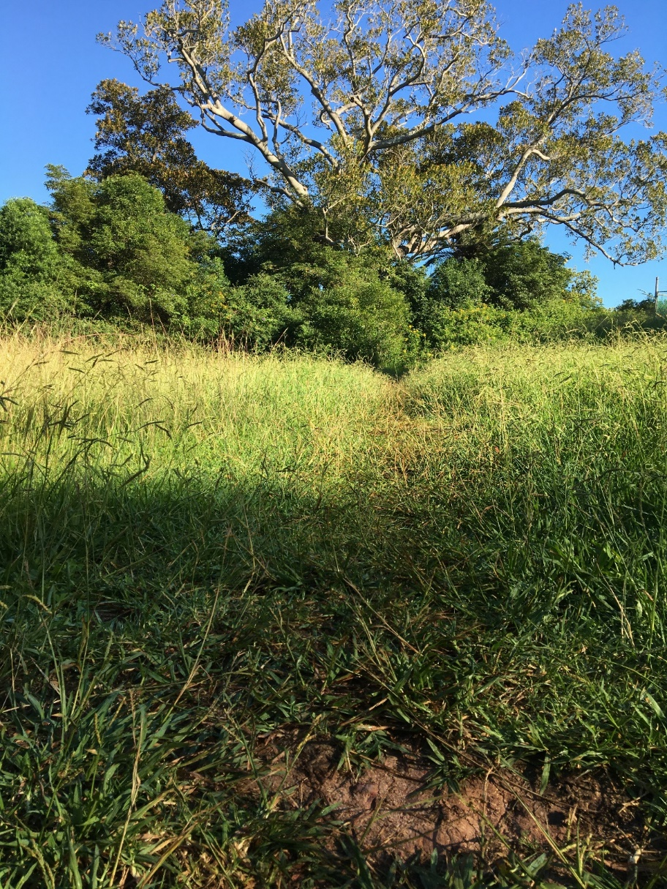
Human actions that change the Earth’s surface
Science activity
Notes:
In this activity you will find out about how people have changed and are still changing the Earth’s surface.
Look at these photos. How are people impacting the natural environment? Add a label to explain your answer.

Slide 38
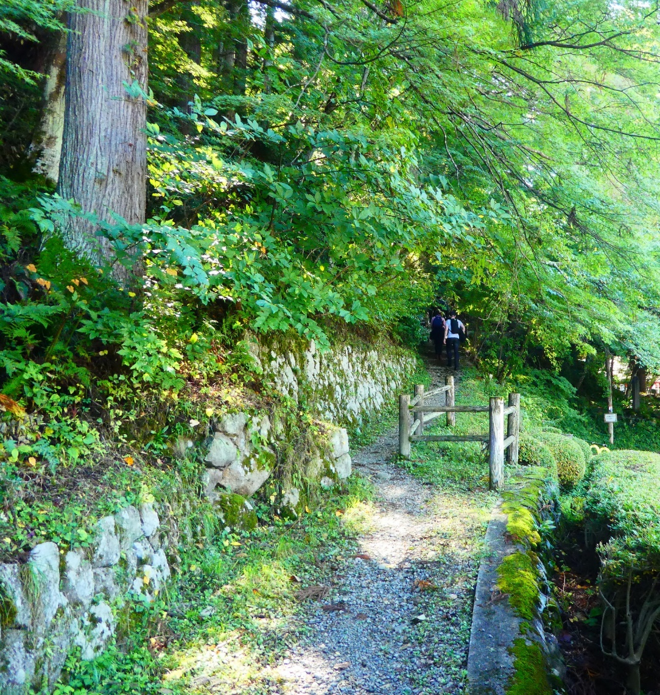
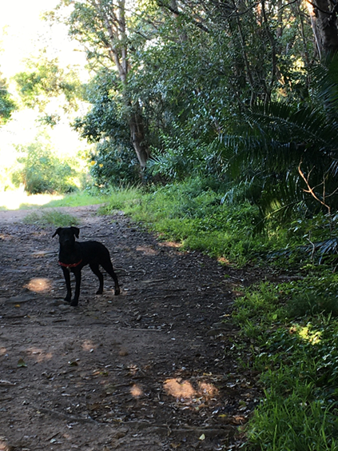
Human actions that change the Earth’s surface
Science activity
Notes:
In this activity you will find out about how people have changed and are still changing the Earth’s surface.
Look at these photos. How are people impacting the natural environment? Add a label to explain your answer.

Slide 39
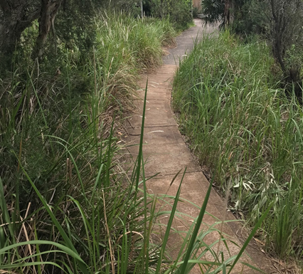
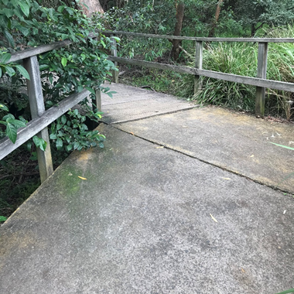
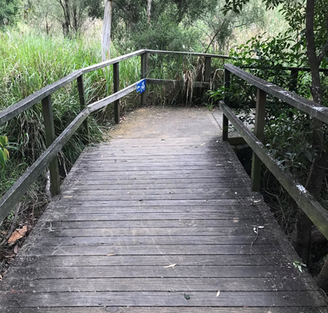
How are people reducing their impact on the natural environment?
Add labels to explain
Science activity
Notes:
In this activity you will find out about how people reducing their impact on the natural environment.
Look at these photos. What are people doing? Add a label to explain your answer.

Slide 40
How are people reducing their impact on the natural environment?
Draw images to match the labels
Science activity
Planting grasses and shrubs
Adding mulch and rocks
Improving drainage
Notes:
In this activity you will find out about how people reducing their impact on the natural environment.
Look at these labels. Add images to match.

Slide 41
An Aboriginal perspective on land
Watch ‘Off to work with Ranger Dam’ (2:42min) ABC Splash to hear about Ranger Dan and his work on caring for land.
Notes:
Aboriginal people care for the land with careful management practices. They have a strong relationship with the land based on respect and an understanding that the land provides for the people all that they need when the people look after and manage the land with care.
View these resources to understand more.

Slide 42
An Aboriginal perspective on land
Common ground
Watch Who we are: Country/Place to listen to Aboriginal and Torres Strait Islander peoples speak about their connection to land and their care for country.
https://www.commonground.org.au/learn/connection-to-country
Notes:
Aboriginal people care for the land with careful management practices. They have a strong relationship with the land based on respect and an understanding that the land provides for the people all that they need when the people look after and manage the land with care.
View these resources to understand more.

Slide 43
Review your exercise space
Take a photo of your exercise space and insert it into the next slide
Science and PDHPE
Go outside to your exercise space and look for any impact that your activity routines are having on the grass or soil.
How many times have you completed your 10x10 activity circuit?
Has your exercise made any impact on the grass or the soil today?
Are there any places where there is a track starting to show?
Then, explain the impact that your exercise routine is having on the Earth’s surface

Slide 44
Review your exercise space
Compare your answer to your Activity 1 session – Slide 11
Science and PDHPE
Insert your photo of your exercise space here.
Explain the impact that your exercise routine is having on the Earth’s surface.

Slide 45
Activity 5
Student resources

Slide 46
Don’t forget to do your 10x10 activity circuit every day that you are doing STEM!

Slide 47
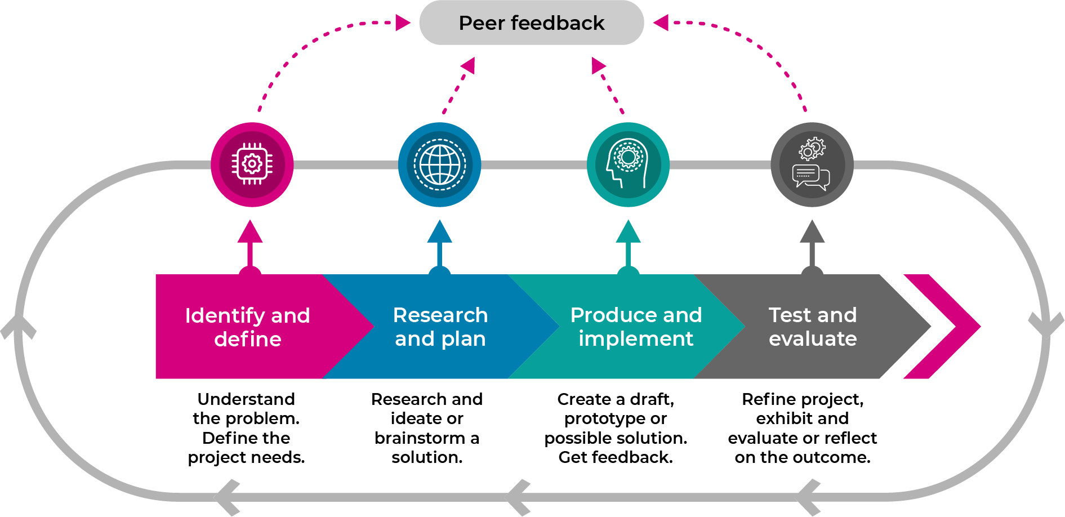
Design thinking
STEM
Design thinking is a process that guides our thinking so that we can create innovative solutions to complex problems.
Notes:
In this project you will be using the STEM design process:
Identify and define the task. This can include building the empathy to focus on the problem
Research and plan - Develop the skills of ideating: imagine, create and express new and innovative ideas (often in a rapid format).
Produce and implement a solution - Prototype your idea, experimenting with solutions.
Test the validity of the solution, allow for refinement.
Share and interrogate the solution with lots of praise and support.
These stages generally follow each other but we often need to go backwards and forwards in loops, especially when we get feedback

Slide 48
6 stages of design thinking
STEM
https://schoolsequella.det.nsw.edu.au/file/ba43743b-baca-4dd2-9689-2da09ad2ffc7/1/design-thinking-across-the-curriculum.zip/index.html#/
Notes:
Go to https://schoolsequella.det.nsw.edu.au/file/ba43743b-baca-4dd2-9689-2da09ad2ffc7/1/design-thinking-across-the-curriculum.zip/index.html#/
Complete the student learning

Slide 49
Empathy map
STEM
An empathy map is a way of recording all the things that you have learnt about a topic so far. By listening to what other people are thinking, feeling, saying or doing about a topic, you are developing empathy for other people
Review the work you have done:
PDHPE – taken you pulse, exercised every day
Science – learnt about the effects of natural and human actions on the Earth’s surface
Mathematics – understanding angles
Aboriginal perspective – caring for the land
Notes:
An empathy map is a way of recording all the things that you have learnt about a topic so far. By listening to what other people are thinking, feeling, saying or doing about a topic, you are developing empathy for other people

Slide 50
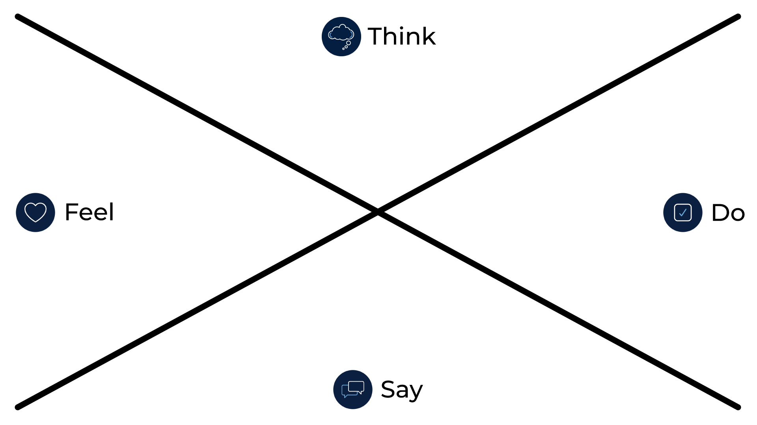
Empathy map
STEM
Notes:
Complete the empathy map here or on a print out:
Think: what people think or believe about caring for the Earth’s surface.
•Feel: feelings and emotions that people express about caring for the Earth’s surface.
•Say: direct quotes and key phrases or words about caring for the Earth’s surface.
•Do: actions that people make to care for the Earth’s surface.

Slide 51
Interviews
STEM
Interview 4 people about how they care for the Earth’s surface.
use different ways to conduct the interviews such as face-to-face, over the fence or a phone call
plan and write questions about how people care for the Earth’s surface.
ask the questions
take notes on the next slides
add this information to your empathy map
Notes:
Interview 4 people about how they care for the Earth’s surface.
use different ways to conduct the interviews such as face-to-face, over the fence or a phone call
plan and write questions about how people care for the Earth’s surface.
ask the questions
take notes on the next slides
add this information to your empathy map

Slide 52
Interview questions -plan
STEM - empathise
Question 1 | For example: about what people do outside in the environment
Question 2 | For example: how often do they do them?
Question 3 | For example: do they think they have an impact on the Earth’s surface?
Question 4 | For example:: explain the impact
Question 5
Question 6
Notes:
plan and write questions about how people care for the Earth’s surface.

Slide 53
Interview questions
STEM - empathise
Who? | Interview question: | Answer

Slide 54
Interview questions
STEM - empathise
Who? | Interview question: | Answer

Slide 55
Interview questions
STEM - empathise
Who? | Interview question: | Answer

Slide 56
Interview questions
STEM - empathise
Who? | Interview question: | Answer

Slide 57
Activity 6
Student resources

Slide 58
Don’t forget to do your 10x10 activity circuit every day that you are doing STEM!

Slide 59
Driving question
STEM
How can we protect Earth’s surface from the effects of human actions involving physical activity?
Notes:
We have a driving question to:
focus our task
challenge our thinking
give us direction

Slide 60
Define
STEM
Highlight the key words. On the next slide, write a definition.
How can we protect Earth’s surface from the effects of human actions involving physical activity?

Slide 61
Driving question
STEM
Define your key words
Notes:
Use a dictionary to help

Slide 62
Define
STEM
Record your answer these questions:
what does it mean to protect the Earth’s surface from physical activity?
who would you need to think about?
what else do you need to consider?
where do you need to think about?
To record your answer, just search for ‘record’ in Tell me what you want to do.

Slide 63
Ideate
STEM
Think about
• how do other people view caring for the Earth’s surface when they are doing physical activities?
• Who is involved?
• What new ideas do we have that will meet the needs and protect the Earth’s surface?
O explore all possibilities
O wild and wacky ideas are encouraged.

Slide 64
Ideate
STEM
Complete the Crazy 8 design thinking strategy.
fold an A4 sheet of paper 8 sections (half, half and half again)
select an aspect of the problem to focus on
draw, write, label one solution to this problem on sector of their paper in 60 seconds
repeat this process 7 more times
at the end of the eighth, share ideas with someone close to you

Slide 65
Activity 7
Student resources

Slide 66
Don’t forget to do your 10x10 activity circuit every day that you are doing STEM!

Slide 67
Prototype
STEM
Collect your resources:
a making box: containing materials found at home or school such as cardboard boxes, cylinders, tape, glue, pipe cleaners, materials, empty PET bottles
Make (engineer) your best ideas to protect the Earth’s surface when people are doing physical activities

Slide 68
Test your prototypes
STEM
Test your innovation
Take photos of your innovation and insert them here

Slide 69
Activity 8
Student resources

Slide 70
Don’t forget to do your 10x10 activity circuit every day that you are doing STEM!

Slide 71
Share your innovations
STEM
Organise a showcase display of your STEM innovation in your exercise space
invite your family to the showcase
explain your learning from science and technology, engineering and mathematics.
perhaps you might like to make invitations and set up a special STEM display space
ask a family member to take some photos for you

Slide 72
Share your innovations
STEM
Insert your photos here

Slide 73
Activity 9
Student resources

Slide 74
Don’t forget to do your 10x10 activity circuit every day that you are doing STEM!

Slide 75
Reflection
Complete your review
Star Something that went well | Star Something that went well | Wish A goal for next time…

