Slide 1
STEM – Future vehicles Learning Sequence Stage 3
Teaching and learning resources
https://www.deviantart.com/riftroamer/art/RiftRoamers-RPG-AeroRig-and-Trailer-372058570

Slide 2
Important teacher information
How to use the Power Point
You may wish to use the whole slide deck, or Module 1 and/or 2, as a teaching tool to work through with your students. It could be saved to USB for home use or some slides download as a PDF for students who don’t have access to any digital devices.
This slide deck is to be redesigned for your context. Included are many examples that can be added to, deleted or adapted for your students.
Revise slides and notes for your needs. Notes at the bottom of each slide have been developed to further improve student understanding and provide thought provoking questions.
Considerations around timeframes, number and frequency of feedback sessions, and how they will be conducted for each student throughout the project needs to be redesigned.
When learning from home - digital platforms and protocols for student, parent and teacher feedback sessions need to be negotiated.
You will need to decide the form of the student portfolio.
Notes:
The first 2 slides could be deleted to create the ‘student only’ version.

Slide 3
Introduction
How can we future proof our transport vehicles to ensure equitable access of our local resources with others in Australia?
http://pinktentacle.com/tag/transportation/page/2/
Notes:
This slide deck is designed to support you through all phases of your learning. You will use it to gain information but to also create information. You may need to add slides to complete activities or create a link to the work that you have saved in another location. Save often!
The slide deck becomes your workbook.

Slide 4
STEM project – future vehicles
STEMtastic design task
In this unit we will investigate and discover future transportation options to carriage resources across Australia for all Australians.
You will:
design and build a prototype of a future transport vehicle and the system that your vehicle will operate in.
develop an understanding of the vast systems in the Australian transport network, due to Australia's large area and low population density in considerable parts of the country and the wide spread of natural and developed resources.
present your prototype and system map to an audience, justifying your design choices.
develop a portfolio of your work in response to all tasks.
Notes:
The PowerPoint will support you along the way.

Slide 5
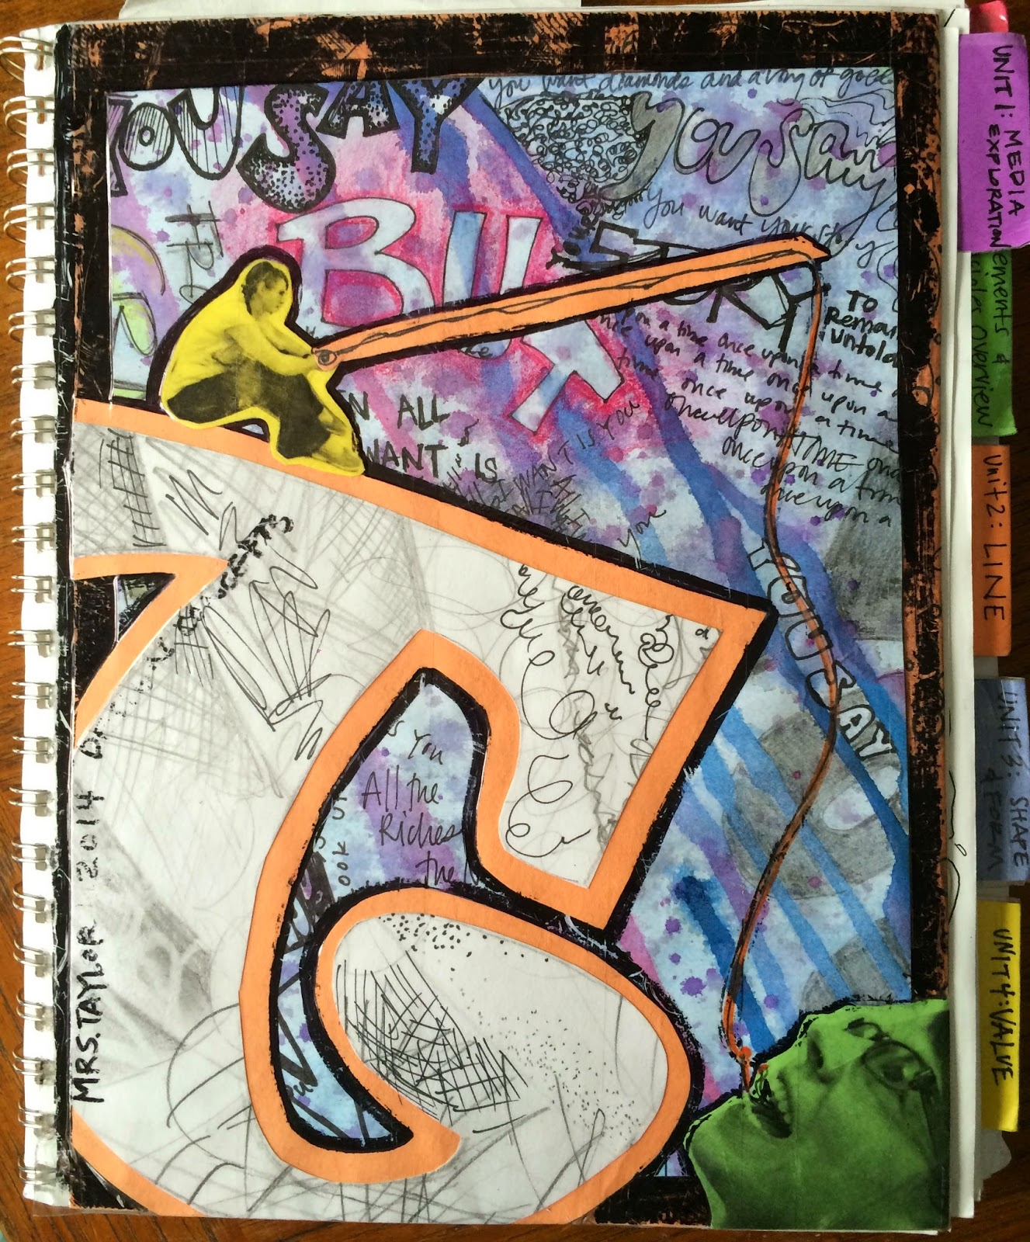
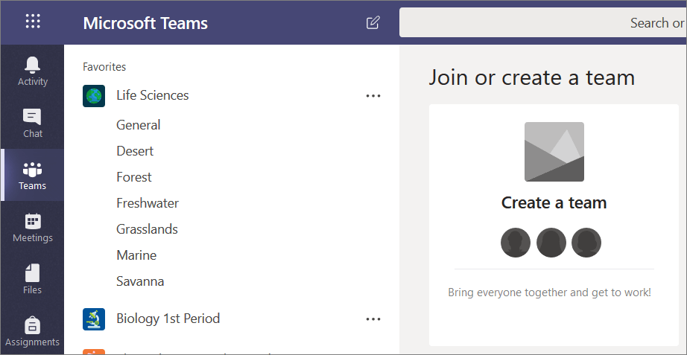
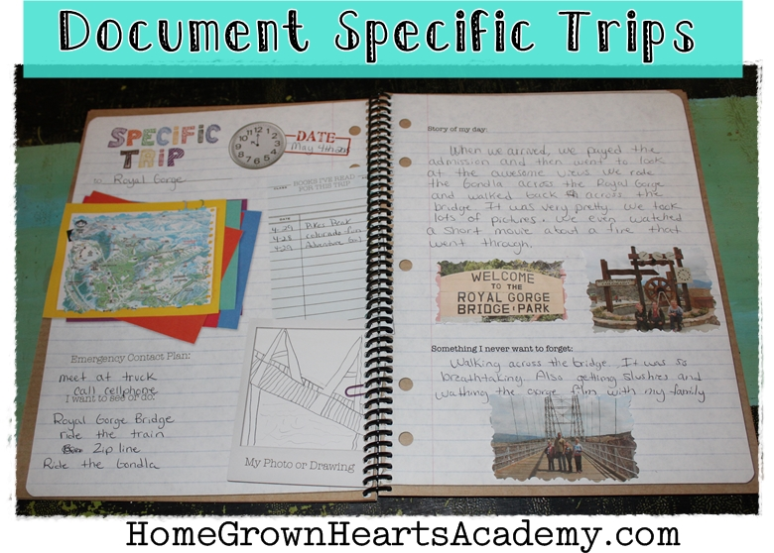
What is a portfolio?
Student portfolio examples
Digital
https://www.commonsense.org/education/top-picks/student-portfolio-apps-and-websites
Non digital
https://c1.staticflickr.com/5/4073/4859858229_d464128be1_z.jpg
NSW DOE Digital Tool Selector
Notes:
You will be required to keep your task work in a portfolio.
Consider:
What it looks like.
Where it is. Digital, non-digital.
How it will be added to.
When it will be reviewed for feedback.
For big items you may need a container or box to house them in or if possible take photographs or video to capture the evidence. Be innovative in your responses and presentation of learning.

Slide 6
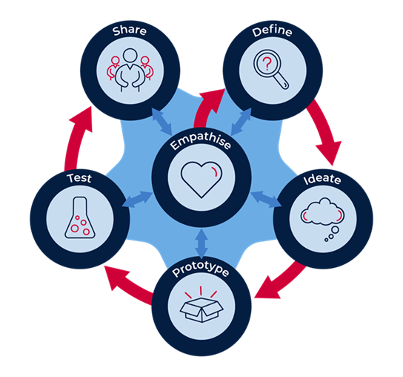
STEM process for our project
Design thinking
Notes:
In this project you will be using the STEM design process:
Build the empathy to focus on the problem.
Define the task.
Develop the skills of ideating: imagine, create and express new and innovative ideas (often in a rapid format).
Prototype your idea, experimenting with solutions.
Test the validity of the solution, allow for refinement.
Share and interrogate the solution with lots of praise and support.
Further in the unit we look at each of these steps in more detail.

Slide 7
Provocation video – Imagine if?
Vehicles Of The Future - Future Transportation System 2050
https://safeYouTube.net/w/oBRB
Notes:
Watch this video then think about: how are they powered? Imagine if ..? Why did the author predict some of these futures? How soon? Why? Do you think some of these future vehicles are possible? Why? Have you seen any of these types of vehicles? Where?

Slide 8
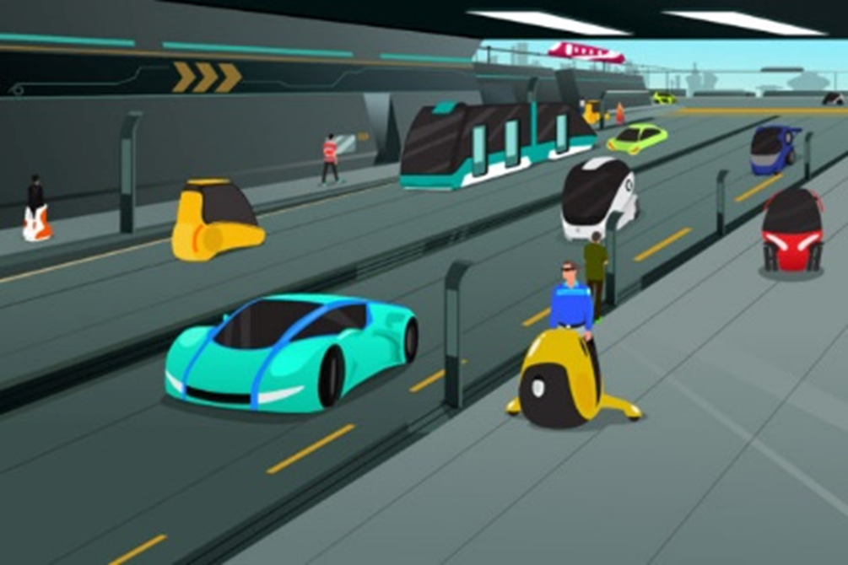
Understanding the driving question
What future?
For our unit we are looking to 2050.
https://thefuturesagency.com/2016/10/27/ai-will-profoundly-change-city-life-in-8-different-ways-by-2030-via-singularity-hub/
https://upload.wikimedia.org/wikipedia/commons/b/be/AEROMOBIL%2C_SRO_%2827448580834%29.jpg
Notes:
For our study we will be looking at a target of 2050 as our future. How many years is that from now?
You can design to go further, but it very difficult to predict an absolute future when there are so many factors that can effect our predictions. THINK - what would some of these factor include?

Slide 9
Driving question
How can we future proof our transport vehicles to ensure equitable access of our local resources with others in Australia?
‘Unpacking the question’
Write down your thoughts to this question.
Add further questions you need help with.
Add your ‘need to knows’ to the class wall.
Notes:
If you do not have access to a device you could write your thoughts and questions in the Power Point or on a piece of paper to add to your portfolio and discuss with the teacher or carer for more clarification.
If you are working in online spaces you could use applications such as Padlet, Google jamboard or Bubble.us. to post your responses. Your teacher will decide which platform you will be using.
This allows you to build off other student responses and provoke alternative thinking.

Slide 10
Response wall example
How can we future proof our transport vehicles to ensure equitable access of our local resources with others in Australia?
Padlet - A virtual online wall that collaborators can add text, links and images to.
Notes:
Padlet example

Slide 11
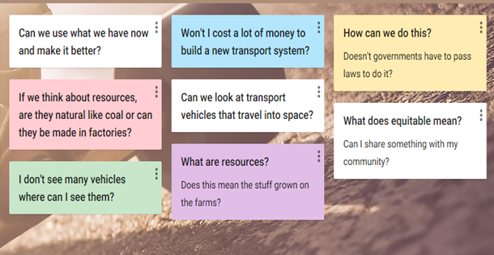
Response wall example
How can we future proof our transport vehicles to ensure equitable access of our local resources with others in Australia?
Padlet - A virtual online wall that collaborators can add text, links and images to.
Notes:
Padlet example

Slide 12
Future vehicles
Why do we need to create a solution for future transport vehicles and systems?
Questions for learning
Notes:
The global citizens need to cut carbon emissions and air pollution, at the same time as improving human development, has created the demand for sustainable and accessible transport systems. Through their actions, city governments are helping to shape the cities of the future, today.

Slide 13
Module 1 Activity 1.2
Developing background knowledge
http://mehallo.com/blog/archives/23019
Notes:
The next series of slides requires some research for you to develop some background knowledge you will need later to develop design solutions.

Slide 14
Researching for resources
When online be:
Notes:
Searching safely is very important – your teacher may have some resources or website links for you to use.

Slide 15
What is transport?
Summary
Notes:
Research and respond by writing a short summary of your findings.

Slide 16
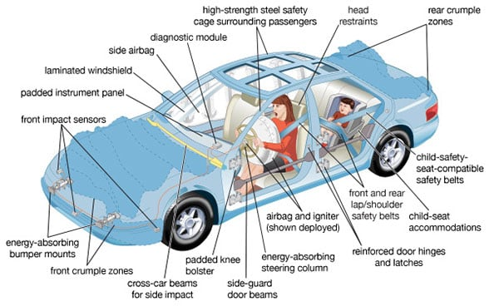
What is a vehicle?
Annotated drawing
Example
https://technofaq.org/posts/2018/11/the-key-safety-features-to-look-for-in-second-hand-cars/
Notes:
Research and respond by creating a labelled drawing of a vehicle of your choice.

Slide 17
Are there similar features of all vehicles?
Draw
Notes:
Respond by drawing all the similar features. Eg wheels ………..
You may need to complete some further research to help you.

Slide 18
List some vehicle types and their purpose.
List
Notes:
Discuss with others and respond by listing all the vehicle types you know, for example, truck, train, motorbike and note what each is used for.

Slide 19
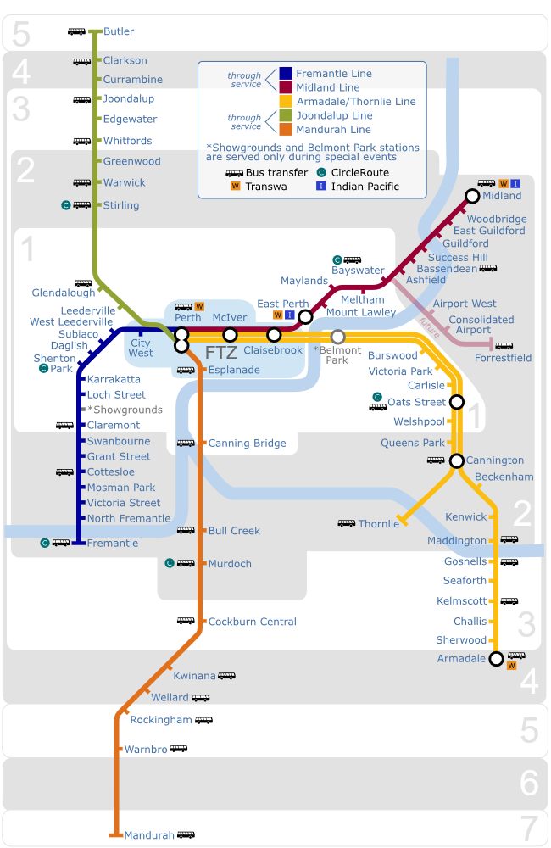
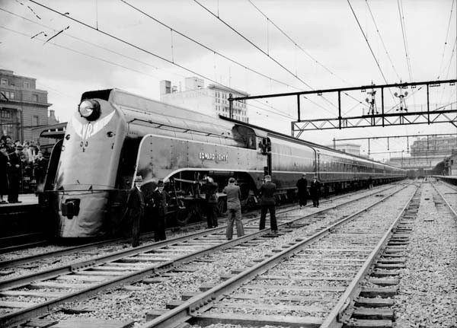
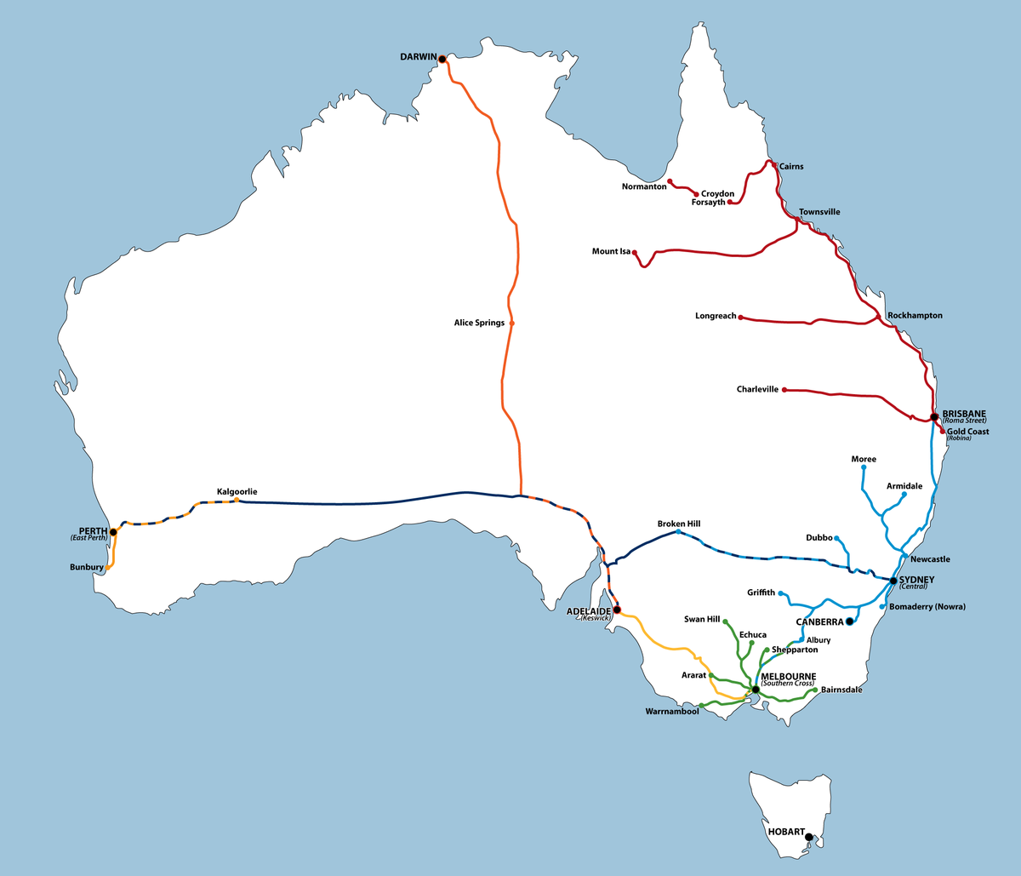
What are transport systems?
Example rail system
https://upload.wikimedia.org/wikipedia/commons/1/12/TransperthRailwayMap.svg
https://en.wikipedia.org/wiki/Rail_transport_in_Australia
Notes:
Brainstorm different types of transport systems. Example rail, road and air.

Slide 20
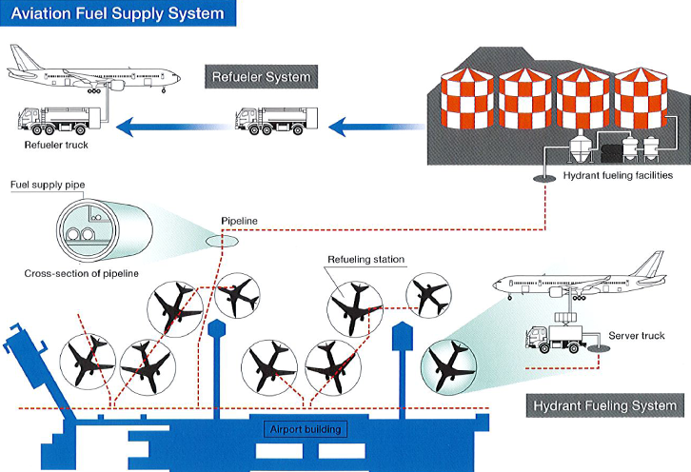
Example of a system
How do large airport refuelling systems work?
https://aviation.stackexchange.com/questions/38106/how-do-large-airport-refuelling-systems-work
Notes:
Review this information: to run a large airport successfully there are many components that complete the system.

Slide 21
Choose a transport system
Map and draw
Notes:
Using the examples on the previous slides, choose a transport system that you are familiar with, then research and respond with mapping and drawing. Try to demonstrate how all the parts are part of one larger system.

Slide 22
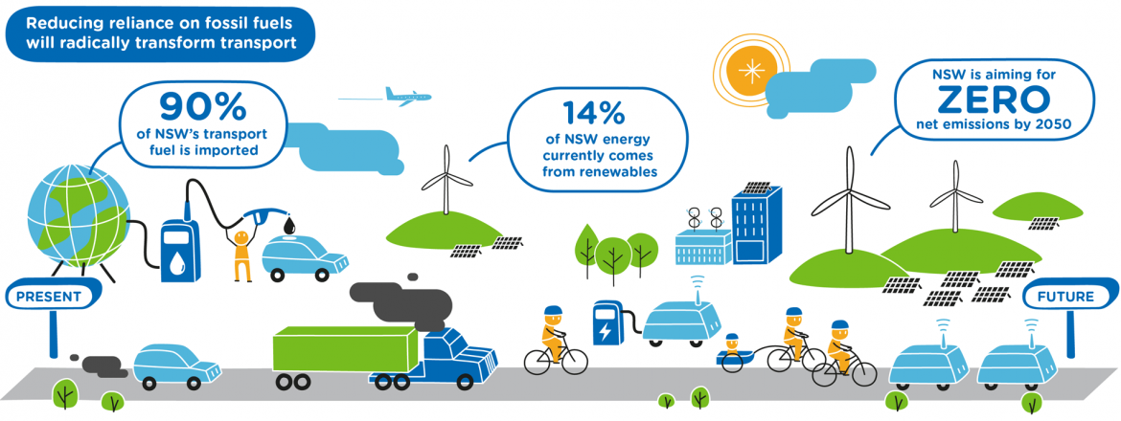
What are sustainability issues for our future?
Future transport 2056 - NSW
https://future.transport.nsw.gov.au/
Notes:
If you can, read the information in the web address to understand how NSW started planning for the future over 40 years ago. If not discuss this infographic with others.
The NSW Future Transport vision is one where urban spaces in our cities and centres are great places for people; and moving more people from high-emitting vehicles to more sustainable public and active transport will reduce our state’s emissions intensity, improve air quality and support better health and wellbeing for all who live in and visit NSW. (From website)

Slide 23
Future transport 2050 - NSW
Research – note 4 most important pieces of information from the website
https://future.transport.nsw.gov.au/
1.
2.
3.
4.
Notes:
Add your answers after the numbers.
Leave this slide if are unable to access a digital device.

Slide 24
Transport industry sustainability
Cause and effect
1. Large energy use, rising fuel prices and emission guidelines are necessitating energy efficiency and the management of greenhouse gas emissions. Reduce global warming.
Transportation activities are a main source of greenhouse gases. The high level of emissions is driving a focus on efficiency and electric vehicles. Airlines spend 25-35 percent of their annual operating costs on fuel!
2. Safety is an issue including passenger safety for industries involved in transporting people (on buses), and worker safety involved in manufacture and operation (in a factory).
For passengers, motor vehicle crashes are one of the leading causes of death in many countries.
For workers, dangerous cargo loading operations can cause serious injuries.
Notes:
Read and discuss

Slide 25
Transport industry sustainability
Cause and effect
3. Unstable fuel prices. Have you noticed how petrol changes price day to day? Check the signs outside the service centres to see how much and when they change.
4. Changing energy rules is creating opportunities for innovation
In the auto industry, many countries have targets for zero-emission vehicles on the road by 2025. Vehicle manufacturers will innovate to bring zero-emission vehicles to the market.
Notes:
Read and discuss

Slide 26
Vehicles of the future - sustainability
Alternative energy sources of the future
Sources will depend on many factors:
Affordability
Renewability
Available technology and organisation
Exhaust emissions
https://www.duurzaamnieuws.nl/zin-en-onzin-van-de-huis-accu/
Notes:
When designers are looking to create solutions they must take into account many factors.

Slide 27
Activity 1.3
Resources in Australia

Slide 28
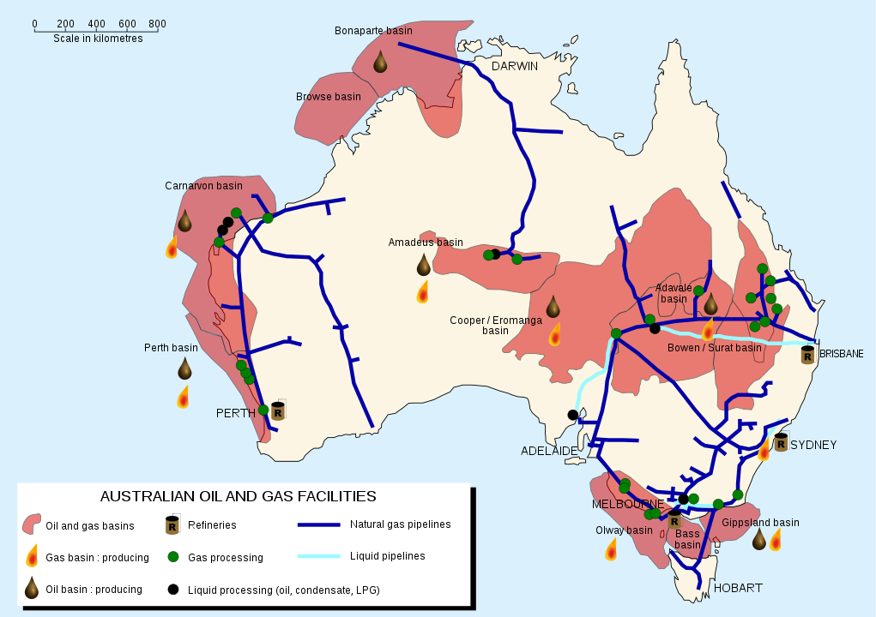
Types of resources - Australian oil and gas
https://en.wikipedia.org/wiki/File:Australian_oil_and_gas_facilities_map-en.svg
Notes:
What resources do you have in your local area?
The production of liquefied natural gas (LNG) from Australia has become an important export industry.
Australia has abundant supplies of natural gas, both offshore and onshore. It can be used to generate electricity and in homes, mainly for hot water and cooking.

Slide 29
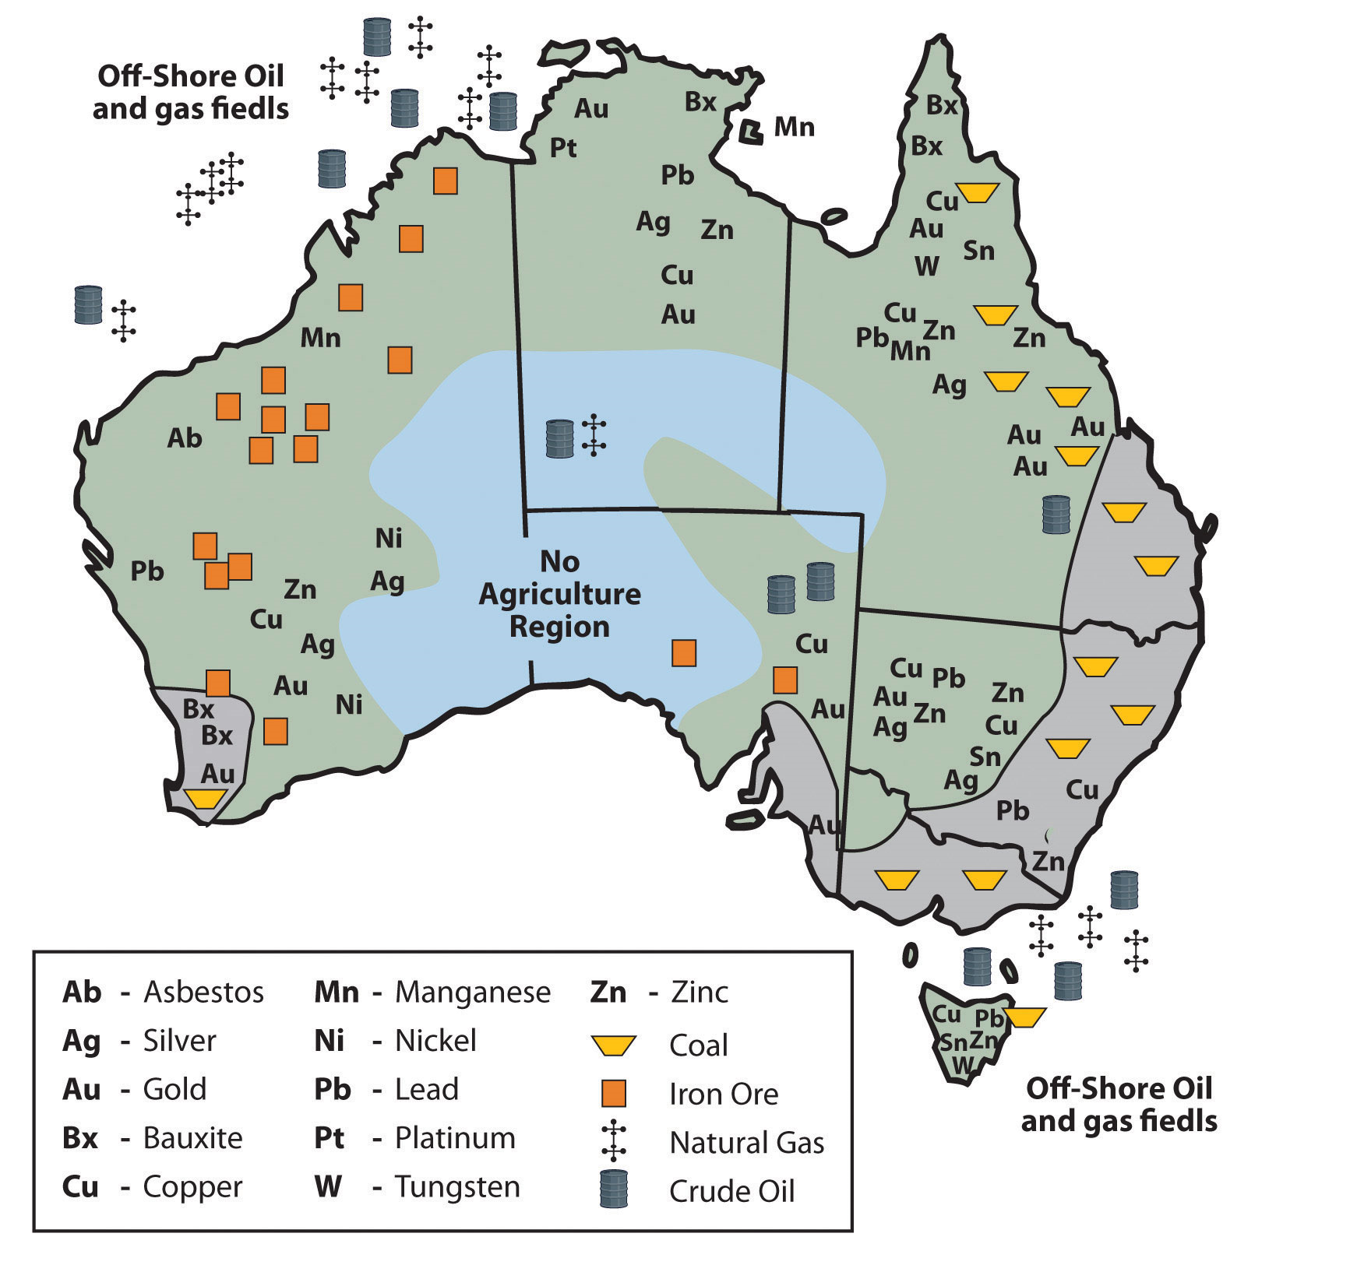
Australia’s distribution of raw materials
Try searching ‘Mining in Australia’ for further information.
Source: Updated from map courtesy of Golbez, http://commons.wikimedia.org/wiki/File:Australia_states_blank.png.
Notes:
Australia has excellent food production capabilities.
It also has an excellent mineral resource base. Different types of minerals can be found in different regions throughout Australia. These minerals are used to manufacture important elements when building, like steel.

Slide 30
Resources of Australia
Manufacturing and distribution of resources - examples
Manufacturing
Containers & packaging
Industrial machinery
Food, farming & fishing products
Brewers and distilleries
Pharmaceuticals
Specialty chemicals
Building materials & fixtures
Clothing & accessories
Storage and distribution
Marine transportation
Transportation services
Delivery services
Airlines
Railroads
Automobiles
Notes:
Read and think about the information.
What manufacturing or distribution centres do you have in your local area?

Slide 31
Back to our driving question
How can we future proof our transport vehicles to ensure equitable access of our local resources with others in Australia?
What does equitable mean?
Research and look up the definition of ‘equitable access’ in the dictionary.
Write your definition in the box supported by images to demonstrate your understanding.
Notes:
Note down some ideas in the spaces. Think about what it means for equitable access of resources for people? How do we ensure equitable access?
Discuss your ideas with others.
Use a variety of dictionaries, if you have access to them, to choose the most appropriate meaning for this topic.

Slide 32
Concepts of time and distance
Traditional Aboriginal peoples of Australia – movement of resources
Aboriginal peoples’ way of life was mainly hunting and gathering.
They used to be mobile (walking) depending on the availability of food and water.
Some Aboriginal people used the sky as a calendar to tell them when it was time to move to a new place and a new food supply.
Most of their communities had permanent settlements used for agriculture.
Aboriginal people deliberately exchanged seeds to begin growing plants where they did not naturally occur.
When travelling, terrain was an important issue for time.
Terrain: land, landscape, environment.
Notes:
Aboriginal peoples had few possessions and made everything they needed. This way of life does not change or harm the fragile environment of Australia. The well-being of the land, and its plants and animals are vital and sacred to the aboriginal people.
The landscape and environment are very important considerations for your design solutions. They will inform how your vehicle will move.

Slide 33
Distance and time – resource transportation
Origin | Destination | Resource | Vehicle type/s | Distance | Leaving time 24hr time | Arrival time 24hr time | Approx. time taken
Coffs Harbour, NSW | Sydney Markets | Bananas | Road - truck | 529km | 6:00 | 12:35 | 6hrs 35min
Newcastle NSW |  | Coal | Ship |  |  | 13:00
Lismore NSW | Margaret River WA | Parcels | Plane
Hobart TAS |  | Timber
Albury NSW | Melbourne VIC | Fuel | Road truck | 315.09km |  |  | 3hrs 36min
Bega NSW |  | Milk & cheese
Cairns Qld | Brisbane Qld |  |  | 1684km |  |  | 20hrs
Notes:
Using the information on the table, complete the blank squares through research. If you don’t have access to a digital device, use your best estimating skills and discuss with others. An atlas may be useful.
Write you answers in the spaces. As you can see, resources need to travel long distances to ensure equitable access for all Australians.
Climate and environments will impact time taken.

Slide 34
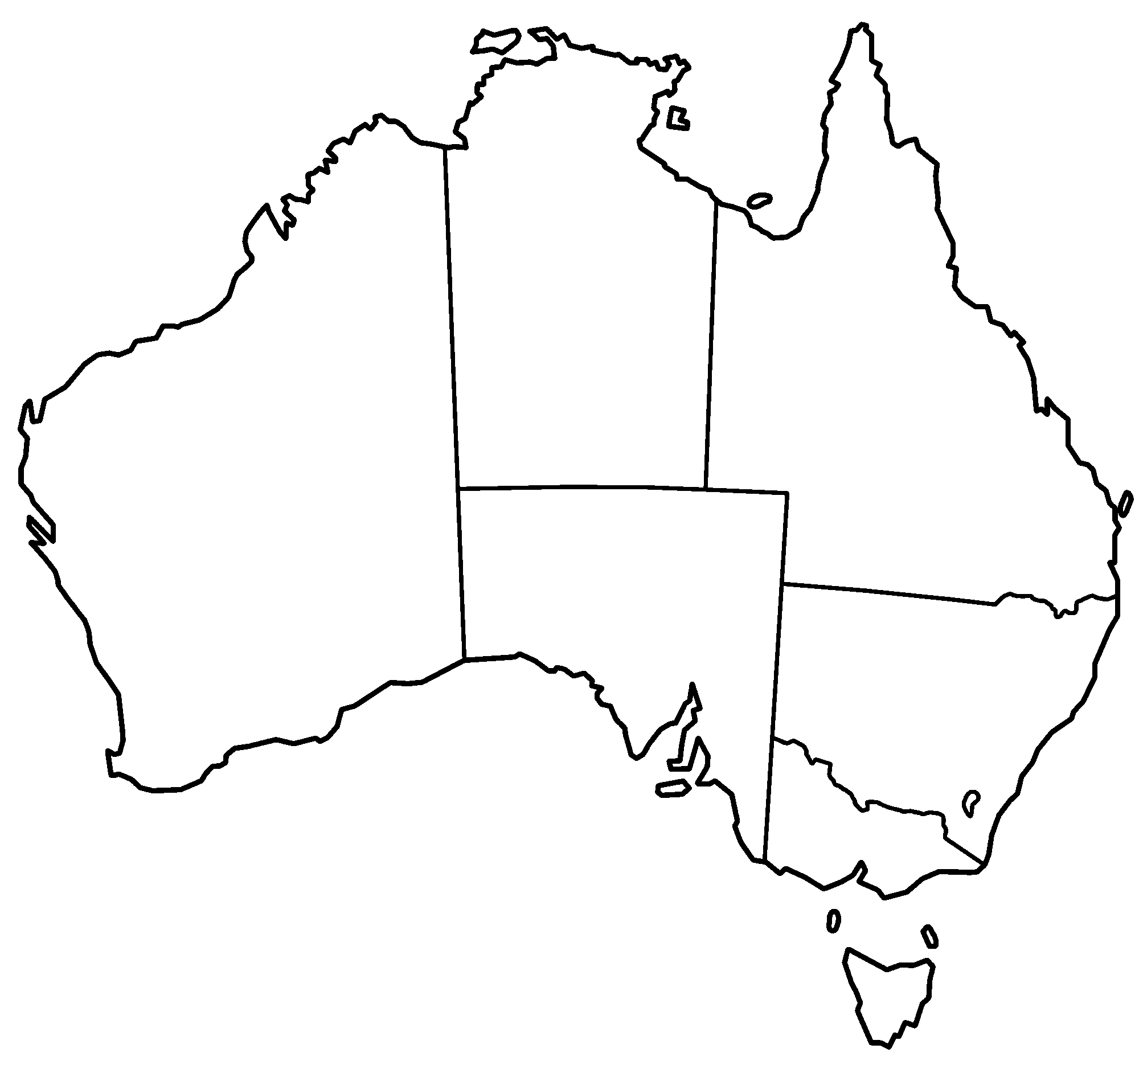
Location – your local area
https://upload.wikimedia.org/wikipedia/commons/3/3b/Australia_states_blank.png
Notes:
Mark on the map the state and territories and capital cities.
Place a circle around your local area.
Show the local resources produced, manufactured or distributed in your local area.
You may use this map and place text boxes with no outlines or print this page and complete the activity offline. Add to your portfolio.

Slide 35
Back to our driving question
How can we future proof our transport vehicles to ensure equitable access of our local resources with others in Australia?
What are resources in your local area that we share with others across Australia?
What makes your area unique to develop these resources? Climate, location, landscape, population, space, government projects.
Notes:
Note down some ideas in the spaces. Think about what it means for equitable access of resources for people? How do we ensure equitable access?
Discuss your ideas with others.
If you are unable to identify resources being developed in your local area – move to next slide.

Slide 36
Transport
Distribution of resources
What resources are manufactured, stored or distributed in your local area?
How are they distributed across Australia?
Notes:
More than 96 percent of fresh food moving through the Sydney Markets has travelled over 150 kilometres.
Nearly 29 percent of all produce comes from regions greater than 1000 kilometres from Sydney.
Discuss with others.
Example, food, furniture, hardware distributed from cities to regional and rural areas.
Sydney fish, flower, fruit and vegetable, and meat markets – regional to city.
Use of trucks, trains and planes to transport.

Slide 37
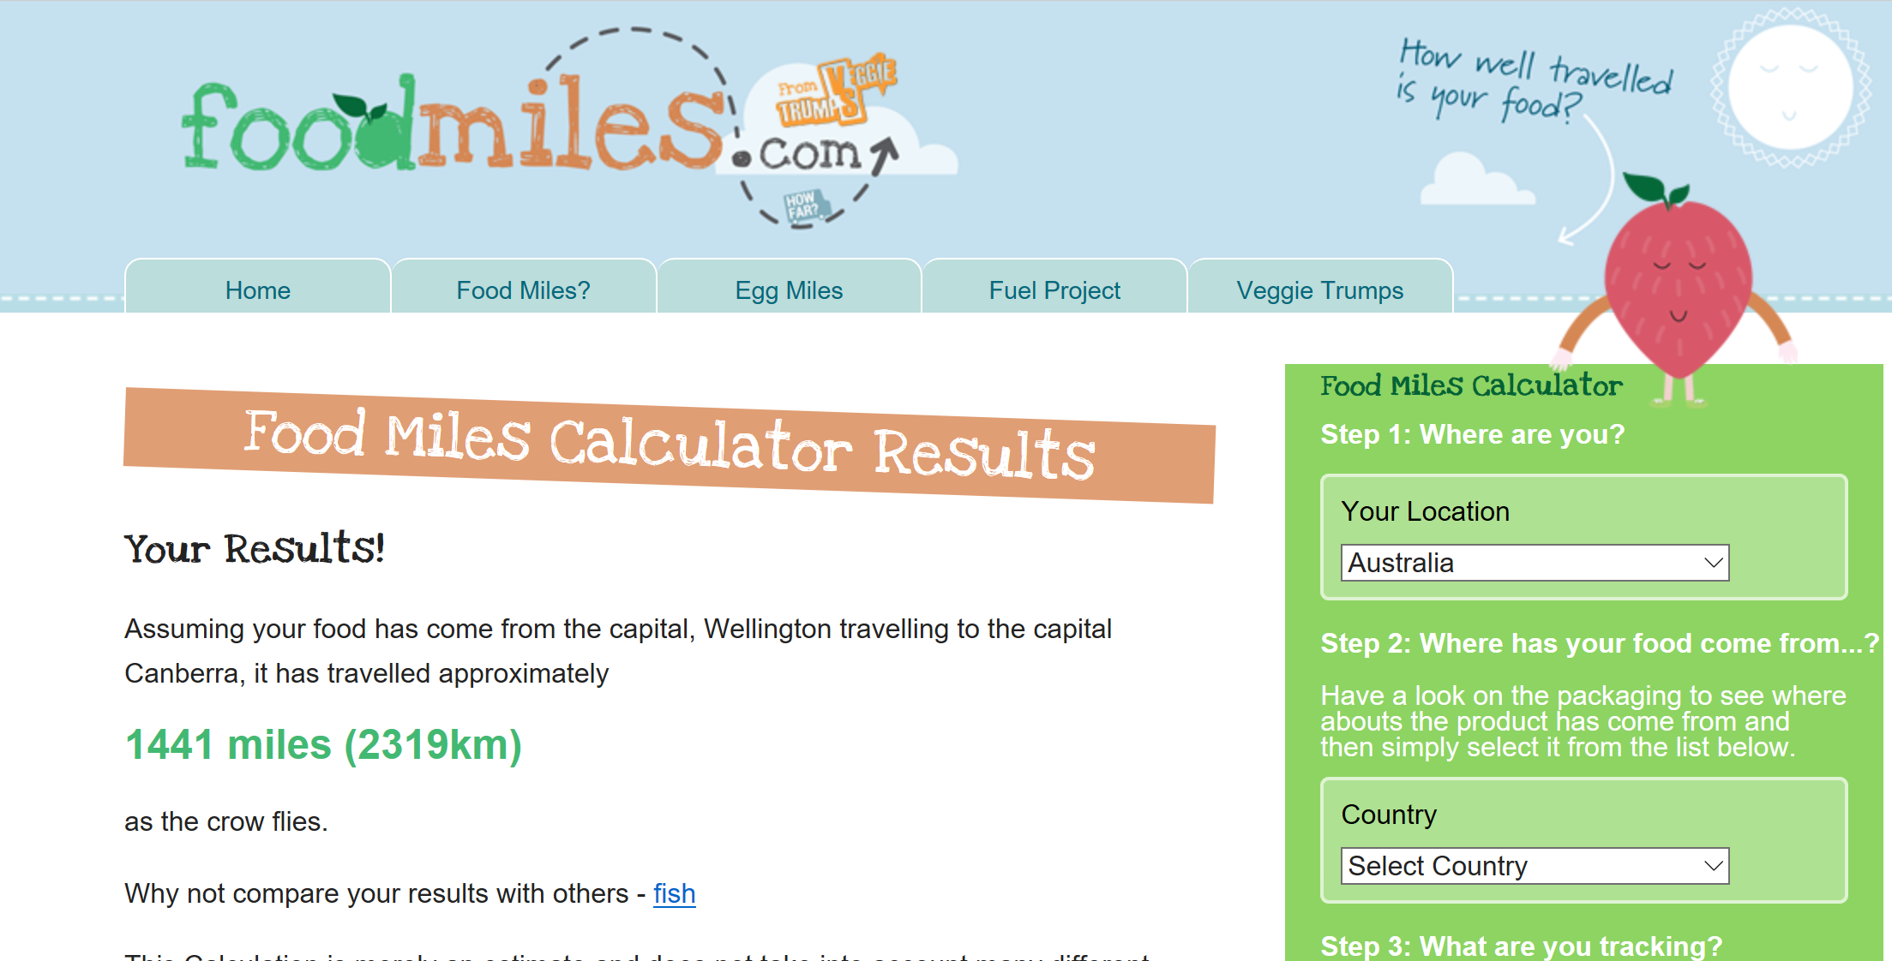
Cost of distribution
Food miles calculator
http://www.foodmiles.com/results.cfm
Notes:
If you have access to the internet you may like to explore the foodmile calculator to see how transport is an integral system that get resources to us.
A kilometre equals 0.62 miles.
1 mile equals 1.6 km.

Slide 38
Activity 2.1
Visual timeline
Transport evolution

Slide 39
Transport
Create a visual timeline of how transport has evolved over time from 1800 - 2020
Complete some background research so you can choose a transport type. Take notes. Develop a timeline to demonstrate the evolution. Demonstrate how technology has contributed to the change.
land transport
air transport
water transport
rail transport
If you need additional support.
How to guide:
https://www.wikihow.com/Make-a-Timeline
Notes:
In your classroom discussion, timelines can be created on a digital platform and then downloaded to be stored either in your USB or in your online space. Choose a scale e.g.. 1cm equals 10 years.
If you choose to complete a hand drawn timeline be careful to measure out each time period carefully. You may need to join pieces of paper together or use a piece of cardboard.
Move to next slide for more information.

Slide 40
Time to look closer
Using what I know about transport, which type will I focus on?
Transport timeline
https://science3.webcindario.com/social/5/the_evolution_of_transport.html
Notes:
Move to next slide for more information.

Slide 41
Timeline checklist
Timeline checklist
Have I included:
 | All titles, ruled lines and labels to show your understanding of timelines.
 | Work that shows a sequence of events, dates, and clear descriptions with images to help the reader understand the timeline.
 | An assortment of categorised images that help the reader gain further information.
 | Clear information that I have researched.
 | A suitable scale to create the timeline
 | Increments for the timeline that are correctly spaced
 | A prediction of how my vehicle type will develop in the future
Notes:
Use this to checklist to ensure all components are complete.
Move to next slide for more information.

Slide 42
Timeline example
Your timeline can be created using a digital online tool, PowerPoint or hand drawn.
You may like to add information boxes near some of your images so the reader can have a better understanding of how transport vehicles have developed over time due to need, technology innovation and purpose.
Notes:
Timeline can be vertical or horizontal in their appearance. Can you spot the mistake? Look closely at how the years have been spread out. Is this to scale?
Move to next slide for more information.

Slide 43
Transport
Create a visual timeline of how transport has evolved over time.
Give your timeline a title
Determine an appropriate scale
Sequence events
Plot events accurately according to their date
Exemplar – the timeline can be vertical or horizontal.
Notes:
Your timeline can be created on a digital platform and then downloaded to be stored either in your Power Point, USB ,or in your online space.
If you choose to complete a hand drawn timeline be careful to measure out each time period carefully. You may need to join pieces of paper together or use a piece of long cardboard. You could take a photo of it when it is complete and add it to your portfolio or Power Point.

Slide 44
Future vehicles
Compare and contrast
Choose the first, middle and last item on your timeline and compare and contrast. the features using the table.
Comparison table
Criteria | First vehicle | Middle vehicle | Last vehicle
What was the vehicle designed for? Purpose
What year was it built?
Where in the world was it used most?
How has the size, shape and design changed?
What technology is in the vehicle?
Cost of vehicle to buy?
How fast and far can it travel?
Notes:
What do the vehicles have that are the same or different? Has the vehicle been adapted for new roads, rails etc. Are the components bigger or smaller? Has the area the vehicle has had to travel further or different? Is the vehicle able to travel further distances in one journey?

Slide 45
Future vehicles – my prediction
Draw a simple diagram in the box.
Make a short prediction of what a future vehicle in 2050 could look like from your selected vehicle type.
In the future I believe ….
Notes:
Use what you have learned through the evolution of your vehicle to shape your simple drawing.
Draw in as much detail as possible. If the space here is too small, you may like to draw a larger image. You could photograph or scan it and put it into this space. Could also add it to your online space or student portfolio.

Slide 46
Activity 2.2
Refining my work
Timeline checklist

Slide 47
Timeline checklist
Timeline checklist
Have I included:
 | All titles, ruled lines and labels to show your understanding of timelines.
 | Work that shows a sequence of events, dates, and clear descriptions with images to help the reader understand the timeline.
 | An assortment of categorised images that help the reader gain further information.
 | Clear information that I have researched.
 | A suitable scale to create the timeline
 | Increments for the timeline that are correctly spaced
 | A prediction of how my vehicle type will develop in the future
Notes:
Use this to checklist to ensure all components are complete.
Move to next slide for more information.

Slide 48
Activity 3
Empathy
Sustainability
Design process

Slide 49
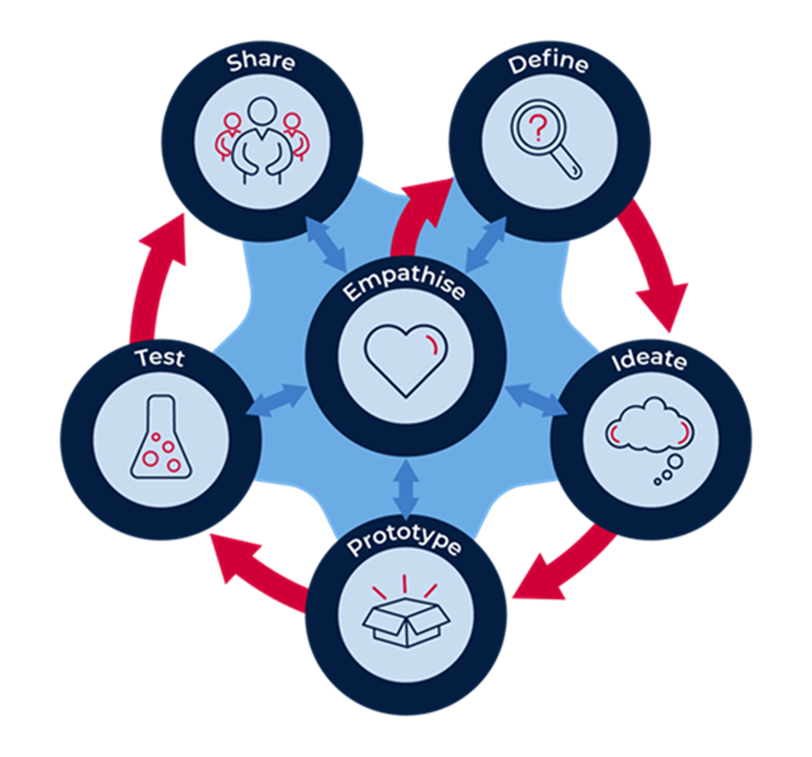
Design thinking
Notes:
We are now going to start the design process by empathising with others that will be affected by our design solutions. For example if we decided to develop all trains as self driving what would happen to all the train drivers and engineers who guide them?
As you move through the process and explore and investigate the topic in more detail, your empathy develops as your understanding grows.

Slide 50
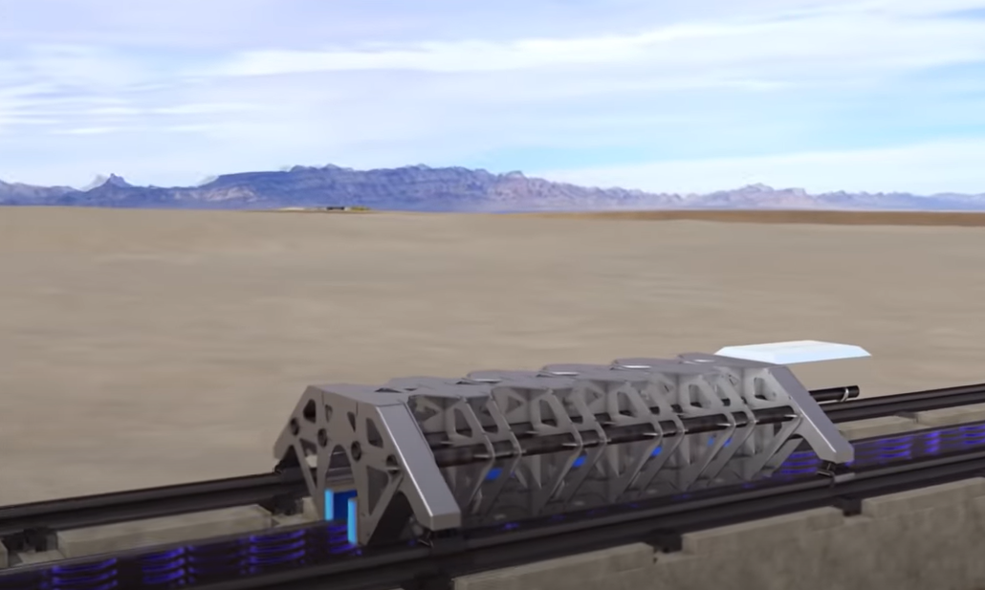
Top 5 future vehicles that will revolutionise transportation
https://safeYouTube.net/w/pcBB
Notes:
View the video and discuss with others.
Are there any other ideas here? Are there any additional alternatives? Could we do this in a different way? Could there be another explanation? What questions do you have? What does the topic make you want to explore?

Slide 51
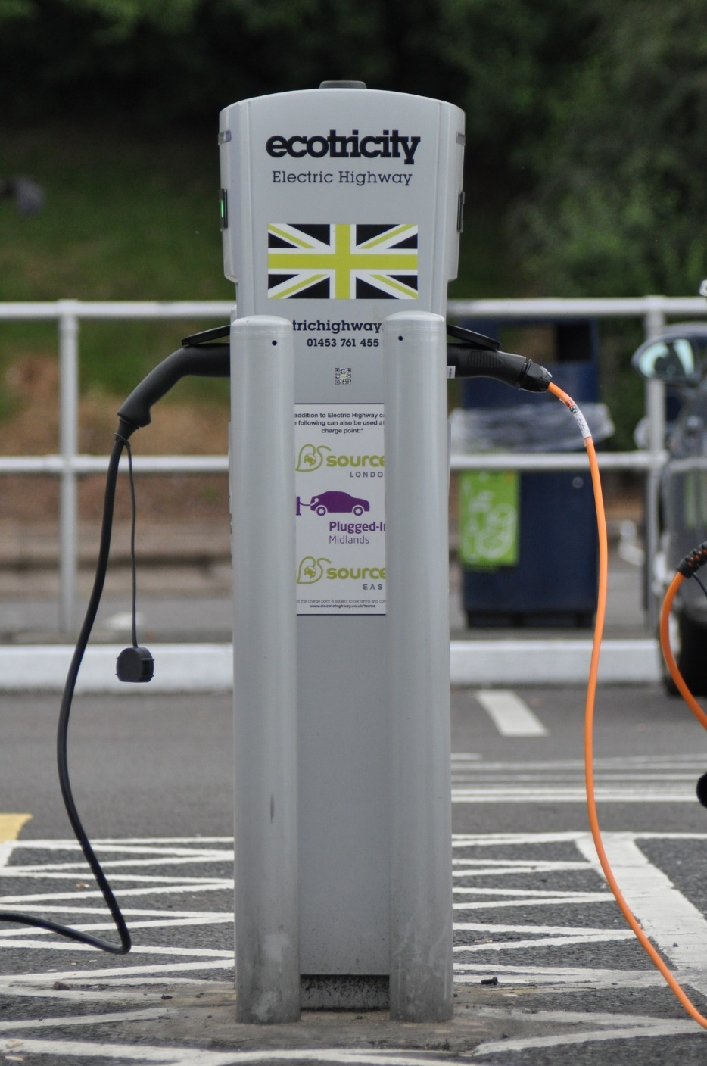
Looking to the future
What’s the problem?
One of the major problems arising from the transformation of the global transport system is a high dependence on fossil fuels. In particular, oil is the main energy provider in the transport energy mix: over 94% of the total energy demand for transport is provided by oil, 3% by natural gas and other fuels, 2% by biofuels and 1% by electricity.
Image by pixabay
Notes:
Read and discuss

Slide 52
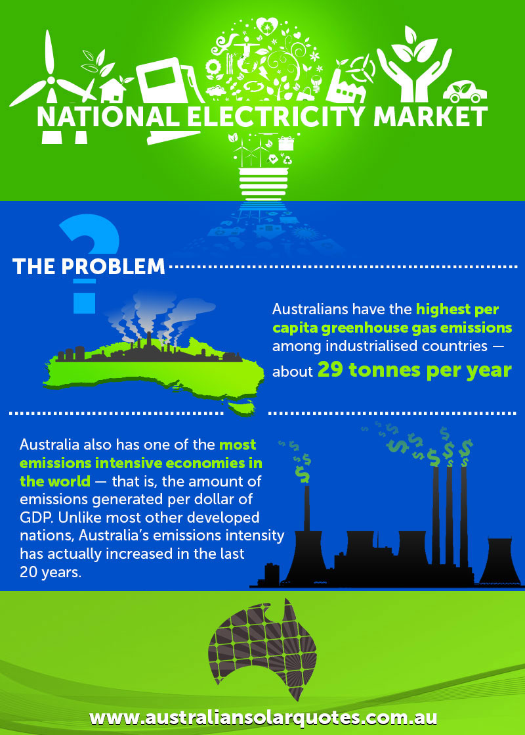
Looking to the future
Why renewable energy sources?
Fossil fuels are running out!
Renewable energy is important for the future because it is reusable.
We can use it as much as we can and still it is going to be available for the future.
Solar Energy, Tidal Energy, Wind Energy, and Water Energy are the most popular renewable energy sources in the world.
https://www.australiansolarquotes.com.au/2014/08/22/australias-national-electricity-market-problem/
Notes:
Read and discuss

Slide 53
Future vehicles - sustainability
Choose one alternative energy source and draw how it works
Battery/electric vehicles. There are already plenty of electric cars on the road, an increasing demand for them, and available infrastructure to charge them.
Plant-based
Biodiesel
Solar
Wind
Hydrogen cell fuel.
Notes:
If you do not have a digital device to research, refer to the infographic style on the previous slide.
There are many infographics online to help you. Try searching ‘transport industry sustainability infographics’. Visit sites for more information.

Slide 54
What does is mean ‘to future proof’?
Collins dictionary definition
Definition of 'future-proof'
1. verb
If you future-proof something, you design or change it so that it will continue to be useful or successful in the future if the situation changes.
2. adjective
If something is future-proof, it will continue to be useful or successful in future if the situation changes.
Notes:
See if you can find the meaning in other dictionaries and compare the messages. What is your understanding now?

Slide 55
Future proof – considerations for transport industry
Does it just mean to make robots?
Experts' predictions are varied, but it's certainly reasonable to expect that in the next 15 to 30 years the digital world will truly come crashing into our transportation systems.
Think of all the people who drive taxis, buses, trains, delivery vans and all other sorts of vehicles. There would be a huge impact on cities if all those jobs were to go away due to automation.
Notes:
When designing we need to think of how our design will affect all people involved. These people are our stakeholders.

Slide 56
Empathy map
Think about how people would react if all vehicles were automated
Think | Do | Say | Feel
Notes:
Discuss with others to get different perspectives.
The people who are impacted by a change or proposed change are the stakeholders of an issue. If the transport industry was to be completely automated:
What would people think of the companies that automate their vehicles and they subsequently lose their jobs?
What could these people do if this were to happen? More study, up skill for new jobs?
What would they say to their bosses? Remember they still need a job.
How would they and their families feel? What worries would they have?
Is it important to think of others when designing solutions? Why?

Slide 57
Module 2 Activity 4
Define

Slide 58
Design thinking
Notes:
In the define stage we consider all stakeholders, understand the terminology, provide an example research and discover future transportation options to carriage resources across Australia.

Slide 59
It's time to define our design solution
Why have vehicles changed over time?
Vehicles have gone through a lot of physical changes over time, and so has everything in it. Things are continuously moving and changing.
Why and how things move depends on a variety of factors, including their size and shape, where they are used and for what purpose.
Movement and change are concepts that we need to understand to make our future vehicle. They are linked to concepts of force and motion.
Scientists and engineers apply these concepts to design toys, vehicles and spacecraft.
Notes:
Read and discuss.
Do you know where we could get more information about these concepts?

Slide 60
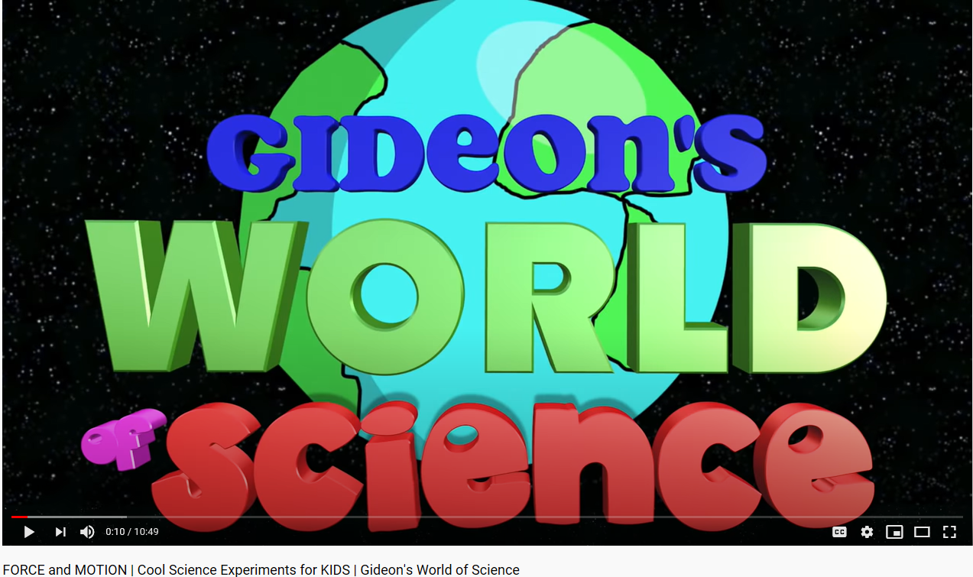
Force and motion
https://safeYouTube.net/w/VRhC
Notes:
Watch this video: Some great experiments, but how can we use this knowledge when we are designing our vehicle for the future?
You may be able to apply some of these principles to your design.

Slide 61
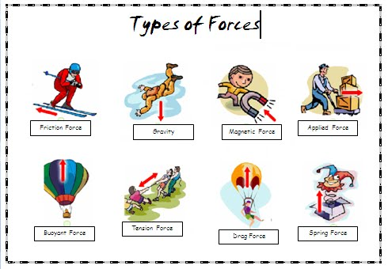
Forces
Notes:
Can you think of any other forces and how they link to motion.

Slide 62
Force and motion – future vehicle
Concepts
What is force?
Force is the energy it takes to do work. For example, if you push or pull an object, it takes energy to make the object move.
What is motion?
Motion is the change of position of an object because of the force that is applied.
Whenever an object is moving we say that it is in motion and to put an object in motion some force needs to be applied to it.
Force is the energy that enables the object to move.
Display your understanding of force or motion by creating a short demonstration to show others. Video or record the steps.
Notes:
Discuss your understanding with others. Video or record the steps taken to complete your demonstration and save in portfolio. You could add a slide and embed it in the PowerPoint.
Vocabulary:
Push – A force to move something away.
Pull – A force to move something closer to you.
Gravity – A force that attracts objects towards each other.
Magnetism – A force that pulls metal towards a magnet

Slide 63
Investigating
ABCiview – Science Max! Experiments at large.
https://iview.abc.net.au/show/science-max-experiments-at-large
Stomp romp
Spool race
Hot air balloon
Electromagnet
Generating electricity
Hoop glider
From the website address choose some episodes to watch.
Choose the ones that would give you more information about the science you may need to design you future vehicle.
Notes:
ABC TV - You will notice that many of these episodes do take some time to view. I would set some spare time aside each day to view an episode.
Only choose the ones that will be helpful to you for you design challenge.

Slide 64
So what is it we need to do?
What is the problem?
Our transport industry needs to be sustainable for the future.
In the define stage we look at lots of possible ways to think of the problems that we could encounter before we start .
Notes:
List some problems you see to make our future transport system sustainable.

Slide 65
Some identified problems
When brainstorming ideas, consider:
The changing ways people use transport.
Designing highways and systems for new transport types.
The cost of transportation – vehicle noise, emissions and the effects on public health.
The cost of transportation – maintaining infrastructure - roads, bridges, stations, docks, airports, runways.
Energy and climate change.
Notes:
When we are designing we have many things to consider if we want our design solution to be successful.

Slide 66
Use the 5 Whys to turn you ideas into actions
https://safeYouTube.net/w/cYiC
Notes:
Watch this video: When thinking about the problem to solve, ask why a number times to get to the bottom of the issue.

Slide 67
Future vehicle type
Thinking of possibilities
Choose one vehicle type to improve, redesign or create.
land transport
air transport
water transport
rail transport
space
Notes:
Think about your interests and ability to design. Choose the type that you are able to get the information you need to develop a design solution.

Slide 68
Activity 5
Ideate

Slide 69
Design thinking
Notes:
When ideating we are develop the skills of generating rapid ideas: imagine, create and express new and innovative ideas.

Slide 70
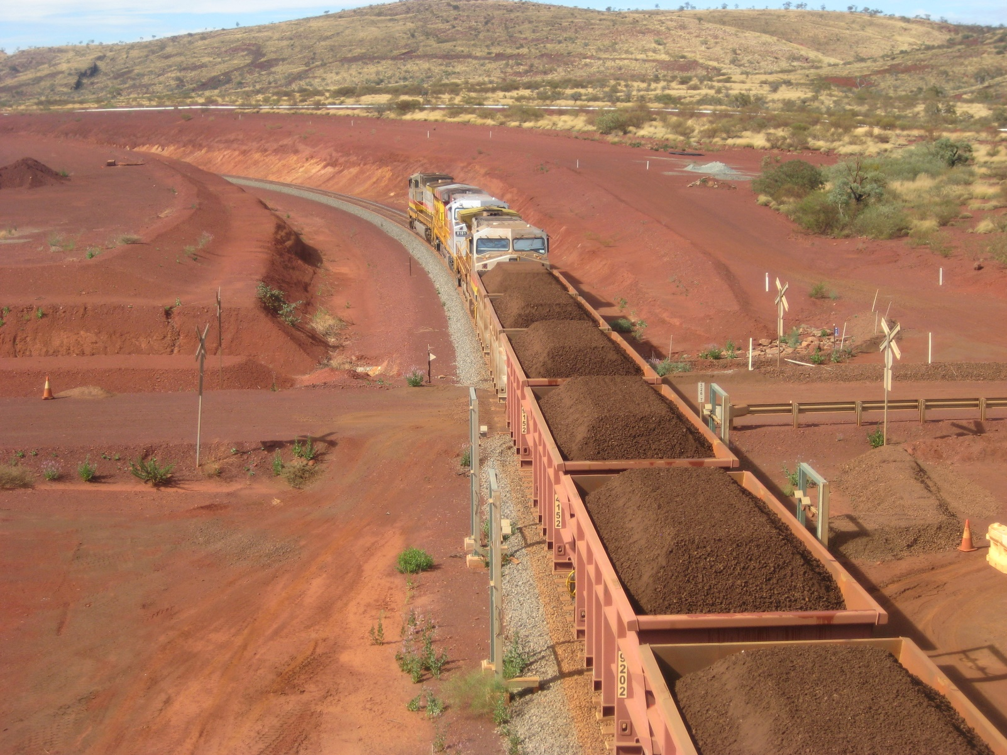
Transport in Australia
There are many forms of transport in Australia
High dependency on road transport.
More than 300 airports.
Passenger rail transport ,
Australian mining reliant upon rail to transport its product to Australia's ports for export.
https://upload.wikimedia.org/wikipedia/commons/4/40/Brockman_4_train_6.JPG
Notes:
Information from Wikipedia.
Road transport is an essential element of the Australian transport network, and an enabler of the Australian economy. There is a heavy reliance on road transport due to Australia's large area and low population density in considerable parts of the country.
Another reason for the reliance upon roads is that the Australian rail network has not been sufficiently developed for a lot of the freight and passenger requirements in most areas of Australia. This has meant that goods that would otherwise be transported by rail are moved across Australia via road trains.
Did you know! Almost every household owns at least one car, and uses it most days.

Slide 71
Infrastructure as part of a system
Transport infrastructure consists of:
Fixed installations, including roads, railways, airways, waterways, pipelines and terminals such as airports, railway stations, bus stations, warehouses, trucking terminals, refuelling depots (including fuelling docks and fuel stations) and seaports.
Terminals may be used both for interchange of passengers and cargo.
Vehicles traveling on these networks may include automobiles, bicycles, buses, trains, trucks, helicopters, watercraft, spacecraft and aircraft.
Notes:
When ideating for your future vehicle, you need to consider what infrastructure it needs. You will be required to map this out in future tasks.

Slide 72
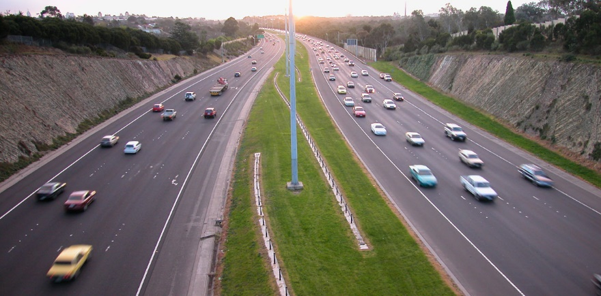
Did you know!
https://en.wikipedia.org/wiki/Transport_in_Australia
Australia has the second highest level of car ownership in the world.
Australia has the third highest per capita rate of fuel consumption in the world.
Melbourne is the most car-dependent city in Australia.
The distance travelled by car (or similar vehicle) in Australia is among the highest in the world.
Notes:
Imagine what the statistics would be now!

Slide 73
Brainstorming in 5 minutes – future vehicle
List and/or draw as many ideas as you can think of
Notes:
Time yourself.
List or draw as many ideas you can think of. Ask others to help you.
Consider:
Environments it will travel – desert, snow, across states, climate
Size, shape – is it aerodynamic?
Resources it will transport. Size, durability, temperature control, delicate, life span.

Slide 74
Time to think! Develop on your ideas
Let your imagination go wild!
Pose questions: ask numerous ‘What if…?” questions.
Piggyback on an existing idea by developing it further (elaboration).
Propose alternatives. “Instead of doing it that way, maybe we could try it this way?”
Pool. Collect several ideas from different sources and combine them.
Pinch existing ideas (e.g. products) and suggest improvements.
Pause… Don’t judge the ideas yet!
How might we …. ?
Notes:
During this activity you will explore possible future transport designs. Let your imagination go wild and generate plenty of ideas and possible solutions. Using what you know about problems associated with transportation vehicles today, create a list of possible solutions to create a sustainable future vehicle from the type you selected earlier.

Slide 75
Use the table to decide on your best idea
Idea | Description of solution | Possible? Practical? | Potential for success | Identify the positives and negatives
1
2
3
4
5
Notes:
Choose the best 5 ideas and write them into the table. Try to complete the table with as much detail as you possible can. It will help you decide on the best idea to create your prototype.

Slide 76
Activity 6.1
Prototype

Slide 77
Design thinking
Notes:
Prototyping is putting everything into action. You will plan and develop your idea, experiment and develop solutions.
You will get to physically make stuff!

Slide 78
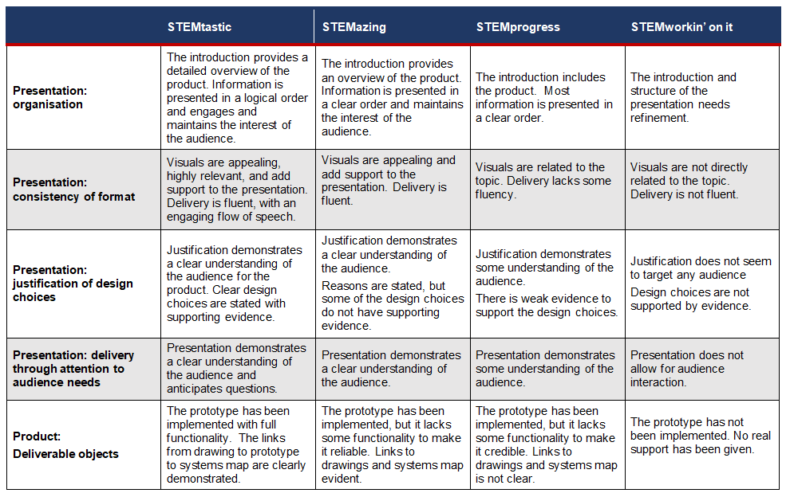
S3 STEM assessment rubric
Notes:
Read and discuss with othes. It is important to understand the elements of the rubric for your final assessment rating.

Slide 79
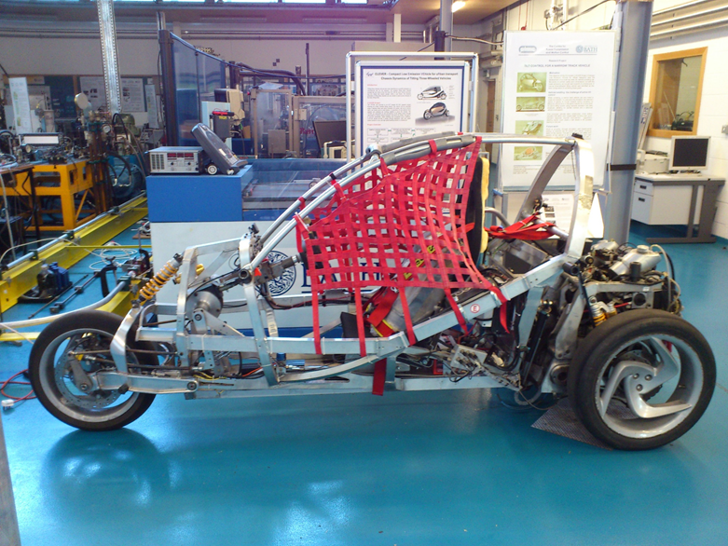
Brainstorm/think
What is a prototype?
Example
https://pbskids.org/designsquad/build/robo-arm/
https://safeyoutube.net/w/AVD4 - how to make a cardboard prototype
https://upload.wikimedia.org/wikipedia/commons/3/37/The_CLEVER_Vehicle_Prototype_at_the_University_of_Bath_Side_View.JPG
Notes:
Follow the links for more information. Discuss with others.
No device? Move onto next slide.

Slide 80
What is prototyping?
Future vehicle
The prototype stage is all about experimenting with two or three of the best ideas. It is also a chance to talk with users and get new ideas.
Prototypes can be anything that helps you test an idea. It should be cheap and simple for our example.
Expect to fail quickly and often so you can try different options without committing to one idea.
Notes:
A prototype is an early model built to test an idea. When you prototype you think with your hands or you make to think.
This stage is all about experimenting. You are looking for the best solution to each of the problems you have selected.
Prototypes can be anything that helps you test an idea. Ask people to play and engage with your prototype to get feedback.

Slide 81
Considerations for you design.
Material choices
When drawing your prototype you will have to decide what materials your future vehicle could be made of.
You will also need to be mindful of the materials you choose to create your prototype.
Notes:
Choices of materials will impact your design significantly.
Imagine if we built houses of feathers, or cars from sand! Ridiculous – you must choose the most suitable materials for your prototype and then think carefully what the real future vehicle could be made of.
Imagine the consequences of choosing inappropriate material??

Slide 82
Material choice examples
Material | Advantages and disadvantages
Steel | Hard and tough, resistant to wear, magnetic conductive of heat strong, can be made at scale, long-lasting, heavy, can corrode, requires heavy industry to process, community – large urban areas, towns and cities.
Plastic | The plastics are strong and can be used for load bearing structural members. The strength of plastics can further be increased by reinforcing them with various fibrous materials. High cost of construction, high temperature susceptibility, poor stiffness. Weather resistant, fire resistant, durable, maintain its shape, chemical resistance, thermal resistant, moisture resistance. Can be 3D printed
Clay | Malleable, brittle, durable, stable, easily workable, abundant source materials, good thermal insulator, low cost poor sound insulation, time consuming construction, not resistant to earthquakes community - global
Wood | Durable, readily available, malleable, low cost, strong, can form mould, cutting down trees removes CO2 sinks – be wary of depletion community – global
Notes:
Choice of material will be important for the life of the vehicle, purpose, cost and design.
When building your prototype be careful to use materials that are going to behave how you want them to. Example, bend, shape, cut holes in, attach things easily, the toughness to survive testing.

Slide 83
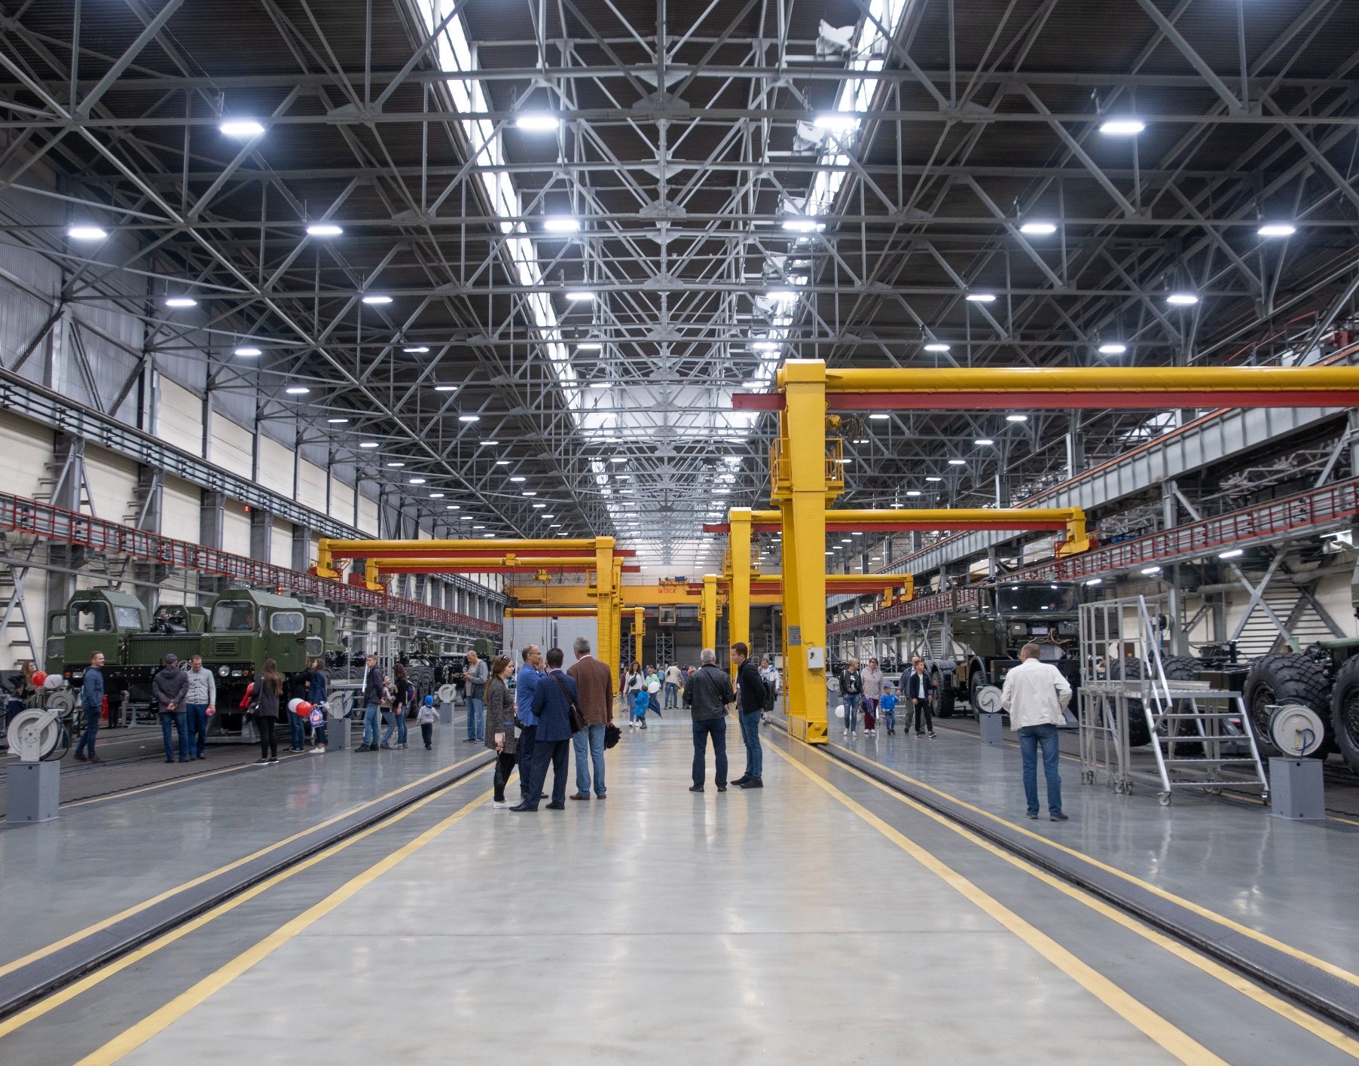
Materials for future manufacturing
Further research
https://www.bigrentz.com/blog/the-future-of-building-materials
https://www.scientificamerican.com/slideshow/9-materials-that-will-change-manufacturing/
https://upload.wikimedia.org/wikipedia/commons/8/8a/MZKT_inside_p04.jpg
Notes:
You may get some good ideas here.
If no device move to next slide.

Slide 84
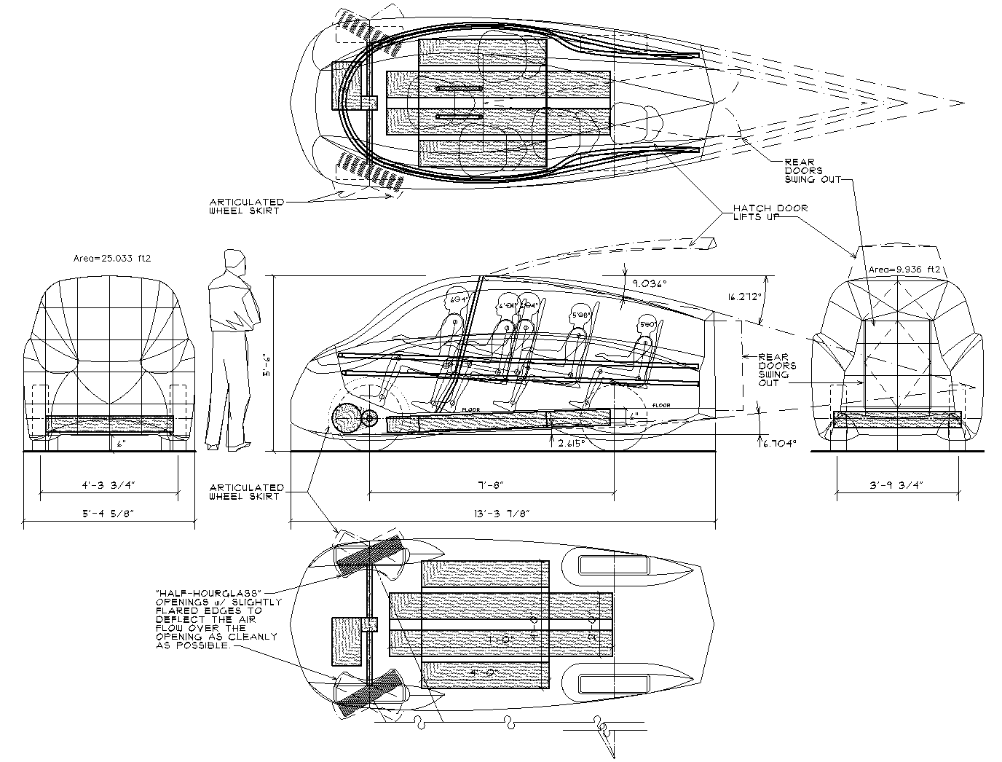
Steps to building a prototype
Step 1
Draw a flat prototype - sketching your idea is the first step in making your idea physical. Drawing is a great way to capture and explain the core of your idea.
http://neilblanchard.blogspot.com/2010/09/carbn-concept-ev-open-source-project.html
Notes:
Draw on paper, take a photograph or scan and upload to your portfolio or this Power Point.

Slide 85
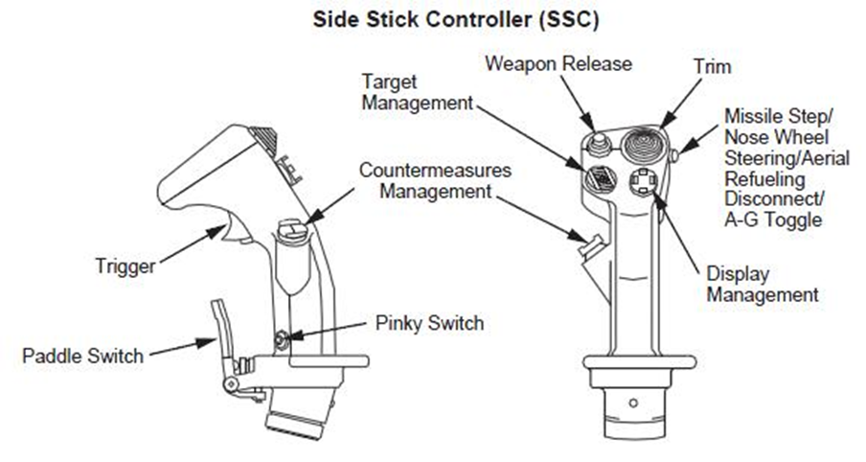
Prototype
Developing the draft
This is what my prototype will look like. (Need to add annotations/labels)
This what my prototype will do. Be clear!
List of materials I will need to create my prototype.
List of materials my future vehicle could be made from.
How your vehicle will be powered.
What terrain your vehicle will have to cover.
Calculate an approximate size of your future vehicle. Label the height, length and width in metres.
https://upload.wikimedia.org/wikipedia/commons/f/fe/F-16_Side_Stick_Controller.jpg
Notes:
It is very important to include detail detail detail!
You may wish to draw your prototype on paper and when you are happy photograph or scan.
This could be uploaded to your digital portfolio or onto the next slide in the Power Point.

Slide 86
Steps for prototyping
Step 2
Build a physical prototype - now you have explored your ideas on paper, it’s time to build a handmade, 3-D non-working prototype.
Your objective is simply to build a cheap and physical version of your idea. This way you go one step further than your line-drawing and ‘paper reality’.
Your prototype in this phase should be nothing more than an inexpensive demonstration of your idea in a physical way. By building a 3-D version, you might also stumble upon flaws in your idea that you might not have discovered from simply looking at a flat drawing.
Notes:
Using recycled materials is all you need at this stage.
Photograph and upload to Power Point or portfolio, or hand into the teacher back at school.

Slide 87
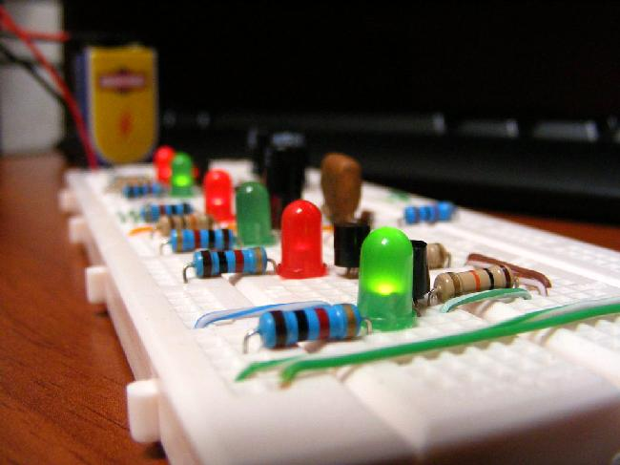
Steps for prototyping
Step 3
Develop a working prototype - this last step is about creating a working (or real looking) product. It should include some of the working parts of your product. For example, major parts of the vehicle, working doors, wheels that spin, places for cargo and any special internal features.
https://upload.wikimedia.org/wikipedia/commons/9/96/Protoboard_circuito_multivibradores.jpg
Notes:
You could use existing models that you have and adapt. You could build out of Lego or use the materials you have at home.
Time to prototype!

Slide 88
Name of prototype
Notes:
Upload you images to this space, you may want to add slides or save in your portfolio.

Slide 89
Activity 6.2
Prototype system

Slide 90
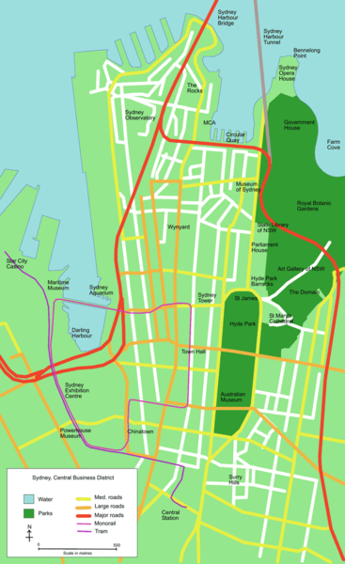
Example Sydney central bus district
https://commons.wikimedia.org/wiki/File:Map_of_Sydney_central_bus_district.PNG
Notes:
You will have to create a key to highlight the components that make up the system/network.
Example bus system:
Depot/storage of buses not I use
Fuelling stations
Maintenance – works facilities
Bus stops, seating, shelters, timetables displays
Stations
Driver training centre
Bus lanes
Company office
Notice that within a system other types of transport may be required to complete the network. The infrastructure supporting the system is also very important.
Fuelling options, storing, maintenance, stations etc

Slide 91
Example - road system
A map like this could be used and added to.
Main depot
Local depot
Service centres for your vehicle
Refuelling stations
Maintenance locations
Management centre
Roadside services
https://www.iloveaustralia.it/autostrade/
Notes:
Considerations
You will need to add the components that are suitable for the future vehicle you have designed.
You may choose to only map the areas where your vehicle is going to operate.

Slide 92
Transport system
My prototype as part of a system?
Upon completion of the working prototype, create a map that demonstrates how your prototype will connect to a sustainable system. How is going to be powered?
You may wish to use an existing system and adapt its use.
You will present your prototype and the systems map together. This way you can easily show something to your audience to prove your design works.
Notes:
Ensure you add as much detail as possible. You will have to justify your choices when presenting your design.

Slide 93
Activity 7
Test

Slide 94
Design thinking
Notes:
When testing our design choices we need to validate the solution. We need to make sure our prototype works.
When testing we need to allow for refinement.

Slide 95
Testing prototypes
Seeking feedback
Think of the test stage as working at the same time to the prototype stage rather than as the next step.
When you prototype you’re looking for what works, but when you test you’re looking for where your solution fails.
Every failure is an opportunity to improve your design so you can prototype and try again.
https://profslusos.blogspot.com/2013_08_01_archive.html
Notes:
A prototype designer will seek out real world subjects who can test the working model of a product to assess if it actually works.

Slide 96
Questions for feedback
Choose your audience
What are three features you like about my prototype? Why?
What are three things you would change about it? Why?
Would you use this to transport ….? Why?
When would you use it?
Would you recommend it to someone in the industry? Why?
Notes:
Your audience needs to be reminded that they would be from the transport industry and a possible stakeholder.
Take some notes when you get feedback. Using the feedback to refine your design before submitting it for final review.
Ideally try to get a number of opinions before deciding on how or if you need to refine your prototype.

Slide 97
Activity 8
Share

Slide 98
Design thinking
Notes:
When sharing our solution we need to get others to really interrogate it.
You will have to justify your design choices.

Slide 99
It’s time to share your awesome work!
Let us celebrate!
It is important to share your great work with others for feedback. Discuss the project, what you have learned and how your design works with other people you know.
When you get back to school you can present your prototype to the class with a justification as to why you ended up with the design/prototype you have and the components within your system map.
Create a persuasive presentation demonstrating your solutions and why it should be selected as the best idea to be developed further.
Notes:
Your persuasive presentation could be in a multimodal form. Create a video of your working prototype. Interactive map to demonstrate the components of your system.
THINK BIG!
This is a great time to reflect on your portfolio of work, whether it is this Power Point a digital portfolio or a collection of all you paper responses and models.

Slide 100
Reflection
Think about your actions, processes and thinking…
Describe two actions you took during the process which you are most proud of.
•
•
Identify two actions in the process which you now think you could have done better.
•
•
So, what would you do differently if there was a ‘next time’?
What do you know now that you didn’t know before this project began?
Notes:
Use these prompts to reflect on the project.

Slide 101
Adult support
Support guide
Students will compile a portfolio of work, could be digital or non-digital.
Use a device like a smartphone, ipad, for research, computer for publishing.
Online research, students should seek permission from an adult in their home.
Guidelines for online behaviours. https://www.digitalcitizenship.nsw.edu.au/parents-articles
If no devices, encourage substantial discussions to support understanding of questions presented. Seek opportunities to speak to experts.
Notes:
Parent, carer support guide.

Slide 102
Congratulations Future vehicle experts!
You are STEMtastic.

