Slide 1
Slow reveal graphs
What do you notice? What do you wonder?
Notes:
More information on slow reveal graphs https://slowrevealgraphs.com/wp-content/uploads/2021/06/vector-2020-61-merged-compressed.pdf
We are using this technique to teach students about the different types of graphs and their features.
The powerpoint will reveal part of the graph at a time for students to notice and wonder.
We want students to learn the important features of a graph and what is necessary to be able convey the full story of a graph and its data.
Encourage responses from all students. There is no wrong answer for what they notice or wonder, so it is a risk-free activity.

Slide 2
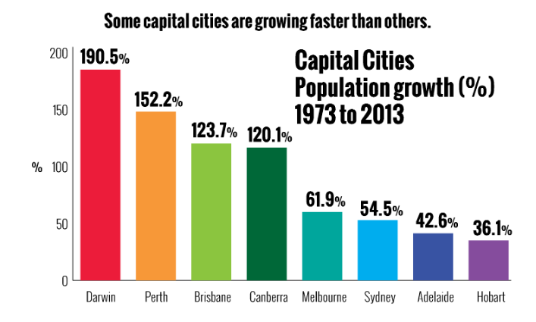
Column graph
What do you notice? What do you wonder?
Notes:
What do you notice? What information do we already know? – Highlight the gap between bars
{click}
What new information do we have? What does it mean when something is more than 100% - Highlight where the scale starts and finishes, that there are uniform distances in the scale
{click}
What new information do we have? What do we now know? What do we still want to know? What type of data is being displayed? Eg categorical
{click}
What new information do we have? What does it mean by growing? What does it tell us? Is there anything else we still want to know?
{click}
What new information do we have? Does that tell us anything new?

Slide 3
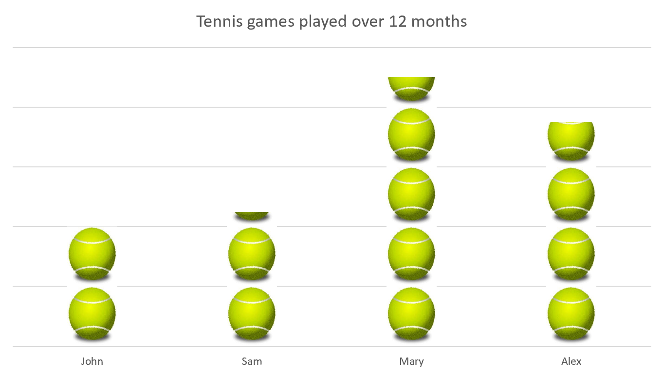
Pictograph
What do you notice? What do you wonder?
= 20 games
Notes:
What do you notice? What do you wonder? Why do some columns only have parts of the pictures?
{click}
What new information do we have? Does this help to tell the graph’s story? What type of data is this? Numerical – discrete or continuous?
{click}
What new information do we have? Does it tell us any more? What do we still wonder?
{click}
What new information do we have? How many games did each person play?

Slide 4
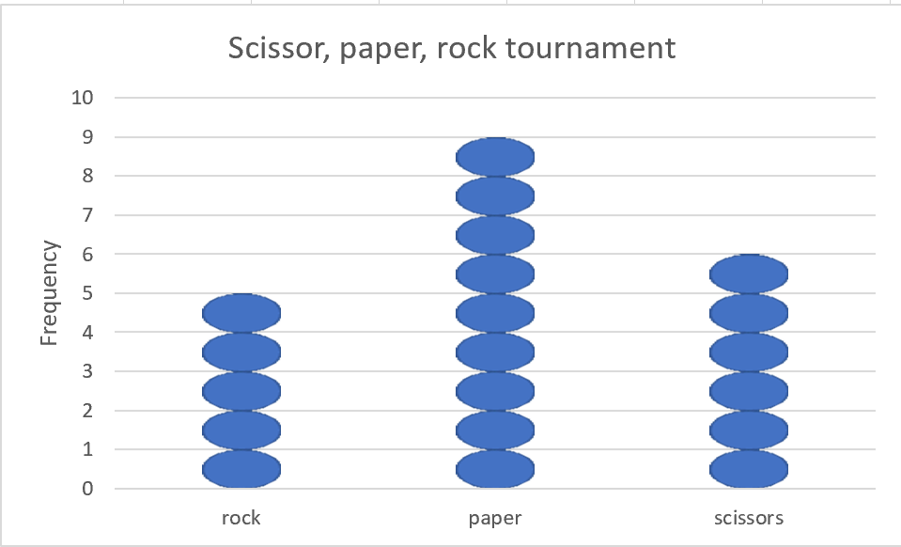
Dot plot
What do you notice? What do you wonder?
Notes:
What do you notice? What do you wonder?
{click}
What new information do we have? What does it tell us? What do you think the graph is about? – Does each dot represent one? Do we know at this point? What type of data is this? - categorical
{click}
What new information do we have now? What does it tell us? What are we still wondering about?
{click}
What is our graph about? Is there anything else we still need to know?

Slide 5
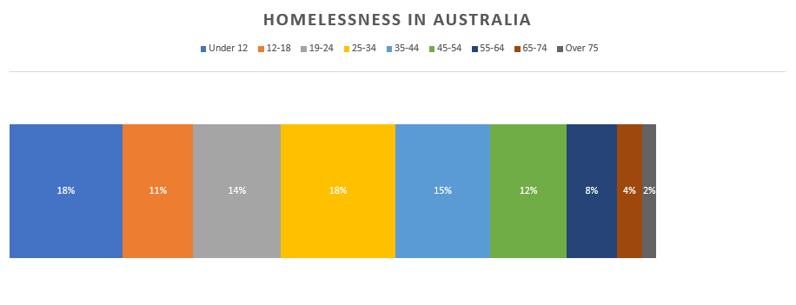
Divided bar graph
What do you notice? What do you wonder?
https://games.abc.net.au/education/statistics-game/index.htm#/
Notes:
What do you notice? What do you wonder? – Students should notice the different colours in the bar and that they are different sizes
{click}
What new information do we have? What does it tell us? What do you wonder now? – We now know the exact size of each bar. What do all of the numbers add up to? – the whole bar represents 100%
{click}
What new information do we have? Does it tell us anymore? What story is the graph trying to tell us? Can you guess what the different colours mean now? What type of data is this? Ie numerical – discussion about whether discrete or continuous – do we know?
{click}
What new information do we have? What does it tell us? Were you right about the colours? Can we now tell the graphs story?

Slide 6
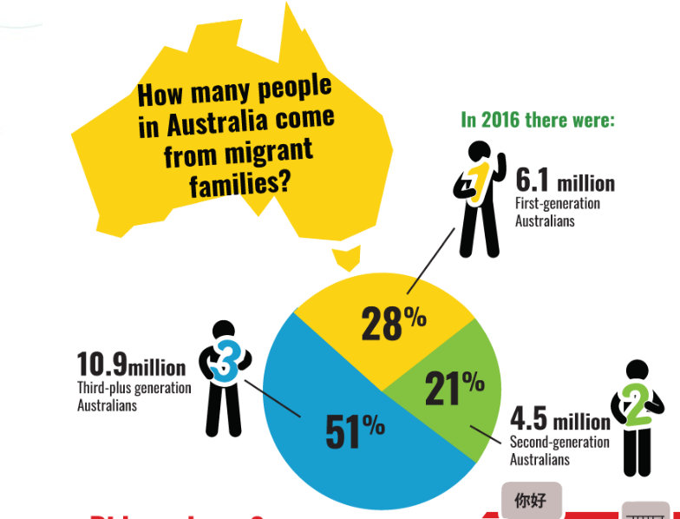
Sector graph
What do you notice? What do you wonder?
Notes:
What do you notice? What do you wonder?
{click}
What new information do we have? How does it help us?
{click}
What new information do we now have? How does this helps us to interpret the graph? What does generation mean? What type of data is this? What would the raw data look like? – categorical, ordinal
{click}
What new information do we now have? Is there anything else we still wonder?

Slide 7
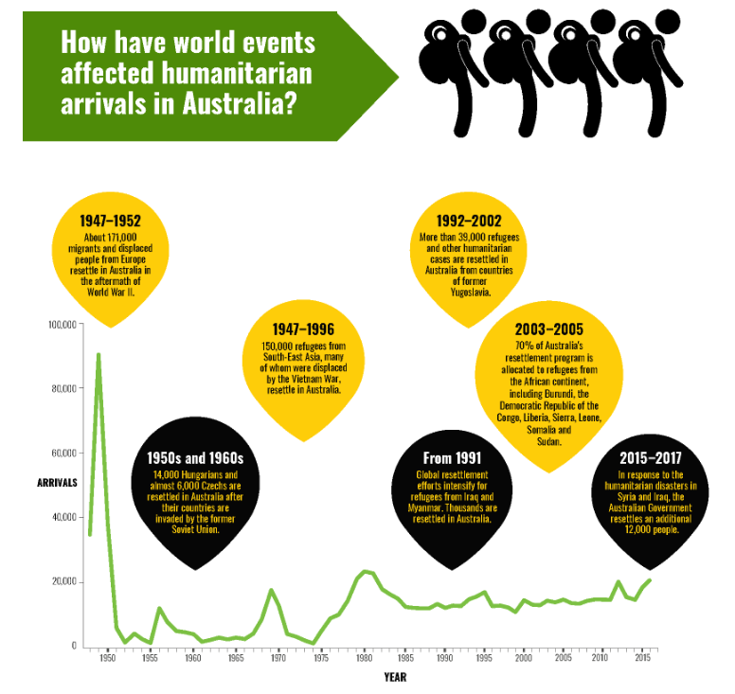
Line graph
What do you notice? What do you wonder?
https://games.abc.net.au/education/statistics-game/index.htm#/
Notes:
What do you notice? What do you wonder? – point out where the line starts and finishes
{click}
What new information do we have? What does it tell us? What do we still wonder?
{click}
What new information do we now have? What does it tell us? – Point out the uniformity of the scales on both axes. Point out that the x-axis doesn’t start from zero. What does it go up by? What type of data is this? – categorical – ordinal?
{click}
What new information do we now have? What does it tell us? What do we still wonder? – Why is there such a large spike around 1950? What could have caused it?
{click}
What new information do we have now? Is there anything we are still wondering?

Slide 8
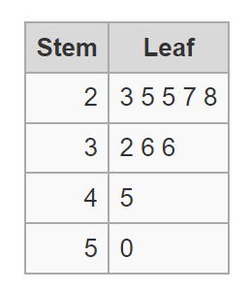
Stem and leaf plot
What do you notice? What do you wonder?
Long jump results for U15 boys at Plainville High School
2 | 3 means 2.3
Notes:
What do you notice? What do you wonder? – Why are the numbers listed like this?
{click}
What new information has been added? What does it tell us? – Why are there two columns of numbers? Why does the second column have lots of numbers in the same row?
{click}
What new information has been added? What does it tell us? – What does stem and leaf mean?
{click}
What new information has been added? How does it change the data? What could these numbers be representing?
{click}
What new information do we have? Is there anything we are still wondering?

