Slide 1
Breaking the code
Making decisions

Slide 2
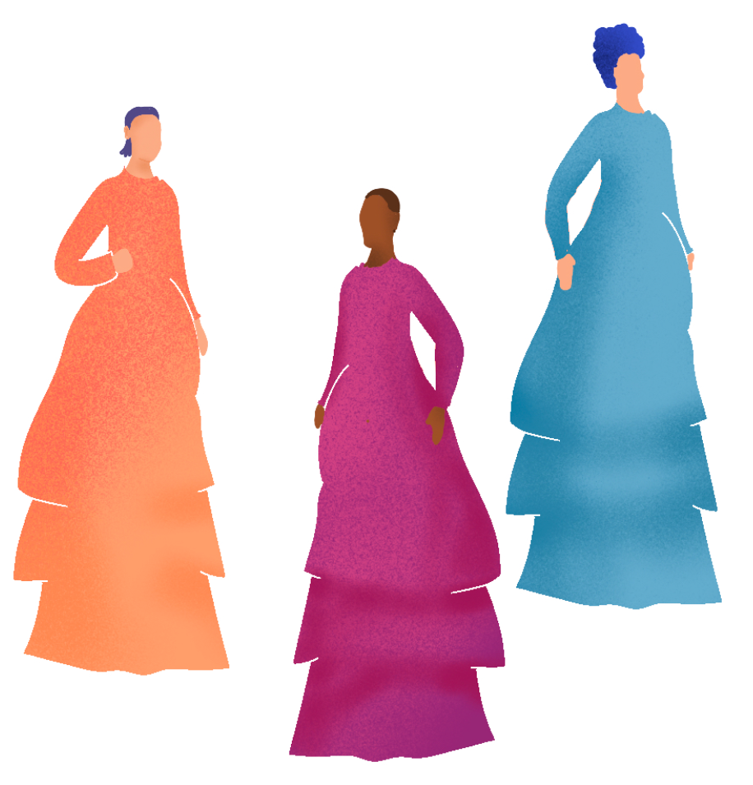
La Mode
Mode comes from the French word La Mode
meaning Fashionable
Can you see any connections between mode in Mathematics and ‘fashionable’?
reSolve: Mathematics by Inquiry
Notes:
Student responses might include:
Mode is most common, fashionable means lots of people wearing it
Purpose of this slide: Students define mode
Mode should be clearly defined as that which occurs most

Slide 3

Ice-cream flavours ordering
Mr Vanilla’s ice-cream truck sells five flavours of ice-cream
When ordering more ice-cream, would you order the same amount of each flavour?
Notes:
Would you order the same amount of each flavour? Pair/Share Why/Why not?
Student responses might include: No, you would order more of the flavours that sell more
Purpose of this slide: Students develop a reason for finding the mode

Slide 4
Ice-cream sales – flavours
Mr Vanilla records his ice-cream sales for one day:
From this data, he determined the modal flavour sold is chocolate.
He also determined that this data set was unimodal.
Flavour | Vanilla | Chocolate | Strawberry | Mint | Coffee
Sold | 30 | 80 | 21 | 32 | 10
Self-explanation prompts:
How did Mr Vanilla determine the mode?
What could unimodal mean?
Notes:
Purpose of this slide: Students identify the mode is the flavour with the highest frequency and unimodal data is data with one mode.

Slide 5
Ice-cream sales – toppings
Mr Vanilla also records his topping sales for one day also:
From this data, he determined the modal toppings sold are Sprinkles and Nuts.
He also determined that this data set was bimodal.
Flavour | Sprinkles | Flake | Nuts | Fruit | Milo | Lollies
Sold | 21 | 4 | 21 | 13 | 10 | 7
Self-explanation prompts:
How did Mr Vanilla determine the mode?
What could bimodal mean?
Notes:
Purpose of this slide: Students realise you can have more than one mode. Two modes is referred to as bimodal.

Slide 6
How many modes?
(1, 2, 3, 4, 5, 6) Uniform
(0, 0, 1, 4, 7, 9) Unimodal
(1, 2, 4, 4, 7, 10, 10) Bimodal
(1, 1, 2, 2, 3, 3, 4) Multimodal
(1, 2, 2, 7, 7, 9, 9, 12, 12) Multimodal
(1, 1, 2, 2, 3, 3, 4, 4, 5, 5) Multimodal
Self-explanation prompts:
Why are different terms used to describe the data sets?
What does each term mean?
Notes:
Purpose of this slide: Students define uniform, unimodal, bimodal, and multimodal.

Slide 7
Finding the mode
Identify and describe each dataset as having no modes (uniform), one mode (unimodal), 2 modes (bimodal) or multiple modes (multimodal)
(0, 1, 2, 3)
(0, 0, 1, 2, 5)
(2, 3, 2, 5, 6, 3)
(12, 3, 7, 3, 10, 12, 7, 9)
(vanilla, chocolate, vanilla, strawberry, mint, mint)
Self-explanation prompts:
What made some of these harder to find than others?
Is there something you can do to make the mode easier to find?
Notes:
Purpose of this slide: Students practise finding the mode(s) in data sets both in and out of order
(0, 1, 2, 3) has no mode so is uniform
(0, 0, 1, 2, 5) has 1 mode = 0 so is unimodal
(2, 3, 2, 5, 6, 3) has 2 modes = 2,3 so is bimodal
(12, 3, 7, 3, 10, 12, 7, 9) has 3 modes = 3, 7, 12 so is multimodal
(vanilla, chocolate, vanilla, strawberry, mint, mint) has 2 modes = vanilla, mint so is bimodal
Students should identify that grouping or ordering data sets makes finding the mode easier

Slide 8

Finding the mode – exercise
The data set: (10, 11, 13, $x$, 10) is bimodal.
What value(s) could $x$ represent?
Notes:
Purpose of this slide: Students apply their understanding of mode inversely

Slide 9
What makes mode special?
Here are two important points to remember about the mode:
      Can be same as mean or median, but isn’t always
      Mode can be used for categorical data, unlike mean and median
Can you think of any other important points to remember?

