Slide 1
Mythbusters
Making decisions

Slide 2
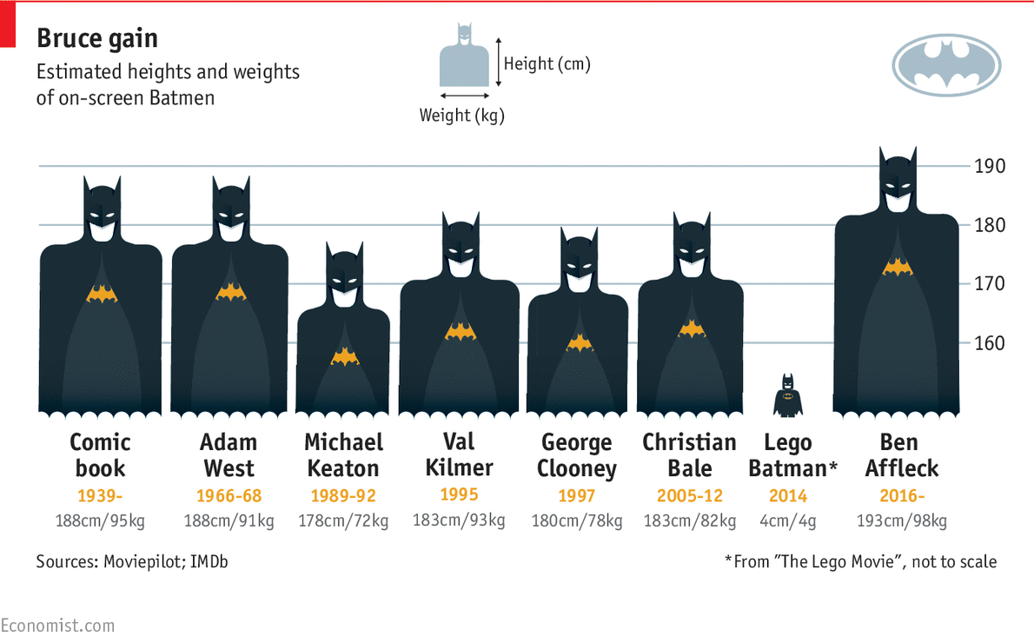
Batman – original graph
Notes:
Display the graph and ask students what story the graph is trying to tell.
Ask pairs to share their ideas with the class.
The graph was designed to show that Ben Affleck, as the newest Batman at that time, is physically larger both in height and weight than previous actors who have played the role.
Discuss with students whether the graph achieves this purpose and whether it is a true reflection of the difference in size between the actors.

Slide 3
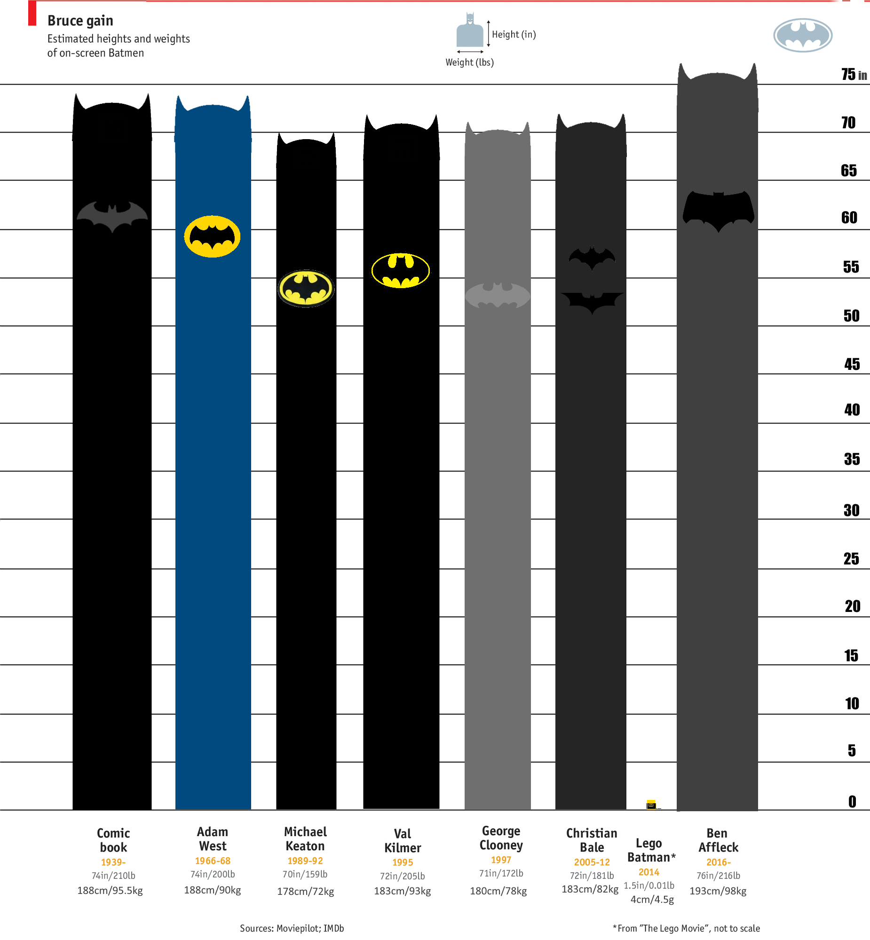
Batman –corrected graph
Notes:
Compare this graph with the one on the previous slide.
Discuss with students whether this graph tells a different story to the original graph? Which one is more accurate?

Slide 4
Batman – alternative graph
Notes:
Discuss whether there is an alternative method of displaying that data that could be even better? Students may consider a column graph similar to the one below

Slide 5
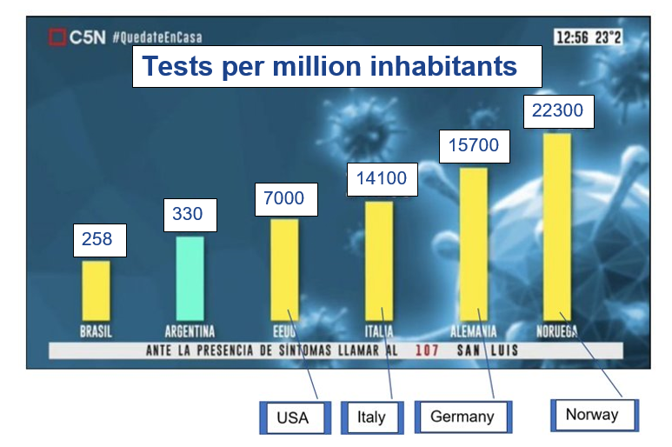
COVID tests graph
Figure 3: https://towardsdatascience.com/stopping-covid-19-with-misleading-graphs-6812a61a57c9

Slide 6
Flattening of the curve
Figure 4: https://towardsdatascience.com/stopping-covid-19-with-misleading-graphs-6812a61a57c9

Slide 7
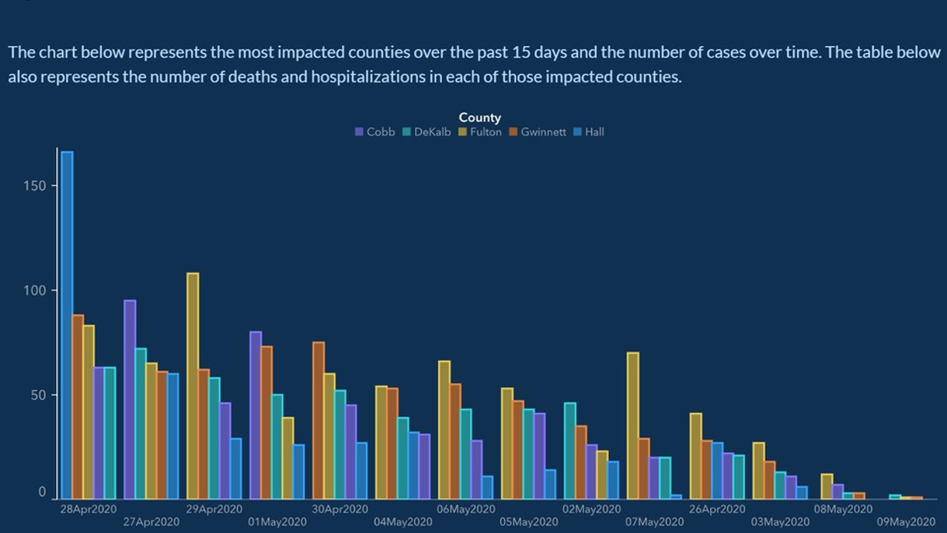
Counties’ cases over the past 15 day
Figure 5: https://towardsdatascience.com/stopping-covid-19-with-misleading-graphs-6812a61a57c9

