Slide 1
Similar figures in art
Explicit teaching
Notes:
Presentation to accompany Stage 5 – unit 1 – lesson 03

Slide 2
Visible learning
Learning intentions
To explore the use of similar figures and scale.
To explore the meaning behind symbols used in Aboriginal artwork.
Success criteria
I can use a grid to draw similar figures.
I can use a vanishing point to draw similar figures.
I can recognise symbols in Aboriginal artwork and appreciate their meaning.

Slide 3
Warm up
Which one doesn’t belong?

Slide 4
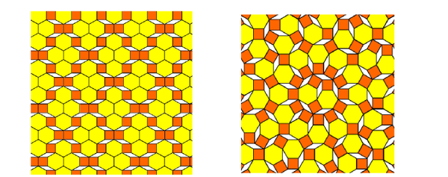
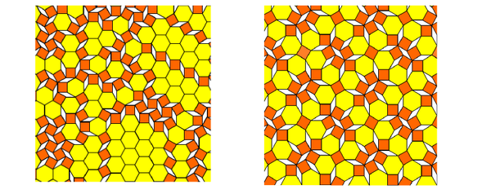
Which one doesn’t belong
Warm up
Notes:
Have students justify which one doesn’t belong in a Think / Pair / Share (bit.ly/thinkpairsharestrategy)

Slide 5
Launch
Grid enlargement

Slide 6
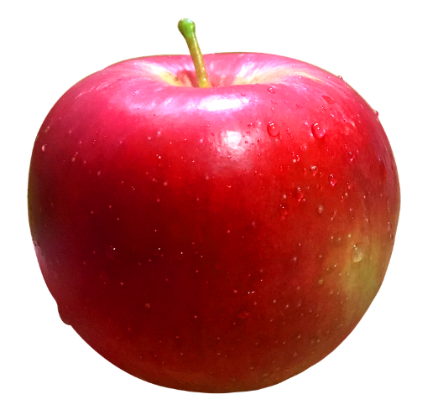
Grid enlargement – part 1
Launch
Notes:
Students are to draw the apple below in their books. The apple should take up ½ a page.
Reflection questions to be considered by students:
Was that an easy activity?
Did you make the apple larger or smaller?
What made the activity difficult?
Is your apple the correct shape and size?
Did you have difficulty making your apple ½ a page?
The background information below should be shared with students, then ask students to do the Enlargement activity (Appendix A).

Slide 7
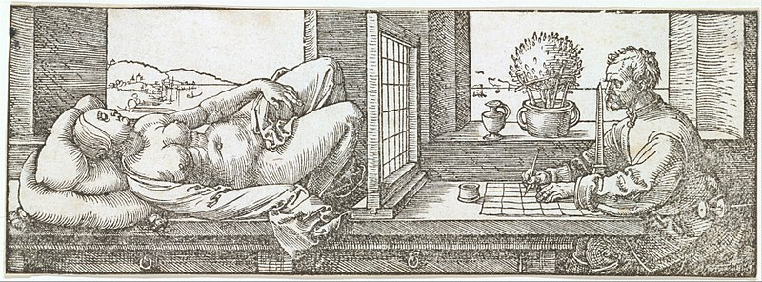
Grid enlargement – part 2
Launch
Background information
Notes:
Artists use similarity in artworks to serve a variety of purposes. With the absence of technology, artists have been using grids to change the size of objects whilst maintaining the object’s true shape for centuries. One of the most famous grid techniques is that of artist Albrecht Durer. Durer used a transparent grid that was positioned between himself and the object of the artwork. For this technique to work, the artist has to position their eye in exactly the same spot each time they look at the subject and re-create what they see onto a smaller grid on their paper. Below is an artwork by Albrecht Durer depicting this process.

Slide 8
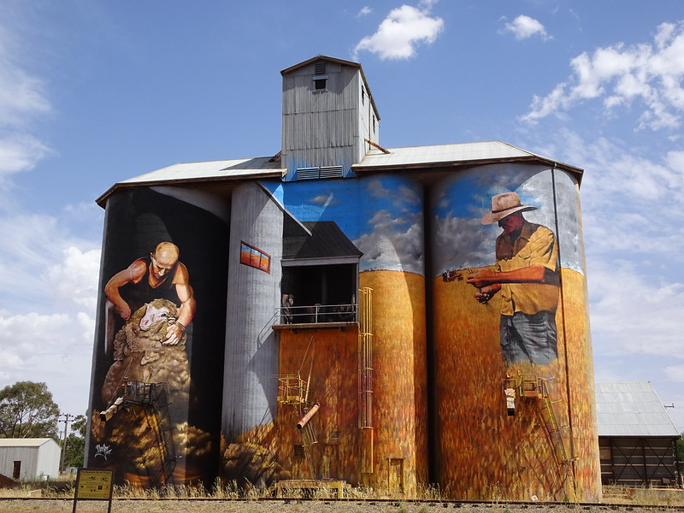
Silo art trail
Notes:
Artists also use grids to enlarge images and create murals. The famous silo art trail in Victoria is a series of large-scale paintings created on silos. These can also be seen in rural NSW.

Slide 9
Success criteria
I can use a grid to draw similar figures.
I can use a vanishing point to draw similar figures.
I can recognise symbols in Aboriginal artwork and appreciate their meaning.

