Slide 1
Corresponding sides and angles
Explicit teaching
Notes:
Presentation to accompany Stage 5 – unit 1 – lesson 5

Slide 2
Visible learning
Learning intentions
To match corresponding sides and angles of similar figures.
To write similarity statements using appropriate notation.
Success criteria
I can locate sides and angles using labelled vertices.
I can identify corresponding sides and angles within similar figures.
I can explain the meaning of symbols used in similarity statements.
I can write similarity statements.

Slide 3
Warm up
Finding angles

Slide 4
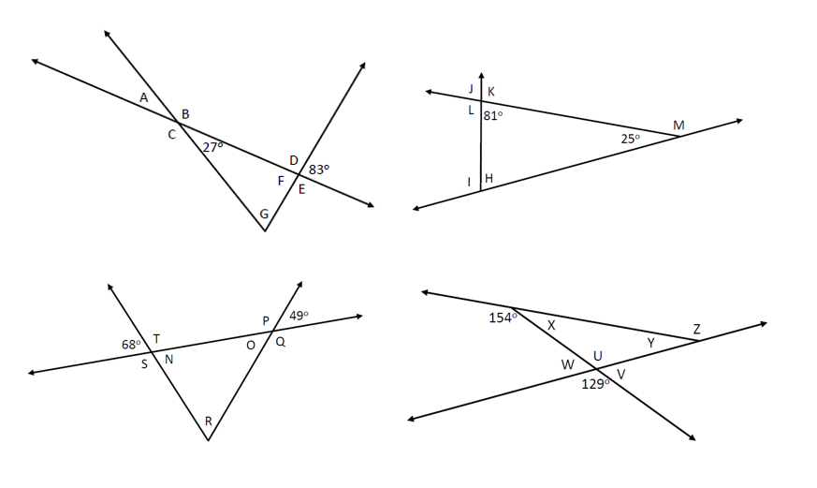
Faded examples – part 1
Explore
Notes:
Have students construct a notice / wonder list (bit.ly/noticewonderstrategy) for Example 1.
Students should identify ($∼$) to mean similar. Ask students to explain why sides are written as fractions and angles have the equal sign ($=$).
Model Example 1 for students, explaining the faded example structure (bit.ly/fadedexamplesstrategy). In example 1 the only missing information is side HE and $∠$EHG.
Students should now attempt examples 2 through to 4 from Appendix B.

Slide 5
Launch
Enough information?

Slide 6
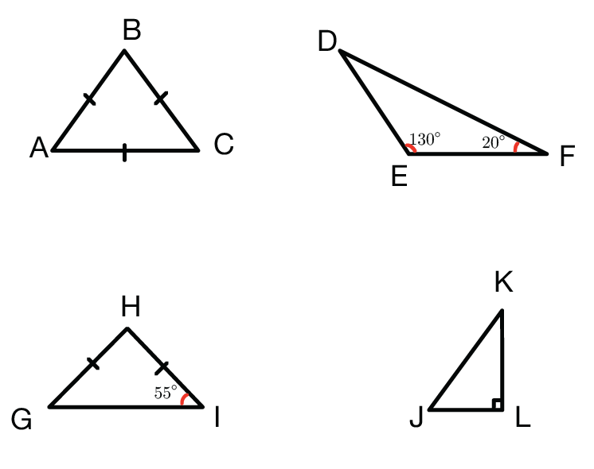
Faded examples – part 2
Explore
Notes:
Have students construct a notice / wonder list (bit.ly/noticewonderstrategy) for Example 1.
Students should identify ($∼$) to mean similar. Ask students to explain why sides are written as fractions and angles have the equal sign ($=$).
Model Example 1 for students, explaining the faded example structure (bit.ly/fadedexamplesstrategy). In example 1 the only missing information is side HE and $∠$EHG.
Students should now attempt examples 2 through to 4 from Appendix B.

Slide 7
Explore
Faded examples

Slide 8
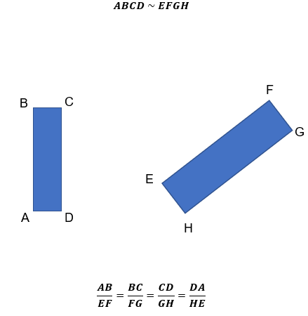
Faded examples – part 3
Explore
Notes:
Have students construct a notice / wonder list (bit.ly/noticewonderstrategy) for Example 1.
Students should identify ($∼$) to mean similar. Ask students to explain why sides are written as fractions and angles have the equal sign ($=$).
Model Example 1 for students, explaining the faded example structure (bit.ly/fadedexamplesstrategy). In example 1 the only missing information is side HE and $∠$EHG.
Students should now attempt examples 2 through to 4 from Appendix B.

Slide 9
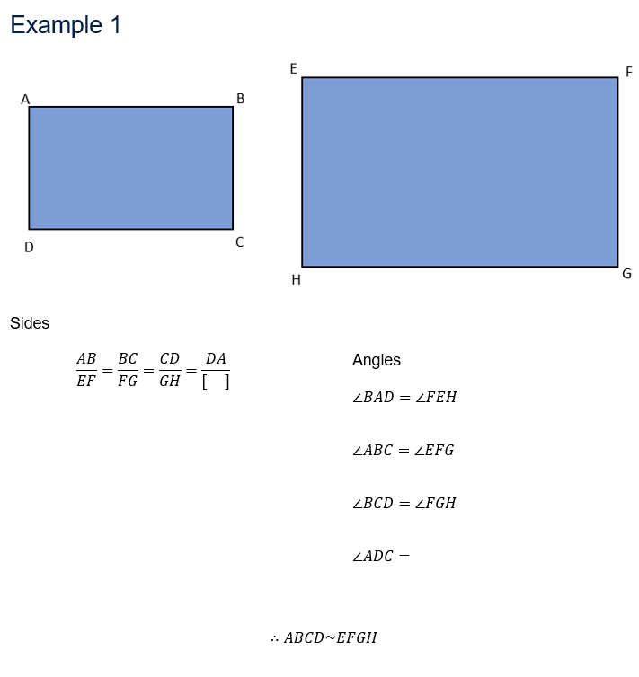
Faded examples – part 4
Explore
Notes:
Have students construct a notice / wonder list (bit.ly/noticewonderstrategy) for Example 1.
Students should identify ($∼$) to mean similar. Ask students to explain why sides are written as fractions and angles have the equal sign ($=$).
Model Example 1 for students, explaining the faded example structure (bit.ly/fadedexamplesstrategy). In example 1 the only missing information is side HE and $∠$EHG.
Students should now attempt examples 2 through to 4 from Appendix B.

Slide 10
Summarise
Show that…

Slide 11
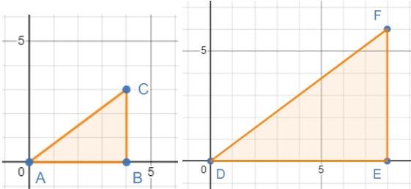
Show that…
Summarise
Notes:
Print and distribute Appendix C to students.
Define ‘show’ with students. Ultimately, they are replicating the process completed in the faded examples.

Slide 12
Success criteria
I can locate sides and angles using labelled vertices.
I can identify corresponding sides and angles within similar figures.
I can explain the meaning of symbols used in similarity statements.
I can write similarity statements.

