Slide 1
Scale factor
Explicit teaching
Notes:
Presentation to accompany Stage 5 – unit 1 – lesson 6

Slide 2
Visible learning
Learning intentions
To understand and be able to determine the scale factor between two similar figures.
To be able to use scale factors to find missing sides in similar figures.
Success criteria
I can identify and name corresponding sides of similar figures.
I can use a scale factor to find missing sides in similar figures.
I can use given information to determine the scale factor between two similar figures.

Slide 3
Warm up
Ratios

Slide 4
Ratios
Warm up
$$4:6$$
$$1:2$$
$$10:16$$
$$20:30$$
$$0.2:0.3$$
Notes:
Display the following ratios and ask students to write each ratio in its simplest form

Slide 5
Launch
How many times taller?

Slide 6
How many times taller?
Launch
Notes:
1. Tell students this photo was taken in the afternoon.
When planted, the trees had identical heights of 0.7 metres.
As of the photo being taken, the left tree was 1.7 metres tall, and the right tree was 1.25 metres tall.
2. Ask students two questions:
How much taller is the tree on the left than the tree on the right?
How many times taller is the tree on the left than the tree on the right?
Using the example of the trees, introduce scale factor as how many times larger one object is than another. You could say Tree A is 1.3 times larger than tree B or the scale factor from tree B to tree A is 1.3.

Slide 7
Explore
What is scale factor?

Slide 8
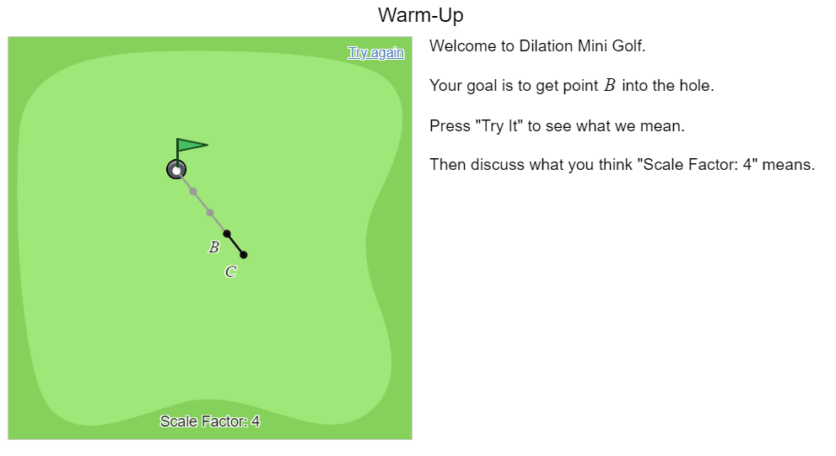
Faded examples
Explore
Complete the following sentence scaffold with a partner:
The total distance is made up of ____ segments. So, the total distance is ____ segments long.
Notes:
Set up this Desmos activity (bit.ly/desmosclassroomstrategy) and share the student code with the class: Scale factor mini golf
Model the first slide to the class. Have students press “Try it” and perform a Think / Pair / Share to discuss what “Scale Factor:4” means.
Have students complete the sentence scaffold with a partner:
Have students complete the activity

Slide 9
Summarise
Faded examples

Slide 10
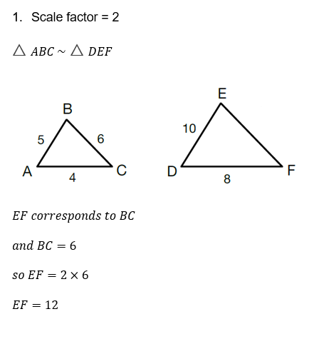
Faded examples – part 1
Summarise
Notes:
Print and distribute Appendix A.
Explain the first example to students and model how to interact with faded examples (bit.ly/fadedexamplesstrategy)
When students are finished, have them write notes to their future selves on: “how to find missing lengths when you know the scale factor”.

Slide 11
Apply
Faded examples

Slide 12
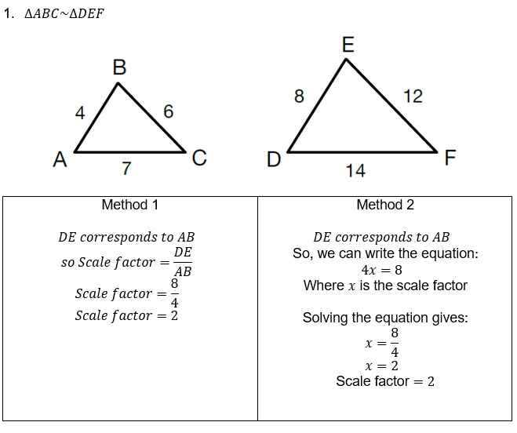
Faded examples – part 2
Summarise
Notes:
Print and distribute Appendix B
Explain the first example to students and model how to interact with faded examples (bit.ly/fadedexamplesstrategy)
When students are finished have them write notes to their future selves on: “how to find the scale factor” (bit.ly/notesstrategy)

Slide 13
Success criteria
I can identify and name corresponding sides of similar figures.
I can use a scale factor to find missing sides in similar figures.
I can use given information to determine the scale factor between two similar figures.

