Slide 1
Scale factor in similar triangles
Explicit teaching
Notes:
Presentation to accompany Stage 5 – unit 1 – lesson 7

Slide 2
Visible learning
    Learning intentions
To solve routine and non-routine problems involving similar triangles.
    Success criteria
I can solve routine problems using similar triangles.
I can recognise problems I can solve using similar triangles.

Slide 3
Warm up
Similar triangles

Slide 4
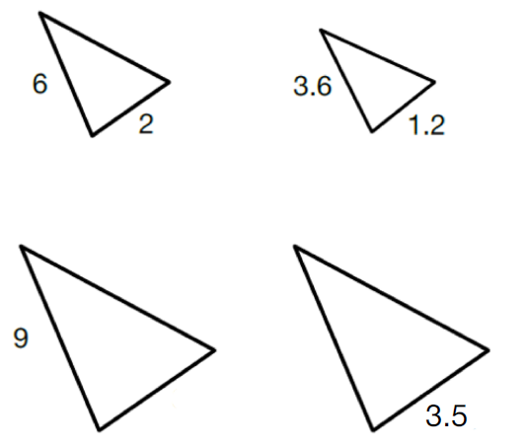
Similar triangles
Warm up
The four triangles shown are similar.
Find as many missing values as you can.
Notes:
Have students draw the four triangles and find as many missing values as possible.

Slide 5
Launch
Shadows

Slide 6
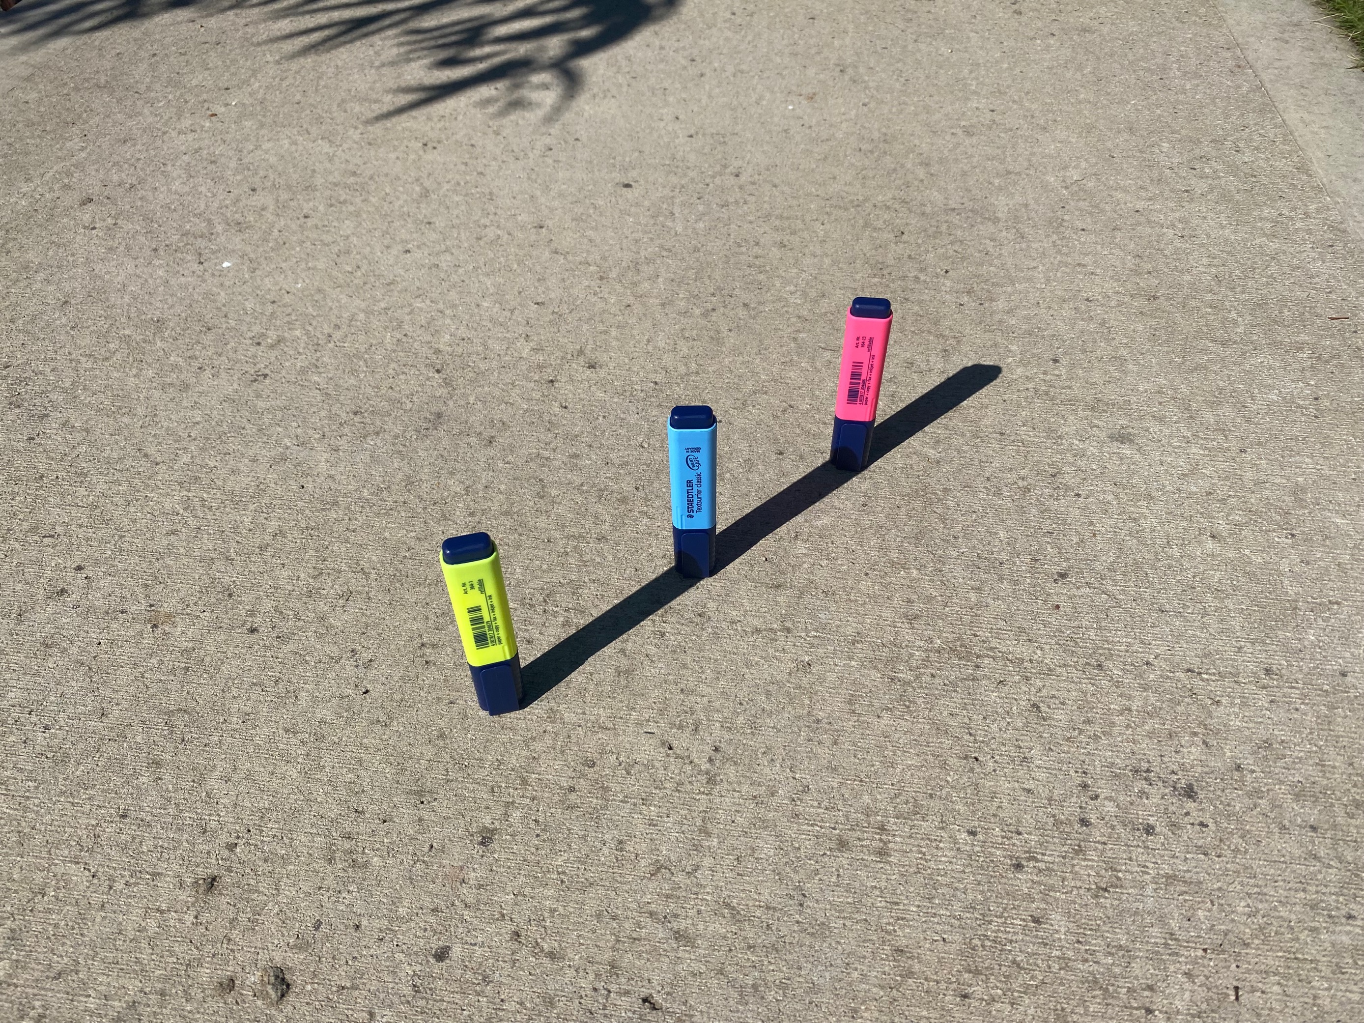
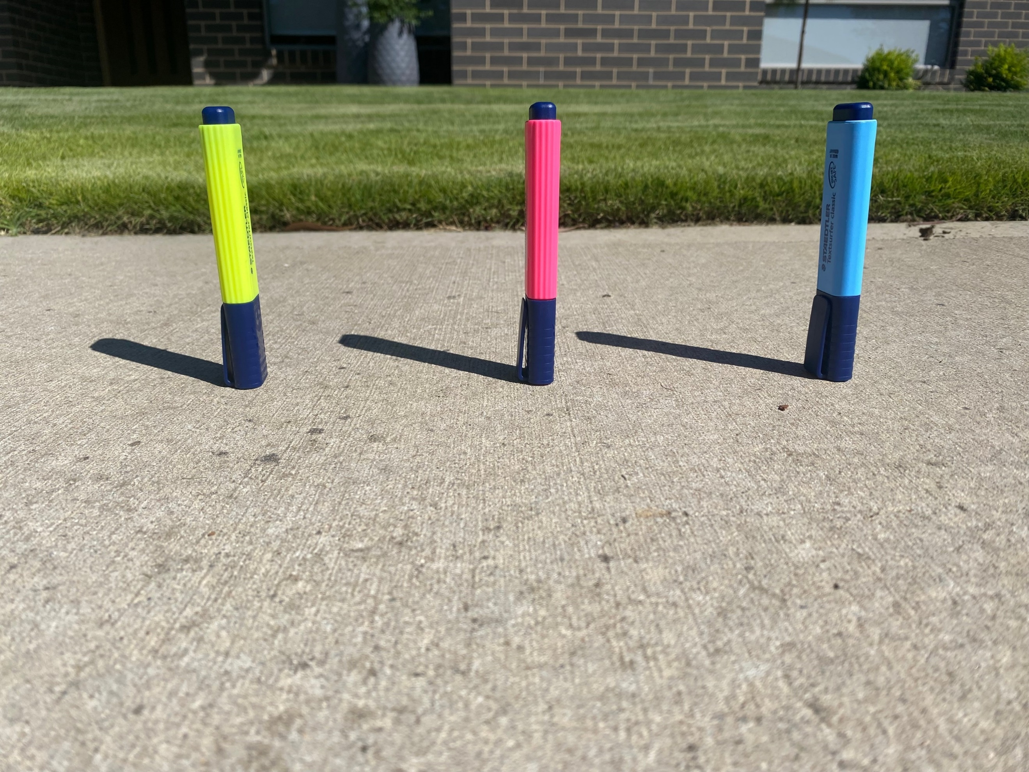
Shadows – part 1
Launch
Notes:
Have students create a notice / wonder list (bit.ly/noticewonderstrategy) based on these images
In discussing students’ notice / wonder lists, emphasise similar triangles. You could even draw a triangle over each highlighter and its shadow.

Slide 7
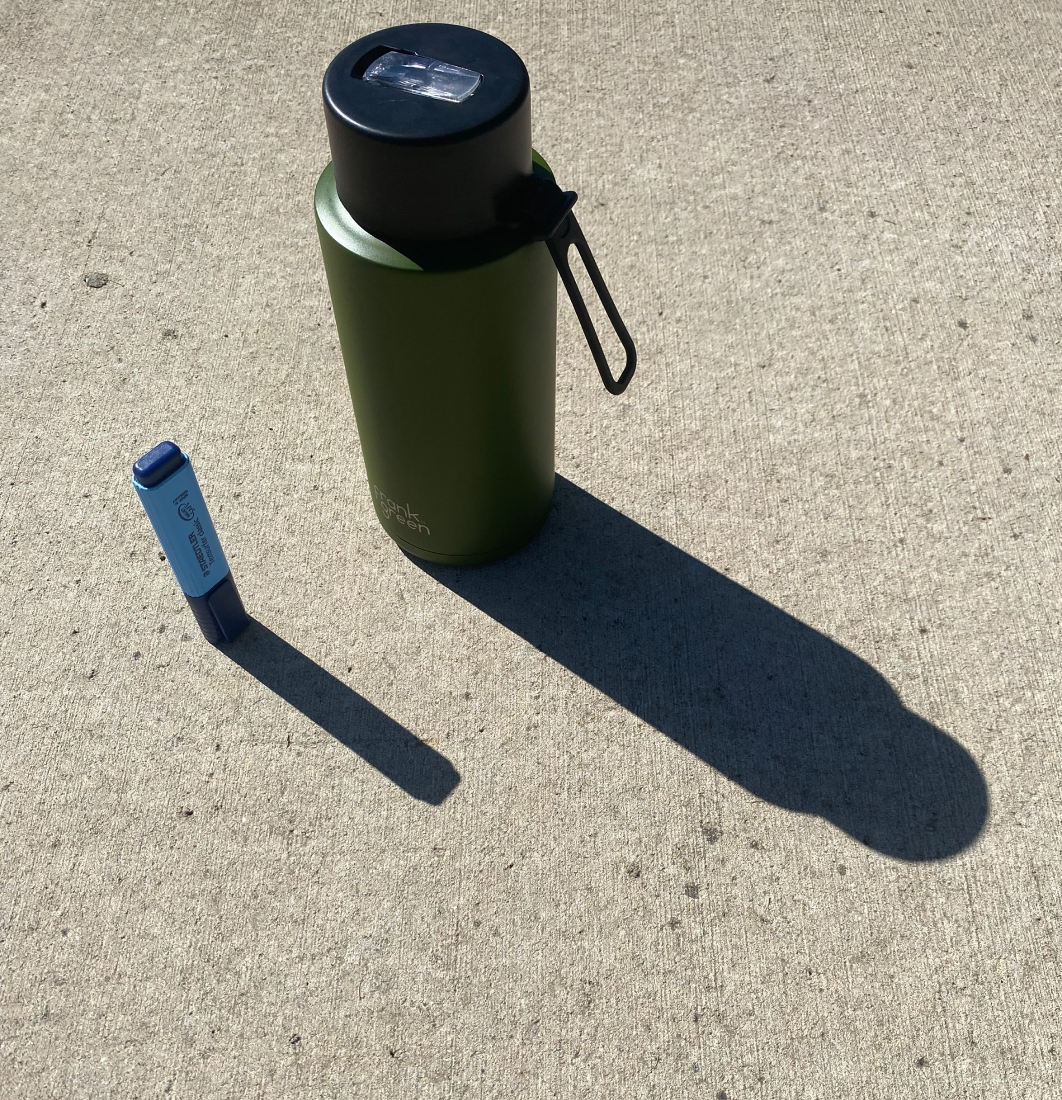
Shadows – part 2
Launch
Notes:
Give students thinking time.
Ask students what maths we could do with the image provided. Prompt students to think of larger scale contexts where this would be useful.

Slide 8
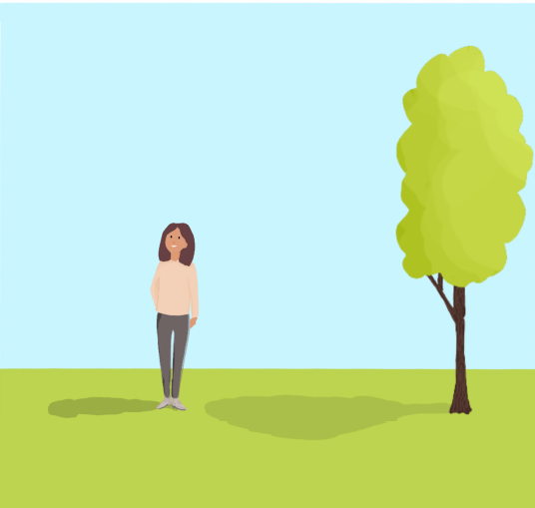
Shadows – part 3
Launch
Notes:
Have students suggest what we could find out about the image presented.
Ensure students are all aware of the similar triangles present.
Lead students to finding the height of the tree.
Ask students what information they would need to find the height of the tree (assuming we can’t measure the tree ourselves).
To provide this information you could do any of the following:
display next slide
add the measurements on yourself
print and have students draw the measurements on

Slide 9
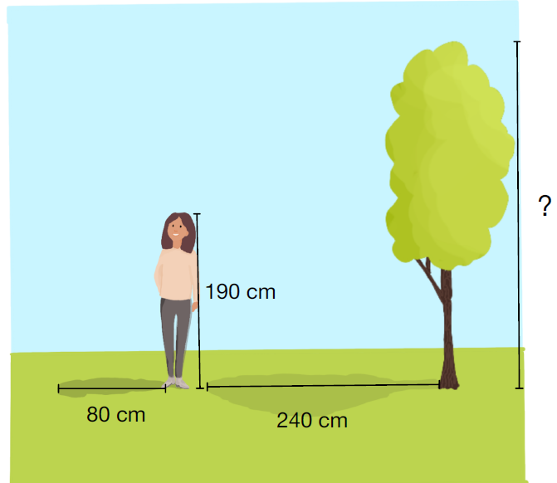
Shadows – part 4
Launch
Notes:
Have students suggest what we could find out about the image presented.
Ensure students are all aware of the similar triangles present.
Lead students to finding the height of the tree.
Ask students what information they would need to find the height of the tree (assuming we can’t measure the tree ourselves).
To provide this information you could do any of the following:
display next slide
add the measurements on yourself
print and have students draw the measurements on
Ask students to find the height of the tree.
Gather student responses and emphasise the multiple possible approaches.
Model a correct response.

Slide 10
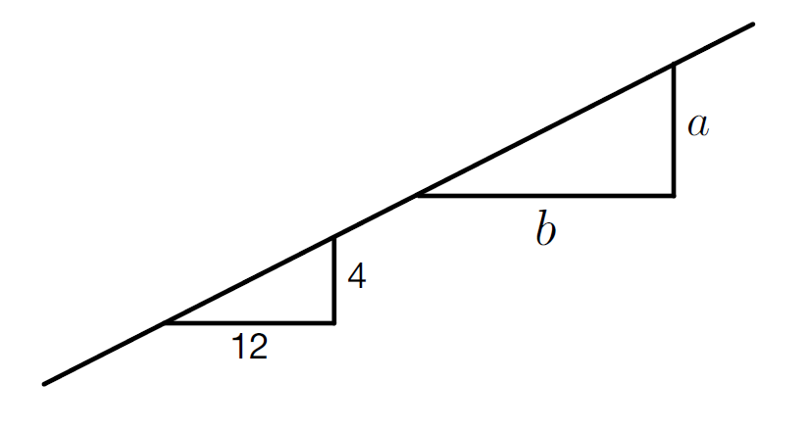
Shadows – part 5
Launch
Notes:
Ask students to answer these questions using the pounce/ bounce (https://www.youtube.com/watch?v=808ogFj3sD4) technique to have other students extend responses:
Are these triangles similar (How do you know? Discuss slope)
Determine the value of $\frac{a}{b}$ (Why do we care about $\frac{a}{b}$? What does $\frac{a}{b}$ mean?)
Model for students how to use the ratio method to find missing lengths in similar triangles.
Emphasise that this method is only applicable if two figures are known to be similar, which is why it was important that we recognised these to be similar triangles.

Slide 11
Success criteria
I can solve routine problems using similar triangles.
I can recognise problems I can solve using similar triangles.

