Slide 1
45 degree angles
Explicit teaching

Slide 2
45 degree angles – part 1
Visible learning
Learning intentions
To understand the constant properties of all right-angled isosceles triangles.
Success criteria
I can use a clinometer to measure angles to tall objects.
I can use ${45}^{o}$, right-angled, isosceles triangles to measure the heights of tall objects.
I can explain why the distance to a tree is the same as the height of a tree when the angle is ${45}^{o}$.

Slide 3
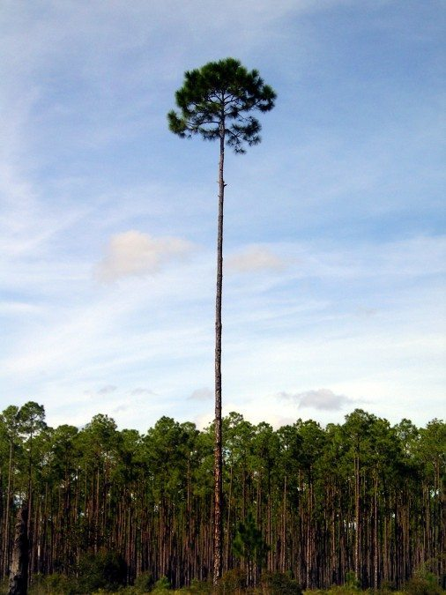
45 degree angles – part 2
Launch
How tall is the tallest tree (or building) in our school?
How do you know which is the tallest?
How would you measure the tree?
Notes:
Teacher to initiate a discussion around the following questions, using strategies such as Think, Pair, Share (bit.ly/thinkpairsharestrategy):
How tall is the tallest tree (or building) in our school?
How do you know which is the tallest?
How would you measure the tree?

Slide 4
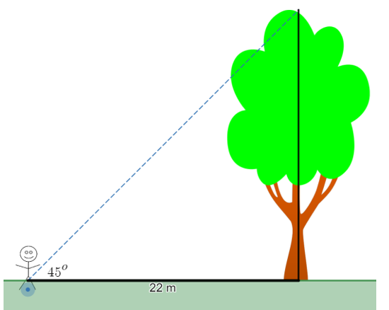
45 degree angles – part 3
Summarise
Predict the height of the tree.
How do you know?
Notes:
Ask students to predict the height of a tree in the scenario below, where we know that we can see the height of the tree at a ${45}^{o}$ angle, and we have measured the distance to the foot of the tree to be 15 m.
Teacher to lead a discussion around significant conclusions from this investigation:
in every isosceles right-angled triangle, the base to height ratio is 1:1, meaning the two sides that form the right angle will be equal.
if we stand back from a tree until our clinometer reads ${45}^{o}$, the height of the tree will be the same as the distance along the ground to the tree, which we can easily measure with a tape measure or trundle wheel.
Have students write notes to their future self about these conclusions(bit.ly/notesstrategy).

Slide 5
45 degree angles – part 4
Summarise – Exit ticket
How tall is the tree?
How do you know?
Notes:
Students complete the exit ticket from Appendix B.

Slide 6
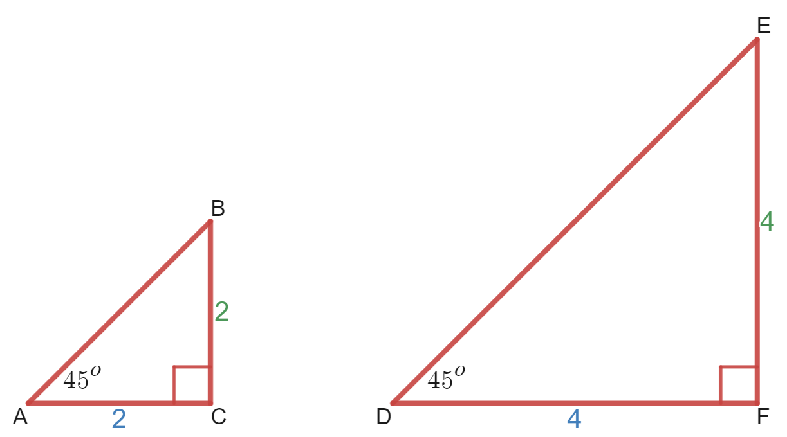
45 degree angles – part 5
Summarise
Think, pair, share
How can you tell that these triangles are similar?
Notes:
Students to engage in a Think, Pair, Share (bit.ly/thinkpairsharestrategy), considering the question "how can you tell that these triangles are similar?"
Lead a discussion connecting this conclusion of similarity to the previous topic regarding similar figures, and the minimum requirements for two triangles to be similar.
Evidence can include"
The common ratio $AC:BC=DF:EF=1:1$
The common pairs of angles, ${∠BAC=∠EDF=45}^{o}$ and $∠ACB=∠DFE={90}^{o}$.

Slide 7
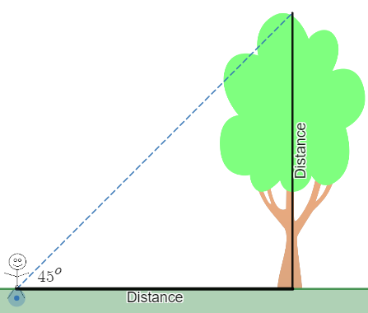
45 degree angles – part 6
Apply
Equipment
Clinometer, trundle wheel or tape measure
Method
Students stand back from a tall tree, looking at the top through a clinometer, until the angle becomes ${45}^{o}$.
A partner measures the distance from this point to the foot of the tree.
This distance will be the same as the height of the tree.
Notes:
Students use ${45}^{o}$ in right-angled triangles to find the heights of tall trees and buildings around the school. This process can be demonstrated to the class using the Desmos graphs, Heights of trees (bit.ly/desmosheightsoftrees).

Slide 8
45 degree angles – part 7
Reflection questions
Why are the distances the same? Try measuring the top angle in the triangles you drew.
What would happen if you couldn't walk back to be at a ${45}^{o}$ angle?
How would you find the height in this circumstance?

Slide 9
Success criteria
I can use a clinometer to measure angles to tall objects.
I can use ${45}^{o}$, right-angled, isosceles triangles to measure the heights of tall objects.
I can explain why the distance to a tree is the same as the height of a tree when the angle is ${45}^{o}$.

